Slide 1
HCV infection in Georgia
First Transcaucasus Liver Conference
September 5-6 Tbilisi
David Metreveli MD PhD
“Mrcheveli” Med. Center, Tbilisi, Georgia

Slide 2
Outline
Prevalence/Incidence
Mode of transmission
Genotypes
Treatment options
Prevention
Conclusion

Slide 3
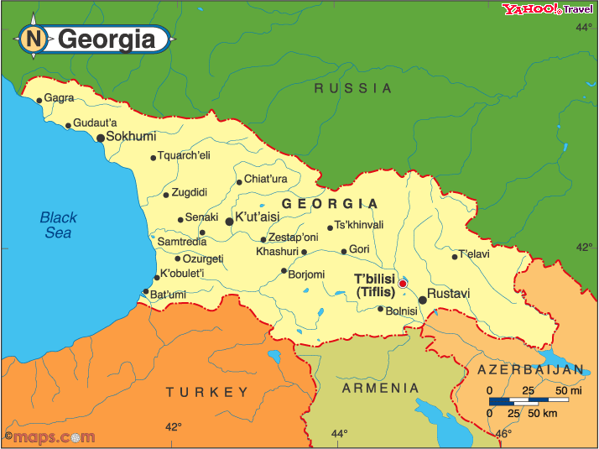
Georgia
Located at the crossroads of Western Asia and Eastern Europe, it is
bounded to the west by the Black Sea, to the north by Russia, to the
south by Turkey and Armenia, and to the southeast by Azerbaijan.
Georgia covers a territory of 69,700 square kilometers (26,911 sq mi).
Its population is almost 4,5 million.

Slide 4
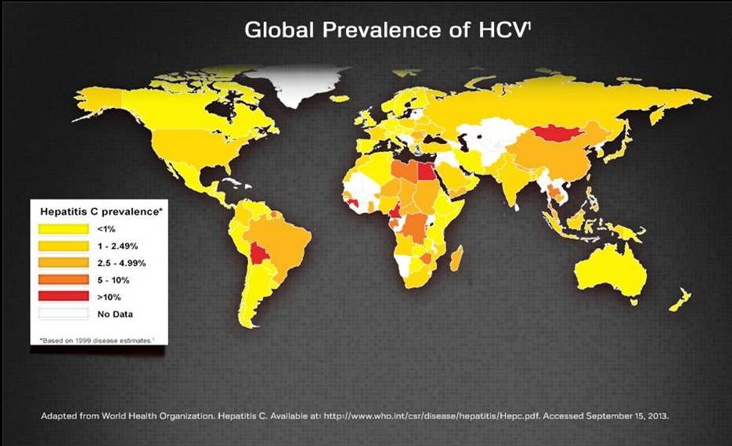
Global Prevalence of HCV

Slide 5
Prevelence of HCV in Georgia
At present the reliable, updated, prevalence of
HCV infection in Georgia is unknown
We get some information from separate medical
Centers and NCDC which enable us to make certain
conclusions.

Slide 6
Prevalence of HCV in Georgia
Data from October 2001 - June 2002.
Age of surveyed individuals was 18-65 years.
8,1% had injected illicit drugs, 85,2% of them reported
sharing needles with injection partners.
anti-HCV was found in 70,4% of those who had injected
drugs.
anti-HCV was found in 6,7% of the total surveyed persons.
Data limitations: Data from 2001-2002; Only Tbilisi; Surveyed individuals – 2000 (Population of Tbilisi almost 1 500 000).
Stvilia, Tsertsvadze, Sharvadze et al. Inf. diseases, AIDS and Clinical Immunology Research Center, Tbilisi. Journal of Urban Health: Bulletin of the New York Academy of Medicine, Vol. 83, No 2

Slide 7
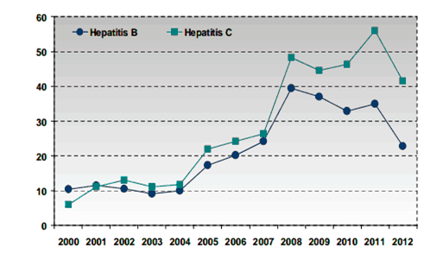
Viral Hepatitis, incidence rates per 100000 population, Georgia
Incidence rate of viral hepatitis C decreased by 26%.
Among new cases of hepatitis C 9.4% was acute and 90.6% - newly registered chronic cases.
Data of National Center of Disease control and Public Health

Slide 8
Viral Hepatitis, incidence rates per 100000 population, Georgia
Data limitations:
Lack of information from many hospitals, medical
centers, Private medical offices, outpatient
clinics.
In some cases the information is copied.

Slide 9
Incidence of HCV in EU and Georgia
Number of reported hepatitis C cases per 100000 in EU
countries versus Georgia, 2006–2012.
 | 2006 | 2007 | 2008 | 2009 | 2010 | 2011 | 2012
EU | 9.3 | 6.8 | 7.3 | 7.4 | 7.1 | 7.8 | 7.8
Georgia | 25 | 27 | 48 | 45 | 47 | 56 | 42
National Center of Disease Control (NCDC) 2012 ©European Centre for Disease Prevention and Control, 2012

Slide 10
Prevalence and risk factors of HCV infection in hemodialysis patients in Georgia
Methods:
The presence of HCV antibodies was determined with an
ORTHO HCV version 3.0 ELISA test system. Laboratory analysis
were performed in Limbach Laboratory Heidelberg, Germany.
The following data were collected:
gender
age
duration of dialysis
actual and previous HCV status
frequency of transfusion
Epidemiological data was also obtained to determine risk factors for HCV in this group of patients.
M. L0midze, I. Rtskhiladze, D. Metreveli, I. Tschokhonelidze et. al. Med. Center “Mrcheveli”, Tbilisi, Georgia; “European Limbach Diagnostic Group”, Heidelberg, Germany; Urology National Center, Tbilisi, Georgia

Slide 11
Prevalence and risk factors of HCV infection in hemodialysis patients in Georgia
Results: A total number of patients162 (F 72, M 90) mean age 51,5 (15-82 year). The overall prevalence of HCV antibody was 67% (109 patients, F 45 (62,5%), M 64 (71%));
Major risk factor identified by a standard questionnaire from 160 patients was the duration of dialysis; Frequent using of blood transfusions did not correlate with higher HCV antibody status.
M. L0midze, I. Rtskhiladze, D. Metreveli, I. Tschokhonelidze et. al. Med. Center “Mrcheveli”, Tbilisi, Georgia; “European Limbach Diagnostic Group”, Heidelberg, Germany; Urology National Center, Tbilisi, Georgia

Slide 12
Prevalence of HCV infection in hemodialysis patients in other countries
Country | Prevalence of HCV (+) | Year(s) of testing | Reference
Brazil | 17% | 2002-2005 | Santos and Souto
Belgium | 7% | 2000 | Jadoul et al.
France | 15% | 1997-2001 | Fissell et al.
Germany | 7% | 1996-1997 | Hinrichsen et al.
India | 12-42% | 2001 | Saha and Agarwal
Italy | 22% | 1997-2001 | Fissell et al.
Poland | 42% | 1992 | Hruby et al.
Saudi Arabia | 68% | 1994 | Huraib et al.
Spain | 22% | 1997-2001 | Fissell et al.
The Netherlands | 3% | 1997 | Schneeberger al.
United States | 14% | 1997-2001 | Fissell et al.
United Kingdom | 3% | 1997-2001 | Fissell et al.

Slide 13
Data from "Mrcheveli" Med. Center - Gastroenterology –Hepatology Department
We observed in total 1413 outpatients in our hepatology department from 05.2012 – to 05.2014.
Metreveli D. Zakalashvili M. et al. Medical Center Mrcheveli, hepatology department 2014

Slide 14
Data from "Mrcheveli" Med. Center - Gastroenterology –Hepatology Department (05.2012-05.2014)
HCV
Metreveli D. Zakalashvili M. et al. Medical Center Mrcheveli, hepatology department 2014

Slide 15
Data from "Mrcheveli" Med. Center - Gastroenterology –Hepatology Department
We observed in total 853 HCV-infected outpatients in our department from 05.2012 – to 05.2014. On average 2 new cases per day.
Metreveli D. Zakalashvili M. et al. Medical Center Mrcheveli, hepatology department 2014

Slide 16
Data from "Mrcheveli" Med. Center Gastroenterology –Hepatology Department (05.2012-05.2014)
99.5%
80%
75%
25%
20%
0.5%*
* Only 4 cases of confirmed acute HCV infection
Metreveli D. Zakalashvili M. et al. Medical Center Mrcheveli, hepatology department 2014

Slide 17
Data from "Mrcheveli" Med. Center Gastroenterology –Hepatology Department (05.2012-05.2014)
Metreveli D. Zakalashvili M. et al. Medical Center Mrcheveli, hepatology department 2014

Slide 18
Distribution of HCV Genotype in Georgia (09.2001-09.2003, 77 samples)
D. Metreveli, I. Rtskhiladze et. al. Med. Center “Mrcheveli”, Tbilisi, Georgia; “Limbach Labor” Heidelberg, Germany; Poster 056; Biennial Meeting of the International Association for the Study of the Liver; Salvador, Brazil, 2004.

Slide 19
Distribution of HCV Genotypes in Georgia (10.2012-12.2013, 261 sampels)
Patients and Methods:
We retrospectively analyzed data of HCV genotypes from Medical Center “Mrcheveli”, Tbilisi, Georgia 2012-2013 (14 month), in 261 patients with chronic HCV. All samples were sent to Limbach Laboratory, Heidelberg,Germany.
Initially all studies were performed on Siemens VERSANT HCV genotype assay (LiPA), a second generation line probe assay, containing probes targeting both the 5’ non coding and the core regions of the viral genome.
M. Zakalashvili (1), M. Weizenegger (2), I. Rtskhiladze (1), D. Metreveli (1) et.al. 1. Med. Center “Mrcheveli” Tbilisi, Georgia; 2. Medizinisches Versorgungszentrum Dr. Limbach & Kollegen, Heidelberg, Germany.
The 3rd World Congress on Controversies in the Management of Viral Hepatitis, Berlin, Germany 2014; Poster N21.

Slide 20
Distribution of HCV Genotypes in Georgia (10.2012-12.2013, 261 samples)
G1 – 109 (43%);
1b – 104 (94%);
1a – 5 (5%);
G 3a – 71 (27.5%);
G 2a/2c – 74 (28.7%);
G 4 (not resident) - 2 (0.8%).
M. Zakalashvili (1), M. Weizenegger (2), I. Rtskhiladze (1), D. Metreveli (1) et.al. 1. Med. Center “Mrcheveli” Tbilisi, Georgia; 2. Medizinisches Versorgungszentrum Dr. Limbach & Kollegen, Heidelberg, Germany.
The 3rd World Congress on Controversies in the Management of Viral Hepatitis, Berlin, Germany 2014; Poster N21.

Slide 21
Distribution of HCV Genotypes in Georgia (10.2012-12.2013)
All HCV genotypes 2a/2c (74 samples) were further specified: partially gene sequencing.
48 (66%) were recombinant
2k/1b.
Gender: M - 41 (85%), F - 7 (15%); Mean age - 41 (18-66);
Age: <20 years 1 (1%), 20-40 years 20 (42%), 40-60 years 26 (46%), >60 years 1(1%).
Every 5th Ch. HCV patient in Georgia is infected with HCV genotype 2k/1b - recombinant form (St Petersburg variant);
M. Zakalashvili (1), M. Weizenegger (2), I. Rtskhiladze (1), D. Metreveli (1) et.al. 1. Med. Center “Mrcheveli” Tbilisi, Georgia; 2. Medizinisches Versorgungszentrum Dr. Limbach & Kollegen, Heidelberg, Germany.
The 3rd World Congress on Controversies in the Management of Viral Hepatitis, Berlin, Germany 2014; Poster N21.

Slide 22
Distribution HCV genotype 2k/1b – recombinant form (St. Petersburg variant)
In other published papers the prevalence of recombinant forms in different
countries do not exceed 2% among of all HCV genotypes.
Authors | Percentage of HCV RF | Country | Journals
Samokhvalov et.al. | 0,8% | Russia | Voprosy virusologii 2013 Jan Feb; 58(1):36-40
Viazov S. et. al. | 1,2% | Germany | Journal of Medical Virology; Vol.82, Issue 2, pages 232-238, February 2010
Demetriou et. al. | 1,6% | Cyprus | Journal of Medical Virology; Vol.81, Issue 2, pages 238-248, February 2009
Kurbanov F. et. al. | 2% Russia 1% in Uzbekistan | from 7 countries | The Journal of Infectious Diseases (2008) 198 (10): 1448-1456
Tallo T. et. al. | 0,5% | Estonia | Journal of Medical Virology; Vol.79, Issue 4, pages 374-382, April 2007

Slide 23
Distribution of HCV Genotypes in Georgia
Conclusions:
HCV genotype 2k/1b - recombinant form (St. Petersburg variant) is
common in Georgia.
About 18% of all genotypes and 66% of Genotype 2 have the HCV
strain that belongs to two different genotypes: 5’ UTR to within the
NS2 region 2k and downstream NS2 type 1b.
As HCV genotypes are predictors of outcome of interferon
based therapy (until now important in Georgia), the widespread of
these genotypes in our country can change the HCV treatment
options.
New anti HCV drugs will replace interferon therapy and most
probably will not depend on genotypes. Therefore, identification of
resistance to anti HCV drugs is a diagnostic challenge.
M. Zakalashvili (1), M. Weizenegger (2), I. Rtskhiladze (1), D. Metreveli (1) et.al. 1. Med. Center “Mrcheveli” Tbilisi, Georgia; 2. Medizinisches Versorgungszentrum Dr. Limbach & Kollegen, Heidelberg, Germany.
The 3rd World Congress on Controversies in the Management of Viral Hepatitis, Berlin, Germany 2014; Poster N21.

Slide 24
Registered/Available anti-HCV drugs in Georgia
1997 Recombinant Interferon α2b and α2a (Intron A,
Roferon A)
1999 Ribavirin (Rebetol)
2001 PegInterferon α2b (PegIntron)
2002 PegInterferon α2a (Pegasys)
2004 Ribavirin (Copegus)
2012 First generation DAA: Boceprevir (Victrelis)
First generation DAA: Telaprevir (Incivek) - Not
registered but available with special order
2014 Second generation DAA: Sofosbuvir (Sovaldi) – Not
registered but available with special order

Slide 25
Availability of antiviral therapy in HCV patients in Georgia
Prior to 2014:
From 2002 to 2014 ≈ 3500 patients were treated with PegInterferon (Pegasys or Pegintron)+ Ribavirin (Copegus or Rebetol) in Georgia.
Limitations of antiviral therapy:
Low social and economic status of population;
Lack of educational programs for patients;
Usage of unneeded medications encouraged by generalists motivated by pharmaceutical companies;
Usage of home-made remedies;
Inability of insurance companies to refund for antiviral therapy.

Slide 26
Availability of antiviral therapy in HCV patients in Georgia
From 2014:
In 2014 the Georgian Government started providing diagnostics and
treatment of Hepatitis C (double therapy with Pegylated Interferon-α2a
and Ribavirin) to 1000 patients in penitentiary institutions.
The Government has also started discounted purchase of drugs for C
Hepatitis treatment for 10 000 beneficiaries from civil sector.
Due to the National support of patients in penitentiary institutions both
diagnostics and treatment are covered by the State.
For the civil sector the cost of a weekly treatment is about 92 USD.
From 01 July to 01 August 2014 antiviral therapy was started in
220 patients in the penitentiary institutions and 527 patients in the civil
sector.

Slide 27
Availability of antiviral therapy in HCV patients in Georgia
In the frame of triple therapy ≈30 patients were
treated with the first generation of DAA (Boceprevir
or Telaprevir);
With the second generation of DAA (Sofosbuvir)
double or triple therapy, were treated about ≈6
patients.

Slide 28
Prevention of HCV infection
Safe Blood Program started in 1997 and included screening
of blood and blood products for HCV, HBV, HIV and Syphilis.
Limitations:
All centers use serological methods only.
Most centers use rapid (express) tests.
None of them use PCR.
Results:
Despite the blood safe program contaminated blood and blood
products still remain occasional route of HCV transmission.
Unfortunately at the moment many medical centers and offices
(dental, plastic surgery offices, beauty, tattoo salons and others)
do not have good standards of safe medical practices and
procedures.

Slide 29
Conclusions(1):
Current, reliable, updated, prevalence of HCV infection
in Georgia is unknown;
According to one of the center’s data the estimated
prevalence of anti-HCV in Georgian population is about
6,7% (survey with numerous limitations);
According to the NCDC data the incidence rate of hepatitis C
per 100000 population is about 40 new cases per year in
Georgia, which is 4 times higher than in EU countries.
All above mentioned enables us to suggest that in reality
the incidence of HCV infection in Georgia is even higher.

Slide 30
Conclusions(2):
HCV infection is common in Georgian hemodialysis
patients. Duration of hemodialysis was associated with
higher prevalence of HCV antibodies.
Our observations reveal that in Georgia G1 is not
predominant over non G1.
HCV genotype 2k/1b - recombinant form (St. Petersburg
variant) is common in Georgia and detected in about 18%
of all genotypes.
Since HCV genotypes are predictors of outcome of
interferon based therapy (up to now important in Georgia
and in Caucasus region), the widespread of these
genotypes in the area might change the HCV treatment
options.

Slide 31
Conclusions(3):
Despite the fact that Blood Safe National Program is in
progress contaminated blood and blood products still
remain an occasional route of HCV transmission.
Lack of guidelines for safe medical practices and
procedures in health care and beauty centers is still a
risk factor of HCV transmission.
NCDC/Georgia with collaboration to CDC/USA are in
process to evaluate prevalence of HCV in general
population.

Slide 32
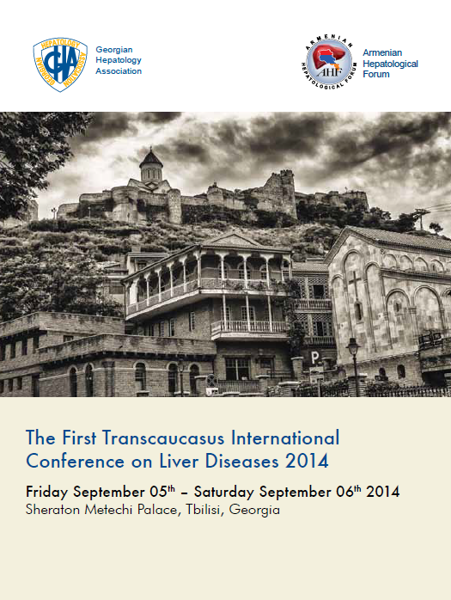
Thank you for attention

