Slide 1
Hepatitis C
Who to Treat ?
Ella Veitsman MD
Center of Liver Diseases
Sheba Medical Center
Tel Hashomer, Tel Aviv, Israel
Tbilisi 12.10.12

Slide 2
I do not have significant financial relationships to disclose

Slide 3
Natural History of Chronic HCV Infection
Acute HCV
1000
60%-85%
800
Chronic HCV
Cirrhosis
Hepatic
Failure
20%-50%
~ 20%
600
~ 20%
ALT (U/L)
Liver Cancer
Liver Transplant
Candidates
400
200
0
0
0.5
1
2
5
10
15
20
25
30
35
40
45
50
Years After Exposure
Adapted - Hoofnagle JH. Hepatology. 2002;36:S21.

Slide 4
The Changing Face of HCV in the US
Ever HCV infected
All chronic HCV
Acute HCV infection
Cirrhosis
Peak
incidence
6,000,000
5,000,000
Peak
cirrhosis
4,000,000
Persons (n)
3,000,000
2,000,000
1,000,000
0
1950
1960
1970
1980
1990
2000
2010
2020
2030
Yr
Reprinted from Gastroenterology, 138, Davis GL, et al, Aging of hepatitis C virus (HCV)-infected persons in the United States: a multiple cohort model of HCV prevalence and disease progression, 513-521, Copyright 2010, with permission from Elsevier.
Notes:
HCV, hepatitis C virus.
The epidemic in the United States began in the 1960s, 1970s, and 1980s. At that time, hepatitis C was spread through the blood supply, through injection drug use, and through other behaviors that involved sharing of contaminated blood. As shown on this slide, the peak incidence occurred around 1990. After that point, the blood supply was screened, and the number of new cases per year dropped precipitously. The major challenge we face in the United States is the large pool of people infected in the 1970s and 1980s. These people have progressed over time, and many of them have developed cirrhosis; indeed, the complications of cirrhosis, such as liver failure and liver cancer, are being observed in many tertiary care centers. Without liver transplant, death is inevitable for these patients. In fact, about 15,000 people die each year from hepatitis C–related disease in the United States.
4

Slide 5
Evolution of Chronic Hepatitis C Treatment
100
PegIFN/
ribavirin
(6-12 mos)^{[6,7]}
80
Interferon/
ribavirin
(6-12 mos)^{[3,4]}
50-60
60
PegIFN
monotherapy
(6-12 mos)^{[5,6]}
SVR (%)
Standard
interferon
(12-18 mos)^{[2,3]}
38-43
40
Standard
interferon
(6 mos)^{[1]}
25-30
15-20
20
8-12
0
1991
1995
1998
2001
1. Carithers RL Jr., et al. Hepatology. 1997;26(3 suppl 1):83S-88S. 2. Zeuzem S, et al. N Engl J Med. 2000;343:1666-1672. 3. Poynard T, et al. Lancet. 1998;352:1426-1432. 4. McHutchison JG, et al. N Engl J Med. 1998;339:1485-1492.
5. Lindsay KL, et al. Hepatology. 2001;34:395-403. 6. Fried MW, et al. N Engl J Med. 2002;347:975-982. 7. Manns MP, et al. Lancet. 2001;358:958-965.

Slide 6
HCV Life Cycle and DAA Targets
Receptor binding
and endocytosis
Transport
and release
Fusion and
uncoating
(+) RNA
ER lumen
Virion
assembly
LD
LD
NS3/4 protease inhibitors
Translation and
polyprotein processing
LD
Membranous
web
NS5B polymerase inhibitors
Nucleoside/nucleotide
Nonnucleoside
RNA replication
ER lumen
NS5A* inhibitors
*Role in HCV life cycle not well defined
Adapted from Manns MP, et al. Nat Rev Drug Discov. 2007;6:991-1000.
Notes:
DAAs, direct-acting antivirals; ER, endoplasmic reticulum; HCV, hepatitis C virus; LD, luminal domain.
The elucidation of the life cycle of the hepatitis C virus (HCV) allowed for the identification of potential targets of antivirals that directly interrupt HCV replication. From the binding of the virus to the plasma membrane and its endocytosis through the membrane, all the way through uncoating and generating the membranous web to translation and replication, viral assembly, and transport and release again into the extracellular space, one may envision a variety of potential targets. The most obvious targets are the NS3/4 serine protease and the NS5B HCV polymerase. Therefore, our first DAAs have been protease inhibitors and nucleoside or nonnucleoside polymerase inhibitors.
Also interesting was the recent discovery of NS5A inhibitors that are inhibitors of the NS5A protein. However, the function of this protein in the hepatitis C life cycle is not yet well understood. Therefore, the inhibitory drugs may help to elucidate the involvement of this protein in the HCV life cycle rather than vice versa.

Slide 7
Boceprevir and Telaprevir Studies
Boceprevir, a potent inhibitor of HCV NS3/4A protease
Telaprevir, a potent inhibitor of HCV NS3/4A protease
Both being tested in combination with standard-of-care pegIFN alfa-2/RBV in phase III studies in chronic HCV infection
Boceprevir
  SPRINT-2: naive GT1 patients
  RESPOND-2: nonresponder GT1 patients (partial responders and relapsers)
  PROVIDE (Null-responders)
Telaprevir
  ADVANCE: naive GT1 patients
  ILLUMINATE: response-guided therapy in naive GT1 paitents
  REALIZE: nonresponder GT1 patients (null responders, partial responders, relapsers)
Notes:
GT1, genotype 1; HCV, hepatitis C virus.
This slide is a summary of the clinical development of the protease inhibitors boceprevir and telaprevir. Both boceprevir and telaprevir are potent inhibitors of the NS3/4A serine protease; both have been tested in combination with the standard of care (peginterferon plus ribavirin) in large phase III trials.
The phase III trials for boceprevir were SPRINT-2 and RESPOND-2. In SPRINT-2, only treatment-naive genotype 1–infected patients were enrolled. The nonresponder trial for boceprevir in phase III is called RESPOND-2. Nonresponders were HCV genotype 1–infected patients who had had a partial response to the previous treatment or a relapse. Partial responders were defined as those patients who had ≥ 2 log10 IU/mL decline at Week 12 of previous therapy.
The pivotal phase III trials that included telaprevir are ADVANCE, ILLUMINATE, and REALIZE. ADVANCE investigated the treatment of treatment-naive, HCV genotype 1–infected patients with the addition of either 8 or 12 weeks of telaprevir to the standard of care. ILLUMINATE investigated the question of whether treatment can be shortened in rapid responders. REALIZE is the nonresponder study for telaprevir, but this trial included not only partial responders and relapsers but also those who have experienced a null response to previous treatment, that is, patients who have had < 2 log10 IU/mL decline in HCV RNA with previous standard of care treatment.

Slide 8
Treatment of Chronic Hepatitis C
PI + PegIFN/RBV
(6-12 mos)^{[8-10]}
100
70-75
80
PegIFN/ribavirin
(6-12 mos)^{[6,7]}
Interferon/
ribavirin
(6-12 mos)^{[3,4]}
50-60
60
PegIFN
monotherapy
(6-12 mos)^{[5,6]}
SVR (%)
Standard
interferon
(12-18 mos)^{[2,3]}
38-43
40
Standard
interferon
(6 mos)^{[1]}
25-30
15-20
20
8-12
0
1991
1995
1998
2001
2011
1. Carithers RL Jr., et al. Hepatology. 1997;26(3 suppl 1):83S-88S. 2. Zeuzem S, et al. N Engl J Med. 2000;343:1666-1672. 3. Poynard T, et al. Lancet. 1998;352:1426-1432. 4. McHutchison JG, et al. N Engl J Med. 1998;339:1485-1492.
5. Lindsay KL, et al. Hepatology. 2001;34:395-403. 6. Fried MW, et al. N Engl J Med. 2002;347:975-982. 7. Manns MP, et al. Lancet. 2001;358:958-965. 8. Poordad F, et al. N Engl J Med. 2011;364:1195-1206. 9. Jacobson IM, et al. N Engl J Med. 2011;364:2405-2416. 10. Sherman KE, et al. N Engl J Med. 2011;365:1014-1024.

Slide 9
Selecting Candidates for Treatment of HCV in the Era of Protease Inhibitors – Boceprevir and Telaprevir
Every HCV patient is a potential candidate for treatment
G-2/3 patients are candidates for PEG/RIB treatment
G-1a/1b patients are candidate for triple therapy unless they have contraindications to PEG-RIBA-Boceprevir/Telaprevir

Slide 10
EASL Clinical Practice Guidelines: Management of Hepatitis C virus Infection
All treatment-naïve and treatment experienced patients with compensated disease due to HCV should be considered for therapy
Treatment should be initiated promptly in patients with advanced fibrosis (METAVIR score F3–F4), and strongly considered in patients with moderate fibrosis (METAVIR score F2)
In patients with less severe disease, indications for therapy are individual
Journal of Hepatology 2011 vol. 55 pp 245–264

Slide 11
Genotype 2/3 Patients
Not to defer therapy for all categories of patients if no contraindications
To treat with PEG/RIBA according to last guidelines
To consider clinical studies

Slide 12
Treatment Candidacy
Categorize your patients:
Viral factors - Genotype , Viral Load
Host factors – IL28B Genotype, gender, age, IR
Treatment naïve or experienced
Patterns of non response – relapse, partial response, null response, breakthrough
Categorize your patients according to fibrosis stage- F0-1, F-2-3, F4 compensated cirrhosis
Select special populations: de-compensated cirrhosis, HIV, HBV co-infected, transplant patients

Slide 13
Role of Liver Biopsy in the Era of Non Invasive Fibrosis Assessment
Higher response rates with PI-based triple therapy in genotype 1 HCV patients may reduce role of liver biopsy in determining treatment strategy for these patients, but…
Settings Where Liver Biopsy May Remain Important
Treatment-experienced patients for whom a combination of previous response category and liver histology inform decision to treat and provide significant information for patient with regard to likelihood of response
Use as a baseline from which to evaluate liver histology and counsel patients
To provide other clinically useful information (eg, amount of steatosis or iron) or in patients with comorbid conditions (eg, autoimmune disease, sarcoid)
For patients who are hesitant to initiate therapy
When noninvasive methods for measuring liver fibrosis are not available
May provide value during subsequent therapy to help make management decisions in patients experiencing difficulties tolerating therapy

Slide 14
To Treat or Not to Treat:
A Constellation of Considerations
Genotype:
virus,
patient (IL28B)
Histologic stage
20%+ lifetime risk
of cirrhosis
Duration of
infection
Personal plans
(marriage,
pregnancy)
Age
Family and
other support
Patient mindset
ALT
Occupation
Extrahepatic
features
(fatigue, EMC, PCT)
HIV coinfection
Contraindications
& comorbidities;
insulin resistance

Slide 15
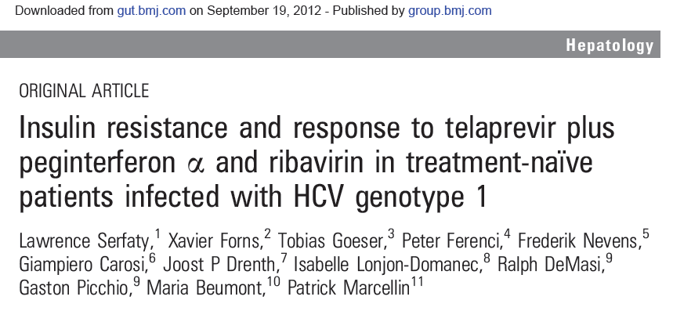
PI Therapies and HOMA-IR Gut, Sept 2012

Slide 16
Conclusions of This Study
In this study, baseline HOMA-IR was not predictive of virological response to telaprevir in HCV genotype 1-infected, treatment-naïve patients, while sustained virological response was associated with improved HOMA-IR.
These results suggest that metabolic factors and insulin resistance do not have a significant effect on telaprevir-based treatment efficacy.

Slide 17
Significance of IL28B
Response rate differences across IL28B genotype were less pronounced in the treatment-experienced patients who received fixed-duration therapy, and this test may be less useful in the treatment-experienced setting
IL28B status may help counsel patients regarding the likelihood of shortening therapy

Slide 18
Telaprevir and Boceprevir SVR by
Patient Type
100
75-83^{[1,2]}
80
68-75^{[3,4]}
60
53-62^{[3-4]}
52-59^{[1,2]}
SVR (%)
40
29-38^{[1,6]}
20
14^{[5]}*
0
Relapser
Naive White/
Nonblack
Naive Black
Partial Responder
Null Responder
Cirrhotic Null Responder
*Pooled TVR arms of REALIZE trial.
1. Zeuzem S, et al. N Engl J Med. 2011;364:2417-2428. 2. Bacon BR, et al. N Engl J Med. 2011;364:1207-1217.
3. Jacobson IM, et al. N Engl J Med. 2011;364:2405-2416. 4. Poordad F, et al. N Engl J Med. 2011;364:1195-1206. 5. Zeuzem S, et al. EASL 2011. Abstract 5. 6. Vierling JM, et al. AASLD 2011. Abstract 931.

Slide 19
Naïve Patients

Slide 20
Telaprevir + PR: SVR Rates in
Treatment-Naive Patients
ADVANCE: TVR + PegIFN/RBV in Treatment-Naive Genotype 1
100
P < .001
T12PR
75
PR
80
60
SVR (%)
44
40
20
n/N =
271/363
158/361
0
SVR
Jacobson IM, et al. N Engl J Med. 2011;364:2405-2416.

Slide 21
Boceprevir + PR: SVR Rates
SPRINT-2: BOC + PegIFN/RBV in Genotype 1 Treatment-Naive Patients
P < .001
100
P < .001
100
P = .004
80
67
68
80
P = .04
60
60
53
40
SVR (%)
42
SVR (%)
40
40
23
20
20
125/
311
211/
316
213/
311
n/N =
12/
52
22/
52
29/
55
n/N =
0
0
PR48
BOC RGT
BOC/PR48
PR48
BOC RGT
BOC/PR48
Nonblack Patients
Black Patients
Poordad F, et al. N Engl J Med. 2011;364:1195-1206.

Slide 22
High SVR Rates Across Baseline Patient and Virus Factors
ADVANCE: TVR + PegIFN/RBV in Treatment-Naive Genotype 1
Data from T12PR arm only
100
79
78
78
75
74
71
62
50
SVR (%)
25
n/
N =
118/
149
152/
213
64/
82
207/
281
226/ 290
45/
73
0
1b 1a
Genotype
< 800K ≥ 800K
HCV RNA (IU/mL)
F0-2 F3-F4
Fibrosis
Jacobson IM, et al. N Engl J Med. 2011;364:2405-2416.

Slide 23
SVR by Fibrosis/Cirrhosis Stage in Patients Receiving BOC + PegIFN/RBV
Subgroup Analysis of SPRINT-2^{[1]}
Subgroup Analysis of RESPOND-2^{[2]}
100
  PR48
  BOC RGT
  BOC/PR48
100
80
80
68
68
67
67
66
60
52
60
SVR (%)
SVR (%)
44
38
38
41
40
40
23
20
20
13
n/
N =
123/
328
213/
319
211/
313
9/
24
14/
34
22/
42
n/
N =
14/
61
77/
117
81/
119
2/
15
14/
32
21/
31
0
0
F0/1/2
F3/4
F0/1/2
F3/4
1. Poordad F, et al. N Engl J Med. 2011;364:1195-1206.
2. Bacon BR, et al. N Engl J Med. 2011;364:1207-1217.
Notes:
When we consider the advantages of treating patients with an early stage of fibrosis, we can see on this slide looking at response rates in patients with mild fibrosis, F0, 1, or 2, there are significant differences between patients with advanced and patients with mild fibrosis. So, for patients taking boceprevir-based regimens, either treatment-naive or treatment-experienced, there is a reduction in response in patients who have cirrhosis.

Slide 24
Summary - Treatment Naïve G-1 Patients, F0-1
Good response, to offer treatment with PI
Option to shorten therapy if IL28B CC
If triple therapy is not allowed by health authorities – to consider PEG/RIBA if IL28B-CC
Option to warehouse for clinical studies
Option to wait for the next generation under the continuous follow up and repeated fibrosis assessment

Slide 25
Summary - Treatment Naïve Fibrosis F3-F4
Compensated cirrhosis
Less favorable response, but it is dangerous to defer therapy – to treat with triple therapy
To consider clinical studies if available now

Slide 26
Experienced Patients

Slide 27
REALIZE: SVR Rates With Telaprevir-Based Therapy by Previous Response
SVR rates with telaprevir-based triple therapy higher among previous relapsers vs previous partial responders vs null responders to pegIFN/RBV
  All groups had higher SVR rates vs pegIFN/RBV alone
T12/PR48
LI T12/PR48
Pbo/PR48
Previous Relapsers
Previous Partial
Responders
Previous Null
Responders
100
88*
83*
80
60
59*
54*
SVR (%)
40
29*
33*
24
20
15
5
n/N=
121/145
124/141
16/68
29/49
26/48
4/27
21/72
25/75
2/37
0
Zeuzem S, et al. N Engl J Med. 2011;364:2417-2428.
*P < .001 vs Pbo/PR48

Slide 28
REALIZE: Treatment-Experienced Patients With Advanced Fibrosis or Cirrhosis
Previous relapsers with liver disease had high SVR rates following treatment with telaprevir plus pegIFN/RBV
  For previous null responders with cirrhosis, SVR rates similar to pegIFN/RBV alone
Previous Relapsers
Previous Partial Responders
Previous Null Responders
100
86
85
84
80
72
Pooled T12/PR48
Pbo/PR48
60
56
SVR (%)
41
39
40
32
34
18
20
20
13
13
6
14
10
3/
17
0
1/
5
1/18
0
144/
167
12/
38
53/
62
2/
15
48/
57
2/
15
34/
47
10/
18
11/
32
24/
59
15/
38
7/
50
n/N=
0/5
0/9
1/
10
0
No,
minimal, or
portal fibrosis
Bridging
fibrosis
Cirrhosis
No,
minimal, or
portal fibrosis
Bridging
fibrosis
Cirrhosis
No,
minimal, or
portal fibrosis
Bridging
fibrosis
Cirrhosis
Stage
Zeuzem S, et al. EASL 2011. Abstract 5.

Slide 29
RESPOND-2: SVR Rates With Boceprevir-Based Therapy by Previous Response
SVR rates with boceprevir-based triple therapy higher among previous relapsers vs previous partial responders to pegIFN/RBV therapy (previous
null responders excluded from study)
  Both groups had higher SVR rates vs pegIFN/RBV alone
100
Previous partial response
80
69
75
Previous relapse
60
52
SVR (%)
40
40
29
20
7
n/N = 23/57 72/105 30/58 77/103 2/29 15/51
0
BOC RGT
BOC/PR48
PR48
Bacon BR, et al. N Engl J Med. 2011;364:1207-1217.

Slide 30
PROVIDE: BOC-Based Therapy in Previous Null Responders
Limited data on efficacy of BOC in previous null responders because excluded from RESPOND-2 trial
Current study: single-arm, multicenter rollover study of pts from pegIFN/RBV arms of phase II/III BOC studies
  Current analysis of null responders from RESPOND-2 and SPRINT-2: < 2 log decline in HCV RNA after 12 wks of pegIFN/RBV (N = 52)
  Pts received 4-wk pegIFN/RBV lead-in followed by ≤ 44 wks triple therapy
Responses in Previous
Null Responders*
100
80
60
Patients (%)
40
38
20
14
n/N =
19/50
3/22
0
SVR†
Relapse
*2 patients are still receiving treatment.
†Includes 3 patients who discontinued treatment during lead-in phase.
Bronowicki JP, et al. EASL 2012. Abstract 11.
Notes:
For boceprevir, the PROVIDE study looking at previous null responders showed a sustained response rate in 38% of patients. So, for patients who had responded poorly to a first course of therapy, the chance of a response to a protease inhibitor regime is relatively low at less than 50%. However, for those 30% to 40% of patients who do respond, this clearly is very advantageous.

Slide 31
SVR by Fibrosis/Cirrhosis Stage in Patients Receiving BOC + PegIFN/RBV
Subgroup Analysis of SPRINT-2^{[1]}
Subgroup Analysis of RESPOND-2^{[2]}
100
  PR48
  BOC RGT
  BOC/PR48
100
80
80
68
68
67
67
66
60
52
60
SVR (%)
SVR (%)
44
38
38
41
40
40
23
20
20
13
n/
N =
123/
328
213/
319
211/
313
9/
24
14/
34
22/
42
n/
N =
14/
61
77/
117
81/
119
2/
15
14/
32
21/
31
0
0
F0/1/2
F3/4
F0/1/2
F3/4
1. Poordad F, et al. N Engl J Med. 2011;364:1195-1206.
2. Bacon BR, et al. N Engl J Med. 2011;364:1207-1217.
Notes:
When we consider the advantages of treating patients with an early stage of fibrosis, we can see on this slide looking at response rates in patients with mild fibrosis, F0, 1, or 2, there are significant differences between patients with advanced and patients with mild fibrosis. So, for patients taking boceprevir-based regimens, either treatment-naive or treatment-experienced, there is a reduction in response in patients who have cirrhosis.

Slide 32
SVR Rates With BOC or TVR in
GT1 Treatment-Experienced Patients
100
PegIFN + RBV
69-83
80
BOC or TVR + PegIFN + RBV
60
40-59
SVR (%)
40
29-38
24-29
20
7-15
5
0
Relapsers
Partial Responders
Null
Responders
Bacon BR, et al. N Engl J Med. 2011;364:1207-1217. Zeuzem S, et al. N Engl J Med. 2011;364:2417-2428.
Vierling JM, et al. AASLD 2011. Abstract 931.

Slide 33
Summary - Experienced Patients
Previous relapsers – good response in any fibrosis stage to treat with triple therapy
Not to postpone triple therapy to all previous non responders with advanced fibrosis –compensated cirrhosis
It is possible to defer therapy in previous null-partial responders with F0-1
To consider clinical studies with new compounds for all patients

Slide 34
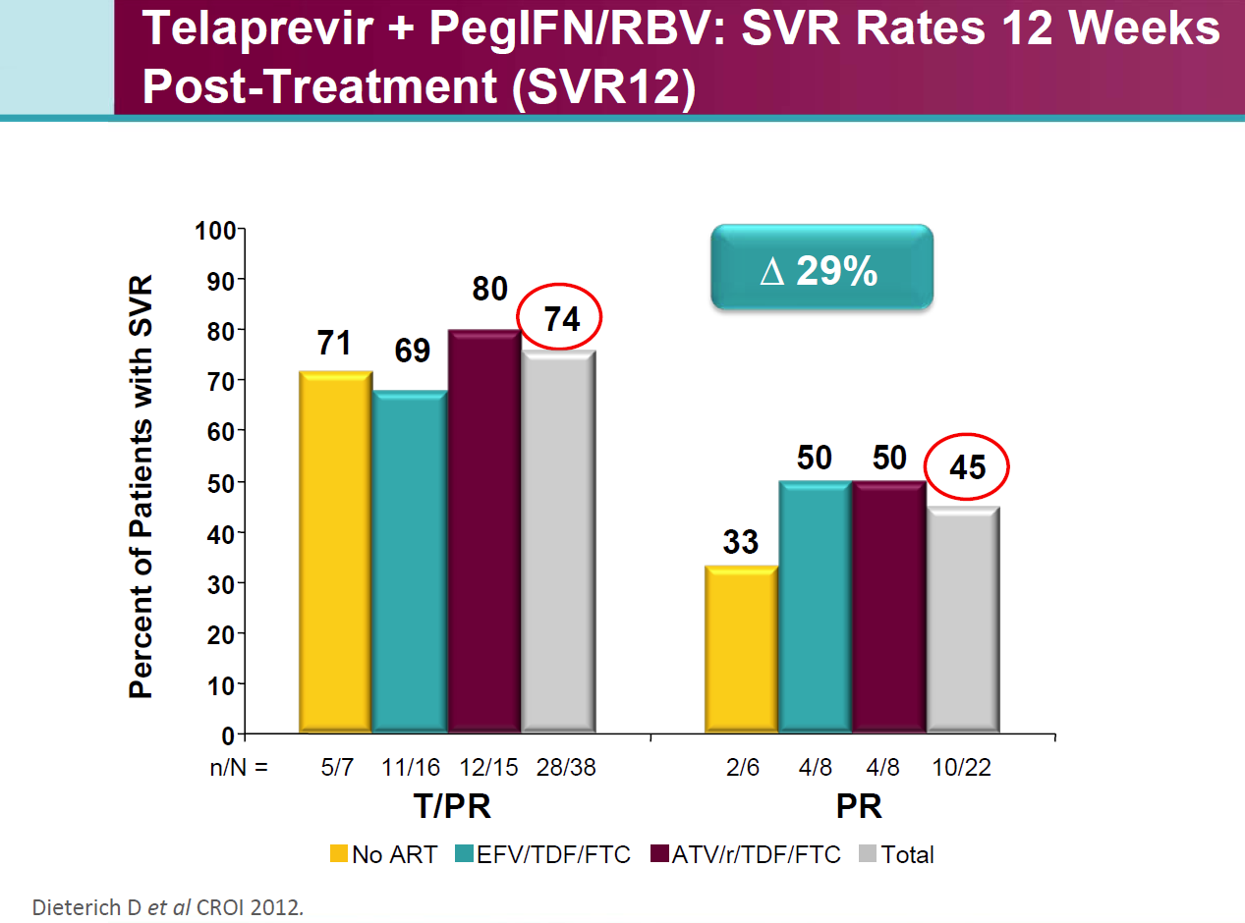
PI in HIV- HCV Co-infected Patients 1

Slide 35
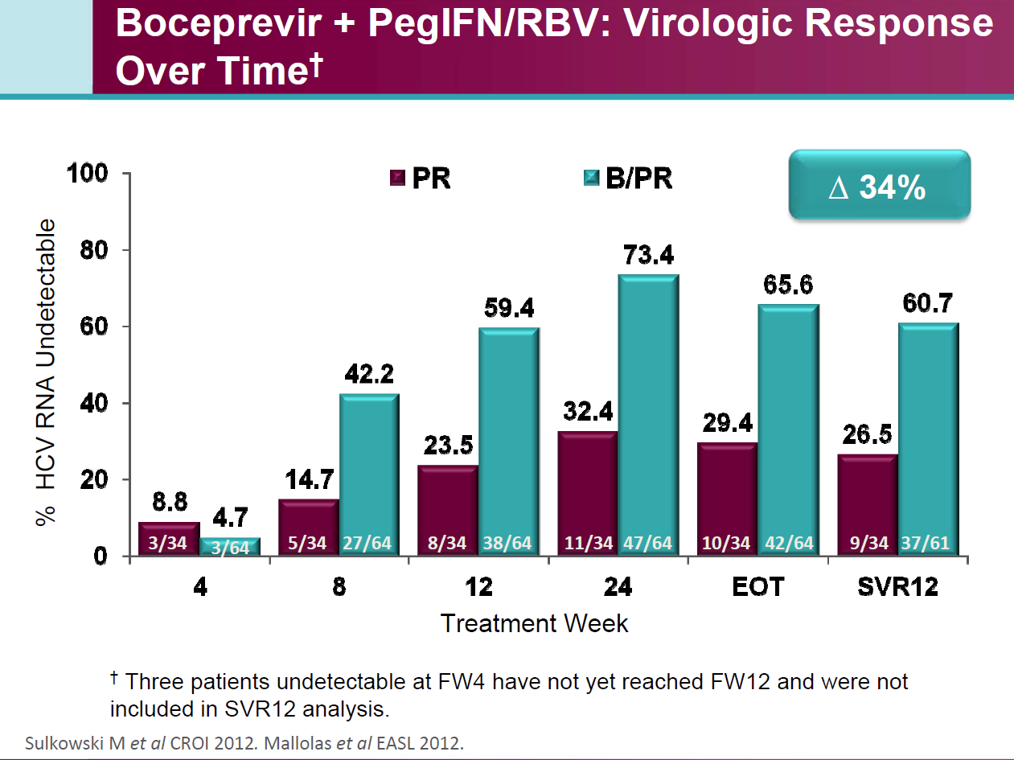
PI in HIV- HCV Co-infected Patients 2

Slide 36
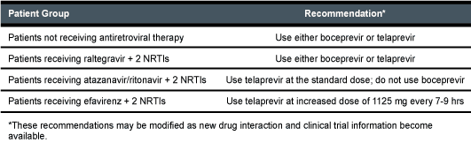
The 2012 update of the US Department of Health and Human Services (DHHS) guidelines contain preliminary recommendations on use of boceprevir and telaprevir in HIV-infected patients co-infected with genotype 1 HCV

Slide 37
Other Patients Who Are Not Candidates for PI-Based Therapy
Patients with previous serious adverse events leading to premature pegIFN/RBV treatment discontinuation
Contraindications for boceprevir and telaprevir therapy
  Pregnant women or men whose female partners are pregnant
  Co-administration with other drugs highly dependent on CYP3A4/5 for clearance and for which elevated plasma concentrations associated with serious/life-threatening events
  When coadministered with potent CYP3A4/5 inducers where significantly reduced boceprevir or telaprevir plasma concentrations may be associated with reduced efficacy
Safety and pharmacokinetics of the PIs have not been studied in patients with decompensated cirrhosis or in liver transplant recipients (on going studies)

Slide 38
Drugs Contraindicated With Boceprevir and Telaprevir
Drug Class | Contraindicated With Boceprevir^{[1]} | Contraindicated With Telaprevir^{[2]}
Alpha 1-adrenoreceptor antagonist | Alfuzosin | Alfuzosin
Anticonvulsants | Carbamazepine, phenobarbital, phenytoin | N/A
Antimycobacterials | Rifampin | Rifampin
Ergot derivatives | Dihydroergotamine, ergonovine, ergotamine, methylergonovine | Dihydroergotamine, ergonovine, ergotamine, methylergonovine
GI motility agents | Cisapride | Cisapride
Herbal products | Hypericum perforatum (St John’s wort) | Hypericum perforatum
HMG CoA reductase inhibitors | Lovastatin, simvastatin | Atorvastatin, lovastatin, simvastatin
Oral contraceptives | Drospirenone | N/A
Neuroleptic | Pimozide | Pimozide
PDE5 inhibitor | Sildenafil or tadalafil when used for treatment of pulmonary arterial hypertension | Sildenafil or tadalafil when used for treatment of pulmonary arterial hypertension
Sedatives/hypnotics | Triazolam; orally administered midazolam | Orally administered midazolam, triazolam
1. Boceprevir [package insert]. May 2011. 2. Telaprevir [package insert]. May 2011.

Slide 39
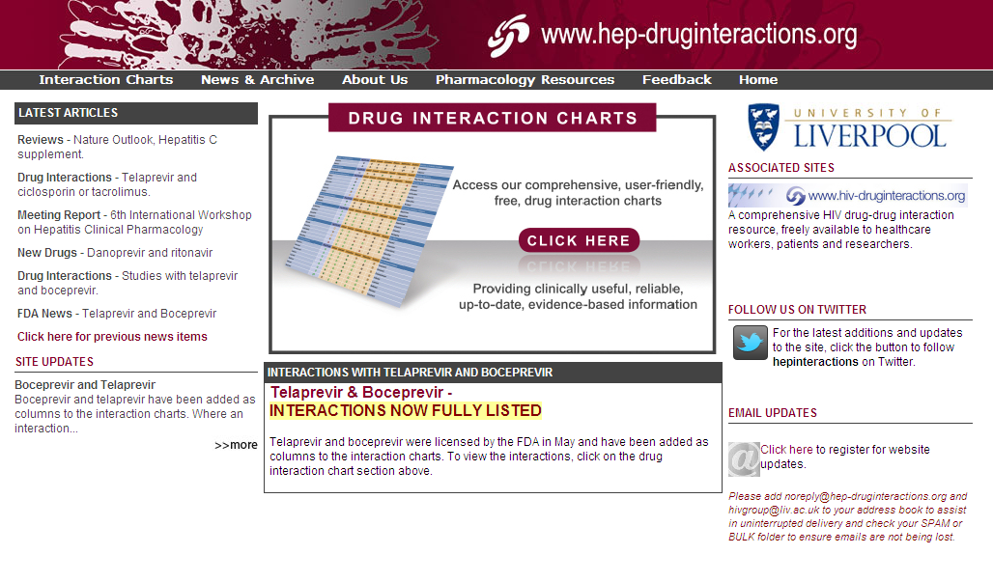
Helpful Drug-Drug Interaction Resource

Slide 40
Pros and Cons of Treating vs Deferring Therapy Once PIs Are Available
Treat
Defer
Protease inhibitors substantially increase chance of SVR
Successful treatment may arrest progression of liver disease (including potential for cirrhosis, HCC, etc)
Many patients already “warehoused” awaiting DAAs, but when is the right time to exit the warehouse?
Current regimens complex, challenging adverse events
Potential for better treatment options in future, eg, better response rates, fewer adverse events, shorter duration
Risk of resistance if therapy fails; impact on future options?
Notes:
DAAs, direct-acting antivirals; HCC, hepatocellular carcinoma; PIs, protease inhibitors; SVR, sustained virologic response.
So if we consider the pros and cons of treating with triple therapy using a protease inhibitor vs deferring, there are several points to discuss. Protease inhibitors added to peginterferon/ribavirin clearly increase the chances of SVR; if treatment is successful, disease progress may be halted and complications may be avoided. Many patients have already been waiting for these new treatments for quite a long time, and they really want to move into successful therapy. But keep in mind the cons of treatment: the current regimens are very complex, and they have challenging adverse events. Newer drugs may be more tolerable with shorter durations of therapy. We may have all-oral therapies that do not include peginterferon/ribavirin. There may be even better chances of SVR with combinations of DAAs. Finally, we must keep in mind the risk of resistance and the potential impact on future treatment options.

Slide 41
What Are the Key Elements of an Ideal HCV Regimen?
Simple Regimen
Short duration, simple, straightforward stopping rules
Easy Dosing
Once daily, low pill burden
All Oral
PegIFN/RBV replaced with alternate backbone with low chance of resistance
Pan-Genotypic
Regimen can be used across all genotypes
Highly Effective
High efficacy in traditionally challenging populations
(ie, nulls, cirrhosis)
Safe and Tolerable
Few or easily manageable adverse effects

Slide 42
Take Home Points 1
Treatment with pegIFN/RBV plus either boceprevir or telaprevir is the new standard of care and where possible should be considered for all patients with genotype 1 HCV infection
Patients should be categorized according to viral, host and other relevant factors
Perform risk-benefit analysis for each patient seeking treatment to determine whether PI-based therapy should be administered
Biopsy should be used when it is helpful for informing a management decision

Slide 43
Take-Home Points 2
Treatment-naive patients with minimal fibrosis have the best chance for successful therapy However, these patients can also afford to wait for future regimens
Previous relapsers have high SVR rate
Assessing fibrosis score in previous null responders helpful to determine if treatment should be initiated immediately or if patient can wait for future options
Clinical studies if available should be considered for all HCV patients
Notes:
So, the take-home points for Section 3 are that assessing fibrosis score in null responders may be helpful to determine the timing of treatment. Approximately 35% of null responders receiving boceprevir or telaprevir-based treatment achieve a sustained virological response. The lead-in phase may be helpful in previous null responders in identifying patients who are likely to be interferon-responsive. And new treatments, of course, may provide new opportunities.

Slide 44
Take-Home Points 3
Safety and efficacy of boceprevir and telaprevir not yet established in certain special populations (transplant, dialysis, decompensated cirrhosis)
HIV-HCV co-infected patients are candidates for PI based treatment according to the new guidelines
Adherence to current regimens is critical and if patient is hesitant about starting, may be better to defer therapy rather than risk development of resistant variants through poor adherence
Next generations therapies may have better response rates , Future regimens may be less complex
Notes:
So, the take-home points for Section 4 are that treatment-naive patients with minimal fibrosis have the best chance for successful therapy with telaprevir or boceprevir-based regimens. However, these are the patients who can afford to wait for new, future regimens that may be easier and more convenient. In my own view, if the patient is hesitant about initiating therapy, it is reasonable to consider waiting for future treatment options. But, the patient does need to understand that the future therapies may have better response rates, may be less complex, but are by no means guaranteed to become available in the foreseeable future. So, if the patient does wish to take current treatments, it is important to ensure that they understand the importance of adherence and if the patient is hesitant and reluctant to go through the complicated regimens it may be better to persuade the patient to defer rather than risk an unacceptable development of drug-resistance mutations because of poor adherence.

Slide 45
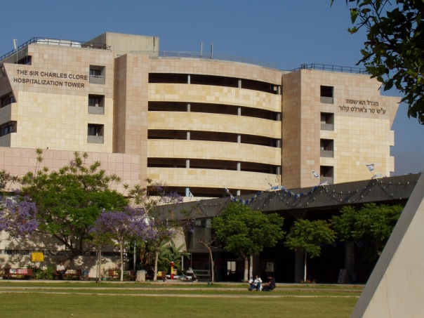
Center of Liver Diseases Tel Hashomer

Slide 46
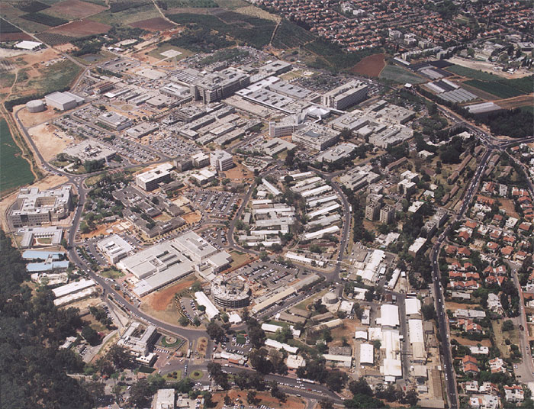
Thank You

