Slide 1
HCC
Transcaucasus Meeting 2014
Robert G Gish MD
Stanford University
Palo Alto CA USA

Slide 2
Disclosures
Dr Gish has consulting relationships with
Bayer
Onyx
BTG, Biocompatibles

Slide 3
Learning Objectives Upon completion of this activity, participants should be better able to:
Identify risk factors associated with HCC, including underlying liver disease, and to thoroughly assess patients upon presentation
Implement appropriate treatment plans for patients with HCC according to patient and tumor characteristics and evidence-based clinical guidelines
Evaluate recent trial data targeting novel agents being evaluated for the treatment of patients with advanced HCC and the potential impact these therapies may have on the current standard of care
Devise strategies to integrate novel targeted agents into treatment plans for patients with advanced HCC
Implement a more successful multidisciplinary approach for treating HCC based on expert and evidence-based recommendations

Slide 4
Hepatocellular Carcinoma (HCC)
5th most common cancer in men; 7th in women worldwide
2nd leading cause of death from cancer worldwide
Incidence and death rate rising whereas many other cancer mortality rates are decreasing
Primarily due to Hepatitis B, C and non-alcoholic steatohepatitis (NASH)
Global HCC: Every 30 seconds, one person in the world dies from liver cancer. These deaths are preventable!
> 80% of cases occur in people from sub-Saharan Africa, S-E Asia and eastern Mediterranean
This geography makes up 45% of world’s population
Monsour et al, 2013; WHO, 2014.
Notes:
Translational Cancer Research. Vol 2, No 6 (December 2013) / Review Article
Hepatocellular carcinoma: the rising tide from east to west—a review of epidemiology, screening and tumor markers
Howard P. Monsour Jr, Emad Asham, Robert S. McFadden, David W. Victor, Bhuvana Muthuswamy, Irum Zaheer
http://globocan.iarc.fr/Pages/fact_sheets_cancer.aspx

Slide 5
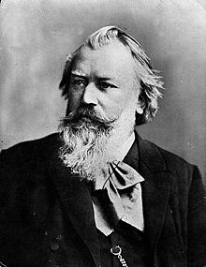
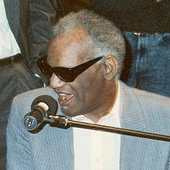

Victims of HCC
Ray Charles
Édith Piaf
Johannes Brahms

Slide 6
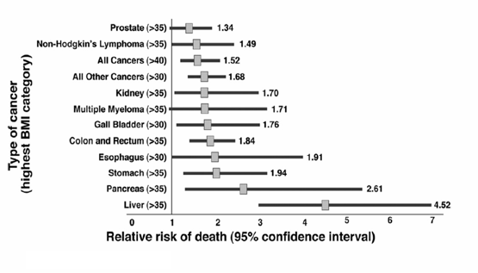
Mortality From Cancer In Obese Men
Calle et al, 2003.
Notes:
Summary of Mortality from Cancer According to Body-Mass Index for U.S. Men in the Cancer Prevention Study II, 1982 through 1998.
Overweight, Obesity, and Mortality from Cancer in a Prospectively Studied Cohort of U.S. Adults
Eugenia E. Calle, Ph.D., Carmen Rodriguez, M.D., M.P.H., Kimberly Walker-Thurmond, B.A., and Michael J. Thun, M.D.
N Engl J Med 2003; 348:1625-1638
April 24, 2003DOI: 10.1056/NEJMoa021423

Slide 7
Population Attributable Fractions of HCC Risk Factors, US, Persons 65+ years
 | White | Black | Asian | Hispanic
Hepatitis C virus | 18.1% | 34.9% | 35.9% | 28.2%
Hepatitis B virus | 2.4% | 2.1% | 28.5% | 1.5%
Alcohol-related conditions | 25.6% | 18.5% | 15.2% | 30.1%
Diabetes and obesity | 38.9% | 11.5% | 18.5% | 38.1%
Rare metabolic disorders | 3.9% |  | 1.9%
Cumulative | 64.0% | 52.4% | 70.1% | 69.7%
Wetzel et al, 2013.
Notes:
Am J Gastroenterol. 2013 Aug;108(8):1314-21. doi: 10.1038/ajg.2013.160. Epub 2013 Jun 11.
Population-attributable fractions of risk factors for hepatocellular carcinoma in the United States.
Welzel TM, Graubard BI, Quraishi S, Zeuzem S, Davila JA, El-Serag HB, McGlynn KA.
Risk factors for hepatocellular carcinoma (HCC) include hepatitis B and C viruses (HBV, HCV), excessive alcohol consumption, rare genetic disorders and diabetes/obesity. The population attributable fractions (PAF) of these factors, however, have not been investigated in population-based studies in the United States.
METHODS:
Persons ≥68 years diagnosed with HCC (n=6,991) between 1994 and 2007 were identified in the SEER-Medicare database. A 5% random sample (n=255,702) of persons residing in SEER locations were selected for comparison. For each risk factor, odds ratios (ORs), 95% confidence intervals (95% CI) and PAFs were calculated.
RESULTS:
As anticipated, the risk of HCC was increased in relationship to each factor: HCV (OR 39.89, 95% CI: 36.29-43.84), HBV (OR 11.17, 95% CI: 9.18-13.59), alcohol-related disorders (OR 4.06, 95% CI: 3.82-4.32), rare metabolic disorders (OR 3.45, 95% CI: 2.97-4.02), and diabetes and/or obesity (OR 2.47, 95% CI: 2.34-2.61). The PAF of all factors combined was 64.5% (males 65.6%; females 62.2%). The PAF was highest among Asians (70.1%) and lowest among black persons (52.4%). Among individual factors, diabetes/obesity had the greatest PAF (36.6%), followed by alcohol-related disorders (23.5%), HCV (22.4%), HBV (6.3%) and rare genetic disorders (3.2%). While diabetes/obesity had the greatest PAF among both males (36.4%) and females (36.7%), alcohol-related disorders had the second greatest PAF among males (27.8%) and HCV the second greatest among females (28.1%). Diabetes/obesity had the greatest PAF among whites (38.9%) and Hispanics (38.1%), while HCV had the greatest PAF among Asians (35.4%) and blacks (34.9%). The second greatest PAF was alcohol-related disorders in whites (25.6%), Hispanics (30.1%) and blacks (and 18.5%) and HBV in Asians (28.5%).
CONCLUSIONS:
The dominant risk factors for HCC in the United States among persons ≥68 years differ by sex and race/ethnicity. Overall, eliminating diabetes/obesity could reduce the incidence of HCC more than the elimination of any other factor.

Slide 8
Pathogenesis of Hepatocellular Carcinoma
15-40 years
3-5% per year
CH
Cirrhosis
HCC
pRb1 Pathway
(pRb1 LOH, p27, p16 cyclin D1, gankirin)
TGF-β1 Pathway
p53 family
P53 (mutations if aflatoxin exposure)
p73 altered expression
Wnt pathway
β-catenin (axin>APC)
Early genetic alterations??
Epigenetic alterations
HBV e HCV
Diabetes
Alcohol
NASH
Aflatoxins
Inflammation
Dysplastic Lesions
Clonal Selection
Adapted from Levrero, 2006.
Notes:
Pathogenesis of human hepatocellular carcinoma (HCC). Chronic hepatitis B and C and associated liver cirrhosis represent
major risk factors for HCC development, being implicated in more than 70% of HCC cases worldwide. Additional etiological factors,
which often represent co-factors of an underlying HBV- or HCV-related chronic liver disease, include toxins and drugs (e.g., alcohol,
aflatoxins, microcystin, anabolic steroids), metabolic liver diseases (e.g., hereditary hemochromatosis, a1-antitrypsin deficiency),
steatosis, non-alcoholic fatty liver diseases and diabetes. Hepatocarcinogenesis is a multistep process that may last for decades and
involves the progressive accumulation of different genetic alterations ultimately leading to malignant transformation. Regardless of the
etiological agent, malignant transformation of hepatocytes is believed to occur through a pathway of increased liver cell turnover,
induced by chronic liver injury and regeneration, in a context of inflammation and oxidative DNA damage. Dysplastic nodules and
macroregenerative nodules are considered as pre-neoplastic lesions. The detailed analysis of HCC development in experimental
animals and the comparison of the results with HCC in humans has identified a variety of genomic and molecular alterations in fully
developed HCC and to a lesser extent in morphologically defined pre-neoplastic precursor lesions. At least four pathways that regulate
either cell proliferation or cell death (i.e., the phospho-retinoblastoma (pRb), p53, transforming growth factor-b (TGF-b) a nd
b-catenin pathways) are affected in HCCs.
Viral hepatitis and liver cancer: the case of hepatitis C
M Levrero
Oncogene (2006) 25, 3834–3847

Slide 9
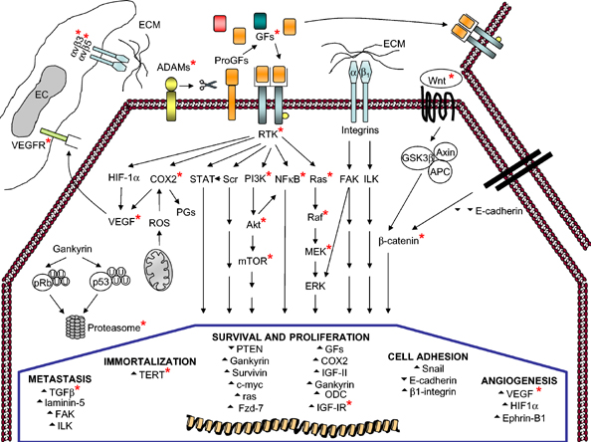
Relevant Pathways in HCC Biology
Avila et al, 2006.
Notes:
Relevant pathways in hepatocellular carcinoma (HCC) biology. Asterisks indicate potential targets (see main text for details). ADAM: a disintegrin and metalloproteinase; APC: adenomatous Polyposis Coli; COX2: cyclooxygenase 2; EC: endothelial cell; ECM: extracellular matrix; ERK: extracellular signal-regulated kinase; FAK: focal adhesion kinase; GF: growth factor; GSK3: glycogen synthase kinase 3-beta; HIF-1: hypoxia-inducible factor 1-alpha; IGF-II: insulin-like growth factor II; IGF-IR: insulin-like growth factor I receptor; ILK: integrin-linked kinase; MEK: mitogen-activated protein kinase kinase (extracellular signal-regulated kinase kinase); mTOR: mammalian target of rapamycin; NF-B: nuclear factor-kappa B; ODC: ornithine decarboxylase; PGs: prostaglandins; PI3K: phosphatidylinositol 3-kinase; pRb: phospho-retinoblastoma (Rb); PTEN: phosphatase and tensin homolog; ROS: reactive oxygen species; RTK: receptor tyrosine kinase; STAT: signal transducer and activator of transcription; TERT: telomerase reverse transcriptase; TGF-: transforming growth factor-beta; VEGF: vascular endothelial growth factor. Up arrow and down arrow indicate enhanced or reduced gene expression in HCC as compared to normal liver.
Oncogene (2006) 25, 3866–3884. doi:10.1038/sj.onc.1209550
New therapies for hepatocellular carcinoma
M A Avila, C Berasain, B Sangro and J Prieto

Slide 10
Molecular Signatures: Etiology, Survival, Metastasis & Stem Cells
P=4.31 x 10⁻⁵
Cluster B
Cluster A Pathways
Proliferation
Anti-apoptotic
Ubiquitination
Hypoxia-induced
DNA instability
Probability
Cluster A
Survival (months)
Lee et al, 2004.
Notes:
Hierarchical clustering analysis.
Hierarchical clustering
of 91 HCC tumors only. Genes
with an expression ratio that had at
least a twofold difference relative to
reference in at least 9 tissues were
selected for hierarchical analysis
(4,187 gene features). The data are
presented in matrix format in which
rows represent the individual gene
and columns represent each tissue.
Each cell in the matrix represents
the expression level of a gene feature
in an individual tissue. The red
and green color in cells reflect high
and low expression levels, respectively,
as indicated in the scale bar
(log2 transformed scale).
Classification and Prediction of Survival in Hepatocellular Carcinoma by Gene Expression Profiling
Ju-Seog Lee,1 In-Sun Chu,1 Jeonghoon Heo,1 Diego F. Calvisi,1 Zongtang Sun,2 Tania Roskams,3 Anne Durnez,3 Anthony J. Demetris,4 and Snorri S. Thorgeirsson1
Hepatology 40:667, 2004

Slide 11
Stem Cell Signature Predicts Survival
P<0.001
Hepatoblast Genes
Oval cell markers
AP-1 transcription factors
Invasion and metastasis genes
Probability
Hepatocyte
Hepatoblast
Survival (months)
Lee et al, 2006.
Notes:
Kaplan-Meier plots of overall survival of individuals with the HB and HC subtypes of HCC from hierarchical clustering analysis of integrated gene expression data. P = 0.001, log-rank test. +, censored data.
Nature Medicine - 12, 410 - 416 (2006)
Published online: 12 March 2006; | doi:10.1038/nm1377
A novel prognostic subtype of human hepatocellular carcinoma derived from hepatic progenitor cells
Ju-Seog Lee¹, Jeonghoon Heo¹, Louis Libbrecht², In-Sun Chu³, Pal Kaposi-Novak¹, Diego F Calvisi¹, Arsen Mikaelyan¹, Lewis R Roberts⁴, Anthony J Demetris⁵, Zongtang Sun⁶, Frederik Nevens², Tania Roskams² & Snorri S Thorgeirsson¹

Slide 12
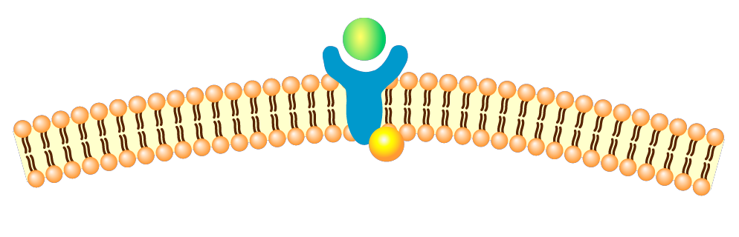

Receptor Tyrosine Kinase Signaling
Growth factor
Receptor tyrosine kinase
Cell membrane
P
GRB
EGF
TGFα
HB-EGF
IGF-1/IRS
FGF
HGF
PDGF
VEGF
cMET
SOS
Ras
c-Raf
P
MAPK/Erk1/2
c-fos/c-jun
Cell growth
Adapted from Llovet et al, 2008.
Notes:
Molecular Targeted Therapies in Hepatocellular Carcinoma
Josep M. Llovet, M.D. and Jordi Bruix, M.D.
Molecular Targeted Therapies in Hepatocellular Carcinoma
Hepatology. 2008 October; 48(4): 1312-1327.

Slide 13
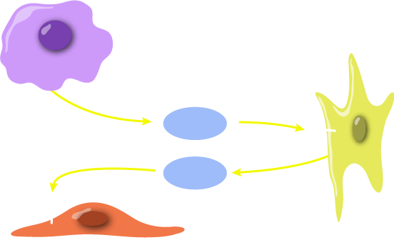
Angiogenic Signaling in Cancer
Tumor cell
Pericyte/
Stellate
cell
PDGF
VEGF
VEGF
Endothelial cell
Proliferation and migration
Pang et al, 2006.
Notes:
Cancer Lett. 2006 Oct 28;242(2):151-67. Epub 2006 Mar 27.
Angiogenesis and antiangiogenic therapy in hepatocellular carcinoma.
Pang R, Poon RT.

Slide 14

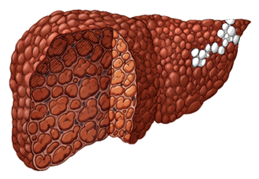
Targeted Therapy for HCC
VEGF Inhibitor or
Anti-VEGF Antibody
Advanced/
Metastatic HCC
Receptor Tyrosine Kinase Inhibitor
Intermediate
HCC
Angiogenesis
Metastasis
Pathways
Early
HCC
Dysregulated Growth
Pathways
Courtesy of Robert G. Gish, MD.

Slide 15
Burrel et al: MRI angiography (MRA) superior to helical CT for detection of HCC
Detection of main HCC and additional nodules pre-transplantation vs in explanted livers: Sensitivity of MRA and helical CT
Variables | Pathology | MRA (%)* | CT (%)†
Per-patient basis (n=29)
Sensitivity (detection) |  | 100 | 100
Sensitivity (characterization) |  | 90 | 96
Specificity |  | 95 | NA
Accuracy |  | 98 | NA
Per-nodule basis (n=76), sensitivity analysis*
All HCC nodules | 76 | 76 (58/76) | 61 (43/70)
>20 mm | 25 | 100 (25/25) | 100 (24/24)
10–20 mm | 28 | 89 (25/28) | 65 (17/26)
<10 mm | 23 | 34 (8/23) | 10 (2/10)
*MRA was performed in 50 cirrhotic patients; 29 patients presented 76 nodules
†Helical CT: Triphasic helical CT was performed in 26 of 29 HCC patients, presenting a total of 70 nodules
CT = computed tomography; MRA = magnetic resonance angiography.
Burrel et al, 2003.
Notes:
15
Hepatology. 2003 Oct;38(4):1034-42.
MRI angiography is superior to helical CT for detection of HCC prior to liver transplantation: an explant correlation.
Burrel M, Llovet JM, Ayuso C, Iglesias C, Sala M, Miquel R, Caralt T, Ayuso JR, Solé M, Sanchez M, Brú C, Bruix J; Barcelona Clínic Liver Cancer Group.
Helical computerized tomography (CT) and magnetic resonance imaging (MRI) are used for staging of hepatocellular carcinoma (HCC) prior to curative treatments but underestimate tumor extension in 30% to 50% of cases when compared with pathologic explants. This study compares a new technology, MRI angiography (MRA), with triphasic helical CT in detection of HCC. Fifty cirrhotic patients, 29 with HCC, undergoing liver transplantation were analyzed. MRA was performed with a 3-D breath-hold fast spoiled gradient-echo sequence by using an effective section thickness of 2 to 2.5 mm. The gold standard was the pathologic examination (liver cut into 5-mm slices). One hundred twenty-seven lesions were identified at the explant: 76 HCC, 13 high-grade dysplastic nodules, 31 macroregenerative nodules, 7 hemangiomas. Diameter of the main HCC nodules was 29 +/- 14 mm and 11 +/- 7 mm for the 47 additional nodules. On a per nodule basis, sensitivity of MRA was superior to CT (58/76 [76%] vs. 43/70 [61%], respectively, P =.001). Sensitivity of MRA for detection of additional nodules decreased with size (>20 mm: 6/6 [100%]; 10-20 mm: 16/19 [84%]; <10 mm: 7/22 [32%]) and was superior to CT for nodules 10 to 20 mm (84% vs. 47%, P =.016). Nonspecific hypervascular nodules >5 mm at MRA were HCC in two thirds of the cases. In conclusion, MRA has a high diagnostic accuracy for HCC > or =10 mm and is more sensitive than triphasic helical CT in nodules sized 10 to 20 mm. MRA is the optimal technique for HCC staging prior to curative therapies.

Slide 16
Liver-Specific MRI Contrast Agents
Gadoxetate Disodium
T1 agent: extracellular + hepatocyte
Excretion: 50% renal, 50% liver
Hepatocyte phase: 20 minutes (in addition to dynamic enhancement)
Lesions lacking hepatocytes have no uptake on hepatocyte phase (cyst, metastases, most HCCs)
Can visualize the bile ducts
EOVIST® (gadoxetate disodium) Injection, bayerimaging.com.
Notes:
16
http://bayerimaging.com/products/eovist/index.php

Slide 17
Surveillance for HCC Reduces Mortality: A Randomized Controlled Trial
Survival rate higher in screening vs control group (P < .01)
0.8
Control
Screening
0.6
0.4
Survival Probability, %
0.2
0.0
0
1
2
3
4
5
Time, Years
Zhang et al, 2004.
Notes:
J Cancer Res Clin Oncol. 2004 Jul;130(7):417-22.
Randomized controlled trial of screening for hepatocellular carcinoma.
Zhang BH, Yang BH, Tang ZY.

Slide 18
Effect of Surveillance on Outcomes
Retrospective analysis of patients with cirrhosis and HCC (N = 269)
Standard-of-care surveillance (n = 172)
Ultrasound or other abdominal imaging ≥ 1 time/year
Substandard surveillance (n = 48)
Lack of abdominal imaging within 1 year of cancer diagnosis
Absence of surveillance (n = 59)
Outcomes, % | Standard-of-Care Surveillance (n = 172) | Substandard Surveillance (n = 48) | Absence of Surveillance (n = 59) | P Value
HCC diagnosis at stages 1/2 | 70 | 37 | 18 | < .001
Liver transplantation | 32 | 13 | 7 | < .001
Mean 3-year survival from cancer diagnosis | 39 | 27 | 12 | < .05
Stravitz et al, 2008.
Notes:
The American Journal of Medicine
Volume 121, Issue 2 , Pages 119-126, February 2008
Surveillance for Hepatocellular Carcinoma in Patients with Cirrhosis Improves Outcome
Richard Todd Stravitz, MD, FACP, FACG, Douglas M. Heuman, Nisha Chand, et al.
Objective
Liver transplantation has become an effective treatment for cirrhotic patients with early-stage hepatocellular carcinoma. We hypothesized that the quality of surveillance for hepatocellular carcinoma influences prognosis by affecting access to liver transplantation.
Methods
A total of 269 patients with cirrhosis and hepatocellular carcinoma were retrospectively categorized into 3 groups according to quality of surveillance: standard-of-care (n=172) (group 1); substandard surveillance (n=48) (group 2); and absence of surveillance in patients not recognized to be cirrhotic (n=59) (group 3).
Results
Three-year survival in the 60 patients who underwent liver transplantation was 81% versus 12% for patients who did not undergo transplantation (P<.001). The percentages of patients who underwent transplantation according to tumor stage at diagnosis (T1, T2, T3, and T4) were 58%, 35%, 10%, and 1%, respectively. Hepatocellular carcinoma was diagnosed at stages 1 and 2 in 70% of patients in group 1, 37% of patients in group 2, and only 18% of patients in group 3 (P <.001). Liver transplantation was performed in 32% of patients in group 1, 13% of patients in group 2, and 7% of patients in group 3 (P<.001). Three-year survival from cancer diagnosis in patients in group 3 (12%) was significantly worse than in patients in group 1 (39%) or group 2 (27%) (each P<.05). Eighty percent of patients in group 3 had subtle abnormalities of cirrhosis on routine laboratory tests.
Conclusion
The quality of surveillance has a direct impact on hepatocellular carcinoma stage at diagnosis, access to liver transplantation, and survival.

Slide 19
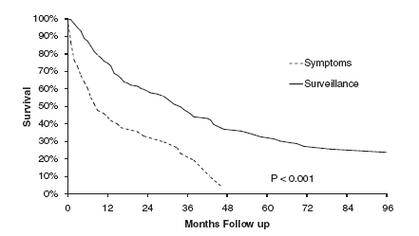
Patient Survival Comparing Detection of HCC by Surveillance vs Presentation With Symptoms
Tong et al, 2010.
Notes:
J Clin Gastroenterol. 2010 Mar;44(3):e63-70. doi: 10.1097/MCG.0b013e3181b4b68b.
Survival in Asian Americans after treatments for hepatocellular carcinoma: a seven-year experience at UCLA.
Tong MJ, Chavalitdhamrong D, Lu DS, Raman SS, Gomes A, Duffy JP, Hong JC, Busuttil RW.
Patient survival comparing detection of hepatocellular
carcinoma by surveillance or by presentation with
Symptom.
Hepatocellular carcinoma (HCC) is a common malignancy in Asians and is related to the high incidence of chronic viral hepatitis in this ethnic population. The aims of this study were to examine the tumor characteristics and liver disease status in HCC patients of Asian ancestry and determine their survival after treatments for HCC.
RESULTS:
Between September 2000 and December 2007, 278 patients, mean age 61.5 years, presented with HCC to the University of California Los Angeles (UCLA) Liver Cancer Center. Hepatitis B (HBV) infection was detected in up to 68% of Chinese, Korean, and Vietnamese patients, whereas 60% of Japanese patients had Hepatitis C (HCV) infection. Compared with HCC patients who presented with symptoms, those detected by surveillance had more tumors within the Milan and University of California, San Francisco (UCSF) criteria and more patients in Child-Turcotte-Pugh class A. On the basis of a predefined UCLA treatment algorithm, 83% of patients received surgical and/or loco-regional therapies. Compared with other treatments, orthotopic liver transplantation (OLT), and radiofrequency ablation had the highest overall patient survival (P<0.0001) and OLT has the highest disease free survival rates (P<0.0001). Independent baseline predictors for: (1) patient survival were HBV [hazard ratio (HR) 0.62, P=0.005], UCSF criteria (HR 0.46, P<0.0001), Child Turcotte Pugh class A (HR 0.57, P=0.005), alphafetoprotein per log10 increase (HR 1.26, P=0.0012), and alkaline phosphatase per log10 increase (HR 2.32, P=0.02); and for (2) disease free survival were UCSF criteria (HR 0.66 P=0.007), aspartate aminotransferase per log10 increase (HR 1.50, P=0.04), and age per year increase (HR=1.02, P=0.04). The 4 Asian subgroups had similar survival rates.
CONCLUSIONS:
HBV and Hepatitis C were associated with over 90% of HCC cases in Asian Americans. HCC detected by surveillance identified more patients eligible for surgical and loco-regional therapies, which improved the overall and disease free survival.

Slide 20
Percutaneous Ablative Therapies for Hepatocellular Carcinoma
Percutaneous ethanol injection
Acetic acid injection
Hot saline injection
Radiofrequency
Microwaves
Cryoablation
Laser
Irreversible electroporation
Light-activated drug therapy
Chemical ablation
Thermal ablation
New non chemical/non thermal
Adapted from Lau et al, 2003.
Notes:
Percutaneous Local Ablative Therapy for Hepatocellular Carcinoma
A Review and Look Into the Future
W. Y. Lau, MD, Thomas W. T. Leung, MD, [...], and Stephen K. W. Ho, PhD
Ann Surg. 2003 February; 237(2): 171-179.

Slide 21
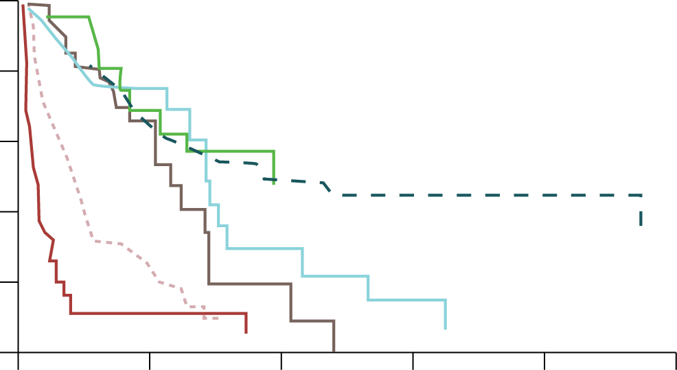
Survival Rates of Asian American Patients With HCC by Treatments
Patient Survival
OLT all
Resection all
100
RFA only
TACE only
80
TACE RFA other
Supportive care
60
Survival, %
40
20
0
0
30
60
90
120
150
Months of Follow Up
OLT = orthotopic liver transplantation; RFA = radiofrequency ablation; TACE = transcatheter arterial chemoembolization.
Tong et al, 2010.
Notes:
J Clin Gastroenterol. 2010 Mar;44(3):e63-70. doi: 10.1097/MCG.0b013e3181b4b68b.
Survival in Asian Americans after treatments for hepatocellular carcinoma: a seven-year experience at UCLA.
Tong MJ, Chavalitdhamrong D, Lu DS, Raman SS, Gomes A, Duffy JP, Hong JC, Busuttil RW.
Patient survival by treatments.

Slide 22
HCC Is Inhibited in HCV Patients With Sustained Viral Response and Sustained Biochemical Response Following Treatment With IFN + RBV
3-year cumulative incidence
5-year cumulative incidence
Cumulative
Incidence
of HCC
(%)
All
Patients
(N=420)
SVR
(n=181)
Non-SVR
(n=239)
Non-SVR,
SBR
(n=131)
Non-SVR,
Non-SBR
(n=108)
SVR = sustained viral response; SBR = sustained biochemical response; IFN = interferon;
RBV = ribavirin; HCV = hepatitis C virus.
Nakajima et al, 2009.
Notes:
Examination of inhibition of hepatocellular carcinoma resulting from treatment of chronic hepatitis C with interferon plus ribavirin – Hepatocellular carcinoma is inhibited in patients with sustained viral response and sustained biochemical response J. Nakajima; A. Ikeda; S. Saito; T. Kimura; Y. Osaki Hepatology. 2009;50(Issue S4): page 710A, AASLD abstract 863.
Objective: Results of treatment of chronic hepatitis C (CHC) with interferon (IFN) suggest that hepatic fibrosis is improved and onset of hepatocellular carcinoma (HCC) is also inhibited if sustained viral response (SVR) is achieved. Adequate data related to this have not necessarily been accumulated with IFN plus ribavirin combination therapy. The primary goal of IFN therapy is SVR, and in the absence of SVR, the secondary goal is the long-term maintenance of ALT normalization, i.e., sustained biochemical response (SBR). Inhibition of the onset of HCC with SBR, however, has not been clarified. We therefore examined the incidence of HCC by virological and biochemical response in patients treated at our hospital with IFN plus ribavirin combination therapy. Patients and methods: Among CHC patients starting treatment with IFN plus ribavirin from January 2002 to May 2009, patients with a history of HCC and patients who developed cancer during treatment were excluded, and the incidence of HCC was examined with 420 patients by response at 6 months after the end of treatment. An ALT value of 44 IU/L or less at 24 weeks after the end of treatment indicated SBR. Results: The mean age of patients was 57.1 years; 213 were male and 200 were female; 314 were Serotype I while 78 were Serotype II. Seventy-five patients received IFN α-2b plus ribavirin, 313 patients received PEG-IFN α-2b plus ribavirin, and 32 received both. The mean duration of observation was 1143 days. The SVR rate with all patients was 43%. The SBR rate with non-SVR patients was 55%. Onset of HCC was observed in 20 patients: 4 with SVR, 16 with non-SVR, 9 with SBR, and 11 with non-SBR. The cumulative incidence of HCC was 4.0% at 3 years and 8.0% at 5 years with all patients and 2.5% at 3 years and 2.5% at 5 years with SVR patients while it was 5.4% at 3 years and 12.7% at 5 years with non-SVR patients, and the incidence was significantly lower with SVR patients (p=0.017). With non-SVR patients, the cumulative incidence of HCC was 3.2% at 3 years and 3.2% at 5 years with SBR whereas with non-SBR, it was 7.9% at 3 years and 19.5% at 5 years, indicating a trend of lower incidence with SBR patients (p=0.190). Conclusions: (1) A clear inhibitory effect on onset of HCC was observed with patients with SVR to IFN plus ribavirin therapy. (2) Even in non-SVR patients, a trend of lowered incidence of HCC was observed in patients with SBR. (3) The results suggest the possibility of inhibition of HCC with IFN plus ribavirin, and treatment not only for SVR but also considering SBR should be instituted.

Slide 23
Not All HCC Make All Biomarkers Patient number of AFP-L3%, DCP and AFP in those with Known HCC (n=685)
AFP > 20
DCP > 40
96
93
110
153
15
45
14
AFP-L3% > 10
159 (23%)
all negative
AFP = alpha-fetoprotein; DCP = des-gamma-carboxy prothrombin;
AFP-L3 = lens culinaris agglutinin A-reactive fraction of AFP.
Toyoda et al, 2006.
Notes:
Distribution of patients with various patterns of positivity for the 3 tumor markers of HCC.
Clin Gastroenterol Hepatol. 2006 Jan;4(1):111-7.
Prognostic significance of simultaneous measurement of three tumor markers in patients with hepatocellular carcinoma.
Toyoda H, Kumada T, Kiriyama S, et al.
We conducted a prospective study to evaluate the significance of simultaneous measurement of 3 currently used tumor markers in the evaluation of tumor progression and prognosis of patients with hepatocellular carcinoma (HCC).
METHODS:
Three tumor markers for HCC, alpha-fetoprotein (AFP), Lens culinaris agglutinin A-reactive fraction of AFP (AFP-L3), and des-gamma-carboxy prothrombin (DCP), were measured in the same serum samples obtained from 685 patients at the time of initial diagnosis of HCC. Positivity for AFP >20 ng/dL, AFP-L3 >10% of total AFP, and/or DCP >40 mAU/mL was determined. In addition, tumor markers were measured after treatment of HCC.
RESULTS:
Of the 685 patients, 337 (55.8%) were positive for AFP, 206 (34.1%) were positive for AFP-L3, and 371 (54.2%) were positive for DCP. In a comparison of patients positive for only 1 tumor marker, patients positive for AFP-L3 alone had a greater number of tumors, whereas patients positive for DCP alone had larger tumors and a higher prevalence of portal vein invasion. When patients were compared according to the number of tumor markers present, the number of markers present clearly reflected the extent of HCC and patient outcomes. The number of markers present significantly decreased after treatment.
CONCLUSIONS:
Tumor markers AFP-L3 and DCP appear to represent different features of tumor progression in patients with HCC. The number of tumor markers present could be useful for the evaluation of tumor progression, prediction of patient outcome, and treatment efficacy.

Slide 24
How Do We Use AFP ?
AFP is a useful biomarker of a patient's increased future RISK for HCC
AFP is not a screening or surveillance tool for diagnosis of HCC
AFP can help modify surveillance tools (US vs MR/CT) and frequency of testing
Wakodiagnostics.com
Notes:
http://www.wakodiagnostics.com/hccbiomarkers.html

Slide 25
AFP L3% Rises before AFP in Typical Course of HCC Occurrence Case
Before HCC
diagnosis
Tumor size:
≤ 2 cm
HCC diagnosis
Tumor size:
3-5 cm
21 months
Sterling et al, 2012.
Notes:
Key point here is that L3% rises before the sharp rise typically seen with total AFP. This may be a crutial lead time for doctors.
Also give reason as to not using absolute concentration of L3 instead of L3%. L3 concentration mimics the pattern of total AFP as far as the increase trend over time.
The American Journal of Gastroenterology 107, 64-74 (January 2012) | doi:10.1038/ajg.2011.312
Frequency of Elevated Hepatocellular Carcinoma (HCC) Biomarkers in Patients With Advanced Hepatitis C
Richard K Sterling, Elizabeth C Wright, Timothy R Morgan, Leonard B Seeff, John C Hoefs, Adrian M Di Bisceglie, Jules L Dienstag, Anna S Lok and and the HALT-C Trial Group10.
Prospective studies of serum hepatocellular carcinoma (HCC) biomarkers in patients with advanced
hepatitis C are lacking. The aim of this study was to determine the frequencies and performance
of elevated α -fetoprotein (AFP), AFP-L3, and des- γ -carboxy prothrombin (DCP) levels as HCC
biomarkers in advanced hepatitis C. METHODS: Patients in the HALT-C Trial were tested every 3 months for 42 months. Screening ultrasound was
performed every 12 months. Levels of biomarkers were compared in patients in whom HCC did or did
not develop. RESULTS: In all, 855 patients were evaluated; HCC developed in 46. Among patients without HCC, 73.2 % had
AFP consistently < 20, 24.5 % had at least one AFP between 20 and 199, and 2.3 % had at least
one AFP value ≥ 200 ng / ml; 73.7 % had DCP consistently < 90, 11.6 % had at least one DCP between
90 and 149, and 14.7 % had at least one DCP value ≥ 150 mAU / ml. AFP-L3 ≥ 10 % was present at
least once in 9.0 % and in 17.1 % of those with AFP ≥ 20 ng / ml. Among all patients with elevated
biomarkers, a diagnosis of HCC was made in 0 – 31.6 % (depending on the biomarker and cutoff) during
the subsequent 24 months. AFP ≥ 200 ng / ml had the highest specicity (99 % ), but sensitivity was
≤ 20 % . DCP ≥ 40 mAU / ml had the highest sensitivity (76 % ), but specicity was ≤ 58 % . Independ-
ent predictors of elevated AFP were gender (female), race (Black), more advanced disease, and HCC.
Elevated DCP was associated with more advanced disease and HCC. CONCLUSIONS: Mild – moderate elevations in total AFP and DCP but not in AFP-L3 occur frequently in patients
with chronic hepatitis C and advanced brosis, are related to factors other than HCC, and are poor
predictors of HCC.

Slide 26
Biomarkers and Other Factors That Correlate With Risk of Portal Vein Invasion
AFP-L3 ≥ 15% - RR: 2.459 (95% CI: 1.005-6.017; P = .0487)
DCP ≥ 100 mAU/mL - RR: 3.019 (95% CI: 1.077-8.464; P = .0357)
Number of HCC tumors ≥2 - RR: 4.912 (95% CI: 1.619-14.905; P = .0049)
AFP-L3 = A-reactive fraction of α-fetoprotein; DCP = des-γ-carboxy prothrombin; RR= relative risk.
Hagiwara et al, 2006.
Notes:
Hagiwara S, Kudo M, Kawakaki T, et al. Prognostic factors for portal venous invasion in patients with hepatocellylar carcinoma. J Gastroenterol 2006; 41:1214-1219.
Results of stepwise multiple Cox regression analysis concerning development of portal venous invasion.
Background
Factors involved in portal venous invasion (PVI) must be clarified to enable better determination of therapeutic strategies and outcomes in patients with hepatocellular carcinoma (HCC).
Methods
Of 365 patients with HCC who consulted our department between January 1999 and January 2003, 53 with PVI at the initial consultation were excluded, and the other 312 without PVI were included in this study. Of these patients, we compared liver function, tumor markers, and initial treatment between 287 patients without PVI during follow-up (until December 2004) and 25 patients who developed PVI, and investigated prognostic factors.
Results
Multivariate analysis using a COX regression model showed that a Lens culinaris A-reactive fraction of α-fetoprotein (AFP-L3) rate of 15% or more, a des-γ-carboxy prothrombin (DCP) level of 100 mAU/ml or more, multiple tumors, and a platelet count of 130 000/mm3 or more were correlated with PVI.
Conclusions
HCC frequently infiltrated the portal vein in patients with a high rate of AFP-L3, a high level of DCP, or multiple tumors. Furthermore, the incidence of PVI was significantly higher in patients with a platelet count of 130 000/mm3 or more.

Slide 27
Biomarkers and Other Factors That Correlate With Risk of Microvascular Invasion
Independent predictors of microvascular invasion:
Tumor size (< 2, 2-4, > 4 cm) - Odds ratio: 3.4 (95% CI: 1.5-4.1)
Preoperative DCP levels (< 100, 100-500, > 500 mAU/mL) - Odds ratio: 2.2 (95% CI: 1.1-2.4)
Tumor grade (3-grade system) - Odds ratio: 2.2 (95% CI: 1.1-3.7)
DCP = des-gammacarboxy prothrombin.
Shirabe et al, 2007.
Notes:
The predictors of microvascular invasion in candidates for liver transplantation with hepatocellular carcinoma—with special reference to the serum levels of des-gamma-carboxy prothrombin†
Ken Shirabe MD, FACS1,*, Shinji Itoh MD1, Tomoharu Yoshizumi MD1, Yuji Soejima MD1, Akinobu Taketomi MD1, Shin-ichi Aishima MD2, Yoshihiko Maehara MD1
Journal of Surgical Oncology
Volume 95, Issue 3, pages 235–240, 1 March 2007
Article first published online: 23 FEB 2007
DOI: 10.1002/jso.20655
Abstract
The microvascular invasion of cancer cells (mvi) is a good prognostic factor after orthotopic liver transplantation (OLT) for hepatocellular carcinoma (HCC). The aim of this study is to predict mvi in patients with HCC who were candidates for OLT. We studied 218 patients with HCC resections who had HCC without any extrahepatic metastases and vascular invasion detected during preoperative evaluation. We analyzed the clinico-pathological data of these patients to predict the mvi presence. The mvi prediction scoring system was made and the accuracy of this system was examined using independent clinico-pathologic factors. The size and histological grade of the tumor were significantly correlated with the mvi. The des-gamma-carboxy prothrombin (DCP) is a mvi predictor. The sensitivity of our mvi prediction system was 75% and the specificity was 85% in 32 patients who underwent living-donor liver transplantations for HCC. Our study shows that besides the tumor size and histological grade, a measurement of the serum DCP levels could be a good predictor for mvi. A tumor biopsy and a preoperative measurement of DCP could improve the selection of patients with HCC for OLT. Our scoring system for mvi provides us a precise prediction of the presence of mvi. J. Surg. Oncol. 2007;95:235–240. © 2007 Wiley-Liss, Inc.

Slide 28
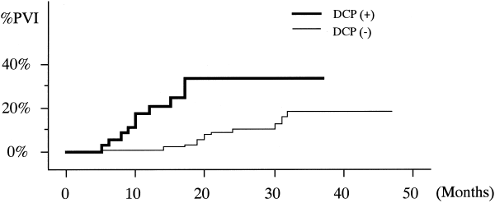
Predicts Clinical Course Incidence of Portal Venous Invasion of HCC in Relation to the Serum DCP Level at Diagnosis
DCP(+): 37 patients with DCP > 100 mAU/mL
DCP(-): 183 patients with DCP < 100 mAU/mL
Koike et al, 2001.
Notes:
Incidence of portal venous invasion (PVI) in patients with hepatocellular carcinoma during follow-up.
Cancer. 2001 Feb 1;91(3):561-9.
Des-gamma-carboxy prothrombin as a useful predisposing factor for the development of portal venous invasion in patients with hepatocellular carcinoma: a prospective analysis of 227 patients.
Koike Y, Shiratori Y, Sato S, Obi S, Teratani T, Imamura M, Yoshida H, Shiina S, Omata M.

Slide 29
Changes in DCP and AFP after Hepatectomy
DCP
α-fetoprotein
104
10³
10³
10²
DCP Conc.(mAU/mL)
α-fetoprotein Conc.（ng/mL）
10²
10
before
after 2 wks
before
after 2 wks
DCP = des-carboxyprothrombin
Sakon et al, 1990.
Notes:
Nihon Geka Gakkai Zasshi. 1990 May;91(5):588-93.
[The clinical significance of PIVKA-II determination in patients with hepatocellular carcinoma: a comparative study with alpha-fetoprotein].
[Article in Japanese]
Sakon M, Monden M, Goto M, Kanai T, Umeshita K, Endo W, Mori T.
The changes in the plasma level of PIVKA-II (Protein Induced by Vitamin K Absence or Antagonist-II) following the treatment or progress of the disease was studied in 60 patients with hepatocellular carcinoma. The positivity rate determined by the changes in PIVKA-II was 58.4 percent (35/60 cases) and was about the same as those reported so far, all of which were obtained by a single determination of PIVKA-II. Plasma PIVKA-II was elevated in 61.9 percent (13/21 cases) of alpha-fetoprotein negative patients and it was almost identical with the overall positivity rate. In parallel with serum alpha-fetoprotein, the plasma level of PIVKA-II was decreased after the surgery or transcatheter arterial embolization and was increased when the recurrence or progress of the disease was observed. Furthermore, the nonspecific elevation of PIVKA-II due to the associated liver cirrhosis or chronic hepatitis was infrequent compared with that of alpha-fetoprotein. In 18 cases positive with both PIVKA-II and alpha-fetoprotein, a close correlation (R = 0.91) was observed between the changes of these markers during the progress or treatment of the disease. Thus, it was suggested that determination of PIVKA-II in blood might be useful not only in the diagnosis but in monitoring the progress or the effectiveness of treatments in hepatocellular carcinoma.

Slide 30
Proposed Liver Ultrasound Algorithm
Poor/Fair quality US
Or
abnormal biomarkers
#gadoxetate disodium MRI
(Or dynamic CT)
Liver Dedicated Surveillance Ultrasound (US)
+ HCC biomarkers^{α}
in at-risk patients*
Negative MRI
Good/Excellent quality US and normal HCC biomarkers
Abnormal US
or
increasing biomarkers
US surveillance q6 months with biomarkers
^{α}blood tests AFP-L3%/DCP (HCC serum biomarkers); *AASLD Guidelines 2009; # see LI-RADS.
AASLD = American Association for the Study of Liver Diseases; AFP = alpha-fetoprotein; CT = computed tomography;
DCP = des-gamma-carboxy prothrombin; HCC = hepatocellular carcinoma; LI-RADS = Liver Imaging Reporting and Data System;
MRI = magnetic resonance imaging; US = ultrasound.
Gastroenterology and Hepatology, 2014.
Notes:
Gish RG. Early Detection of Hepatocellular Carcinoma Through Surveillance Using Biomarkers. Gastroenterology and Hepatology, 2014. Volume 10, Issue 2; 121-123.
http://www.gastroenterologyandhepatology.net/index.php/archives/february-2014/early-detection-of-hepatocellular-carcinoma-through-surveillance-using-biomarkers/.

Slide 31
LI-RADS: Algorithm
Observation in high-risk patient
Treated observation
Untreated observation
Definitely benign
Probably benign
Neither definitely nor probably benign
LR-Treated
LR-1
LR-2
Possible non-HCC malignancy
LR-M
Tumor in vein
LR-5V
Diameter (mm):
Arterial phase
hypo- or iso-enhancement
Arterial phase
hyper-
enhancement
< 20
≥ 20
< 10
10-19
≥ 20
“Washout”
None:
LR-3
LR-3
LR-3
LR-3
LR-4
“Capsule”
One:
LR-3
LR-4
LR-4
LR-4
LR-5
Threshold growth
≥ Two:
LR-4
LR-4
LR-4
LR-5
LR-5
Apply ancillary features and then tie-breaking rules to adjust category
American College of Radiology.

Slide 32
LI-RADS: Categories
LR-1
Definitely benign
LR-2
Probably benign
LR-3
Intermediate probability for HCC
LR-4
Probably HCC
LR-5
Definitely HCC
LR-5V
Definitely HCC with Tumor in Vein
LR-M
Malignant, not necessarily HCC
American College of Radiology, version 2013.1.

Slide 33
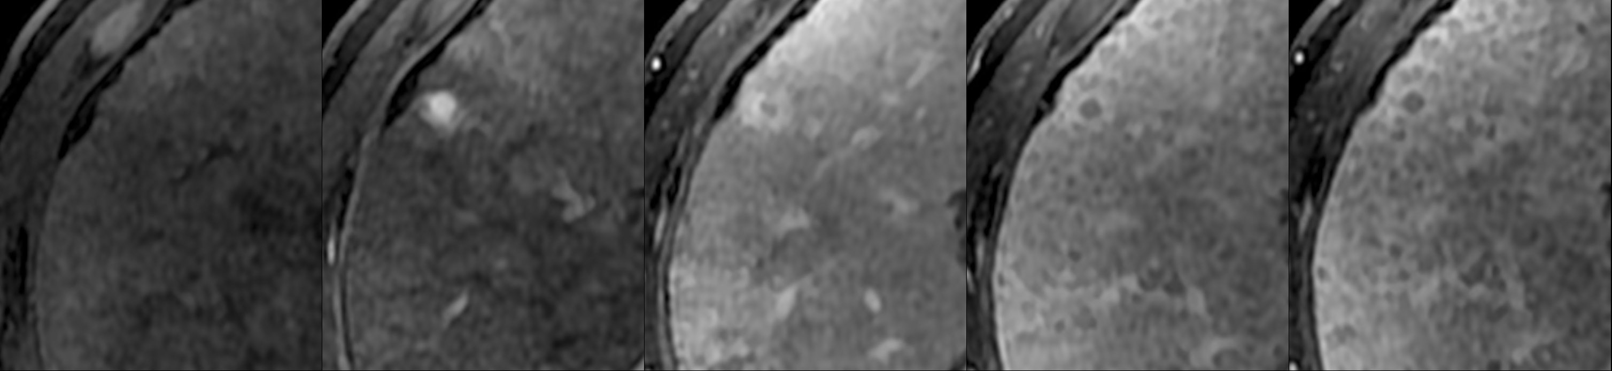
LR-4 Example
Pre
Arterial
Portal Venous
Delayed 3 minutes
Delayed 5 minutes
Washout appearance
9mm
Arterial
Hyper-enhancement
Capsule appearance
MRI at 3T
Diameter (mm):
Arterial phase
hyper-
enhancement
LI-RADS
Table
< 10
“Washout”
“Capsule”
≥ Two:
LR-4
American College of Radiology.
Notes:
LR4: Probably HCC
Concept: High probability observation is HCC but there is not 100% certainty.
Definition: Observation with imaging features suggestive but not diagnostic of HCC.
Criteria: Not definite benign entity, not probable benign entity, not non-HCC malignancy, and as follows:
LR 4A (<20mm mass)
Mass with arterial phase hypo- or iso- enhancement
≥ 2 of the following: “washout”, “capsule”, threshold growth
Mass with arterial phase hyper-enhancement
<10mm mass with ≥ 1 of following: “washout”, “capsule”, threshold growth OR
10-19mm mass with only 1 of following: “washout”, “capsule”, threshold growth

Slide 34
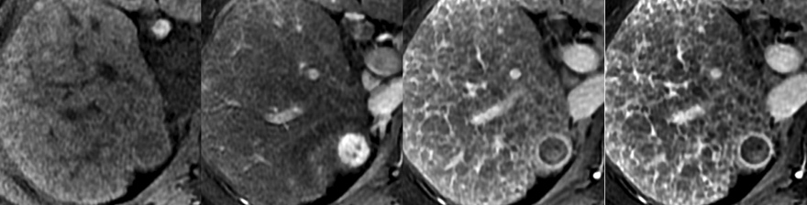
LR-5 Example
Pre
Arterial
Portal Venous
Delayed 3 Minutes
Arterial phase hyper-enhancement
“Washout”
18 mm
“Capsule”
MRI at 3T
Diameter (mm):
Arterial phase
hyper-
enhancement
LI-RADS
Table
10-19
“Washout”
“Capsule”
≥ Two:
LR-5
American College of Radiology.
Notes:
LR5: Definitely HCC
Concept: 100% certainty observation is HCC. LR5 is essentially equivalent to OPTN 5.
Definition: Observation with imaging features diagnostic of HCC or proven to be HCC at histology.
Criteria: Not definite benign entity, not probably benign entity, not non-HCC malignancy, and as follows:
LR 5A (10-19mm mass)
Mass with arterial phase hyper-enhancement
10-19mm mass with ≥ 2 of following: “washout”, “capsule”, threshold growth

Slide 35
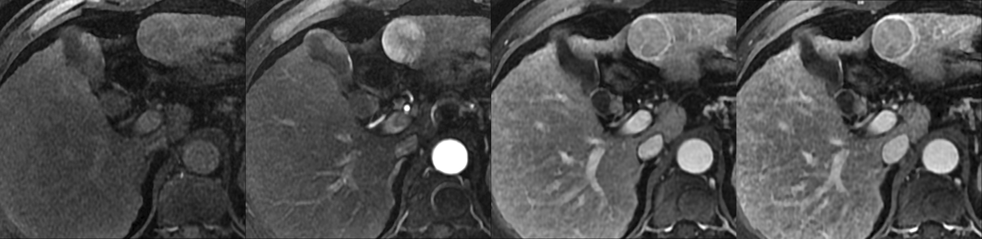
Liver Transplant Candidate
Pre
Arterial Phase
Portal Venous Phase
3-min Delay
MRI at 3T
Solitary 3.2 cm LR-5 nodule
Radiologic T-Stage 2
American College of Radiology.

Slide 36
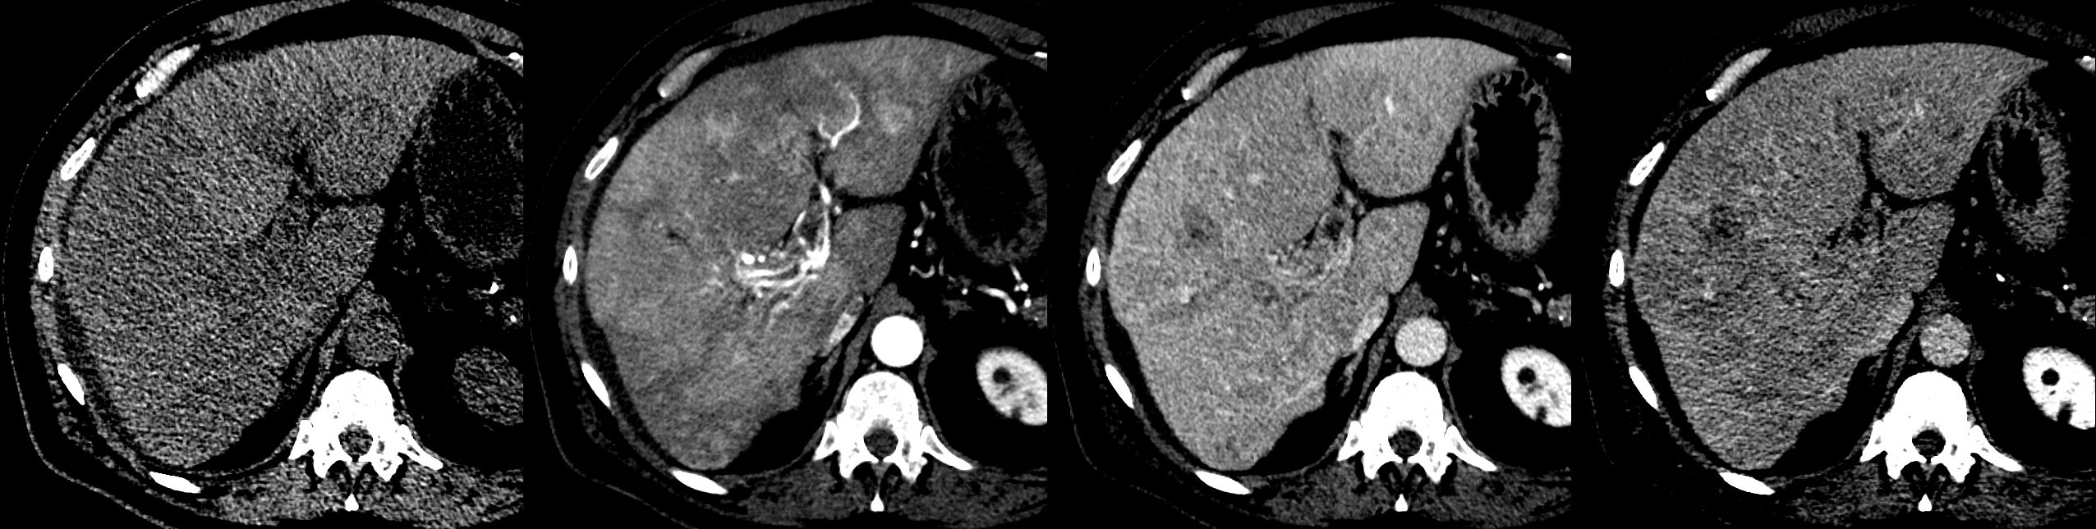
Not Liver Transplant/Resection Candidate
Pre
Arterial Phase
Portal Venous Phase
3-min Delay
MDCT
Infiltrative HCC occupying most of right lobe and invading right portal vein
LR-5V
Radiologic T-Stage 4b
American College of Radiology.

Slide 37
Barcelona Clinic Liver Cancer (BCLC) Staging Classification and Treatment Schedule: proposed modifications/additions*
Hepatocellular carcinoma
(Modified from: Llovet JM et al. J Natl Cancer Inst. 2008;100:698-711.)
Stage 0
PST 0,
Child-Turcotte-Pugh A
Stage A-C
PST 0-2,
Child-Turcotte-Pugh A or B
Stage D
PST >2,
Child-Turcotte-Pugh C
Very early stage (0)
Single <2 cm
carcinoma in situ
Early stage (A)
Single nodule <5 cm
or 3 nodules ≤3 cm,
PST 0
Intermediate stage (B)
Multinodular, PST 0
Advanced stage (C)
Portal invasion,
N1, M1, PST 1-2
Terminal
stage (D)
Single
3 nodules ≤3 cm
Increased portal
pressure and elevated
bilirubin levels
Yes
Associated diseases
No
No
Yes
TAE or TACE
Sorafenib
Median survival 11-20 months
Resection
Liver transplantation
(CLT or LDLT)
RFA (PEIª)
Supportive Care
*Sequence: TARE, TABE ± sorafenib?^{b}
*Combinations,
TARE, TABE?^{b}
Survival <3 months
5-year survival 40%-70%
ª Rarely used. ^{b} Confirmation required from RCTs.
Notes:
Llovet JM, DiBisceglie AM, Bruix J, et al. Design and endpoints of clinical trials in hepatocellular carcinoma. J Natl Cancer Inst. 2008;100(10):698-711.
The BCLC staging system for HCC. M, metastasis classification; N, node classification; PS, performance status; RFA, radiofrequency ablation; TACE, transarterial chemoembolization.
Barcelona Clinic Liver Cancer (BCLC) staging classification and treatment schedule. Patients with very early hepatocellular carcinoma (HCC) (stage 0) are optimal candidates for resection. Patients with early HCC (stage A) are candidates for radical therapy (resection, liver transplantation [LT], or local ablation via percutaneous ethanol injection [PEI] or radiofrequency [RF] ablation). Patients with intermediate HCC (stage B) benefit from transarterial chemoembolization (TACE). Patients with advanced HCC, defined as presence of macroscopic vascular invasion, extrahepatic spread, or cancer-related symptoms (Eastern Cooperative Oncology Group performance status 1 or 2) (stage C), benefit from sorafenib. Patients with end-stage disease (stage D) will receive symptomatic treatment. Treatment strategy will transition from one stage to another on treatment failure or contraindications for the procedures. Modified from Llovet et al. (4).

Slide 38
Staging Treatment Algorithm
HCC
PST 0, Child-Pugh A
PST 0-2, Child-Pugh A-B
PST > 2, Child-Pugh C
Very early stage 0
Early stage A
Intermediate stage B
Advanced stage C
Terminal stage D
Single < 2 cm
Single or 3 nodules ≤ 3 cm, PST 0
Multinodular, PST 0
Portal invasion, N1, M1, PST 1-2
Single
3 nodules ≤ 3 cm
Portal pressure/bilirubin
Portal invasion, N1, M1
Increased
Associated diseases
Normal
No
Yes
No
Yes
Resection
OLT
RFA/MW
TACE/TABE
/TARE
Combination
w/sorafenib
TARE (PVT)
Sorafenib/
Clinical Trial/
Combination
Symptomatic/
Palliative
Down Stage
Down Stage
Adapted from: Llovet et al, 2008.
Notes:
38
Llovet JM et al. J Natl Cancer Inst. 2008;100:698-711

Slide 39
HCC is Not ‘One Disease’
Cancer and underlying liver disease
Clinically diverse cancer
physiological staging
anatomical staging
Molecularly diverse cancer
distinct molecular ‘subtypes’ have begun to be identified
molecular ‘drivers’ still largely unknown
angiogenesis is a validated target in HCC
Finn, 2010.
Notes:
39
39
Clin Cancer Res. 2010 Jan 15;16(2):390-7. doi: 10.1158/1078-0432.CCR-09-2084. Epub 2010 Jan 12.
Development of molecularly targeted therapies in hepatocellular carcinoma: where do we go now?
Finn RS.
Hepatocellular carcinoma (HCC), once considered an orphan disease in the West, has become a global health concern. It is the third leading cause of cancer death worldwide, and its incidence continues to increase. Historically, the development of new systemic agents for advanced HCC has been lacking despite no clear benefit with traditional cytotoxic therapies. Although two randomized studies with sorafenib for the treatment of HCC patients have recently been completed, survival benefits have been modest and highlight the unmet medical need among patients with HCC. Given the clear need, clinical development of novel systemic agents in HCC has begun in earnest. These clinical studies are founded on a growing body of basic and translational science that has identified several potential molecular targets in HCC. The successful development of such targeted agents in the future will be linked to our ability to appropriately select patients for treatment based on their clinical stage (including extent of liver disease and extent of tumor) and on potential predictive markers of response. Here, we review these data in the context of rational drug development in HCC in the front-line setting and in previously treated patients.

Slide 40
Management of Hepatocellular Carcinoma Requires a Multidisciplinary Approach
Hepatobiliary Surgery
Hepatology
Oncology
Pathology
Radiology
Radiation Oncology
Guy et al, 2012.
Notes:
Clin Gastroenterol Hepatol. 2012 Apr;10(4):354-62. doi: 10.1016/j.cgh.2011.11.008. Epub 2011 Nov 12.
Multidisciplinary management of hepatocellular carcinoma.
Guy J, Kelley RK, Roberts J, Kerlan R, Yao F, Terrault N.

Slide 41
What We Know About Treating HCC:
Staging patients is important
physiologic and anatomic
The only curative approach is surgery (resection or transplant)
Most patients are not candidates for above
Chemoembolization (TACE) and radiofrequency ablation can improve survival
In selected patients
Eventually most patients will require systemic treatment if they live long enough
Cytotoxic chemotherapy has not had any impact on this disease
Sorafenib improves survival for patients with advanced HCC

Slide 42
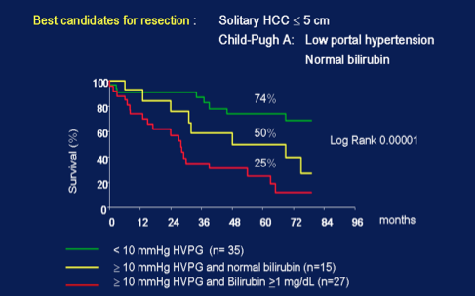
Survival After Surgical Resection for HCC
Llovet et al, 1999.
Notes:
Hepatology. 1999 Dec;30(6):1434-40.
Intention-to-treat analysis of surgical treatment for early hepatocellular carcinoma: resection versus transplantation.
Llovet JM, Fuster J, Bruix J.
Liver transplantation is proposed as the best therapy for early hepatocellular carcinoma in cirrhotic patients. However, the confrontation with the results obtained by surgical resection has never been done on an intention-to-treat basis. Between 1989 and 1997, 164 out of 1,265 patients with hepatocellular carcinoma were evaluated for surgery. Seventy-seven (48 men, mean 61 years of age, 74 Child-Pugh class A, size 33 +/- 18 mm) were resected (first line option) and 87 (65 men, mean 55 years of age, 50 Child-Pugh class B/C, size 24 +/- 14 mm) were selected for transplantation. The 1-, 3-, and 5-year "intention-to-treat" survival was 85%, 62%, and 51% for resection and 84%, 69%, and 69% for transplantation (8 drop-outs on waiting list). Bilirubin and clinically relevant portal hypertension were independent survival predictors after resection. Thereby, the 5-year survival of the best candidates (absence of clinically relevant portal hypertension, n = 35) was 74%, whereas it was 25% for the worst candidates (portal hypertension and bilirubin >/=1 mg/dL, n = 27) (P <.00001). The variable "drop-out on waiting list" was the sole survival predictor after transplantation. The 2-year survival rate of patients evaluated for transplantation was 84% in the 1989 to 1995 period (mean waiting time, 62 days; no drop-outs) and 54% during 1996 to 1997 (mean waiting time, 162 days; 8 drop-outs)(P <.003). This outcome was significantly lower than that of the best candidates for resection (P =.002). In conclusion, a proper selection of candidates for resection promotes better results than transplantation, in which the results are significantly hampered by the growing incidence of drop-outs because of the increasing waiting time.

Slide 43
Validation of evaluation criteria for TACE Multi institutional study (JIVROSG-0602)
HCC
TACE
20%
Which is the best surrogate criteria for survival ?
100%
80%
orig.WHO* mod.WHO* orig.RECIST* mod.RECIST* EASL/JSHCC **
Reduction: 0%
Response: SD
80%
PR
0%
SD
25%
SD
80%
PR
*confirmed by 4w interval
*one point in EASL/ 6mo interval in JSHCC
Neovascularization in blue
Sato et al, 2013.
Notes:
Ups J Med Sci. 2013 Mar;118(1):16-22. doi: 10.3109/03009734.2012.729104. Epub 2012 Nov 20.
Tumor response evaluation criteria for HCC (hepatocellular carcinoma) treated using TACE (transcatheter arterial chemoembolization): RECIST (response evaluation criteria in solid tumors) version 1.1 and mRECIST (modified RECIST): JIVROSG-0602.
Sato Y, Watanabe H, Sone M, Onaya H, Sakamoto N, Osuga K, Takahashi M, Arai Y; Japan Interventional Radiology in Oncology Study Group-JIVROSG.
Abstract
BACKGROUND:
Two standard sets of criteria are used to evaluate the tumor response of hepatocellular carcinoma (HCC): RECIST (Response Evaluation Criteria in Solid Tumors) and modified RECIST (mRECIST). The purpose was to compare two tumor response evaluation criteria, RECIST version 1.1 and mRECIST, for HCC treated using transcatheter arterial chemoembolization (TACE).
METHODS:
The radiological findings of patients who underwent TACE for HCCs in a multicenter clinical trial were examined. Sixty-five lesions in 21 patients treated with TACE without mixing iodized-oil were evaluated. The tumor size was evaluated by measuring the entire lesion, including the necrotic part, using RECIST version 1.1, whereas only the contrast-enhanced part observed during the arterial phase was measured using mRECIST. Five radiologists independently measured each lesion twice. To evaluate the inter-criteria reproducibility, the complete response (CR) rate, the response rate, the kappa statistics, and the proportion of agreement (PA) for response categories were calculated. The same analyses were conducted for inter- and intra-observer reproducibility.
RESULTS:
In the inter-criteria reproducibility study, the CR rate and the response rate obtained using mRECIST (56.9% and 79.7%) were higher than those obtained using RECIST version 1.1 (9.2% and 43.1%). In the inter- and intra-observer reproducibility study, mRECIST exhibited an 'almost perfect agreement', while RECIST version 1.1 exhibited a 'substantial agreement'.
CONCLUSIONS:
Considerable differences in the CR rate and the response rate were observed. From the viewpoint of the high inter- and intra-observer reproducibility, mRECIST may be more suitable for tumor response criteria in clinical trials of TACE for HCC

Slide 44
Early HCC Treated with RFA
Lencioni et al, 2005:
206 patients with early stage unresectable HCC treated with RFA
Favorable 5 year survival
 | 3yr Survival | 5yr Survival
Child A with single lesion | 89% | 61%
Child A | 76% | 51%
Child B | 46% | 31%
Tateishi et al, 2005:
1000 RFA procedures in >700 patients:
Survival: 94, 77, and 54% (1-, 3-, and 5-year)
RFA in small resectable lesions?
Lencioni et al, 2005; Tateishi et al, 2005.
Notes:
Recent publications of large series, notable from the Lencioni group with favorable 5 year survival after RFA close to 50%, reaching 60% with single lesions with good hepatic reserve. Two other series published in March, one Korean and one Japanese, with over 1000 cases each of RFA reporting similar 5 year survival rates.
Early-Stage Hepatocellular Carcinoma in Patients with Cirrhosis: Long-term Results of Percutaneous Image-guided Radiofrequency Ablation
Riccardo Lencioni, MD, , Dania Cioni, MD, , Laura Crocetti, MD, , Chiara Franchini, MD, , Clotilde Della Pina, MD, , Jacopo Lera, MD, and , Carlo Bartolozzi, MD
Radiology; March 2005
Volume 234, Issue 3
Percutaneous Radiofrequency Ablation for
Hepatocellular Carcinoma
An Analysis of 1000 Cases
Ryosuke Tateishi, M.D.
Shuichiro Shiina, M.D.
Takuma Teratani, M.D.
Shuntaro Obi, M.D.
Shinpei Sato, M.D.
Yukihiro Koike, M.D., Ph.D.
Tomonori Fujishima, M.D.
Haruhiko Yoshida, M.D., Ph.D.
Takao Kawabe, M.D., Ph.D.
Masao Omata, M.D., Ph.D.
CANCER March 15, 2005 / Volume 103 / Number 6

Slide 45
Is RFA Better Than Surgical Resection? Surgery considered better, but...
148 patients Child A; case control RFA vs. Surgical resection
 | 1yr Survival | 3yr Survival | Recurrence
Surgery (N=93) | 97.9% | 83.9% | 45.2%
RFA (N=55) | 100.0% | 72.7% | 58.2%
 |  | P=0.24 | P=0.54
Overall survival + recurrence-free survival: RFA = surgical resection for single small HCC with good hepatic reserve
Rate of local recurrence: RFA > surgical resection
Hong et al, 2005.
Notes:
There has been strong interest in RFA versus surgical resection for small HCC lesions. Report from Clinical Gastroenterology in March in a case series comparing surgical resection Childs A patient versus a group where patients had refused surgery undergoing RFA. The data suggested that RFA was as effective for single small HCC lesions with good hepatic reserve, although having a higher rate of local recurrences but having comparable overall and disease free survival at 3 years. RFA group had decreased peri-procedural mortality and morbidity. However, surgical resection has been shown in earlier papers to be superior than RFA, although the RFA groups typically had limited follow-up.
J Clin Gastroenterol. 2005 Mar;39(3):247-52.
Comparing the outcomes of radiofrequency ablation and surgery in patients with a single small hepatocellular carcinoma and well-preserved hepatic function.
Hong SN, Lee SY, Choi MS, Lee JH, Koh KC, Paik SW, Yoo BC, Rhee JC, Choi D, Lim HK, Lee KW, Joh JW.
To compare the efficacy of radiofrequency ablation (RFA) and surgical resection in a group of patients with a Child-Pugh score of 5 and a single HCC less than 4 cm in diameter.
BACKGROUND:
Radiofrequency ablation (RFA) has become a popular method for treatment of hepatocellular carcinoma (HCC) and has been applied as an alternative primary therapy to surgical resection.
STUDY:
We compared outcomes for 148 patients treated with RFA (n = 55) and those treated surgically (n = 93).
RESULTS:
The rate of local recurrence among patients in the RFA group was significantly higher than in the surgery group (P = 0.005), while the incidence of remote recurrence was similar between the two groups (P = 0.30). The cumulative 1- and 3-year overall survival rates (P = 0.24) and the cumulative 1- and 3-year recurrence-free survival rates (P = 0.54) were not significantly different between the two groups.
CONCLUSIONS:
Despite a higher rate of local recurrence, RFA was found to be as effective as surgical resection for the treatment of single small HCC in patients with well-preserved liver function, in terms of the incidence of remote recurrence and the patients' likelihood of achieving overall and/or recurrence-free survival.

Slide 46


Treatment: Chemoembolization
Normal liver gets 75% of blood supply from portal vein and 25% of blood supply from hepatic artery
Tumor receives most of its blood supply from the hepatic artery
Injection into the hepatic artery spares most of the normal liver
Embolization of the hepatic artery prevents systemic absorption of chemotherapy agents and induces ischemic necrosis of tumor
Catheter placement for chemoembolization
Tumor
Hepatic artery
Liver
Portal vein
Ramsey et al, 2004.
Notes:
Multiple studies with anti tumor effect, no survival benifit
Chemoembolization of Unresectable Hepatocellular Carcinoma: A Review
Douglas E. Ramsey, AB, Jean-Francois H. Geschwind, MD
Appl Radiol. 2004;33(3).
http://www.medscape.com/viewarticle/474054_3.
Image adapted from/can be found at: http://www.uphs.upenn.edu/radiology/patient/services/ir/info/chemo.html
46

Slide 47
Chemoembolization: Randomized Trials (Nearly Identical Techniques)
Lo et al^{[1]}: N = 80 with newly diagnosed unresectable HCC, 80% HBV positive, 7-cm tumors (60% multifocal)
Technique | Survival, %
 | Year 1 | Year 2 | Year 3
TACE | 57 | 31 | 26
Supportive care | 32 | 11 | 3
Llovet et al^{[2]}: N = 112 with unresectable HCC, 80% to 90% HCV positive, 5-cm tumors (~ 70% multifocal)
Technique | Survival, %
 | Year 1 | Year 2
TACE | 82 | 63
Supportive care | 63 | 27
HBV = hepatitis B virus; HCV = hepatitis C virus; TACE = transcatheter arterial chemoembolization.
Lo et al, 2002; Llovet et al, 2002.
Notes:
47
Until the publication of studies by Lo and colleagues and Llovet and colleagues, it was difficult to assert whether chemoembolization significantly improves survival in patients with HCC.
Hepatology. 2002 May;35(5):1164-71.
Randomized controlled trial of transarterial lipiodol chemoembolization for unresectable hepatocellular carcinoma.
Lo CM, Ngan H, Tso WK, Liu CL, Lam CM, Poon RT, Fan ST, Wong J.
Lancet. 2002 May 18;359(9319):1734-9.
Arterial embolisation or chemoembolisation versus symptomatic treatment in patients with unresectable hepatocellular carcinoma: a randomised controlled trial.
Llovet JM, Real MI, Montaña X, Planas R, Coll S, Aponte J, Ayuso C, Sala M, Muchart J, Solà R, Rodés J, Bruix J; Barcelona Liver Cancer Group.

Slide 48
TACE vs Surgical Resection: A Case-Control Prospective Study
N = 182, ~ 70% HBV positive, 99% Okuda stage I, 76% with tumors < 3 cm
Technique | Survival, %
 | Year 1 | Year 2 | Year 3 | Year 5
TACE | 96 | 80 | 56 | 30
Surgical resection | 90 | 80 | 70 | 52
Surgery superior to TACE for tumors smaller than 2 cm and/or CLIP stage 0
BUT for tumors > 3 cm and/or CLIP stage 1-2, 5-year survival identical for both groups (27%)
Median OS (P = .1529)
Resection: 65.1 months
TACE: 50.4 months
CLIP = Cancer of the Liver Italian Program; HBV = hepatitis B virus; TACE = transcatheter arterial chemoembolization.
Lee et al, 2002.
Notes:
48
Chemoembolization can also be used at earlier stages of disease presentation. This important case-controlled study showed that when patients were treated at an early stage with chemoembolization, survival was almost identical to that following surgical resection. Surgical resection was better than chemoembolization only in those patients who presented with tumors smaller than 2 cm (probably because they were not yet arterialized) and with no evidence of underlying liver dysfunction.
Lee HS, et al. J Clin Oncol. 2002;20:4459-4465.

Slide 49
Response to TACE as a Biological Selection Criterion for LT in HCC
1.0
Transplanted
Overall 5-year survival: 51.9%
Highly significant difference in 5-year survival between downstaged (transplanted) patients and patients not responding to TACE (P < .0001)
Survival calculated from the beginning of TACE treatment
80.9%
0.8
All patients
0.6
51.9%
Survival
0.4
TACE nonresponders
0.2
0%
0
0
365
730
1095
1460
1825
Days
LT = liver transplantation; TACE = transcatheter arterial chemoembolization.
Otto et al, 2006.
Notes:
49
A favorable response to chemoembolization facilitates a better outcome following transplantation. This approach is similar to the use of chemotherapy before surgical resection in patients with colorectal cancer metastasis.
Survival of 96 patients enrolled in the TACE protocol.
The difference in 5-year survival between downstaged
(transplanted) patients and patients not responding to TACE
is highly significant (P < 0.0001). (Survival is calculated from
the beginning of TACE treatment.) Solid line denotes all patients
included in the analysis. Dotted line denotes patients
not responding to TACE. Dashed line denotes transplanted patients.
Cross denotes censored.

Slide 50
Response to TACE as a Biological Selection Criterion for LT in HCC
1.0
94.5%
0.8
P = .0017
TACE responders
TACE nonresponders
0.6
Freedom From Recurrence
0.4
35.4%
0.2
0
0
365
730
1095
1460
1825
Days
LT = liver transplantation; TACE = transcatheter arterial chemoembolization.
Otto et al, 2006.
Notes:
50
Posttransplant freedom from recurrence. TACE
without progression (denoted by solid line) during waiting
time vs. TACE with progression (denoted by dashed line) during
waiting time. Cross denotes censored.

Slide 51
Intra-arterial Radioembolization With Yttrium-90: Rationale and History
Radioembolization: Use of intra-arterially delivered yttrium-90 microspheres emitting high-dose radiation for the treatment of liver tumors
Yttrium-90 microspheres
Average diameter: 20-30 µm
100% pure beta emitter (0.9367 MeV)
Physical half-life: 64.2 hours
Irradiates tissue with average path length of 2.5 mm (maximum: 11 mm)
Murthy et al, 2006.
Notes:
Radioembolization is similar to chemoembolization except that it delivers yttrium-90 instead of chemotherapy.
The advantage of yttrium‑90 is not only the size of the spheres (20‑30 microns), which suggests a deeper penetration of the tumor in the microenvironment, but also the physical half‑life of 64 hours and the minimal 2.5-mm penetration through tissue. This means that patients do not need to be isolated and can go home the same day.
Biomed Imaging Interv J 2006; 2(3):e43
doi: 10.2349/biij.2.3.e43
© 2006 Biomedical Imaging and Intervention Journal
REVIEW ARTICLE
Trans-arterial hepatic radioembolisation of yttrium-90 microspheres
R Murthy^{1,*}, MD, FACP, A Habbu¹, MD, R Salem², MD, MBA, FSIR
51

Slide 52
Yttrium-90 Radiotherapy for HCC Patients With and Without PVT
EASL = European Association for the Study of the Liver; WHO = World Health Organization; PVT = portal vein thrombosis.
Kulik et al, 2008.
Phase II study: N = 108 (37 with PVT, 71 without PVT)
Stratified by toxicity: Child-Pugh score (in cirrhotics), dose, location of PVT
Median dose: 134 Gy
Partial response rate: 42% (WHO), 70% (EASL)
Adverse event rate highest in patients with main PVT and cirrhosis
Median survival, main PVT: 133.5 days
Branch PVT: 304 days
No PVT: 467 days
Notes:
52
An important study from Kulik and colleagues looked at the effect of radioembolization with yttrium-90 in patients both with and without portal vein thrombosis. The investigators reported similar data as seen with chemoembolization: Patients without portal vein thrombosis lived for approximately 1.5 years whereas those patients who had some thrombosis in the portal vein lived for approximately 1 year.
Hepatology. 2008 Jan;47(1):71-81.
Safety and efficacy of 90Y radiotherapy for hepatocellular carcinoma with and without portal vein thrombosis.
Kulik LM, Carr BI, Mulcahy MF, Lewandowski RJ, Atassi B, Ryu RK, Sato KT, Benson A 3rd, Nemcek AA Jr, Gates VL, Abecassis M, Omary RA, Salem R.

Slide 53
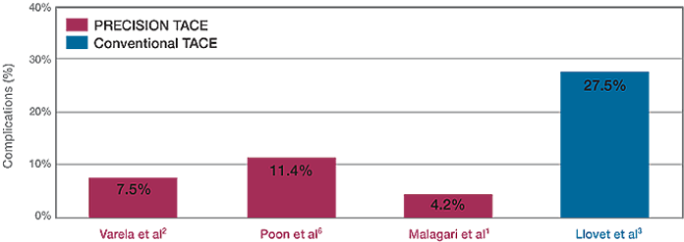
Complications SAE Comparison: Conventional TACE vs PRECISION TACE
75% Reduction in SAE’s at the same institution
Courtesy of Dr. David Brophy, St. Vincent’s University Hospital, 2013.
Notes:
Varela: 2 tumor abscess’
Poon: 10cm subcapsular tumor rupture; 22cm tumor treated and patient died of liver failure; caution should be used in tumors larger than 15cm
Malagari: 1 pleural effusion; 1 colecystitis; 1 tumor abscess. Percentages less than those presented in TACE literature (15-27%).
From slide deck: Interventional Radiology and Liver Disease. February 12th, 2013. Dr. David Brophy, Consultant Radiologist, Department of Radiology, St. Vincent’s University Hospital. http://www.stvincents.ie/dynamic/File/CCHLT%20IR%20and%20Liver%20Disease%20DB%2012-2-2013%20PDF.pdf
Slide
53

Slide 54
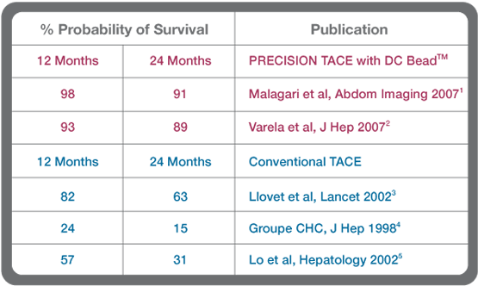
PRECISION TACE with DC Bead™ Addressing the challenge of improved survival in hepatocellular carcinoma
Courtesy of Dr. David Brophy, St. Vincent’s University Hospital, 2013.
Notes:
DC Bead® is not currently cleared by the FDA for sale or distribution in the USA.
From slide deck: Interventional Radiology and Liver Disease. February 12th, 2013. Dr. David Brophy, Consultant Radiologist, Department of Radiology, St. Vincent’s University Hospital. http://www.stvincents.ie/dynamic/File/CCHLT%20IR%20and%20Liver%20Disease%20DB%2012-2-2013%20PDF.pdf
Slide
54

Slide 55
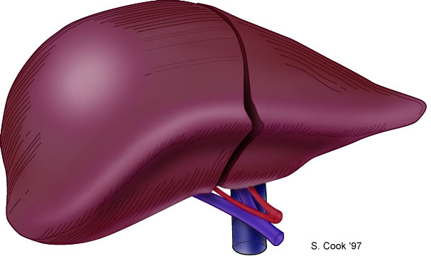
Milan Criteria
1 lesion < 5 cm
No evidence of extrahepatic spread
Based on pre-transplant imaging
4 year survival – 74%
Recurrence rate - <10%
Validated in several studies with > 1000 patients
5 yr survival >70%
Recurrence < 15%
3 lesions, none > 3 cm
Mazzaferro et al, 1996.
Notes:
The early experience with transplant for HCC was dimsal with high recurrence rates and overall poor survival (5 yr of 25%). Transplant for HCC BECAME A CONTAINDICATION UNTIL A Landmark paper by mazzoferro in 1996 (48 pts) demonstrated that when pts are properly selected, they have an outcome similar to pt transplanted w/o hcc. These criteria are known as the Milan criteria.
MEDLINE Full Record
N Engl J Med 1996; 334:693-9.
Liver transplantation for the treatment of small hepatocellular carcinomas in patients with cirrhosis.
Mazzaferro V, Regalia E, Doci R, Andreola S, Pulvirenti A, Bozzetti F, Montalto F, Ammatuna M, Morabito A, Gennari L
BACKGROUND
The role of orthotopic liver transplantation in the treatment of patients with cirrhosis and hepatocellular carcinoma is controversial, and determining which patients are likely to have a good outcome after liver transplantation is difficult.
METHODS
We studied 48 patients with cirrhosis who had small, unresectable hepatocellular carcinomas and who underwent liver transplantation. In 94 percent of the patients, the cirrhosis was related to infection with hepatitis B virus, hepatitis C virus, or both. The presence of tumor was confirmed by biopsy or serum alpha-fetoprotein assay. The criteria for eligibility for transplantation were the presence of a tumor 5 cm or less in diameter in patients with single hepatocellular carcinomas and no more than three tumor nodules, each 3 cm or less in diameter, in patients with multiple tumors. Twenty-eight patients with sufficient hepatic function underwent treatment for the tumor, mainly chemoembolization, before transplantation. After liver transplantation, the patients were followed prospectively for a median of 26 months (range, 9 to 54). No anticancer treatment was given after transplantation.
RESULTS
The overall mortality rate was 17 percent. After four years, the actuarial survival rate was 75 percent and the rate of recurrence-free survival was 83 percent. Hepatocellular carcinoma recurred in four patients (8 percent). The overall and recurrence-free survival rates at four years among the 35 patients (73 percent of the total) who met the predetermined criteria for the selection of small hepatocellular carcinomas at pathological review of the explanted liver were 85 percent and 92 percent, respectively, whereas the rates in the 13 patients (27 percent) whose tumors exceeded these limits were 50 percent and 59 percent, respectively (P = 0.01 for overall survival; P = 0.002 for recurrence-free survival). In this group of 48 patients with early-stage tumors, tumor–node–metastasis status, the number of tumors, the serum alpha-fetoprotein concentration, treatment received before transplantation, and 10 other variables were not significantly correlated with survival.
CONCLUSIONS
Liver transplantation is an effective treatment for small, unresectable hepatocellular carcinomas in patients with cirrhosis.

Slide 56
Phase III SHARP Trial: Overall Survival Intent-to-Treat Population
1.00
1.00
sorafenib
Median: 46.3 weeks (10.7 months)
(95% CI, 40.9-57.9)
0.75
0.75
Placebo
Placebo
Median: 34.4 weeks (7.9 months)
(95% CI, 29.4-39.4)
Survival Probability
0.50
0.50
0.25
0.25
Hazard ratio in sorafenib group: 0.69
(95% CI, 0.55-0.87)
P
=0.00058*
0
0
0
8
16
24
32
40
48
56
64
72
80
Patients at risk
Time (weeks)
Patients at risk
299
299
274
274
241
241
205
205
161
161
108
108
67
67
38
38
12
12
0
sorafenib
0
303
303
276
276
224
224
179
179
126
126
78
78
47
47
25
25
7
7
2
placebo
2
*
O
’
Brien
-
Fleming threshold for statistical significance was
P
=0.0077.
Llovet et al, 2008.
Notes:
Kaplan–Meier Analysis of Overall Survival
Among 602 patients (of whom 299 received sorafenib
and 303 received placebo), the median overall survival
was 10.7 months in the sorafenib group, as compared
with 7.9 months in the placebo group (hazard ratio for
death in the sorafenib group, 0.69; 95% CI, 0.55 to 0.87)
In this multicenter, phase 3, double-blind, placebo-controlled trial, we randomly assigned
602 patients with advanced hepatocellular carcinoma who had not received
previous systemic treatment to receive either sorafenib (at a dose of 400 mg twice
daily) or placebo. Primary outcomes were overall survival and the time to symptomatic
progression. Secondary outcomes included the time to radiologic progression
and safety.
At the second planned interim analysis, 321 deaths had occurred, and the study was
stopped. Median overall survival was 10.7 months in the sorafenib group and 7.9
months in the placebo group (hazard ratio in the sorafenib group, 0.69; 95% confidence
interval, 0.55 to 0.87; P<0.001). There was no significant difference between the
two groups in the median time to symptomatic progression (4.1 months vs. 4.9 months,
respectively, P = 0.77). The median time to radiologic progression was 5.5 months
in the sorafenib group and 2.8 months in the placebo group (P<0.001). Seven patients
in the sorafenib group (2%) and two patients in the placebo group (1%) had a partial
response; no patients had a complete response. Diarrhea, weight loss, hand–foot
skin reaction, and hypophosphatemia were more frequent in the sorafenib group.
In patients with advanced hepatocellular carcinoma, median survival and the time
to radiologic progression were nearly 3 months longer for patients treated with
sorafenib than for those given placebo.
N Engl J Med. 2008 Jul 24;359(4):378-90. doi: 10.1056/NEJMoa0708857.
Sorafenib in advanced hepatocellular carcinoma.
Llovet JM, Ricci S, Mazzaferro V, et al.

Slide 57
Phase 3 SHARP: Toxicity
Toxicity (%)
Sorafenib (n=297)
Placebo (n=302)
All
Grade 3/4
All
Grade 3/4
Anorexia
14
<1
3
<1
Weight loss
9
2
<1
0
Alopecia
14
0
2
0
Hand/foot
21
8
3
<1
Pain (abdominal)
8
2
3
<1
Nausea
11
<1
8
1
Vomiting
5
1
3
<1
Diarrhea
39
8
11
2
Liver dysfunction
<1
<1
0
0
Bleeding
7
<1
4
<1
Llovet et al, 2008.
Notes:
Phase 3 SHARP: Toxicity
The most frequent grade 3/4 events for sorafenib versus placebo were diarrhea (8% vs 2%, respectively) and hand-foot skin reaction (8% vs <1%, respectively)
Reference
Llovet J, Ricci S, Mazzaferro V, et al. Randomized phase III trial of sorafenib versus placebo in patients with advanced hepatocellular carcinoma (HCC). Presented at: American Society of Clinical Oncology Annual Meeting; June 1-5, 2007; Chicago, IL. Abstract LBA1.

Slide 58
Unmet Needs in Advanced HCC
First-line therapies that improve clinical outcomes relative to treatment with sorafenib (the standard of care)^{1,2} with regard to
efficacy¹
safety and tolerability¹
(options also needed for patients who are ineligible)
quality of life (QoL)³
Second-line therapies for patients who progress on or do not tolerate sorafenib¹
What is the natural history of this population after sorafenib?
1. Finn et al, 2010; 2. Llovet et al, 2008; 3. Fan et al, 2010.
Notes:
58
58
Clin Cancer Res. 2010 Jan 15;16(2):390-7. doi: 10.1158/1078-0432.CCR-09-2084. Epub 2010 Jan 12.
Development of molecularly targeted therapies in hepatocellular carcinoma: where do we go now?
Finn RS.
Design and Endpoints of Clinical Trials in Hepatocellular Carcinoma
Josep M. Llovet, Adrian M. Di Bisceglie, Jordi Bruix, Barnett S. Kramer, Riccardo Lencioni, Andrew X. Zhu, Morris Sherman, Myron Schwartz, Michael Lotze, Jayant Talwalkar, Gregory J. Gores, for the Panel of Experts in HCC-Design Clinical Trials
JNCI J Natl Cancer Inst (2008) 100 (10): 698-711.
doi: 10.1093/jnci/djn134
First published online: May 13, 2008
Health-Related Quality of Life in Patients With Hepatocellular Carcinoma: A Systematic Review
Sheng–Yu Fan, Christine Eiser, Ming–Chih Ho
published online 22 March 2010.
Clinical Gastroenterology and Hepatology
Volume 8, Issue 7 , Pages 559-564.e10, July 2010

Slide 59
Phase III Trials of First-Line Therapy in Advanced HCC
Study drug (trial acronym) | Mechanism | Control | N | Primary endpoint | Data
Sorafenib + doxorubicin (CALGB-80802)¹ | Sorafenib: multikinase inhibitor (VEGFR, PDGFR, Raf, others) Doxorubicin: cytotoxic | Sorafenib | 480 | OS | Currently recruiting
Sorafenib + erlotinib (SEARCH)² | Sorafenib: multikinase inhibitor (VEGFR, PDGFR, Raf, others) Erlotinib: RTKI of EGFR-1 | Sorafenib | 720 | OS | negative
Linifanib³ | Multikinase inhibitor (VEGFR, PDGFR, others) | Sorafenib | 1035 | OS | negative
Brivanib (BRISK-FL)⁴ | Selective inhibitor of FGFR + VEGFR | Sorafenib | 1050 | OS | negative
Sunitinib⁵ | Oral multitargeted tyrosine kinase inhibitor | Sorafenib | 1075 | OS | negative
Lenvatinib⁶ | Multikinase inhibitor of (VEGFR, FGFR, others) | Sorafenib | 940 | OS | Currently recruiting
¹ NCT01015833; ² NCT00901901; ³ NCT01009593; ⁴ NCT00858871; ⁵ NCT00699374; ⁶ NCT01761266.
Notes:
59
59

Slide 60
Phase III Trials of Second-Line Therapy in Advanced HCC
Study drug (trial acronym) | Mechanism | Control | N | Primary endpoint | Data
Brivanib (BRISK-PS)¹ | Selective inhibitor of FGFR + VEGFR | Placebo | 395 | OS | Negative
Everolimus (EVOLVE-1)² | mTOR inhibitor | Placebo | 546 | OS | Negative
Ramucirumab (REACH)³ | MAb to VEGFR-2 | Placebo | 544 | OS | Negative
Brivanib (BRISK-APS)⁴ | Selective inhibitor of FGFR + VEGFR | Placebo | 252 | OS | Terminated
Tivantinib (METIV-HCC)⁵ | cMET inhibitor | Placebo | 303 | OS | Currently recruiting
Regorafenib (RESORCE)⁶ | VEGFR inhibitor | Placebo | 530 | OS | Currently recruiting
Cabozantinib (CELESTIAL)⁷ | cMET, VEGFR2, RET | Placebo | 760 | OS | Currently recruiting
ADI-PEG-20⁸ | Arginine-deiminase | Placebo | 633 | OS | Currently recruiting
¹ Llovet et al, 2012; ² Zhu et al, 2014; ³ NCT01140347; ⁴ NCT01108705; ⁵ NCT01755767; ⁶ NCT01774344; ⁷ NCT01908426; ⁸ NCT01287585.
Notes:
60
60

Slide 61
Conclusions
Molecular targeted therapeutics will play a role in the future of HCC management
Sorafenib has established a benchmark for front-line studies
Great unmet need for patients who are ineligible for, intolerant to, and who progress on sorafenib
Integrating new clinical assessment tools into clinical trials
Randomized Phase II trials are needed to better assess activity for moving agents into Phase III
Identify promising new targets for therapy
better identify patients who will receive benefit

Slide 62
Optimizing Multidisciplinary Management of HCC
Current standard
Interv.
radiology
Hepatology
Surgery
Oncology
Pathology
Treatment
decision
What we want
Patient
call
All relevant specialists
Treatment decision
Patient communication
Treatment
Courtesy of Carrie Frenette, MD, CPMC integrated HCC clinic.

Slide 63
Thank you
Questions?

