Slide 1
HBV/HDV infection in Georgia
The First Transcaucasus International Conference on Liver Diseases
Tbilisi, Georgia
05.09.2014
ML MRCHEVELI EUROPEAN LIMBACH DIAGNOSTIC GROUP
Mamuka Zakalashvili MD
Mrcheveli Medical Center
Hepatology and Gastroenterology Department

Slide 2
Outline
Epidemiology
Mode of transmission
Diagnostic methods
Management options
Screening and vaccination
Conclusion

Slide 3
15 – 40 % develop
cirrhosis, liver failure, or HCC
>240
3. Lozano et al. lancet 2012
Notes:
Global impact of Hepatitis B
Approximately 2 billion people worldwide are infected with the hepatitis B virus (HBV) with approximately 350–400 million of those individuals being chronic carriers of HBV infection, and 15–40% of these people will develop cirrhosis, liver failure, or HCC. It is estimated that ~1 million of these will die each year from HBV-associated liver disease. The incidence of hepatocellular carcinoma (HCC) has increased worldwide, killing 300,000–500,000 people each year.
References
WHO Fact Sheets, available at www.who.int. Accessed: September 24, 2004.
Conjeevaram HS, Lok ASF. J Hepatology. 2003;38:S90–S103.
Lee WM. N Engl J Med. 1997;337:1733–1745.
Lok ASF. N Engl J Med. 2002;346:1682–1683.

Slide 4
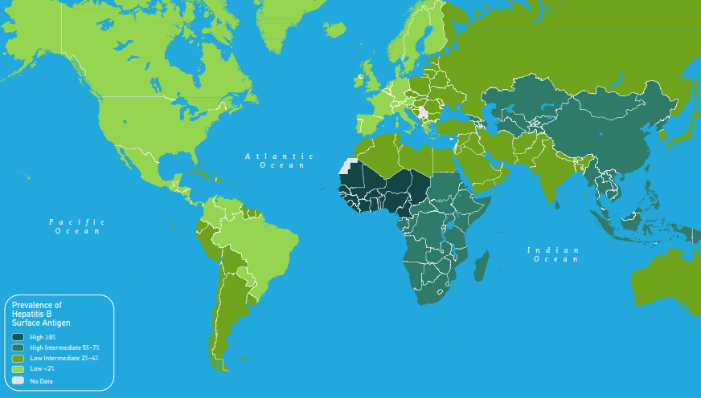

Prevalence of chronic hepatitis B virus infection worldwide, 2005, adults (19-49 Years)
5-7 %
For multiple countries estimates of prevalence of HBsAg are based on limited data and might not reflect current prevalence
Centers for Disease Control and Prevention (CDC), USA
wwwnc.cdc.gov/travel/content/yellowbook/2014/map_3-04.pdf
CDC 2008

Slide 5
Prevalence of HBV infection
At present the reliable, updated, prevalence of HBV infection in Georgia is unknown
According the data from separate medical centers and NCDC we may do some estimate conclusions

Slide 6
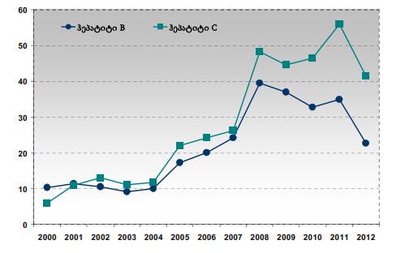
Incidence rate of HBV infection in Georgia from 2000 to 2012 per 100 000 population
Hepatitis B
Hepatitis C
22.7
National Center of Disease Control and Public Health (NCDC), Georgia, 2014

Slide 7
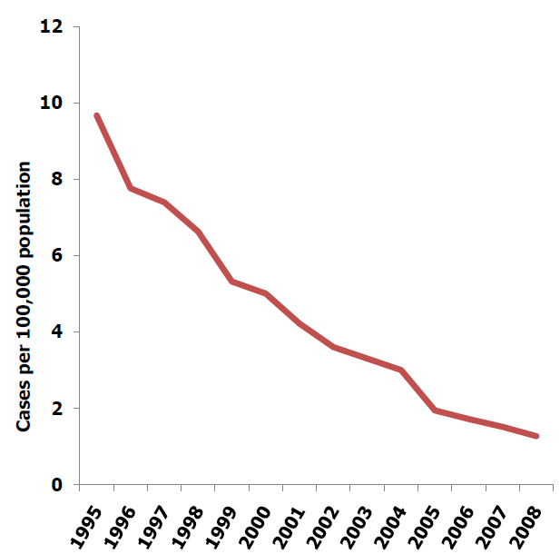
Incidence rate of HBV infection in EU
Incidence of HBV infection in EU in 2012 was 3.5 per 100 000 population
Surveillance and prevention of hepatitis B and C in Europe, Stockholm, 2010;
European Centre for Disease Prevention and Control, 2010

Slide 8
Prevalence of Acute HBV infection
Prevalence of acute hepatitis B infection among newly diagnosed HBV infection in Georgia in 2012 was 15.9%.
 | Acute | Chronic | Non differentiated
Hepatitis B In EU | 16.1% | 71.0% | 12.9%
National Center of Disease Control and Public Health (NCDC), Georgia, 2012
European Centre for Disease Prevention and Control, 2012

Slide 9
Prevalence HBV infection
Limitations of data from Georgia:
As in almost all developing countries, estimates of prevalence and incidence rate of diseases are often unreliable and incomplete
Data are lacking for many public health facility, hospitals, outpatient clinics, private medical centers
NCDC/Georgia with collaboration to CDC/USA are in process to evaluate prevalence of HCV in general population and also is planed to evaluate HBV. So we might have the reliable prevalence of HBV within the next year

Slide 10
HBV infection in pregnancy
National prenatal screening program, which includes: HIV, Syphilis and Hepatitis B, started from 2008 in Georgia.
In 2013 screening on HBV was done to 41714 women, which is about 85% of total pregnant women

Slide 11
HBV infection in pregnancy
National Center of Disease Control and Public Health (NCDC), Georgia, 2014

Slide 12

HBV infection in pregnancy
Hepatitis B Virus Infection Among Pregnant Women in Mtskheta Region, Georgia.
Mtskheta
We determined prospectively Hepatitis B surface Antigen (HBsAg) in serum of 223 pregnant women, admitted in ambulances from 03.2003 till 02.2004 by enzyme immunoassay (EIA).
The gestational age was not taken in account.
D. Metreveli et al, Laboratory Mrcheveli, Tbilisi, Georgia;
Poster 3-198, World Congress of Pathology and Laboratory Medicine, Istambul, Turkey, 2005

Slide 13
Prevalence of HBsAg Among Pregnant Women in Mtskheta Region, Georgia.
HBV infection in pregnancy
Total 223 pregnant women
216 - HBsAg (-), 7 - HBsAg (+)
96,9%
3,1%
D. Metreveli et al, Laboratory Mrcheveli, Tbilisi, Georgia;
Poster 3-198, World Congress of Pathology and Laboratory Medicine, Istambul, Turkey, 2005

Slide 14
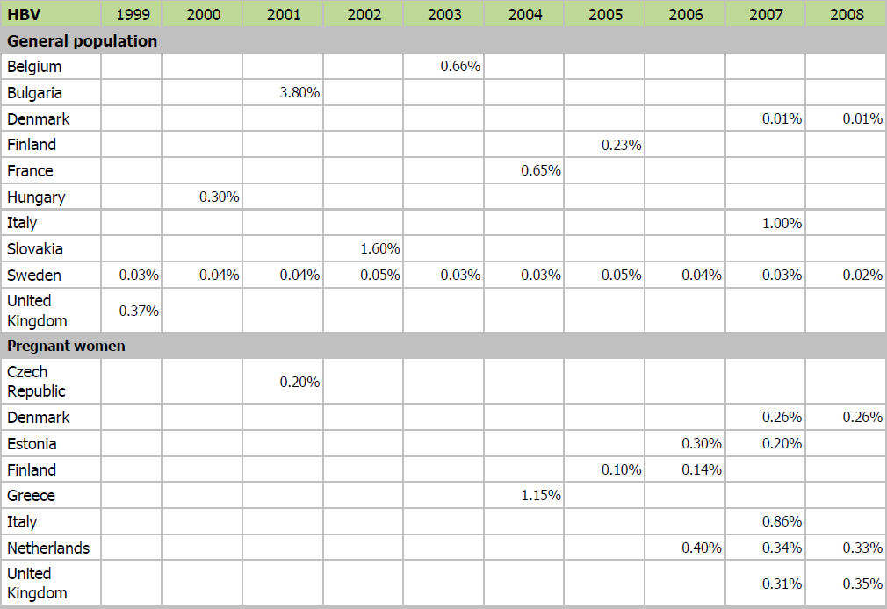
Prevalence of HBV in EU
Surveillance and prevention of hepatitis B and C in Europe, Stockholm, 2010;
European Centre for Disease Prevention and Control, 2010

Slide 15
Data from "Mrcheveli" Med. Center - Hepatology Unit (05.2012-05.2014)
We observed total 1413 patients admitted in our hepatology department as an outpatient from 05.2012 – to 05.2014.

Slide 16
Data from "Mrcheveli" Med. Center - Hepatology Unit (05.2012-05.2014)
Total 1413 patients
HCV
M. Zakalashvili , D. Metreveli et al. Medical Center Mrcheveli, hepatology department 2014

Slide 17
Data from "Mrcheveli" Med. Center - Hepatology Unit (05.2012-05.2014)
We observed total 207 HBV-infected patients in our department as an outpatient from 05.2012 – to 05.2014.
M. Zakalashvili , D. Metreveli et al. Medical Center Mrcheveli, hepatology department 2014

Slide 18
Data from "Mrcheveli" Med. Center - Hepatology Unit (05.2012-05.2014)
Total 207 HBV infected patients
97%
87%
59%
41%
13%
3%
M. Zakalashvili , D. Metreveli et al. Medical Center Mrcheveli, hepatology department 2014

Slide 19
Data from "Mrcheveli" Med. Center - Hepatology Unit (05.2012-05.2014)
Total 207 HBV infected patients
Co-infections
84% (173)
10% (21)
3% (7)
3% (6)
M. Zakalashvili , D. Metreveli et al. Medical Center Mrcheveli, hepatology department 2014

Slide 20
Mode of Transmission
Total 207 HBV infected patients
M. Zakalashvili , D. Metreveli et al. Medical Center Mrcheveli, hepatology department 2014

Slide 21
Available diagnostics methods of HBV/HDV
Almost all laboratory and instrumental diagnostic methods including PCR of HBV/HDV and even HBV genotyping is available in Georgia.
in some cases with collaboration to the medical centers from EU.
Unfortunately, at this moment insurance do not pay for diagnostics of chronic HBV.

Slide 22
Available treatment options for HBV/HDV
Recommended treatment options for HBV/HDV:
PEG INF-2a / PEG INF-2b
Available in Georgia
NUC analogues
Lamivudine
Tenofovir
Available in Georgia
Available in Georgia
Telbivudine, Entecavir, Adefovir
Not available in Georgia

Slide 23
Antiviral Treatment Uptake in Georgia
Antiviral treatment coverage is limited
Lamivudine is used more frequently than Tenofovir
Limitations of antiviral therapy:
Inability to cure;
In majority of cases lifelong therapy;
Low socio-economic status of population;
Lack of educational programs for patients;
Usage of home remedies;
Impossibility of financing antiviral treatment and diagnostics by insurance companies

Slide 24
Viral Characteristics of HBV in Georgia
Vast majority of HBV infected patients in Georgia have HBV genotype D;
May be more then 80% of patients with chronic active HBV infection are HBeAg negatives.
PEG-INF usage is rare for HBV patients
Price reduction of PEG INF-2a is planed for hepatitis B and D infected patients in near future, which somehow may increase INF treatment uptake

Slide 25
Hepatitis D infection in Georgia
Statistics about HDV co-infection prevalence and about antiviral treatment responses do not exist
Based on our experience:
Sustain virological response is extremely rare for HDV co-infected (maybe less then 10%?)
During last 2 years 10 HDV patients were treated with standard regimes – PEG-INF 48 weeks:
5 cases treatment was stopped at week 24 (in all cases due to ineffectiveness)
3 patients had positive HDV-RNA at week 48
1 patient was relapsed after 12 weeks from the end of treatment
1 patient had negative HDV-RNA after 12 weeks from the end of treatment (But he is under follow-up, so we do not know the final result yet)

Slide 26
Prevention of HBV Infection
Screening of blood/organ/tissue donors
Hepatitis B vaccine
Available since 1981
Routine vaccination of infants and previously unvaccinated children (by age 11)
Screening pregnant women and rapid vaccination of infants born to infected women (HBIg and vaccine)
(since 1997 in Georgia)
Screening of blood/organ/tissue donors
(since 1998 in Georgia)
Since 2002 in Georgia
Pregnant screening since 2008 regularly in Georgia
HBIg since 2007 regularly in Georgia
World Health Organisation WHO-CSR, HBV Report 2002

Slide 27
Prevention of HBV Infection
Problems in Prevention:
At this moment lack of guidelines for safe medical practices and sterilization procedures in many medical centers and offices (dental, plastic surgery offices, beauty, tattoo salons and etc) still remains a risk factor of HBV transmission
Lack of education about HBV vaccination
HBV vaccination coverage among risk group individuals and even healthcare workers is rare
Screening of blood and blood products and also pregnant screening at first step is being done by rapid tests (not PCR, not EIA)
Because of this there is a risk of false negative results and missing acute infections

Slide 28
Summary
Prevalence of HBV/HDV infection in general population is unknown
Prevalence of HBV infection is about 3% in pregnancy;
Unsterile procedures seems to be higher route of HBV transmission (?)
Modern diagnostic methods and management options are available in Georgia – but uptake is low (main reason is that it do not covered by insurance)
Prevention methods had been implementing gradually (1997 – blood screening, 2002 - child vaccination, 2007 – HBIg, 2008 – pregnant screening)
But needs more effort and commitment to improve screening methods and increase a HBV prevention coverage

Slide 29

Thank you for your attention!
Tbilisi at night

