Slide 1
Emergence of a HCV genotype genomic variant with elements of type 1 and 2 in Georgia
Michael Weizenegger
Laboratory Group Limbach, Heidelberg, Germany
Department of Microbiology and Molecular Genetic
Sheraton Metechi Palace, Tbilisi 5-6 September 2014

Slide 2


Slide 3
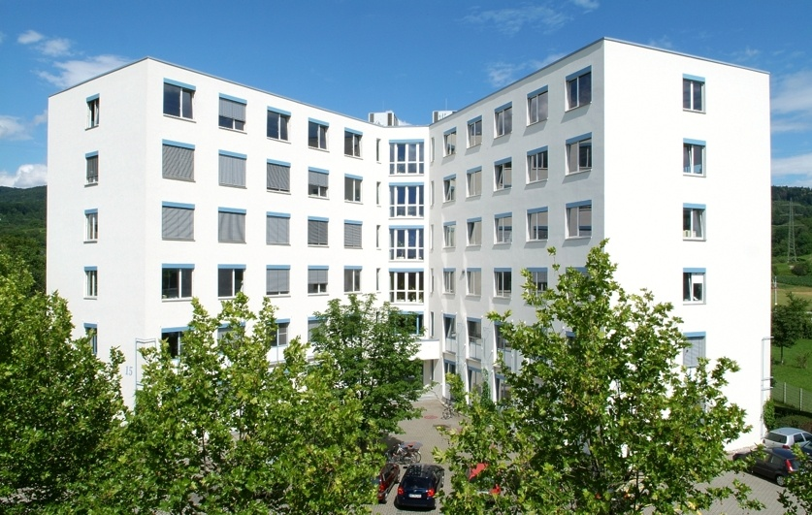

Slide 4
HCV Genotype
What is a HCV genotype and why should I be tested?
Genotypes are genetic subclasses of HCV – there are 11 genotypes, common are type 1 through 6.
The greatest predictor of response to PEG(IFN)/RBV therapy is genotype. Geno 1 is least responsive, but still has 40 - 50% chance for SVR. Geno 2 is most responsive, 80 – 90% SVR.
Genotype does not predict rate of progression, severity of liver disease, or risk for HCC.

Slide 5
HCV Genotypes and Subtypes
c
a
Genotype (1-6)
≥ 30% nucleotide difference
25-30% Amino acid difference
Well-established diversity
Subtype (a-k)
~20% nucleotide difference
b
a
2
1
3
a
4
b
b
5
6
a
a
a
Adapted from Simmonds J Gen Virol. 2004;85:3173-88
Notes:
Each of the 6 major genetic groups of HCV contain a series of more closely related subtypes, typically different from each other by 20% in nucleotide sequences compared with >30% between genotypes, Genotypes 1a, 1b and 3a have become very widely distributed as a result of transmission through unscreened blood transfusion and between injecting drug users, and now represent the vast majority of infections in Western countries. These are the HCV types most commonly encountered clinically, and therefore the ones for which most information has been collected.
The Geographical distribution of each HCV type and subtype is depicted in the next slide.

Slide 6
SVR Rates with Peg-IFN/RBV: According to Genotype
SVR (%)
76%-82%
42%-46%
Genotype 1
Genotype Non-1
Adapted from Strader DB et al. Hepatology. 2004;39:1147-1171.

Slide 7
HCV-1 Genome Structure
5‘-non-coding
region
5‘NTR, 5‘UTR
3‘-non-coding
region
3‘NTR, 3‘UTR
structural
non-structural
C
E1
E2
NS2
NS3
NS4A
NS4B
NS5A
NS5B
http://www.ncbi.nlm.nih.gov/entrez/query.fcgi?cmd=Retrieve&db=Protein&list_uids=00130455&dopt=GenPept

Slide 8
What commercial assays are available for genotyping?
Siemens VERSANT HCV genotype assay (LiPA), a second generation line probe assay, contains probes targeting both the 5’ non coding and the core regions of the viral genome (core region for improved 1a/b subtyping.
Line probe format
z
Purple
substrate
Colourless
substrate
DNA•STRIP®

Slide 9

What commercial assays are available for genotyping?
Siemens TRUGENE HCV 5′NC genotyping
Formate: Sequence of the 5‘ UTR
Source: Siemens

Slide 10
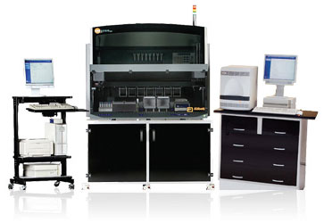
What commercial assays are available for genotyping?
Abbott RealTime HCV Genotype
Real time PCR formate
Target region 5'UTR & NS5b (1a/b subtyping)
Source: Abbott

Slide 11
Analysis HCV Genotype Laboratory Mrcheveli October 2012 to December 2013
29.5%
Genotype 2 = 77
42.5%
Genotype 1 = 111
Genotype 1b = 104
Genotype 1a = 5
0.8% Genotype 4 = 2
27.2%
Genotype 3 = 71
Data: Laboratory Mrcheveli, Tibilisi

Slide 12
Analysis HCV Genotype Laboratory Mrcheveli October 2012 to December 2013
34%
66%

Slide 13
Analysis HCV Genotype Laboratory Mrcheveli October 2012 to December 2013
80%

Slide 14
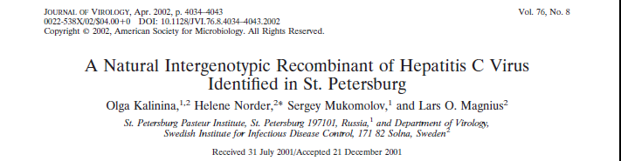
Literature

Slide 15
The St. Petersburg variant
Kalinina et al. identified in the early 1990s HCV strains, which were differing regarding the genotype when different parts of the genome were sequenced.
They found that this genetic divergence was not due to mutations but to fusions of parts of different HCV genomes.
Such chimeric variants were known from other viruses of the Flaviviridae family e.g. dengue virus.

Slide 16
The St. Petersburg variant
Recombination seems to play an important role in the evolution of RNA viruses.
It is no surprising that the common subtype 1b is part of the chimeric HCV clone. But 2k is very uncommon in Russia and in the early 1990s only described in Moldawia. In this time Moldowian and other workers started to travel forth and back between Moldowia and St. Petersburg.
The recombinant strain was found in 5% of HCV infected patients in St. Petersburg.

Slide 17
The St. Petersburg variant
By accident in 2012 during a verification phase in laboratory Limbach to introduce the Abbott Genotyping system, we investigated also HCV isolates from laboratory Mrcheveli.
Four strains typed as genotype 2 with Siemens Versant system appeared to be a mixture of 1b/2k with the Abbott Genotyping system.
HCV isolates were sent to Prof. Ross, University of Essen, Germany and were partly sequenced and identified as “St. Petersburg variant”.

Slide 18
The St. Petersburg variant
structural
non-structural
2k
1b
C
E1
E2
NS2
NS3
NS4A
NS4B
NS5A
NS5B
The HCV strain belongs to two different genotypes: 5’ UTR to within the NS2 region 2k and downstream NS2 type 1b.
http://www.ncbi.nlm.nih.gov/entrez/query.fcgi?cmd=Retrieve&db=Protein&list_uids=00130455&dopt=GenPept

Slide 19
Literature
The Journal of Infectious Diseases 2008; 198:1448 –56
Molecular Epidemiology and Interferon Susceptibility of the Natural Recombinant Hepatitis C Virus Strain RF1_2k/1b
Fuat Kurbanov,1 Yasuhito Tanaka,1 Elena Chub,1,5 Isao Maruyama,3 Aziza Azlarova,1,6 Hiroshi Kamitsukasa,4
Tomoyoshi Ohno,2 Stefania Bonetto,7 Isabelle Moreau,8 Liam J. Fanning,8 Florence Legrand-Abravanel,9
Jaques Izopet,9 Nikolai Naoumov,7 Takashi Shimada,3 Sergei Netesov,5 and Masashi Mizokami1
1Department of Clinical Molecular Informative Medicine, Nagoya City University Graduate School of Medical Sciences, and
„Interestingly, although the RF1_2k/1b strain in this study had a single mutation within the ISDR, it demonstrated IFN susceptibility that was slightly higher than that observed even for control 1b-SVR.”

Slide 20
Conclusion
Recombinant genotypes do not fit into the nomenclature.
Kalinia et al. extended the current classification with the term “recombinant form(RF)”.
Several recombinant genotypes were discovered, but only the 2k/1b seems to emerge successfully.

Slide 21
Conclusion
Genotypes are predictors of outcome of interferon based therapy.
The St Petersburg variant is common in Georgia, but epidemiological data are not available.

Slide 22
Conclusion
Do we need for genotyping to include more than one region of the HCV genome?
How can we separate these chimeric forms from “mixed” infections?
For this reason we introduced sequencing of the core- and NS5-region as our routine method providing higher genotype resolution and recognizing RF- and mixed infection.

Slide 23
Conclusion
Interferon resistance seems to be lower in RF-types.
Of commercial assays only the ABBOTT assay currently can give a suspicion of RF-types.
Second and third generation anti HCV drugs promising IFN free therapies. What will be the future value of genotyping?
Will diagnostic then concentrate on finding genetic resistance e.g. Q80K?

Slide 24
Looking forward for questions

