Slide 1
HCV SOTA Transcaucasus Liver Symposium 2014
Robert Gish MD
Professor Consultant
Stanford University

Slide 2
Disclosures Slides are derived from the Singapore June 2014 Viral Hepatitis Meeting, Dr TeerHa P.
Dr Gish has consulting relationships with
AbbVie
Gilead
BMS
Merck
Genentech
Roche

Slide 3
Currently, yes
Is there still a role for interferon?
Probably , yes in near future,
particularly in Asia
Counting down the final day of IFN
Revival of IFN?
Notes:
3
GT, genotype; HCV, hepatitis C virus; P/R, peginterferon/ribavirin.
Schering-Plough PPT Template
9/4/2014 9:46 PM
3

Slide 4
Development of HCV treatment
SVR 79%
SVR 85-90+%
SVR 90+%
SVR *
20-25%
Boceprevir or Telaprevir + P/R
Simeprevir or Sofosbuvir + P/R
IFN free DAAs
Therapy
Interferon + Ribavirin
2005
2011
2013-14
GT1
1991
1998
2001
GT2/3
Standard Interferon
Peginterferon/ Ribavirin
2013-14
SVR 15%
SVR
70% G1 85% G2,3
Sofosbuvir + Ribavirin
IFN free DAAs
Therapy
SVR in Asian
Notes:
4
GT, genotype; HCV, hepatitis C virus; P/R, peginterferon/ribavirin.
Schering-Plough PPT Template
9/4/2014 9:46 PM
4

Slide 5
Although the new therapeutic strategies with DAA is quickly emerging, PegIFN/RBV remains a standard of care in many countries in Asia
Notes:
5
GT, genotype; HCV, hepatitis C virus; P/R, peginterferon/ribavirin.
Schering-Plough PPT Template
9/4/2014 9:46 PM
5

Slide 6
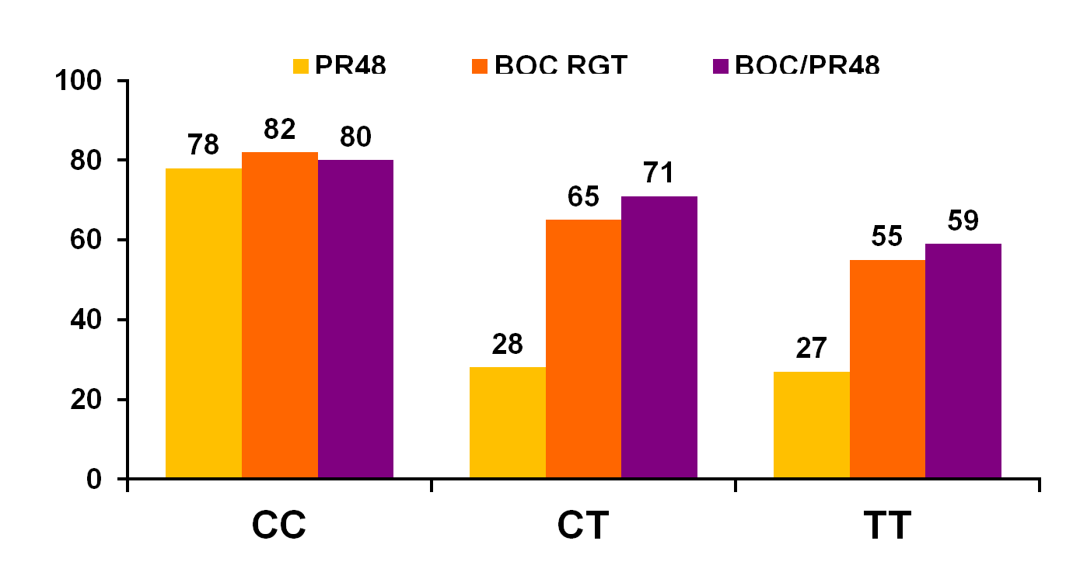
SPRINT-2: SVR by IL28B Polymorphism
62% of individuals (653/1048) had consented to IL28 pharmacogenomic studies
(%) SVR
50
64
63
77
44
55
33
116
67
103
82
115
10
37
23
42
26
44
*~90% eligible for short duration duration therapy

Slide 7
Very high SVR rates with 24 weeks’ therapy in Taiwanese G1 patients with RVR and LVL
PegIFN alfa weekly plus Ribavirin 1000/1200 mg/day
100%
96%
100%
100
89%
90
80
70
64%
60
SVR (%)
50
40
35%
30
20
10
n=
45
42
28
24
55
58
0
24 wks
48 wks
24 wks
48 wks
24 wks
48 wks
RVR
RVR and LVL
No RVR
RVR = HCV RNA <50 IU/mL at week 4;
LVL (low viral load) <400 000 IU/mL
YU ML. et al. Hepatology 2008; 47: 1884-93.
Notes:
7

Slide 8
SVR rates in genotype 6 patients (found almost exclusively in south East Asia)
Peg-IFN α-2a 180 µg/week plus weight-based RBV 800–1200 mg/day
24 weeks
48 weeks
100
p=0.45
80
79
72**
70
60
SVR (%)
40
20
n=27
n=33
n=63
0
Genotype 6 patients*
Lam KD, et al. Hepatology 2010; 52: 1573
*All except one patient was of Asian descent
** Piratvisuth T.APASL 2012
Notes:
8
GT, genotype; HCV, hepatitis C virus; P/R, peginterferon/ribavirin.
Schering-Plough PPT Template
9/4/2014 9:46 PM
8

Slide 9
Role of IFN in DAA therapy Genotype 1
Notes:
9
GT, genotype; HCV, hepatitis C virus; P/R, peginterferon/ribavirin.
Schering-Plough PPT Template
9/4/2014 9:46 PM
9

Slide 10
SPRINT-2 Adding Boceprevir to PR in non-RVR patients significantly increases SVR rate vs PR
PR48
BOC RGT
BOC PR48
% of Patients With SVR
Log₁₀ Viral Load Decrease After 4 week of P/R Lead-in
Vierling JM, et al. 46th EASL; Berlin, Germany; March 30-April 3, 2011: Abst. 481.

Slide 11
Simeprevir + P/R for GT1 HCV: Approved Indications
Simeprevir 150 mg/day with food, administered with P/R
Fixed duration (no RGT)
Treatment-naive patients and relapsers (including cirrhotic patients)
Previous partial or null responders (including cirrhotic patients)
Stopping rules
12 weeks
12 weeks
Simeprevir + P/R
P/R
12 weeks
36 weeks
Simeprevir + P/R
P/R
Treatment Wk | HCV RNA (IU/mL) | Action
4 | ≥ 25 | Discontinue simeprevir, pegIFN, and RBV
12 | ≥ 25 | Discontinue pegIFN and RBV (SMV stops at 12 wks)
24 | ≥ 25 | Discontinue pegIFN and RBV
Simeprevir [package insert]. November 2013.

Slide 12
QUEST-1, QUEST-2, PROMISE: SMV + P/R in GT1 Treatment-Naive Patients/Relapsers
Treatment-Naive Patients
Prior Relapsers
100
100
80
81
SMV + P/R
80
80
79
P/R
60
50
50
60
SVR12 (%)
SVR12 (%)
40
40
37
20
20
210/ 264
65/ 130
209/ 257
67/ 134
206/ 260
49/ 133
0
QUEST-1^{[1]}
QUEST-2^{[2]}
0
PROMISE^{[3]}
1. Jacobson I, et al. EASL 2013. Abstract 1425. 2. Manns M, et al. EASL 2013. Abstract 1413. 3. Lawitz E, et al. DDW 2013. Abstract 869b.

Slide 13
QUEST: 88% Qualified for Shortened Therapy in Simeprevir Phase III Studies
100
88
88
80
60
Patients (%)
40
20
459/ 521
405/ 459
n/N =
0
Met RGT Criteria
Achieved SVR
8% did not meet RGT→SVR 25%; therefore, RGT not recommended in US label
Jacobson I, et al. AASLD 2013. Abstract 1122.

Slide 14
QUEST: No Benefit of Simeprevir if Q80K Positive
100
SMV + P/R
85
84
P/R
80
60
58
SVR12 (%)
53
52
43
40
20
n/N =
228/
267
70/
133
138/
165
36/
83
49/
84
23/
44
0
GT1b
GT1a no Q80K
GT1a + Q80K
Q80K present in 34% of GT1a patients No benefit of simeprevir if Q80K positive
Jacobson I, et al. AASLD 2013. Abstract 1122.

Slide 15
Sofosbuvir + P/R for GT1 HCV: Approved Indications
Sofosbuvir 400 mg/day with or without food, administered with P/R
All GT1 patients receive same regimen, regardless of previous treatment history or fibrosis level
Same regimen approved for GT4 HCV
Additional option for GT1 patients ineligible for IFN therapy
Sofosbuvir + ribavirin for 24 weeks
If drugs combined with sofosbuvir must be permanently discontinued, sofosbuvir should also be discontinued
12 weeks
Sofosbuvir + P/R
Sofosbuvir [package insert]. December 2013.

Slide 16
NEUTRINO: Sofosbuvir + P/R for 12 Weeks in Treatment-Naive GT 1/4/5/6 HCV
Open-label, single-arm study of sofosbuvir 400 mg QD + P/R for 12 weeks in treatment-naive patients with GT1/4/5/6 HCV
17% cirrhosis; 89% GT1; 9% GT4; < 1% GT5; 2% GT6
96
100
100
92
100
90
89
80
80
80
60
60
SVR12 (%)
40
40
20
20
n/N =
295/327
261/292
27/28
7/7
252/273
43/54
0
0
Overall
GT1
GT4
GT5,6
No Cirrhosis
Cirrhosis
Lawitz E, et al. N Engl J Med. 2013;368:1878-1887.

Slide 17
Previous Null Responders: Quad Therapy
Daclatasvir (NS5A) + Asunaprevir (PI)
+ P/R x 24 wks (Quad)
Danoprevir/r (PI) + Mericitabine (Nuc)
+ P/R x 24 wks (Quad)^{[3]}
Initial cohort
Expanded cohort (88% GT1a)
100
93*^{[2]}
100
61% GT1a
90^{[1]}
84^{[3]}
80
80
60
60
SVR12 or 24 (%)
SVR12 (%)
40
40
20
20
n/N =
9/10
38/41
n/N =
62/74
0
0
*Asunaprevir QD and BID combined.
Quad therapy may be a good option for null responders
Well tolerated BUT cirrhotic patients excluded; potent IFN-free therapy likely equally effective
1. Lok AS, et al. N Engl J Med. 2012;366:216-224. 2. Lok AS, et al. AASLD 2012. Abstract 79.
3. Feld JJ, et al. AASLD 2012. Abstract 81.

Slide 18
EASL HCV Guidelines 2014: Genotype 1
Genotype | Options for Therapy
Genotype 1* | PegIFN/ribavirin + sofosbuvir: 12 wks (A1)
 | PegIFN/ribavirin + simeprevir†: 12 wks, followed by 12 wks of pegIFN/ribavirin in previously untreated pts and prior relapsers (A1), or 36 wks of pegIFN/ribavirin in previous partial responders and null responders (B1)
 | PegIFN/ribavirin + daclatasvir (genotype 1b only; B1): 12 wks followed by 12 wks of pegIFN/ribavirin alone or a further 12 wks of pegIFN/ribavirin + daclatasvir (response-guided therapy) (B2)
 | Sofosbuvir + ribavirin: 24 wks for interferon-intolerant pts only, where no other interferon-free option available (B2)
 | Sofosbuvir + simeprevir: 12 wks (ribavirin may be added for previous nonresponders & cirrhotics) (B1)
 | Sofosbuvir + daclatasvir: 12 wks in previously untreated pts; 24 wks in treatment-experienced patients (including TVR/BOC-experienced patients) (ribavirin may be added in previous nonresponders and cirrhotics) (B1)
*In settings where recommended options are not available, treatment with pegIFN/ribavirin + TVR or BOC remains acceptable.
†Not recommended in pts with genotype 1a and detectable Q80K polymorphism.
EASL. J Hepatology. 2014;60:392-420.
Notes:
BOC, boceprevir; HCV, hepatitis C virus; pegIFN, peginterferon; TVR, telaprevir.

Slide 19
Role of IFN Genotype 2,3
Notes:
19
GT, genotype; HCV, hepatitis C virus; P/R, peginterferon/ribavirin.
Schering-Plough PPT Template
9/4/2014 9:46 PM
19

Slide 20
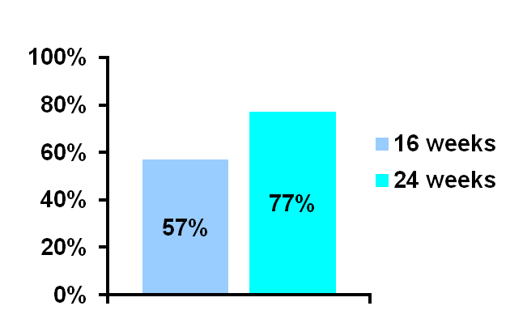
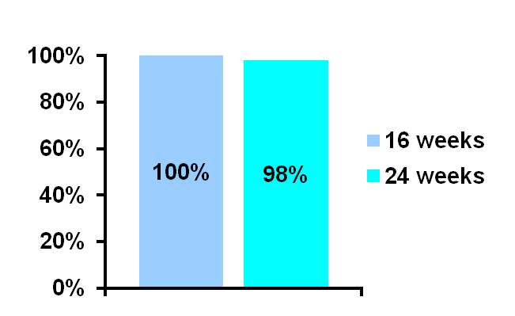
High SVR rates with a shorter treatment duration in Taiwanese G2 patients achieving an RVR
PegIFN alfa weekly
plus RBV 1000/1200 mg/day
SVR
RVR: YES
87%
(130/150)
All patients
(n=150)
43/43
85/87
SVR
RVR: NO
13%
(20/150)
4/7
10/13
RVR = HCV RNA <50 IU/mL at week 4
G2 = genotype-2
Yu M-L, et al. Gut 2007: 56: 553
Notes:
20
In my own study that included only genotype-2 patients, all of those with an RVR achieved an SVR after 16 weeks of treatment.

Slide 21
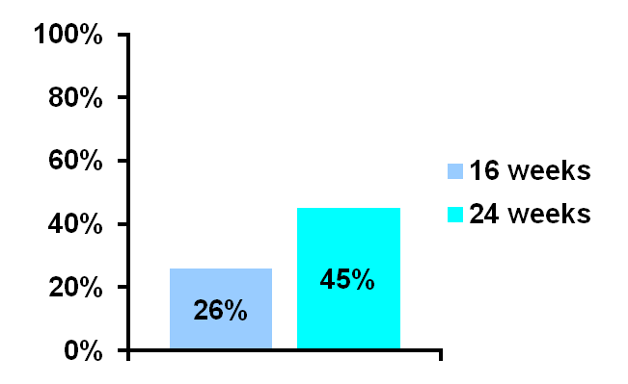
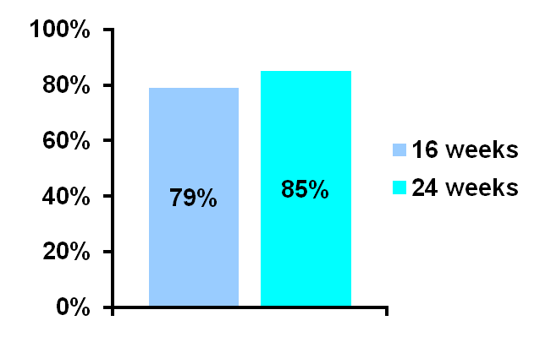
High SVR rates with a shorter duration in G2/3 patients achieving an RVR
PegIFN plus RBV
SVR
RVR: YES
66%
(953/1445)
p=0.02
All patients
(n=1445)
387/489
400/470
SVR
RVR: NO
33%
(492/1445)
58/220
110/247
G2/3 = genotype 2 or 3
RVR: <50 IU/mL at week 4
Shiffman M, et al. NEJM 2007; 357: 2

Slide 22
Sofosbuvir + RBV for GT2 and GT3 HCV: Approved Indications
All GT2 patients receive same regimen, regardless of previous treatment history or fibrosis level
All GT3 patients receive same regimen, regardless of previous treatment history or fibrosis level
If drugs combined with sofosbuvir must be permanently discontinued, sofosbuvir should also be discontinued
12 weeks
Sofosbuvir + RBV
24 weeks
Sofosbuvir + RBV
Sofosbuvir [package insert]. December 2013.

Slide 23
SOF plus RBV for Genotype 2
SOF + RBV (12 wks)
SVR
SOF + RBV (16 wks)
97
*
93
82
89
Treatment Naive
Treatment Ineligible
Treatment Experienced
FISSION
POSITRON
FUSION
Lawitz E, N Engl J Med 2013; 368: 1878-87.
Jacobson IM, et al. N Engl J Med 2013; 368: 1867-1877.

Slide 24
SOF plus RBV for Genotype 3
SVR
SOF + RBV (12 wks)
SOF + RBV (16 wks)
*
61
62
56
30
Treatment Naive
Treatment Ineligible
Treatment Experienced
FISSION
POSITRON
FUSION
Lawitz E, N Engl J Med 2013; 368: 1878-87.
Jacobson IM, et al. N Engl J Med 2013; 368: 1867-1877.

Slide 25
Valence Study: Extended Treatment with SOF/RBV : G2 and G3
%
SOF 400 mg + RBV 1000-1200 mg daily for 24 wks
261 (78%) GT 3
195 (58%) treatment experienced
70 (21%) cirrhotic
114 (34%) had the IL28b CC genotype
93%
85%
GT 2
GT 3
Zeuzum S, AASLD Abstract 1085

Slide 26

SOF + RBV for 24 weeks: Effect of Cirrhosis and Prior Treatment Response
Zeuzum S, AASLD Abstract 1085

Slide 27
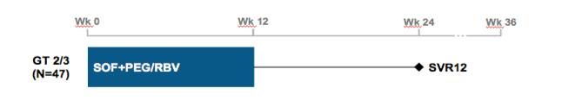
LONESTAR-2 Study
Study population
HCV GT 2 or 3
Failed treatment with pegylated interferon and ribavirin
Approximaterly 50% with compensated cirrhosis
HIV and HBV coinfected patients excluded
Lawitz, et al. AASLD LB-4. Presented Nov 4, 2013.

Slide 28
Results: SVR12 by Cirrhosis Status
100
93
83
83
SVR12 (%)
9/9
13/14
10/22
10/12
24 wks SOF+RBV 91 88% 87 60%
Error bars represent 95% confirmed intervals
Lawitz, et al. AASLD LB-4. Presented Nov 4, 2013.

Slide 29
New agents in various combinations are being developed for different patient types
NS3/4A
NS5A
NS5A
RBV
Alfa
RBV
In different patient types:
Alfa
NS3/4A
Lambda
Alfa
Lambda
NS5A
Different genotypes
Treatment-naive
Null-responders to prior therapy
Intolerant to previous therapy
Cirrhotics
HIV/HCV co-infected
RBV
RBV
RBV
NS5B
(nuc inhibitor)
NS5A
NS3/4A
NS5A
RBV
NS5B
(nuc inhibitor)
NS5B
(non-nuc inhibitor)
Lambda
NS3/4A
NS5A
RBV
NS3/4A
IFN-free DAAs with SVR >90%
This slide represents just a small selection of studies and regimens in current clinical development – other combinations are therefore possible.
Alfa, Peg-IFN alfa-2a; Lambda, Peg-IFN lambda-1a.

Slide 30
IFN may have potential role to rescue CHC failed to IFN-free DAA therapy
Notes:
30
GT, genotype; HCV, hepatitis C virus; P/R, peginterferon/ribavirin.
Schering-Plough PPT Template
9/4/2014 9:46 PM
30

Slide 31
Conclusions : Role of IFN
Due to unaffordability and unavailability of new DAAs
SOF is 74,000 $ under special request in Central Asia and TransCaucasus
PegIFN/RBV/(PI?) remains the main current treatment for CHC in Central Asia
IFN is a part of currently available DAAs treatment strategies
IFN still have a role in near future DAA therapy, particularly in G3
Counting down for the final day of IFN in Central Asia will be started in future
IFN+Riba+DAAs may have potential role in rescue patients who failed to multiple all oral DAA therapy

Slide 32
Thank you to
Teerha Piratvisuth MD Thailand for his insightful slides
The Transcaucasus Group

