Slide 1
Emergence of a HCV genotype genomic variant with elements of type 1 and 2 in Georgia
Michael Weizenegger
Laboratory Group Limbach, Heidelberg, Germany
Deptartment of Microbiology and Molecular Genetic
Friday October 12th , 2012

Slide 2

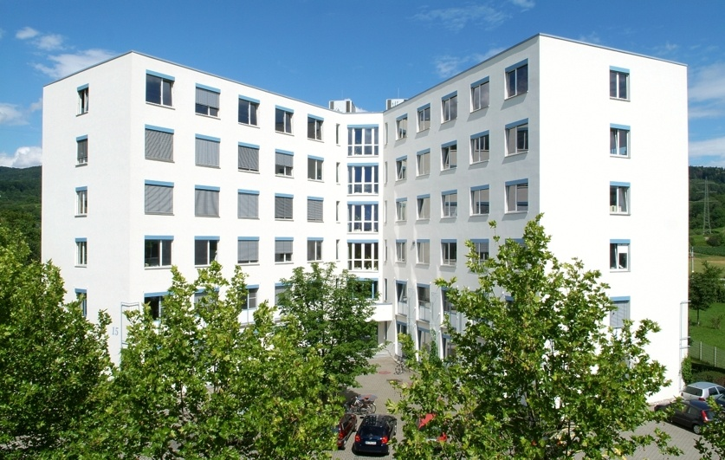
Overview infection with HCV
Introduction HCV
Impact of genotype in antiviral therapy
St. Petersburg variant
Conclusions

Slide 3
Relative Infectivity
Transmission Route | HCV Risk | HBV Risk | HIV Risk
Injection drug users (IDU) | ~ 30%/yr ≥60% acute/yr | ~ 12-30% acute/yr | ~30%/yr
Blood Tx | Now rare | Rare | Rare
Sporadic | 10% cases | 20-30%
Needle-stick | 0.44-10% | 3-40% | 0.3%
Tattoos/Piercing | 1-5% | ? | ? 0%
Sexual | ≤5% | Highest | Higher
Vertical | ≤6% | ~40% | ~26%

Slide 4
Natural History of HCV Infection
70%-80%
ACUTE HEPATITIS C
CHRONIC HEPATITIS C
Chronic progressors
~25%

Slide 5
Overview infection with HCV
Introduction HCV
Impact of genotype in antiviral therapy
St. Petersburg variant
Conclusions

Slide 6
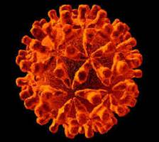
HCV is a Flavivirus
Properties
Single strand RNA
Enveloped
Spheroidal: 40-60 nm in diameter.
Surface projections (appears rough)
3 structural proteins
Variable number of non-structural proteins
Courtesy of HCV sequence database:
http://hcv.lanl.gov
And The Linnaean Society of London
Choo et al. Science1989: 244.359-62

Slide 7
HCV-1 Protein Structure
Structural
Non-structural
C
E1
E2
P7
NS2
NS3
NS4a
NS4b
NS5a
NS5b
747
809
1658
1711
1
191
192
383
384
746
810
1026
1027
1657
1712
1972
1973
2420
2421
3011
5’UTR
3’UTR
9.6 kb + RNA Open Reading Frame
3010-3033 Amino Acid Polyprotein Precursor (HCV-1= 3011)
10 Proteins: Structural and Nonstructural
http://www.ncbi.nlm.nih.gov/entrez/query.fcgi?cmd=Retrieve&db=Protein&list_uids=00130455&dopt=GenPept

Slide 8
HCV Life Cycle
HCV entry into a liver cell
The single strand of + sense viral RNA is released:
– RNA strand provides a template on which many + strands are synthesized:
+ RNA strand makes a mirror image of itself: a – (negative) strand
Three potential avenues for a new + strand:
Viral protein synthesis (following attachment to host ribosomes)
Packaged to form new HCV particles
Formation of further negative strands

Slide 9
HCV Genotype
What is genotype and why should I be tested?
Genotypes are genetic subclasses of HCV – there are 6 common genotypes, 1 through 6.
The greatest predictor of response to PEG(IFN)/RBV therapy is genotype. Geno 1 is least responsive, but still has 40 - 50% chance for SVR. Geno 2 is most responsive, 80 – 90% SVR.
Genotype does not predict rate of progression, severity of liver disease, or risk for HCC.

Slide 10
SVR Rates with Peg-IFN/RBV: According to Genotype
SVR (%)
76%-82%
42%-46%
Genotype 1
Genotype Non-1
Adapted from Strader DB et al. Hepatology. 2004;39:1147-1171.

Slide 11
Overview infection with HCV
Introduction diagnosis of HCV
Impact of genotype in antiviral therapy
St. Petersburg variant
Conclusions

Slide 12
HCV Genotypes and Subtypes
c
a
Genotype (1-6)
≥ 30% nucleotide difference
25-30% Amino acid difference
Well-established diversity
Subtype (a-k)
~20% nucleotide difference
b
a
2
1
3
a
4
b
b
5
6
a
a
a
Adapted from Simmonds J Gen Virol. 2004;85:3173-88
Notes:
Each of the 6 major genetic groups of HCV contain a series of more closely related subtypes, typically different from each other by 20% in nucleotide sequences compared with >30% between genotypes, Genotypes 1a, 1b and 3a have become very widely distributed as a result of transmission through unscreened blood transfusion and between injecting drug users, and now represent the vast majority of infections in Western countries. These are the HCV types most commonly encountered clinically, and therefore the ones for which most information has been collected.
The Geographical distribution of each HCV type and subtype is depicted in the next slide.

Slide 13
HCV in One Infected Person
}
Genotype (population)
≥ 30% nucleotide difference
25-30% Amino acid difference
Well-established diversity
Subtype (population)
~20% nucleotide difference
Quasispecies (individual)
1-5% nucleotide difference
Genotype 1a HCV
sequences retrieved
from a single person:
A Quasispecies
a
1
4
b
a

Slide 14
What commercial assays are avaible for genotyping?
Siemens VERSANT HCV genotype assay (LiPA), a second generation line probe assay, contains probes targeting both the 5’ non coding and the core regions of the viral genome (core region for improved 1a/b subtyping.
Line probe formate
Siemens TRUGENE HCV 5′NC genotyping
Formate: Sequence of the 5‘ UTR

Slide 15
What commercial assays are avaible for genotyping?
Abbott RealTime HCV Genotype
Real time PCR formate
Target region 5'UTR & NS5b (1a/b subtyping)

Slide 16
Overview infection with HCV
Introduction diagnosis of HCV
Impact of genotype in antiviral therapy
St. Petersburg variant
Conclusions

Slide 17
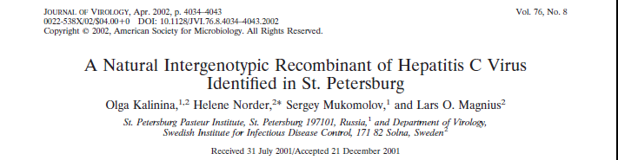
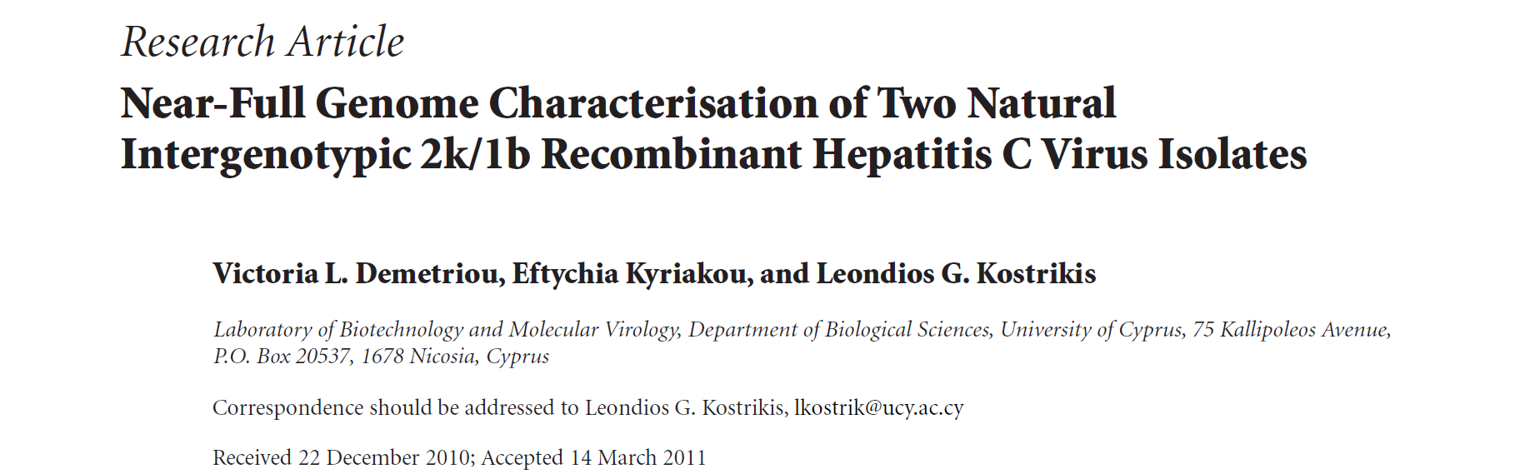
Literture

Slide 18
The St. Petersburg variant
Kalinina et al. identified in the early 1990s HCV strains, which were differing regarding the genotype when different parts of the genome were sequenced.
They found that this genetic divergence was not due to mutations but to fusions of parts of different HCV genomes.
Such chimeric variants were known from other viruses of the Flaviviridae faminly e.g. dengue virus.

Slide 19
First finding of the chimeric variant in St. Petersburg
Recombination seems to play an important role in the evolution of RNA viruses.
It is no surprising that the common subtype 1b is part of the chimeric HCV clone. But 2k is very uncommon in Russia and in the early 1990s only described in Moldawia. In this time Moldowian and other workers started to travel forth and back between Moldowia and St. Petersburg.
The recombinant strain was found in 5% of HCV infected patients in St. Petersburg.

Slide 20
The St. Petersburg variant
Structural
Non-structural
C
E1
E2
P7
NS2
NS3
NS4a
NS4b
NS5a
NS5b
747
809
1658
1711
1
191
192
383
384
746
810
1026
1027
1657
1712
1972
1973
2420
2421
3011
2k
1b
The HCV strain belongs to two different genotypes: 5’ UTR to within the NS2 region 2k and downstream NS2 type 1b.

Slide 21
The St. Petersburg variant
Demetriou et al. identified eight years later HCV strains, which seems to be identical with the chimeric strains found in St. Petersburg..
Interestingly these strain derived from Georgian immigrants.
By accident in 2012 during a verification phase in laboratory Limbach to introduce the Abbott Genotyping system, we investigated also HCV isolates from laboratory Mrcheveli.
Four strains typed as genotype 2 with Siemens Versant system appeared to be a mixture of 1b/2k with the Abbott Genotyping system.
HCV isolates were sent to Prof. Ross, University of Essen, Germany and were partly sequenced and identified as “St. Petersburg variant”.

Slide 22
Overview infection with HCV
Introduction diagnosis of HCV
Impact of genotype in antiviral therapy
St. Petersburg variant
Conclusions

Slide 23
Conclusion
Recombinant genotypes do not fit into the nomenclature.
Kalinia et al. extended the current classification with the term “recombinant form(RF)”.
Several recombinant genotype were discovered, but only the 2k/1b seems to emerge successfully.

Slide 24
Conclusion
Genotypes are predictors of outcome of interferon based therapy.
The St Petersburg variant is common in Georgia, but epidemiological data are not available.

Slide 25
Conclusion
Do we need for genotyping inclusion of more than one region of the HCV genome?
How can we separate these chimeric forms from “mixed” infections?

Slide 26
Conclusion
Interferon resistance is attributed to sequence variability of the NS5A sequence, but also to the structure of the 5’ UTR.
Only the ABBOTT assay currently can give a suspicion of this variant.
Modern sequencing techniques like next generation sequencing implementing different targets will improve specificity.

Slide 27
Conclusion
New anti HCV drugs like the new protease inhibitors are so far known therapy outcome independent from the genotype.
They may in the near future replace interferon.
Then, identification of resistance to anti HCV drugs will become a diagnostic challenge.

Slide 28
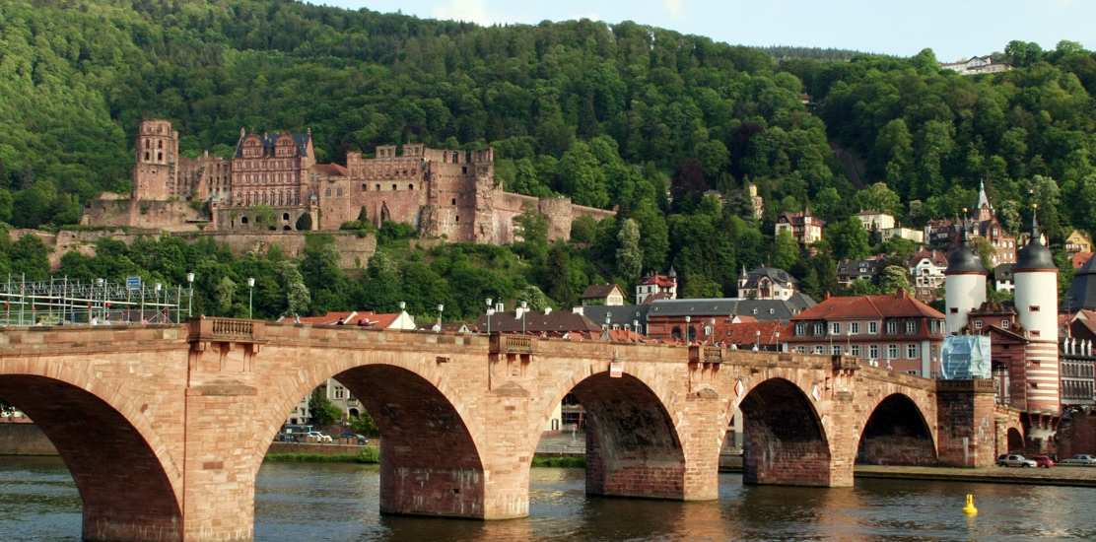
Thank you for attention

