Slide 1
Does Treating HBV Change Outcomes?
TransCaucausus Liver Symposium
2014
Robert G Gish MD
Professor Consultant
Stanford University

Slide 2
Disclosures
Dr Gish has consulting relationships with
Gilead
BMS
Genentech

Slide 3
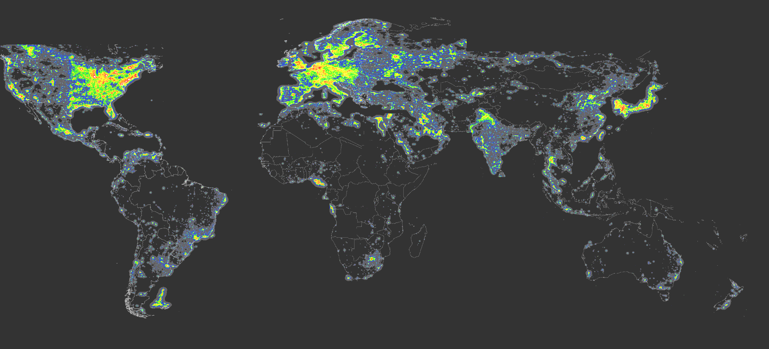
Ultimate Goal of CHB Treatment
AASLD Guidelines
The ultimate goal is to prevent cirrhosis, hepatic failure and HCC
APASL Guidelines
Treat to Control Disease and Prevent Unfavorable Outcomes
EASL Guidelines
The goal of therapy for hepatitis B is to improve QoL and survival by preventing progression of disease

Slide 4
Natural History of Chronic Hepatitis B Infection
Acute
hepatitis
Chronic
hepatitits
Liver
Cancer
Clinical
Cirrhosis
Virological
HBeAg: HBV DNA
Anti-HBe
HBsAg
Liver
Replication
Integration
Time
Months
Years
Decades
Yim et al. Hepatology 2006
4

Slide 5
History of CHB treatement
Landmark study: antiviral therapy
slows disease progression in CHB⁴
REVEAL data associates viral load
with cirrhosis/HCC^{7,8}
1992
2003
2005
2007
1998
2004
2006
2008
Interferons approved
for CHB treatment¹
ADV³
ETV⁶
TDF¹⁰
LVD²
PegIFN⁵
LdT⁹
*Year of first marketing approval
1. Zoulim F, et al. J Hepatol 2008;48(Suppl.1):S2–S19. 2. GSK. Zeffix® (lamivudine) EU SPC. Feb 2007. 3. Gilead. Hepsera® (adefovir) EU SPC. 2008. 4. Liaw YF, et al. N Engl J Med 2004;351:1521–1531. 5 Roche. Pegasys® (pegylated interferon alfa-2a) EU SPC. Jun 2007. 6. BMS. Baraclude® (entecavir) SPC. Jan 2008. 7. Chen CJ, et al. JAMA 2006;295:65–73. 8. Iloeje U, et al. Gastroenterology 2006;130:678–686. 9. Novartis. Sebivo® (telbivudine) EU SPC. Feb 2007. 10. Gilead. Viread® (tenofovir) EU SPC. Feb 2007.
Notes:
Speaker guide
Since the approval of IFN for CHB in 1991 and the introduction of LVD in 1998, 5 more agents have become available: ADV, pegIFN-α, ETV, LdT and TDF (not available yet in Asia)
Note: This slide shows the year of first approval obtained for the respective treatment options
Two pivotal developments greatly influenced the evolution of CHB treatment guidelines:
The finding that elevated HBV DNA places patients at an elevated risk of cirrhosis and HCC, triggering a paradigm shift on the importance of DNA Monitoring and the need for suppression of viral replication
The 2004 findings by Liaw et al. that LVD can prevent disease progression

Slide 6
Interferon Therapy: HBV
1
Interferon
Standard Care
Compensated Cirrhosis
Decompensated Cirrhosis
Hepatocellular Carcinoma
0.8
0.6
Cumulative Probability
0.4
0.2
0
0
10
20
30
40
50
Years
Wong et al. 2002

Slide 7
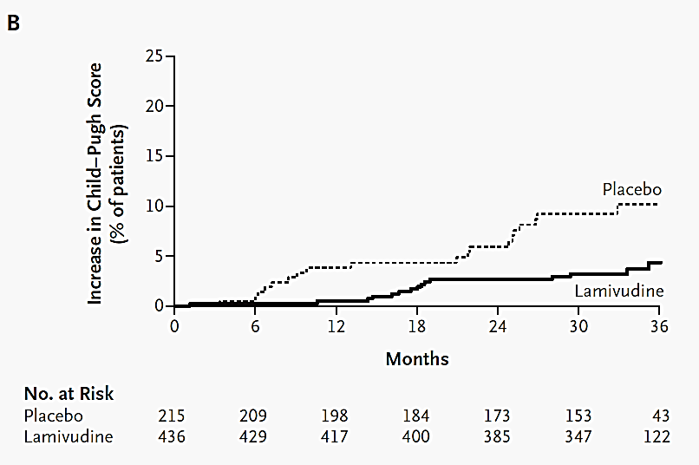
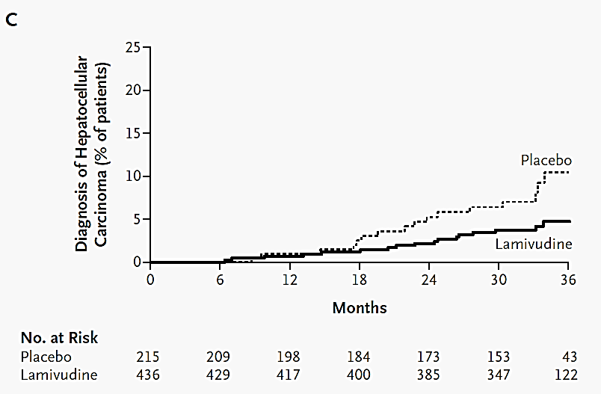


Does antiviral therapy save lives?
Controversies
  Cannot extrapolate to non-cirrhotic patients
  Difference in HCC incidence not significant if excluded cases in the 1st year
  Not powered to detect survival difference
Liaw et al. NEJM 2004;351:1521

Slide 8
Entecavir vs Lamivudine in HBeAg(+) Patients at 48 Weeks
For your nucleoside-naive CHB patients with compensated liver disease:
% Patients
n=314^{b}
n=314^{b}
n=354
n=355
n=354
n=355
n=354
n=355
c
d
ETV 0.5 mg QD
LVD 100 mg QD
ªP<0.05.
^{b} Subjects with evaluable baseline histology (baseline Knodell necroinflammatory score ≥2).
^{c} ≥2-point decrease in Knodell necroinflammatory score from baseline with no worsening of the Knodell fibrosis score.
^{d} Roche COBAS Amplicor® PCR Assay (Lower Limit of Quantification [LLOQ]=300 copies/mL).
Notes:
Key Points:
At Week 48, HBeAg(+) patients from ETV-022 were measured for:
Histologic improvement
In HBeAg(+) patients, ETV was superior to LVD on the primary efficacy endpoint of histologic improvement at Week 48 (72% ETV vs 62% LVD), P<0.05
HBV DNA
67% of nucleoside-naïve HBeAg(+) patients treated with ETV (n=354) achieved undetectable viral load compared to 36% of LVD-treated patients (n=355), P<0.05
ALT normalization
68% of ETV-treated HBeAg(+) patients achieved ALT normalization compared to 60% of LVD patients, P<0.05
HBeAg seroconversion
21% of ETV-treated HBeAg(+) patients achieved HBeAg seroconversion compared to 18% of LVD-treated patients
HBV DNA was measured using Roche COBAS Amplicor® PCR Assay (LLOQ=300 copies/mL)
Navigation Notes:
Left Arrow will take the user to the previous slide
Right Arrow will take the user to the next slide
The Important Safety Information, including Boxed WARNINGS button will take the user to the beginning of the Important Safety Information for BARACLUDE® (entecavir) section

Slide 9
Korean Cohort: Impact of Entecavir and Lamivudine on Survival in HBV (1999-2011)
Single-center cohort of chronic HBV (n=9615 treatment-naïve)
  Entecavir 0.5 mg/day or lamivudine 100 mg/day
  >20 years of age; no prior HCC, transplant, HCV, HDV, or HIV; HBV DNA >2000 IU/mL
Treatment with entecavir was associated with
  Minimal risk of drug resistance 1.5% verus 50.8%; P<0.001)
  Minimal need for rescue therapy (1.8% verus 39.3%; P<0.001)
  Significantly lower risk of death or transplantation (adjusted hazard ratio 0.42; P<0.001)
Death or Transplantation
(Propensity-Score-Matched)
Solid lines: cirrhotics
Dotted lines: no cirrhosis
Lamivudine
HR: 0.66
P=0.005
Cumulative Rates (%)
Entecavir
HR: 1.10
P=0.81
Lamivudine
Entecavir
0 1 2 3 4 5 6
Years
Lim Y, et al. Hepatology. 2013;58(suppl 1):223A. Abstract 32.
Notes:
Slide: Korean Cohort: Impact of Entecavir and Lamivudine on Survival in HBV (1999-2011)
Lim and colleagues conducted a single-center study comprising a cohort of 9615 consecutive, treatment-naïve, patients with chronic HBV to assess the efficacy and safety of entecavir 0.5 mg/day or lamivudine 100 mg/day.¹
>20 years of age.
No prior HCC, transplant, HCV, HDV, or HIV; HBV DNA >2000 IU/mL.
Treatment with entecavir was associated with a significant reduction in death or transplantation compared with lamivudine among patients with cirrhosis.¹
Overall, entecavir (versus lamivudine) was associated with:¹
Minimal risk of drug resistance 1.5% verus 50.8%; P<0.001).
Minimal need for rescue therapy (1.8% verus 39.3%; P<0.001).
Significantly lower risk of death or transplantation (adjusted hazard ratio 0.42; P<0.001).
Reference
Lim Y, Heo N, Han S, et al. Comparative effectiveness of entecavir and lamivudine on survival of patients with chronic hepatitis B virus infection. Hepatology. 2013;58(suppl 1):223A. Abstract 32.

Slide 10
HCC Risk in Caucasian, Chronic HBV Patients Treated With Entecavir or Tenofovir DF
Multi-country cohort (Greece, Itlay, Turkey, Spain, The Netherlands) (n=1231)
  Chronic HBV with no co-infection, liver transplantation, or HCC
  Initiated either entecavir (43%) or tenofovir DF (55%)
HCC 5-year incidence
  4.2% at median of 17 months
  13.5 new HCC cases/1000 person-years
Strongest HCC risk factors
  Decompensated liver disease (HR: 2.78; P=0.019), lower platelet count (HR: 0.97; P=0.002), older age (HR: 1.05; P=0.12)
Asian-based HCC risk scores may not be applicable to Caucasians with chronic HBV
Probability of HCC
Log-Rank P<0.001.
Decompensated
Cirrhosis
29.7%
20.9%
Cumulative Probability
Cirrhosis
No Cirrhosis
2.5%
0 1 2 3 4 5
Time Since Initiation of Treatment (Years)
Papatheodoridis GV, et al. Hepatology. 2013;58(suppl 1):302A-303A. Abstract 190.
Notes:
Slide: HCC Risk in Caucasian, Chronic HBV Patients Treated With Entecavir or Tenofovir DF
Papatheodoridis conducted a multi-country study to evaluated the incidence and risk factors of HCC in a cohort of predominantly Caucasian adults with chronic HBV infection who initiated treatment with either entecavir or tenofovir (n=1231).¹
The 5-year cumulative incidence of HCC was 4.2% (52 events/1231) at a median of 17 months (13.5 new HCC cases/1000 person-years).¹
The strongest HCC risk factors were decompensated liver disease (HR: 2.78; P=0.019), lower platelet count (HR: 0.97; P=0.002), and older age (HR: 1.05; P=0.12).¹
These data illustrate that Asian-based HCC risk scores may not be applicable to Caucasians with chronic HBV.¹
Reference
Papatheodoridis GV, Dalekos GN, Yurdaydin C, et al. Risk and risk factors of hepatocellular carcinoma (HCC) in Caucasian chronic hepatitis B (CHB) patients with or without cirrhosis treated with entecavir (ETV) or tenofovir (TDF). Hepatology. 2013;58(suppl 1):302A-303A. Abstract 190.

Slide 11
‡
Reversal of Fibrosis/Cirrhosis: Results From Studies -022/-027/-901
Distribution of Knodell Necroinflammatory Scores at Baseline, Year 1, and Years 3–7
Distribution of Knodell Necroinflammatory Scores at Baseline, Year 1, and Years 3–7 (n=57)
Change in Knodell Necroinflammatory Score and HAI from Baseline
Efficacy Evaluable Cohort (n=57)
 | Week 48 | Long-term*
Mean change from baseline in Knodell necroinflammatory score | -3.39 | -6.37
Knodell HAI <3 in patients with baseline HAI ≥4, n (%)† | 12/54 (22)‡ | 41/55 (75)
60
55
50
45
40
35
30
25
20
15
10
5
0
Number of patients
* Median time of long-term biopsy: 280 weeks
(range: 144–316 weeks)
† Fifty-five patients had baseline Kndell HAI score ≥4
‡ One patient had an inadequate Week 48 biopsy
Baseline Week 48 Long-term
10–14 7–9 4–6 0–3 Missing
Knodell Necroinflammatory Score
Liaw Y, et al., AASLD 2008; Poster # 894
Notes:
BACKGROUND:
These patients had liver biopsies performed as part of their baseline evaluation when enrolled in the Phase 3 parent studies and again at Week 48 within those studies.
They have now had at least a third liver biopsy following longer term therapy. Within the parent studies and during therapy in the rollover -901, these patients achieved good virologic control with 100% of them having HBV DNA < 300 copies/mL at the time of their last biopsy.
ALT normalization was seen in 86% of the Cohort at the time of their last biopsy.
MAIN MESSAGE:
Extended therapy against CHB with good virologic control results in improvement in necroinflammatory status.

Slide 12
‡
Reversal of Fibrosis/Cirrhosis: Results From Studies -022/-027/-901
Distribution of Ishak Fibrosis Scores at Baseline, Year 1, and Years 3–7
Distribution of Ishak Fibrosis Scores at Baseline, Year 1, and Years 3–7 (n=57)
Change in Ishak Fibrosis Score from Baseline
Efficacy Evaluable Cohort (n=57)
 | Week 48 | Long-term*
Mean change from baseline in Ishak fibrosis score | -0.20 | -1.53
≥2 point decrease in Ishak fibrosis score, n (%)† | 3/42 (7)‡ | 25/43 (58)
60
55
50
45
40
35
30
25
20
15
10
5
0
Number of patients
* Median time of long-term biopsy: 280 weeks
(range: 144–316 weeks)
† Forty-three patients had baseline Ishak fibrosis score ≥2
‡ One patient had an inadequate Week 48 biopsy
Baseline Week 48 Long-term
6 5 4 3 2 1 0 Missing
Ishak Fibrosis Score
Liaw Y, et al., AASLD 2008; Poster # 894
Notes:
BACKGROUND:
These patients had liver biopsies performed as part of their baseline evaluation when enrolled in the Phase 3 parent studies and again at Week 48 within those studies. They have now had at least a third liver biopsy following longer term therapy. Within the parent studies and during therapy in the rollover -901, these patients achieved good virologic control with 100% of them having HBV DNA < 300 copies/mL at the time of their last biopsy. ALT normalization was seen in 86% of the Cohort at the time of their last biopsy.
MAIN MESSAGE:
With the majority of patients having received over 5 years of therapy, fibrosis was also much improved.

Slide 13
Study 102/103:
Liver fibrosis regression over 5 years with TDF
344 patients had liver biopsy data available at all three time points
Percentage of the population with cirrhosis (Ishak Score ≥5) progressively
decreased : 28% → 8% at year 5
100
Ishak Fibrosis Score
90
80
6
70
5
60
Patients (%)
4
50
3
40
30
2
20
1
10
0
0
Baseline
Year 1
Year 5
Marcellin P, et al. Lancet 2012;6736: 61425-1.
13

Slide 14
Study 103 and 102: Regression of Histologic Fibrosis at Week 240 in Asian Patients
Fibrosis Response
Fibrosis score either improved (>1 unit decrease) or did not change in 95% of patients with paired biopsies
HBV DNA <400 copies/mL: 96%
Improvement No change Worsening
Patients (%)
<5
(Non-Cirrhotic)
>5
(Cirrhotic)
Baseline Ishak Fibrosis Scores
Paired biopsies at baseline and 240 weeks (n=88).
Gane EJ, et al. Hepatology. 2011;54(suppl):1038A-1039A. Abstract 1429.
Notes:
Slide: Study 103 and 102: Regression of Histologic Fibrosis at Week 240 in Asian Patients
At year 5, fibrosis score either improved (>1 unit decrease) or did not change in 95% of Asian patients with paired biopsies.
At year 5, 96% of Asian patients on treatment had HBV DNA <400 copies/mL.¹
Reference
Gane EJ, Marcellin P, Sievert W, et al. Five years of treatment with tenofovir DF for chronic hepatitis B infection in Asian patients is associated with sustained viral suppression and significant regression of histological fibrosis and cirrhosis. Hepatology. 2011;54(suppl):1038A-1039A. Abstract 1429.

Slide 15
Study 103 and 102: Regression of Histologic Cirrhosis at Week 240 in Asian Patients
Ishak Fibrosis scores
There was a progressive decrease in patients with cirrhosis at baseline to year 5
86% of Asian patients with cirrhosis at baseline treated with tenofovir DF were no longer cirrhotic at year 5
Ishak
Fibrosis
Score
0-1
2
3
4
5
6
Patients (%)
Baseline
Year 5
Paired biopsies at baseline and 240 weeks (n=88).
Gane EJ, et al. Hepatology. 2011;54(suppl):1038A-1039A. Abstract 1429.
Notes:
Slide: Study 103 and 102 : Regression of Histologic Cirrhosis at Week 240 in Asian Patients
There was a progressive decrease in patients with cirrhosis at baseline to year 5 (from 28% to 8%).¹
86% of Asian patients with cirrhosis at baseline treated with tenofovir DF were no longer cirrhotic at year 5.¹
Reference
Gane EJ, Marcellin P, Sievert W, et al. Five years of treatment with tenofovir DF for chronic hepatitis B infection in Asian patients is associated with sustained viral suppression and significant regression of histological fibrosis and cirrhosis. Hepatology. 2011;54(suppl):1038A-1039A. Abstract 1429.

Slide 16
Decompensated, Chronic HBV Liver Disease: Tenofovir DF + Emtricitabine Versus Entecavir
Double-Blind
Phase 2 Study
HBV DNA: >1000 copies/mL
ALT: <10 x ULN
Child-Pugh-Turcotte score: 7-12
Creatinine clearance:
>50 mL/min C-G method
Randomization
2:2:1
Tenofovir DF (n=45)
Emtricitabine/Tenofovir DF (n=45)
Entecavir (n=22)
Week 0 48 168
Current
Analysis
Other eligibility criteria: age 18-69 years; α-fetoprotein <20 ng/mL and ultrasound or other imaging with no
evidence of hepatocellular carcinoma (or α-fetoprotein 21-50 ng/mL and CT/MRI with no evidence of
hepatocellular carcinoma); no co-infection with HCV, HIV, or HDV; no prior use of tenofovir DF or
entecavir; <24 months of prior adefovir.
Liaw Y-F, et al. Hepatology. 2011;53:62-72.
Notes:
Slide: Decompensated, Chronic HBV Liver Disease: Tenofovir + Emtricitabine Versus Entecavir
Liaw and colleagues reported the interim results (week 48) of a phase 2, double-blind, randomized study comparing the safety of tenofovir DF, emtricitabine/tenofovir DF, and entecavir in patients with decompensated chronic HBV liver disease.¹
Patients were randomized in a 2:2:1 ratio to either tenofovir DF, emtricitabine/tenofovir DF, or entecavir. Baseline and disease characteristics were similar across the 3 treatment arms.¹
Reference
Liaw Y, Lee C, Akarca US, et al. Tenofovir disoproxil fumarate (TDF), emtricitabine/TDF, and entecavir in patients with decompensated chronic hepatitis B liver disease. Hepatology. 2011;53:62-72.

Slide 17
Decompensated, Chronic HBV Liver Disease: Week 48 Safety Results
Tenofovir DF (n=45)
Emtricitabine/tenofovir DF (n=45)
Entecavir (n=22)
Patients (%)
9%
9%
9%
7%
6%
6%
5%
4%
4%
2%
2%
0%
Tolerability
Failures
>0.5 mg/dL Increase
in Creatinine
Phosphorous
<2.0 mg/dL
Discontinuations
Due to
Adverse Events
P=NS for all variables.
Liaw Y-F, et al. Hepatology. 2011;53:62-72.
Notes:
Slide: Decompensated, Chronic HBV Liver Disease: Week 48 Safety Results
There were no statistically significant differences between the 3 treatment arms with regard to safety and all treatments were well-tolerated.¹
The overall incidence of renal events was low and no significant renal difference was observed between the treatment arms.¹
Reference
Liaw Y, Lee C, Akarca US, et al. Tenofovir disoproxil fumarate (TDF), emtricitabine/TDF, and entecavir in patients with decompensated chronic hepatitis B liver disease. Hepatology. 2011;53:62-72.

Slide 18
Decompensated, Chronic HBV Liver Disease: Week 48 Efficacy Results
Tenofovir DF
Emtricitabine/tenofovir DF
Entecavir
88%
89%
71%
73%
Patients (%)
50%
33%
27%
21%
21%
13%
0%
(n=7)
0%
(n=7)
n=44
n=41
n=22
n=8
n=9
n=3
n=14
n=15
n=14
n=13
Overall
Lamivudine-Resistant
(n=8/9/3)
HBeAg
Loss
HBeAg
Seroconversion
HBV DNA <400 Copies/mL
ITT: missing=failure. P=NS for all variables.
Liaw Y-F, et al. Hepatology. 2011;53:62-72.
Notes:
Slide: Decompensated, Chronic HBV Liver Disease: Week 48 Efficacy Results
There were no statistically significant differences between the 3 treatment arms with regard to efficacy at week 48. Patients in the emtricitabine/tenofovir DF arm tended to have numerically higher proportion of patients achieving efficacy outcomes, followed by patients in the tenofovir DF arm. Only patients who received tenofovir DF achieved HBeAg loss and seroconversion.¹
Reference
Liaw Y, Lee C, Akarca US, et al. Tenofovir disoproxil fumarate (TDF), emtricitabine/TDF, and entecavir in patients with decompensated chronic hepatitis B liver disease. Hepatology. 2011;53:62-72.

Slide 19
Decompensated, Chronic HBV Liver Disease: Week 48 Efficacy Results
 | Tenofovir DF (n=45) | Emtricitabine/ Tenofovir DF (n=45) | Entecavir (n=22)
Child-Pugh-Turcotte score
Baseline | 7 | 7 | 7
>2 point decrease (%) >2-point increase (%) | 26 0 | 48 3 | 42 0
Model for end-stage liver disease score
Baseline | 11.0 | 13.0 | 10.5
Week 48 change | -2.0 | -2.0 | -2.0
ALT (U/L) Baseline Week 48 change | 48 -7 | 54 -17 | 52 -26
Liaw Y-F, et al. Hepatology. 2011;53:62-72.
Notes:
Slide: Decompensated, Chronic HBV Liver Disease: Week 48 Efficacy Results
There were no statistically significant differences between the 3 treatment arms with regard to change from baseline in the Child-Pough-Turcotte score, the model for end-stage liver disease score, and ALT levels.¹
Reference
Liaw Y, Lee C, Akarca US, et al. Tenofovir disoproxil fumarate (TDF), emtricitabine/TDF, and entecavir in patients with decompensated chronic hepatitis B liver disease. Hepatology. 2011;53:62-72.

Slide 20
Chronic HBV With Evidence of Hepatic Decompensation: Entecavir Versus Adefovir
Randomization
1:1
Open-Label
Phase 3b Study
HBV DNA: >10⁵ copies/mL
ALT: <15 x ULN
Child-Pugh-Turcotte score: >7
Entecavir 1 mg (n=100)
Long-Term
Observation
Adefovir 10 mg (n=91)
Week 0 24 48 96 5 Years
Current
Analysis
Other eligibility criteria: age >16 years; HbsAg( α-fetoprotein <400 ng/mL and absence of hepatocellular carcinoma on
imaging; nucleos(t)ide naïve or lamivudine experienced; serum creatinine <2.5 mg/dL.
Liaw Y-F, et al. Hepatology. 2011;54:91-100.
Notes:
Slide: Chronic HBV With Evidence of Hepatic Decompensation: Entecavir Versus Adefovir
Liaw and colleagues reported the interim results (week 48) of a phase 3b, open-label, randomized study comparing the efficacy and safety of entecavir and adefovir in patients with evidence of hepatic decompensation.¹
Patients were randomized in a 1:1 ratio to either entecavir 1 mg or adefovir 10 mg. Baseline and disease characteristics were similar across the 3 treatment arms.¹
The study design did not include prospective measurements of serum lactate levels.¹
One adverse event of lactic acidosis in an entecavir-treated patient required no treatment and resolved on continued entecavir treatment.
Onset: day 1293; bicarbonate 16 mmol/L and creatinine 1.4 mg/dL; no lactate level reported.
Days 1340 and 1417, lactate levels were 2.5 and 2.8 mmol/L, respectively.
Reference
Liaw YF, Raptopoulou-Gigi M, Cheinquer H, et al. Efficacy and safety of entecavir versus adefovir in chronic hepatitis B patients with hepatic decompensation: a randomized, open-label study. Hepatology. 2011;54:91-100.

Slide 21
Chronic HBV With Evidence of Hepatic Decompensation: Week 48 Efficacy Results
Entecavir (n=100)
Adefovir (n=91)
P<0.0001
P=0.0425
63%
57%
Patients (%)
46%
20%
18%
11%
10%
6%
HBV DNA
<300 Copies/mL
ALT
Normalization
HBeAg
Loss
HBeAg
Seroconversion
ITT: missing=failure.
Liaw Y-F, et al. Hepatology. 2011;54:91-100.
Notes:
Slide: Chronic HBV With Evidence of Hepatic Decompensation: Week 48 Efficacy Results
A significantly greater proportion of patients in the entecavir arm achieved HBV DNA <300 copies/mL and ALT normalization compared with the adefovir arm. The rate of HBeAg loss and seroconversion was similar between the 2 treatment arms.¹
Reference
Liaw YF, Raptopoulou-Gigi M, Cheinquer H, et al. Efficacy and safety of entecavir versus adefovir in chronic hepatitis B patients with hepatic decompensation: a randomized, open-label study. Hepatology. 2011;54:91-100.

Slide 22
Chronic HBV With Evidence of Hepatic Decompensation: Week 48 Efficacy Results
 | Entecavir (n=100) | Adefovir (n=91)
Child-Pugh-Turcotte score
Baseline | 8.81 | 8.35
>2 point reduction at Week 48 (%) | 35 | 27
Model for end-stage liver disease score
Baseline | 17.1 | 15.3
Week 48 change | -2.6 | -1.7
Liaw Y-F, et al. Hepatology. 2011;54:91-100.
Notes:
Slide: Chronic HBV With Evidence of Hepatic Decompensation: Week 48 Efficacy Results
There were no statistically significant differences between the 3 treatment arms with regard to change from baseline in the Child-Pugh-Turcotte score and the model for end-stage liver disease score.¹
Reference
Liaw YF, Raptopoulou-Gigi M, Cheinquer H, et al. Efficacy and safety of entecavir versus adefovir in chronic hepatitis B patients with hepatic decompensation: a randomized, open-label study. Hepatology. 2011;54:91-100.

Slide 23
Cumulative Hepatocellular Cancer and Death Rates at Week 288
Baseline predictors of hepatocellular cancer with entecavir or adefovir
  HBV genotype B or C versus others
    Hazard ratio: 3.31 (95% CI 1.51-7.24) (P=0.0027)
Baseline predictors of death with entecavir or adefovir
  High total bilirubin (>2.5 versus <2.5 x UNL)
    Hazard ratio: 2.08 (95% CI 1.17-3.70) (P=0.0122)
  Low albumin (<3.0 versus >3.0 g/dL)
    Hazard ratio: 4.24 (95% CI 2.25-7.98) (P<0.0001)
Cumulative Rates (week 288)
Entecavir (n=100)
Adefovir (n=91)
33%
Patients (%)
23%
20%
12%
Hepatocellular
Cancer
Death
Liaw Y-F, et al. J Hepatol. 2010;52(suppl 1):S390-S391. Abstract 1011.
Notes:
Slide: Cumulative Hepatocellular Cancer and Death Rates at Week 288
Analysis of the secondary outcomes form this study found that the cumulative hepatocellular cancer rates at week 288 were 12% and 20% among patients with evidence of hepatic decompensation who were treated with entecavir or adefovir, respectively.¹
HBV genotype B or C were the only baseline predictors of hepatocellular cancer identified by univariate analysis (hazard ratio 3.31; 95% CI: 1.51-7.24; P=0.0027) in patients treated with either entecavir or adefovir.
Age, sex, race, MELD score, HBeAg status, and body mass index were not independent predictors of hepatocellular cancer.
Cumulative mortality was 23% and 33% through week 288 in patients treated with entecavir or adefovir, respectively.¹
Independent baseline predictors of mortality included elevated total bilirubin and low albumin.
Age, sex, race, MELD score, HBeAg status, body mass index, presence of hepatic encephalopathy, ALT, creatinine, and platelets were not independent predictors of mortality.
References
Liaw Y, Raptopoulou-Gigi M, Cheinquer H, et al. Risk and predictors of mortality or hepatocellular carcinoma among entecavir- or adefovir-treated chronic hepatitis B patients with evidence of hepatic decompensation. J Hepatol. 2010;52(suppl 1):S390-S391. Abstract 1011.

Slide 24
LAM, ETV or Placebo for Patients with Liver Failure due to CHB
Multicenter, placebo controlled, prospective study in China evaluating treatment with ETV, LAM and placebo and relationship between baseline HBV DNA levels and 12-week mortality rate of patients with CHB liver failure (N=931)
Baseline Characteristics
 | Placebo (n=315) | LAM (n=326) | ETV (n=290)
Age (years) | 39.7 (18-65) | 42.1 (19-68) | 40.3 (20-66)
Males (%) | 220 (70%) | 241 (74%) | 208 (72%)
ALT | 586.5 (179-2869) | 605.1 (165-2075) | 571.8 (191-1945)
Bilirubin (umol/L) | 396.2 (175-637) | 408.4 (186-701) | 411.4 (153-689)
INR | 1.98 (1.5-4.0) | 1.88 (1.6-4.1) | 2.01 (1.5-3.9)
HBeAg Positive, n (%) | 165 (52.4%) | 178 (57.%) | 159 (54.8%)
HBV DNA (copies/ml) | 5.3 x 10⁷ (3.8 x 10² – 2.8 x 10⁹) | 1.3 x 10⁷ (5.8 x 10³ – 3.2 x 10⁸) | 5.9 x 10⁷ (7.3 x 10² – 4.3 x 10⁹)
Genotype B:C | 134:176 | 138:184 | 122:163
Cirrhosis, n (%) | 93 (29.5%) | 91 (27.9%) | 87 (30.0%)
CTP Score | 11 (8-14) | 12 (9-14) | 11 (9-13)
MELD Score | 22 (19-35) | 23 (10-37) | 22 (18-38)
Yang Y et al. 47th EASL; Barcelona, Spain; April 18-22, 2012. Abst. 526.
Notes:
Background and aim: Currently there is a lack of a large a cohort study to demonstrate the effectiveness of antiviral treatment for chronic hepatitis B liver failure. There is no head-to-head study to compare the efficacy of lamivudine, entecavir and placebo in patients with chronic hepatitis B liver failure.
Method: We consecutively enrolled 931 patients with chronic hepatitis B liver failure, among them a total of 315 patients refused to sign an informed consent form to receive nucleoside analogue treatment were served as control. 326 patients received lamivudine treatment and 290 patients received entecavir treatment. The relationship between baseline HBV DNA levels and 12-week mortality rate of patient chronic hepatitis B liver failure was firstly investigated. The cumulative survival rate during 12-week follow-up of three groups was evaluated.
Results: Firstly our results clearly indicated that the cumulative mortality rate of chronic hepatitis B liver failure was highly associated with serum HBV DNA levels. Besides the HBV DNA levels, the high baseline bilirubin levels, high INR values, low platelet numbers, and cirrhosis were found to be significantly related to mortality of these group of patients. Lamivudine and entecavir treatment significantly reduce HBV DNA level from 8 weeks than that of in placebo group, but there were no significant difference between lamivudine and entecavir group. The number of patients in lamivudine and entecavir group with undetectable HBV DNA was 30.5% and 36.6% at week 12 respectively, there was significant difference between two groups (P< 0.05). . Among patients with HBeAg positive diseases, 45.3% patients in lamivudine group and 44.7% in entecavir group lost HBeAg at follow up week 12 respectively, whereas none in placebo group. 36.0% patients in lamivudine group and 34.2% in entecavir group had HBeAg seroconversion at week 12, while none of patient in placebo had HBeAg seroconversion at follow up period.
Conclusion: Antiviral treatment therapy can significantly reduce the mortality of patients with chronic hepatitis B liver failure. Both lamivudine and entecavir can be prescribed as an initial treatment in patients with chronic hepatitis B liver failure to reduce the mortality.
However, for long term treatment drugs with a high barrier of resistance like ETV or TDF should be preferred.

Slide 25
LAM, ETV or Placebo for Patients with Liver Failure due to CHB: Cumulative Survival
Kaplan-Meier estimate of the cumulative survival rate in the three groups of CHB liver failure patients treated with LAM, ETV or placebo
P<0.05 (ETV vs. Placebo)
P<0.05 (LAM vs. Placebo)
P>0.05 (ETV vs. LAM)
ETV (n=290)
LAM (n=326)
Placebo (n=315)
Yang Y et al. 47th EASL; Barcelona, Spain; April 18-22, 2012. Abst. 526.
Notes:
Antiviral Therapy significantly improves survival in this patient population with no difference between ETV and LAM, during a short follow up perod of 12 weeks.

Slide 26
LAM, ETV or Placebo for Patients with Liver Failure due to CHB: HBV DNA Level Affects Survival in Placebo Group
Kaplan-Meier estimate of the cumulative survival rate of CHB liver failure by HBV DNA load in patients who received placebo*
HBV DNA<10³ copies/ml
HBV DNA10³ - 10⁵copies/ml
HBV DNA10⁵ - 10⁷copies/ml
HBV DNA>10⁷ copies/ml
*due to refusal to sign an informed consent form to receive NA treatment
Yang Y et al. 47th EASL; Barcelona, Spain; April 18-22, 2012. Abst. 526.
Notes:
In this patient population, if antiviral therapy is not used, HBV DNA level affects survival.

Slide 27
LAM, ETV or Placebo for Patients with Liver Failure Due to CHB:
Change in CTP and MELD Scores
Change in median CTP score and MELD following 12 weeks of lamivudine, entecavir and placebo treatment in the patients with CHB liver failure.
*
*
*
*
*
*
*
*
*
*
*
*
*P<0.05
Conclusions:
  Improved survival in patients with liver failure strongly linked to HBV DNA suppression
  Treatment is strongly recommended in this patient population
Yang Y et al. 47th EASL; Barcelona, Spain; April 18-22, 2012. Abst. 526.
Notes:
During this observation period treatment with either LAM or ETV significantly improved CTP as well as MELD score compared to placebo. This is in agreement with previous observations that sometimes such patients can be taken off the transplant list. However, there is also some improvement of CPT and MELD score in the placebo group, maybe due to other therapies for decompensated liver disease. In conclusion, therapy with oral HBV polymerase inhibitors like LAM and ETV is strongly recommended in chronic decompensated liver disease. With a median CPT score of 11 – 12 and a MELD score of 22 and 23 these are severely advanced end stage liver disease patients, more advanced than in many of the other studies on anti HBV therapy in end stage liver disease.

Slide 28


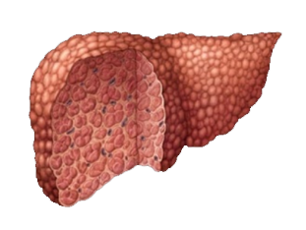
Key considerations
in long-term CHB management
Prevention of liver disease progression
Improved liver histology
Hepatitis B
Virus
No/ineffective
treatment
Fibrosis
CHB
infection
Potent viral
suppression
Prevention of
resistance
Uncontrolled
viral replication
Potent viral
suppression
Liver
Cirrhosis
HCC
Keeffe E. Clin Gastroenterol Hepatol. 2008;6:1315–1341.
2. Liaw YF, et al. Hepatol Int. 2008;2:263–283.
3. Lok A & McMahon B. Hepatology. 2009;50:1–36.
28
Notes:
SPEAKER NOTES:
In CHB infection, uncontrolled viral replication due to no or ineffective treatment leads to fibrosis, cirrhosis, hepatocellular carcinoma and death.
Potent and durable viral suppression of HBV DNA to an undetectable level can lead to improved liver histology, and effective long-term treatment may help to reverse fibrosis and liver damage. Durable viral suppression is therefore vital for effective disease management.
Preventing disease progression and improving liver histology are recognized as the primary goals of CHB treatment, and potent viral suppression with the prevention of resistance are vital to achieve these goals.

Slide 29
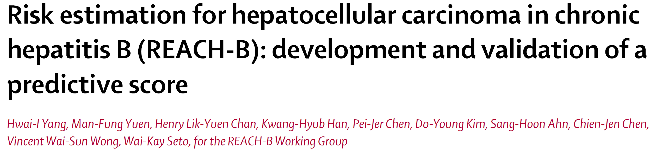


Slide 30
Risk calculator for HCC risk estimation
Generation of risk calculator
  Database of REVEAL study
    population-based cohort
    3,584 patients, age 30-65 years
    HBsAg (+), anti-HCV (-)
    No cirrhosis
    HBV DNA measured at study entry
    No antiviral therapy
    Median follow-up of 12 years
    131 HCC developed
HI Yang et al. Lancet Oncol 2011;12:568-74

Slide 31
Risk calculator for HCC risk estimation
Validation of risk calculator
  Three independent hospital-based cohort
  Korea (Yonsei University)
    259 non-cirrhotic patients
    Aged 24-70 years
    Median follow-up of 7 years
  Hong Kong (University of Hong Kong)
    -820 patients
    -Aged 14-83 years
    -Median follow-up of 6.3 years
  Chinese University of Hong Kong
    -426 patients
    -Aged 12-80 years
    -Median follow-up of 9.4 years
HI Yang et al. Lancet Oncol 2011;12:568-74

Slide 32
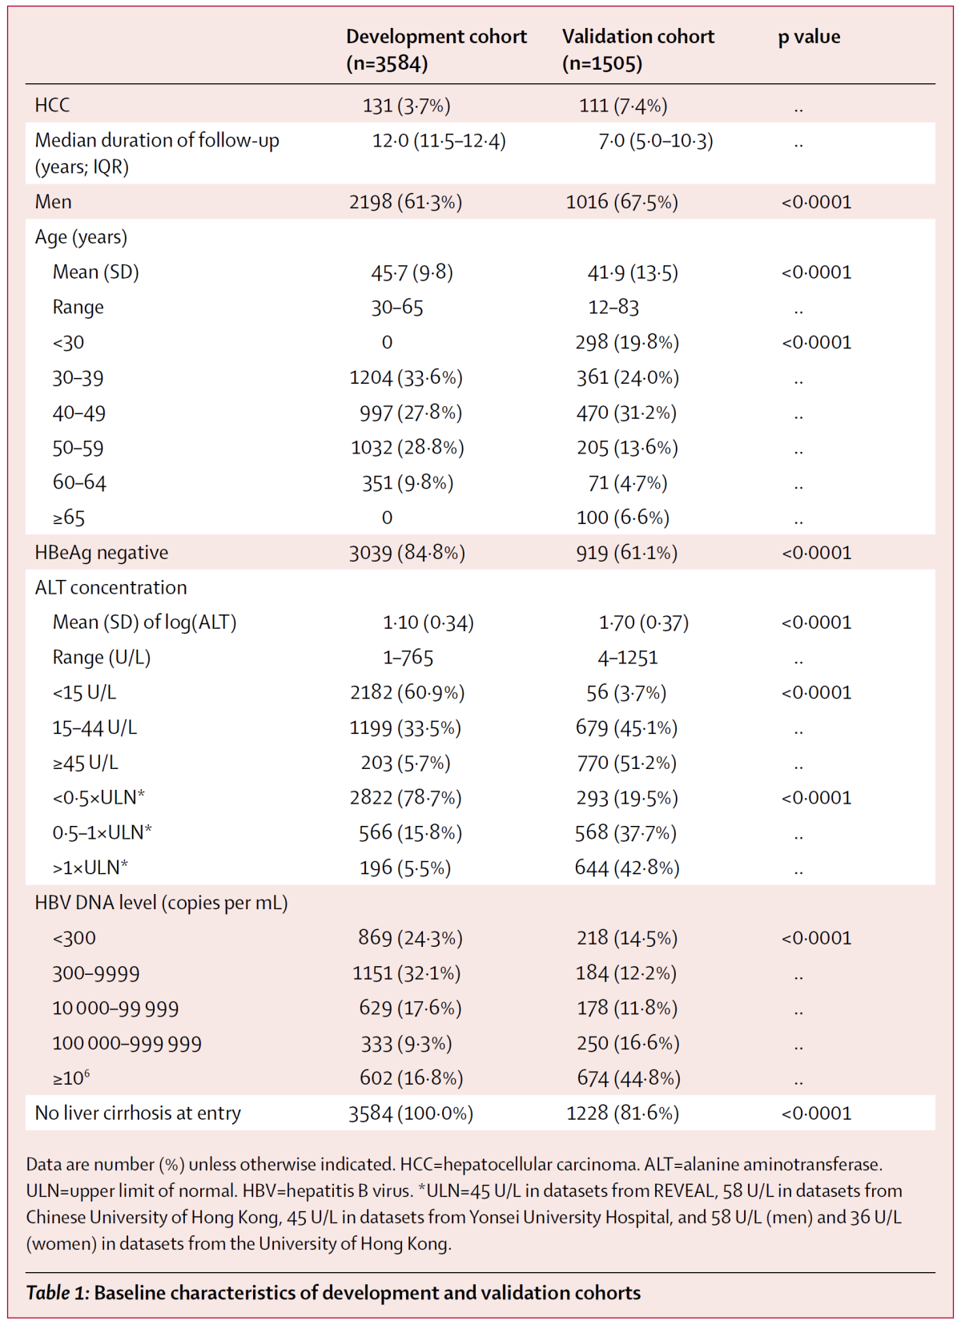
HI Yang et al. Lancet Oncol 2011;12:568-74

Slide 33
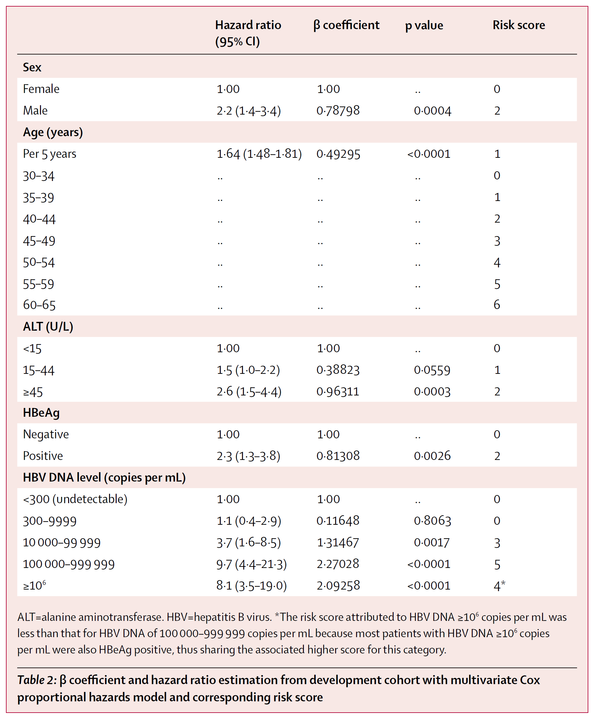

Slide 34
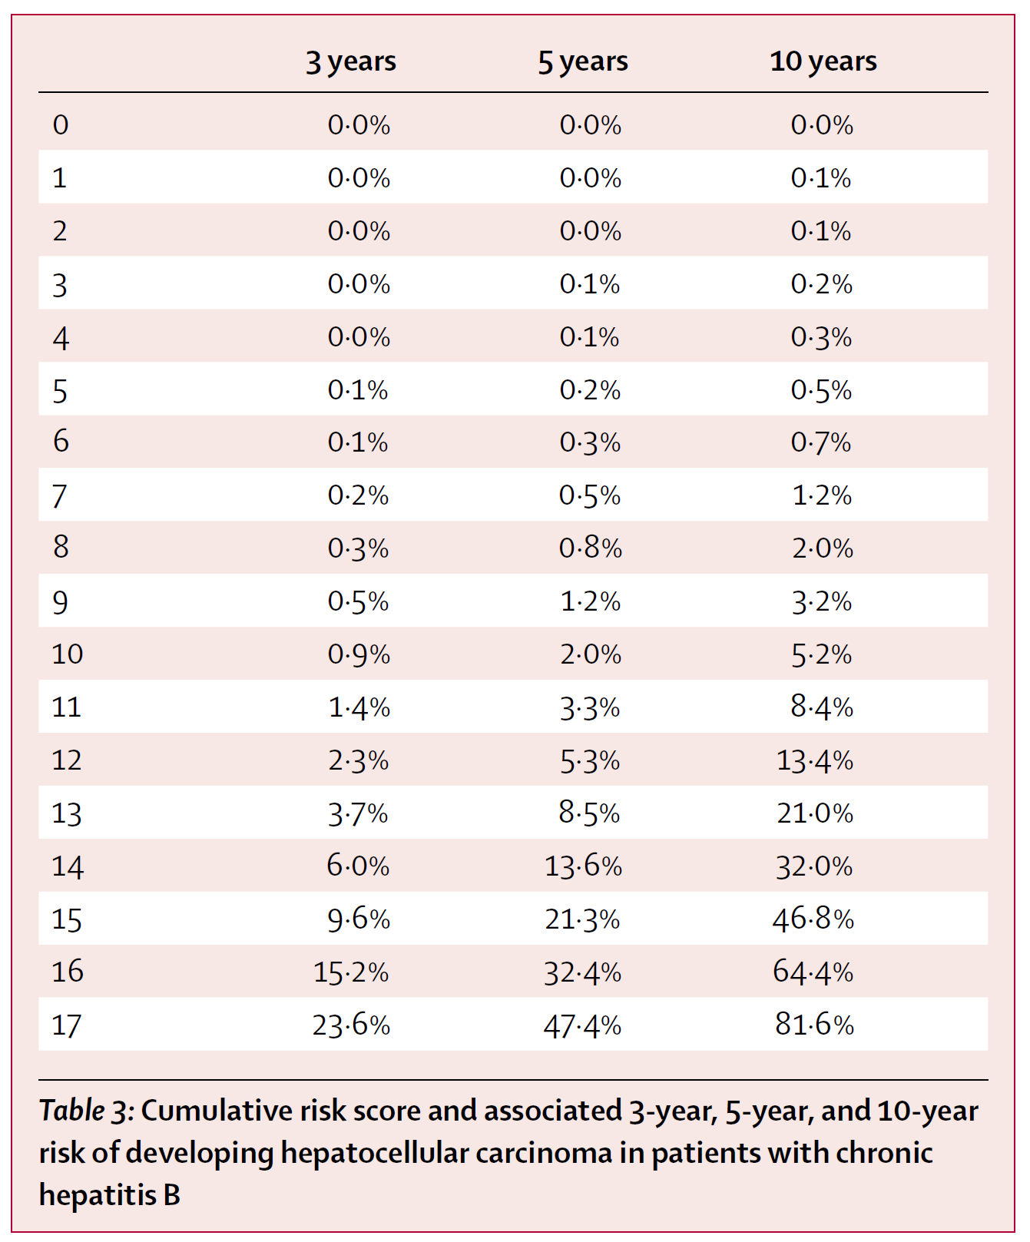
HI Yang et al. Lancet Oncol 2011;12:568-74

Slide 35
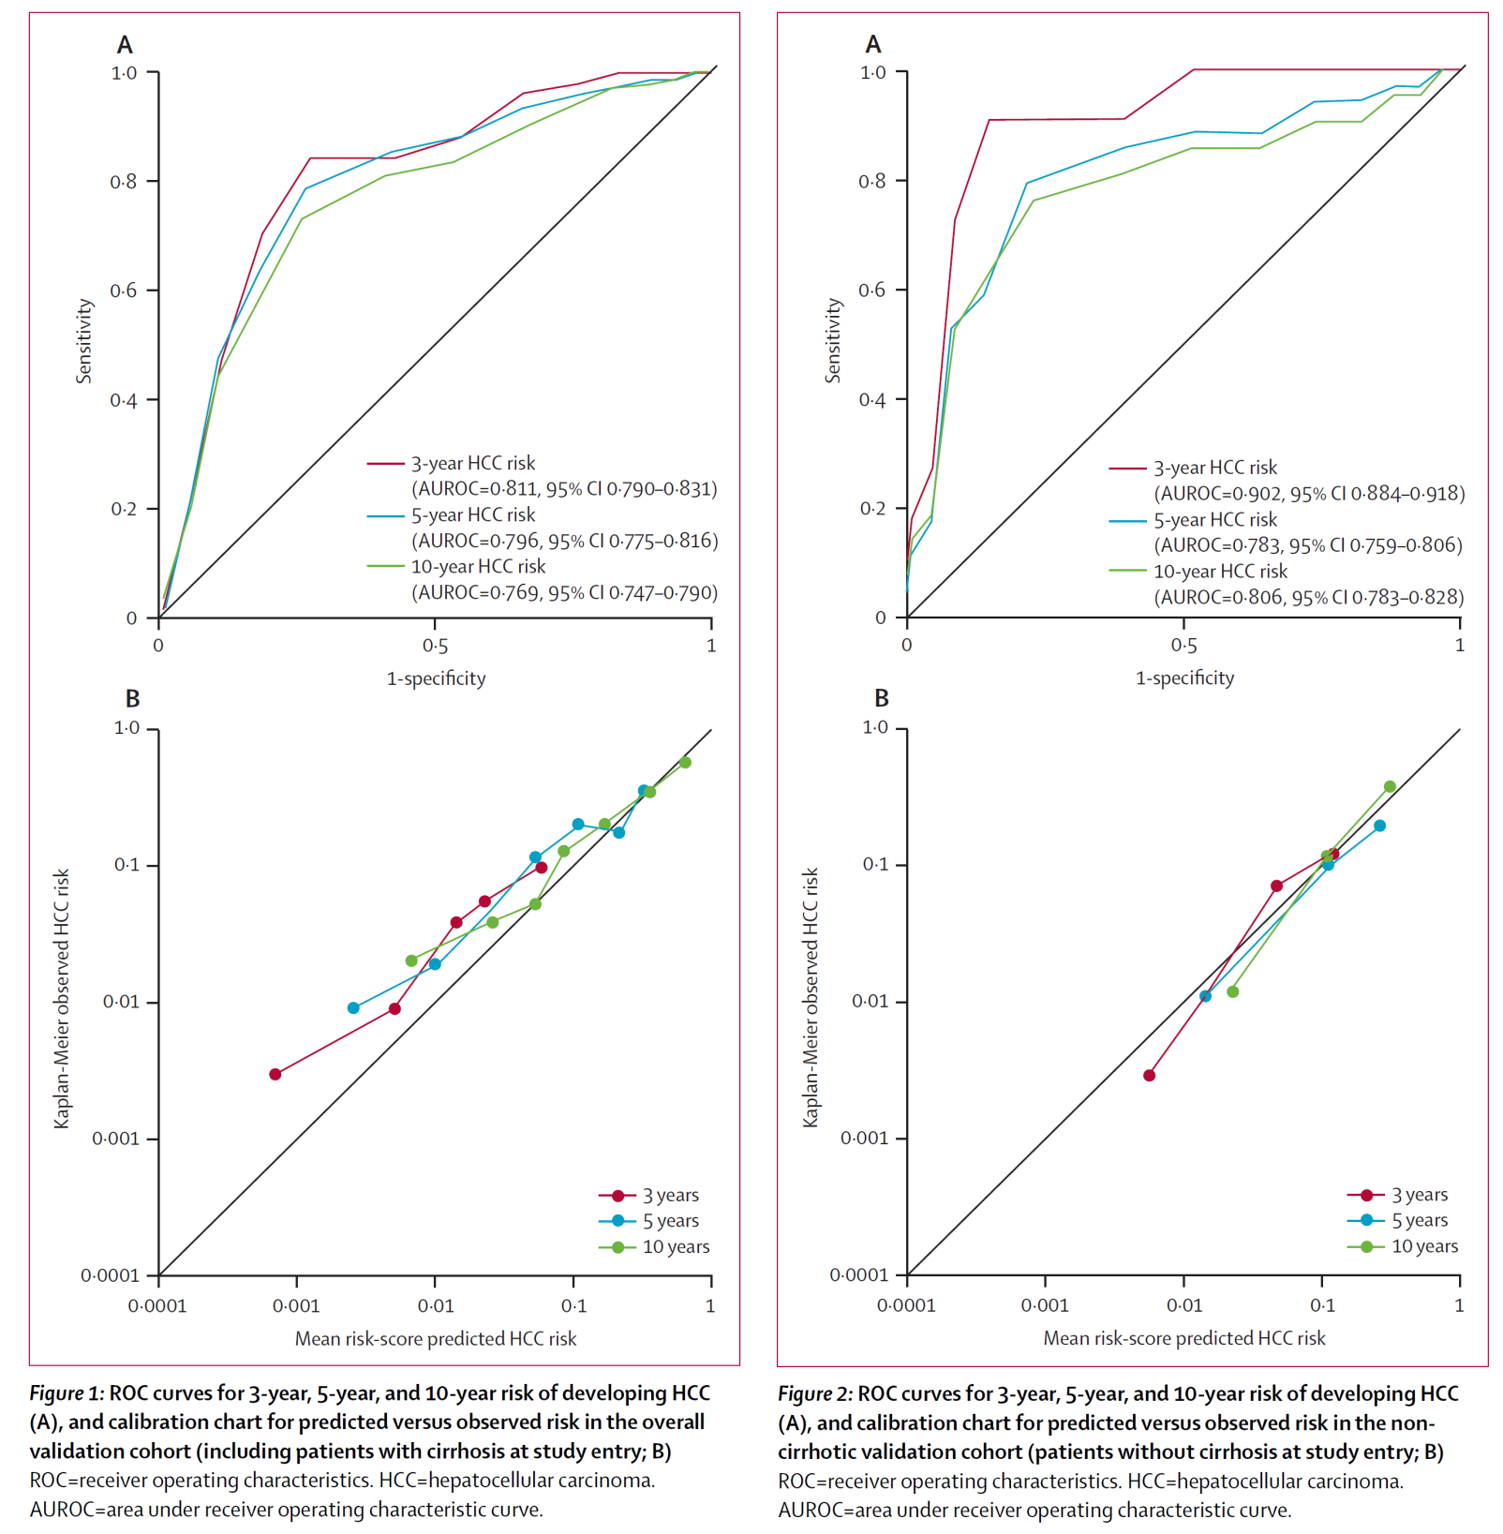
HI Yang et al. Lancet Oncol 2011;12:568-74

Slide 36
Merits, limits, and further directions
Simple variables included
  Alcohol, smoking, genotype, obesity, mutation excluded
  Easily applied in private clinic
What is the cutoff of risk for recommendation of therapy?
Is this model effective for patients who received therapy?
More validation in other ethnic is needed.
HI Yang et al. Lancet Oncol 2011;12:568-74

Slide 37
Key considerations
in long-term CHB management
Prevention of liver disease progression
Improved liver histology
Hepatitis B
Virus
No/ineffective
treatment
Fibrosis
CHB
infection
Potent viral
suppression
Prevention of
resistance
Uncontrolled
viral replication
Potent viral
suppression
Liver
Cirrhosis
1. Keeffe E. Clin Gastroenterol Hepatol. 2008;6:1315–1341. 2. Liaw YF, et al. Hepatol Int. 2008;2:263–283.
3. Lok A & McMahon B. Hepatology. 2009;50:1–36.
37
Notes:
SPEAKER NOTES:
In CHB infection, uncontrolled viral replication due to no or ineffective treatment leads to fibrosis, cirrhosis, hepatocellular carcinoma and death.
Potent and durable viral suppression of HBV DNA to an undetectable level can lead to improved liver histology, and effective long-term treatment may help to reverse fibrosis and liver damage. Durable viral suppression is therefore vital for effective disease management.
Preventing disease progression and improving liver histology are recognized as the primary goals of CHB treatment, and potent viral suppression with the prevention of resistance are vital to achieve these goals.

Slide 38
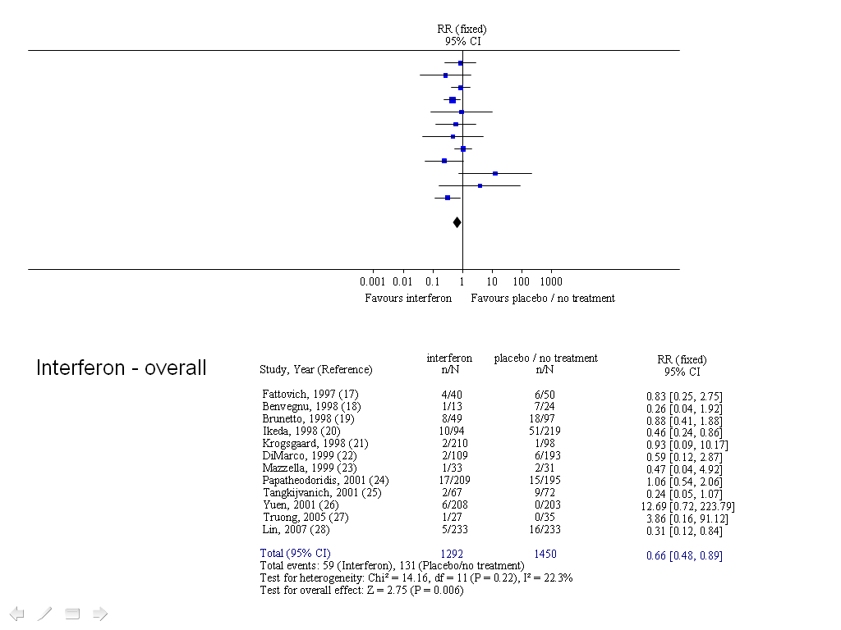
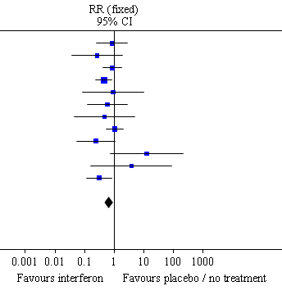
Overall Results for Interferon
Prevent HCC
Total events: 59 (Interferon), 131 (Placebo/no treatment)
Test for heterogeneity: Chi² = 14.16, df = 11 (P = 0.22), I² = 22.3%
Test for overall effect: Z = 2.75 (P = 0.006)
Sung et al. APT 2008

Slide 39
Studies 102/103
Long Term TDF Therapy and Risk of HCC
Phase 3, randomized, double-blind, placebo-controlled
All patients received open-label TDF after Year 1 for total study duration of 8 years
Previously reported 5-year data showed no resistance and reversal of fibrosis*
Study Aim: To compare the observed incidence of HCC in patients treated with TDF in Studies 102/103 with the predicted HCC incidence based on the REACH-B risk calculator
Year
0
1
2
3
4
5
7
8
TDF 300 mg
(n=426)
HCC data analysis
Chronic HBV:
(HBeAg– and +)
Open-label TDF 300 mg QD
ADV 10 mg
(n=215)
*Marcellin P, et al. Lancet. 2013 Feb 9;381(9865):468-75.
Kim WR, et al. EASL 2013. Amsterdam, The Netherlands. Oral #43
Notes:
Analysis Aim: To compare the observed incidence of HCC in patients treated with TDF in Studies 102/103 with the predicted HCC incidence based on the REACH-B risk calculator
These data are generated from the first 7 years of 102/103
Primary endpoint: HBV DNA < 400 copies/mL and histologic improvement (reduction of ≥ 2 points in Knodell score) at Week 48
Emtricitabine could be added at the investigator’s discretion for confirmed viremia on/after Week 72
HCC recognized as AE
There are at least 3 HCC risk calculators than can be used; GAG-HCC, GU-HCC, and REACH-B. The REACH-B calculator was chosen since it is the most granular in choosing the exact percentage
Study 102-103 exclusion criteria: evidence of HCC by either α-fetoprotein > 50 ng/mL or by any other standard of care measure

Slide 40
REACH-B Model
Prediction model to estimate HCC risk in non-cirrhotic patients up to 10 years
Hypothetical Patient:
60-year-old HBeAg+ male, ALT 60, HBV DNA 100,000 copies/mL
REACH-B score: 13
Variable | Data | Score
Sex | Male/female | 0‒2
Age | Every 5 y >30 | 0‒6
ALT, U/L | <15 15‒44 >45 | 0‒2
HBeAg | +/– | 0‒2
HBV DNA, copies/mL | Und. ~10⁴ ~10⁵ ~10⁶ >10⁶ | 0‒5
HCC Risk (%)
Year
Yang HI, et al. Lancet Oncol 2011;12:568-74.
Notes:
REACH-B is designed for non-cirrhotics and may underestimate risk in cirrhotics
On the right, we applied the model to a hypothetical patient; a 60 year-old HBeAg+ man, with an ALT of 60 IU/mL and HBV DNA of 5 logs
The REACH-B calculator was developed in a non-cirrhotic cohort (REVEAL), but it was validated separately in 3 large, urban hospitals (2 in Hong Kong and 1 in Korea) in cirrhotics
REACH-B is a predictive model designed to estimate the HCC risk in non-cirrhotic patients up to 10 years
It uses a point system up to 17 to delineate risk based on sex, age, ALT, HBeAg status, and HBV DNA levels
The higher the number, the higher the risk of developing HCC

Slide 41
Studies 102/103
HCC Incidence Based on Cirrhosis Status at Baseline
Cirrhotic
n=6
4.5%
HCC diagnosis (%)
Non-cirrhotic
n=8
1.5%
No. at risk
Non-cirrhotic | 482 | 453 | 425 | 396 | 377 | 360 | 343 | 324*
Cirrhotic | 152 | 146 | 137 | 132 | 126 | 120 | 115 | 109*
*Patients completing 336 weeks in study as defined by protocol
Kim WR, et al. EASL 2013. Amsterdam, The Netherlands. Oral #43
Notes:
Not surprisingly, a higher percentage of HCC was noted in cirrhotics (~4.5%) than in non-cirrhotics (~1.5%) over the 7-year time block
There were 8 non-cirrhotics and 6 cirrhotics with HCC in this analysis
Cirrhosis defined as Ishak 5 or 6; Non-cirrhosis defined as Ishak of 4 or less based on liver biopsy
4 HCC cases occurred within the first year (3 in the non-cirrhotic arm and 1 in the cirrhotic arm) and all were HBeAg negative
4 HCC cases occurred between weeks 96–144 (2 in non-cirrhotic arm and 2 in the cirrhotic arm). 2 were HBeAg negative and 2 were HBeAg positive
2 HCC cases occurred between weeks 144–192 (1 in the non-cirrhotic arm and 1 in the cirrhotic arm). 1 was HBeAg negative and 1 was HBeAg positive
2 HCC cases occurred between weeks 192–240 (1 in the non-cirrhotic arm and 1 in the cirrhotic arm). Both were HBeAg positive.
1 HCC case occurred between weeks 240–288 (1 HBeAg negative non-cirrhotic patient)
1 HCC case occurred between weeks 288–336 (1 HBeAg negative non-cirrhotic patient)
Of note, there was no HCC occurrence in the cirrhotic group after Week 194 (Year 4) (last HCC case was on day 1359)
According to study protocol, 4 of 437 patients completing Week 336 did not have baseline biopsy data available
All HCC cases were Ishak 6 at Baseline

Slide 42
Study 102
Study 103
Studies 102/103
HCC Cases Over Time by Study
Day on study when HCC cases emerged
197
350*
799*
1697
121
323
797*
1206
2227
782
872*
1222*
1359*
1442
48
96
144
192
240
288
336
Weeks
*Cirrhotic at baseline (Ishak fibrosis score = 6)
Kim WR, et al. EASL 2013. Amsterdam, The Netherlands. Oral #43
Notes:
42
The timing of the 14 HCC cases observed in Studies 102 (HBeAg–) and 103 (HBeAg+) is depicted here
Among the 641 patients treated in 102 and 103, there were a total of 14 cases of HCC detected during the first 7 years. 9 of these cases were in Study 102 and 5 were in study 103
Three of the cases occurred within the first 48 weeks of the study
Among the cases in Study 102, 3 were cirrhotic at baseline
Among patients in Study 103, 3 were cirrhotic at baseline according to biopsy specimens. An additional patient was later determined to have cirrhosis based on a sample take at the time of surgical resection (this is the case from D1442)
All HCC cases that were cirrhotic were Ishak 6 at baseline (no Ishak 5’s)

Slide 43
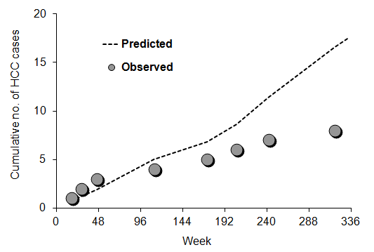
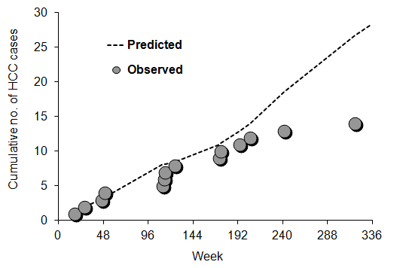
Studies 102/103
Observed vs. Predicted HCC Cases
Non-cirrhotics
n=482
All Patients
n=634
SIR = 0.45*
95% CI (0.227, 0.909)
SIR = 0.50*
95% CI (0.294, 0.837)
1st significant difference
1st significant difference
Incidence of HCC in patients on TDF in Studies 102/103 was lower than predicted by the REACH-B model
In non-cirrhotic patients, the effect of TDF becomes noticeable between 2–3 years of therapy and became statistically significant (55% reduction) at 6 years of therapy
*Statistically significant at nominal α-level of 0.05.
Kim WR, et al. EASL 2013. Amsterdam, The Netherlands. Oral #43
Notes:
Observed vs. predicted HCC cases are displayed on this slide
No cases of HCC were excluded; so patients who had HCC in the first year were included in the analysis
In non-cirrhotics (n=482) there was a > 50% reduction in the incidence of HCC which started to become noticeable after 96 weeks (Year 2), and became statistically significant at 240 weeks (Year 5) based on the calculated Standardized Incidence Ratio (SIR)
These data can’t be extrapolated to patients with inactive disease
14 cases of HCC total in this analysis, 8 in non-cirrhotics
3–4 cases occurred in the first year and likely represent small HCC that was already present very early in this study. (Fourth HCC case occurred at Day 350)
The analysis was conservative as no cases were excluded

Slide 44
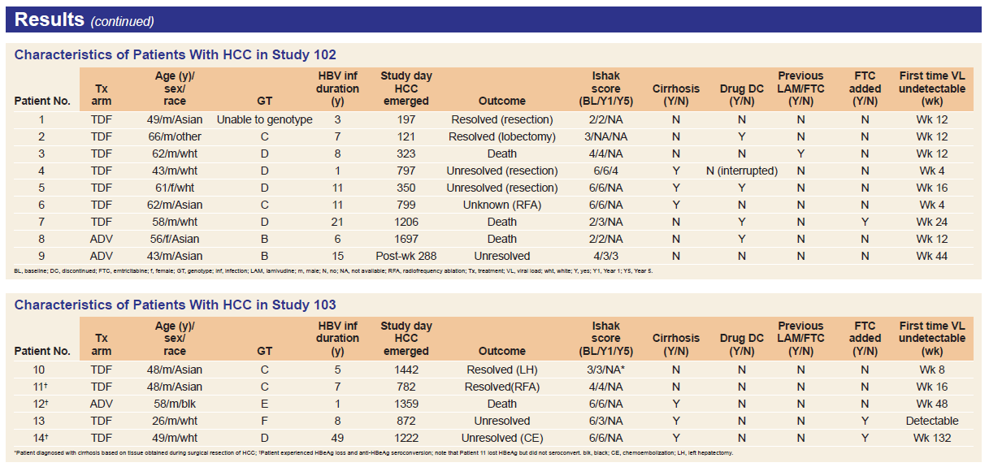
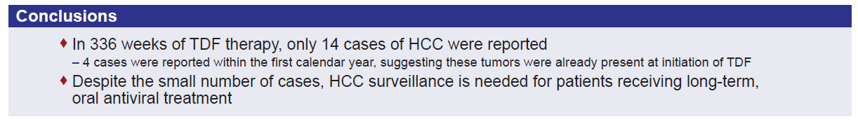
Kim WR, et al. APASL 2013Singapore. PE #004.
Notes:
14 HCC cases during the first 336 weeks of Studies 102 and 103
– 4 cases occurred within the first calendar year
9 HCC cases in Study 102
– 3 cases occurred in setting of cirrhosis (Ishak fibrosis score = 6)
5 HCC cases in Study 103
– 3 cases occurred in setting of cirrhosis (Ishak fibrosis score = 6)
12 of 14 cases were in males
Among the 14 HCC cases, 5 were HBV genotype (GT) D, 4 GT C, 2 GT B,
1 GT E, 1 GT F, and 1 was unable to be genotyped

Slide 45
SUMMARY
The incidence of HCC in patients on TDF in studies GS-US-174-0102 and GS-US-174-0103 was lower than predicted by the REACH-B model
In noncirrhotic patients, the effect of TDF becomes noticeable at approximately 2 years of therapy and became significant (55% reduction) at 6 years of therapy
TDF effect was less pronounced in cirrhotic patients; however, the number of cirrhotics with HCC was small and may not rule out longer-term benefits
Kim WR, et al. EASL 2013. Amsterdam, The Netherlands. Oral #43

Slide 46
Key considerations
in long-term CHB management
Prevention of liver disease progression
Improved liver histology
Hepatitis B
Virus
No/ineffective
treatment
Fibrosis
CHB
infection
Potent viral
suppression
Prevention of
resistance
Uncontrolled
viral replication
Potent viral
suppression
Prevent cancer
Liver
Cirrhosis
1. Keeffe E. Clin Gastroenterol Hepatol. 2008;6:1315–1341. 2. Liaw YF, et al. Hepatol Int. 2008;2:263–283.
3. Lok A & McMahon B. Hepatology. 2009;50:1–36.
46
Notes:
SPEAKER NOTES:
In CHB infection, uncontrolled viral replication due to no or ineffective treatment leads to fibrosis, cirrhosis, hepatocellular carcinoma and death.
Potent and durable viral suppression of HBV DNA to an undetectable level can lead to improved liver histology, and effective long-term treatment may help to reverse fibrosis and liver damage. Durable viral suppression is therefore vital for effective disease management.
Preventing disease progression and improving liver histology are recognized as the primary goals of CHB treatment, and potent viral suppression with the prevention of resistance are vital to achieve these goals.

Slide 47
Questions ?

