Slide 1


Self-Limited Liver Injury in a 5 Year Old Girl with a History of Autoimmune Alopecia Treated with Solu-Medrol Pulse Therapy
Case Presentation
Georgi Chaltikyan, MD, PhD
President of Armenian Association of Telemedicine (AATM)
http://armtelemed.org
LIVER INTERNATIONAL SYMPOSIUM • October 12-13, 2012 • Tbilisi, Georgia

Slide 2
Clinical Findings
Patient K.A., female, DOB: 07.07.2005
Admitted to in-patient service: 23.03.2011
Discharged from in-patient service: 17.05.2011
Presenting Complaint: icterus of the skin and sclerae, itching, dark urine, acholic stools, fatigue.
Secondary Complaint: alopecia.

Slide 3
Clinical Findings
General Medical History:
The child from the first normal pregnancy and delivery, breast fed until 6 mo old.
History of measles and respiratory infections.
Normal development.
No history of trauma or surgery.
No allergies.

Slide 4
Clinical Findings
History of Present Illness:
Since 2009 – focal, then total alopecia (scalp, eyebrows, eyelashes), thickening and yellowish discoloration of the toenails. Multiple failed treatment attempts.
June 2010 – diagnosed Autoimmune Alopecia, prescribed Solu-Medrol pulses (180 mg/day х 3 days of each month).
July 2010 – March 2011 – received 6 courses of Solu-Medrol therapy at “Arabkir” Pediatric Center in Yerevan, Armenia.
Sept 2010 – Feb 2011 – parallel use of Rubia tinctorum L.

Slide 5
Clinical Findings
History of Present Illness (cont’d):
Alopecia responded well to Solu-Medrol, with partial recovery of scalp hair, eyebrows, eyelashes, and toenails.
Oct 2010 – liver enzyme elevation after 4th Solu-Medrol pulse (mixed cytolysis-cholestasis pattern); consultant dermatologist decided to continue the course.
March 2011 – liver damage progressed to overt jaundice; Solu-Medrol discontinued; admitted to in-patient pediatric service at “Arabkir” MC, further evaluated and treated.

Slide 6
Clinical Findings
Physical Findings on Admission:
Normally developed afebrile child in no acute distress.
Skin and sclerae grossly icteric; no rash; focal growth pattern of the scalp hair; no lymphadenopathy; musculo-skeletal normal.
Lungs clear; heart clear; HR 112; abdomen supple, non-tender; liver palpable 2 cm below the costal margin, slightly firm, homogenous; spleen non palpable.
Stools once daily, acholic, normal consistency.
Normal urinary output.

Slide 7
Lab Findings
Complete Blood Count:
 | Course 1 | Course 2 | Course 3 | Course 4 | Course 5 | Course 6
 | 19.07.10 | 19.08.10 | 22.09.10 | 25.10.10 | 07.12.10 | 22.02.11 | 05.04.11 | Normal values
Hb | 129 | 128 | 131 | 133 | 137 | 137 | 127 | 120 – 140g/L
RBC | 4.3 | 4.3 | 4.36 | 4.43 | 4.56 | 4.56 | 4,4 | 3.9 – 4.7х10¹²/L
Fi | 0.9 |  | 0.9 | 0.9 |  | 0.9 | 0,86 | 0.85 – 1.05
Ht | 38 |  | 37 | 39 |  | 38 | 37 | 36 - 46%
Reticulocytes |  |  |  |  |  |  |  | 2 – 14 ‰
Platelets | 320 | 300 | 317 | 310 | 281 | 286 | 314 | 150-400х10⁹/L
WBC | 13.7 | 8.4 | 10.5 | 10.7 | 10.7 | 11.4 | 9 | 4.0-10х10⁹/L
Bands | 4 | 2 | 4 | 2 | 2 | 2 | 1 | 1-6%
PMN | 64 | 25 | 50 | 54 | 48 | 41 | 35 | 47-72%
Eos | 1 | 7 | 2 | 1 | 2 | 2 | 2 | 0.5-5%
Bas |  |  |  |  |  |  |  | 0-1%
Lym | 23 | 54 | 36 | 35 | 36 | 47 | 52 | 19-37%
Mon | 6 | 12 | 8 | 8 | 12 | 8 | 10 | 3-11%
ESR | 11 | 12 | 5 | 9 | 5 | 5 | 6 | 2-10 mm/h

Slide 8
Lab Findings

Slide 9
Lab Findings

Slide 10
Lab Findings
NORMAL LEVELS: Total protein, protein fractions, urea, creatinine, glucose, electrolytes, LDL, amylase, cholesterol, triglycerides, and CRP.
Normal clotting panel.
HBsAg: negative
Anti-HBs-ab: 100 IU/l
HBcor-IgG: negative
HCV total ab: negative
IgM – EBV: negative
CMV IgG 5 U/ml (N <2 U/ml)
HSV 2 IgG 0.46 U/ml (N <0.9 U/ml)
HAV IgM: negative
PCR HSV: negative
PCR CMV: negative

Slide 11
Lab Findings
АNA 12 U negative (N < 20)
dsDNA 125 negative (N 0-200 ME/ml)
Thyroid peroxidase AB (TP-ab): 11.1 (<50 U/ml)
C3 fraction compl 0.98 (0.84 – 1.67 g/L)
C4 fraction compl 0.2 (0.16 – 0.31 g/L)
АSLО <200 (normal <200)
Tuberculosis, antibodies: negative
Brucellosis, antibodies: negative
Serum Cu: 0.236 g/L (N 0.18 – 0.45 g/L)
Urinary Cu: 56.4 mcg/L (N below 70)
Cerulloplasmin: 0.007 g/L (< 0.03 g/L)
IgG 1.167 g/L (N 3.5 - 14 g/L)
IgA 0.242 g/L (N 0.3 – 2.3 g/L)
IgM 0.179 g/L (N 0.4 – 1.5 g/L)
AFP (April 2011) – 450-750 IU/mL

Slide 12
Lab Studies at
Ceruloplasmin in Serum | 275 mg/l | 260 - 460
Copper, total in serum | 1096 ug/l | 800 - 1600
AAb to Mitochondrions (AMA) | 1: < 10 | 1: < 10
AAb to Liver-Kidney Microsomes | 1: < 10 | 1: < 10
AAb to Smooth Muscles (SMA) | 1: < 10 | 1: < 10
Ab agaist sol. liver antigen | < 2.0 E/ml | < 20
Hepatitis A Ab, IgM | negative
HBs-Antigen | negative
anti - HBc | negative
Hepatitis C - Antibody | negative
Epstein-Barr-VCA-IgM (serum) | < 4 U/ml | < 13
CMV IgM Ab | negative
AFP (Roche - ECLIA) | 396 kIU/l | < 5.8
Hepatitis-B-Virus-DNA in plasma (PCR) | < 0.010 kIU/ml
Hepatitis C-Virus-RNA in plasma (PCR) | negative

Slide 13
Instrumental Findings
Normal ECG, EchoCG, chest film.
Abdominal Ultrasound: Liver – right lobe mid-clavicular size 9.8 сm, antero-post size 7.6 cm, oblique size 10.67 cm, left lobe length 6 cm, hilar lymph node 1.16 cm; echogenicity normal, increased density of intrahepatic bile duct walls and vascular walls. Portal vein 0.5 – 0.6 – 0.4 cm, wall 0.21 cm – mild hepatomegaly, otherwise unremarkable.
MSCT IV enhanced: no mass lesion identified; mild hepato-splenomegaly.
Liver biopsy: mild periportal lymphoid infiltration with interface activity, and confluent intralobular necrosis.

Slide 14
Treatment & Course
Mostly supportive treatment.
Received oral ACC (acetylcysteine) for 5 days for presumed DILI.
Received IV Heptral® (S-Adenosyl methionine) 200 mg/day, for 20 days; continued oral Heptral® after discharge for 2 mo.
Chemistries began normalizing late April-May, 2011.
Complete clinical and chemical recovery by fall 2011.
Serum Hepatitis E positive (HEV-IgM) Aug 2012.
Stools PCR negative.
Resumed Solu-Medrol pulses since Aug 2012; received two courses, currently feeling well, chemistries normal.
OPEN ISSUES FOR DISCUSSION:
  Mechanism of liver injury – viral, or an interplay of factors?
  Prognosis?
  Further management?

Slide 15
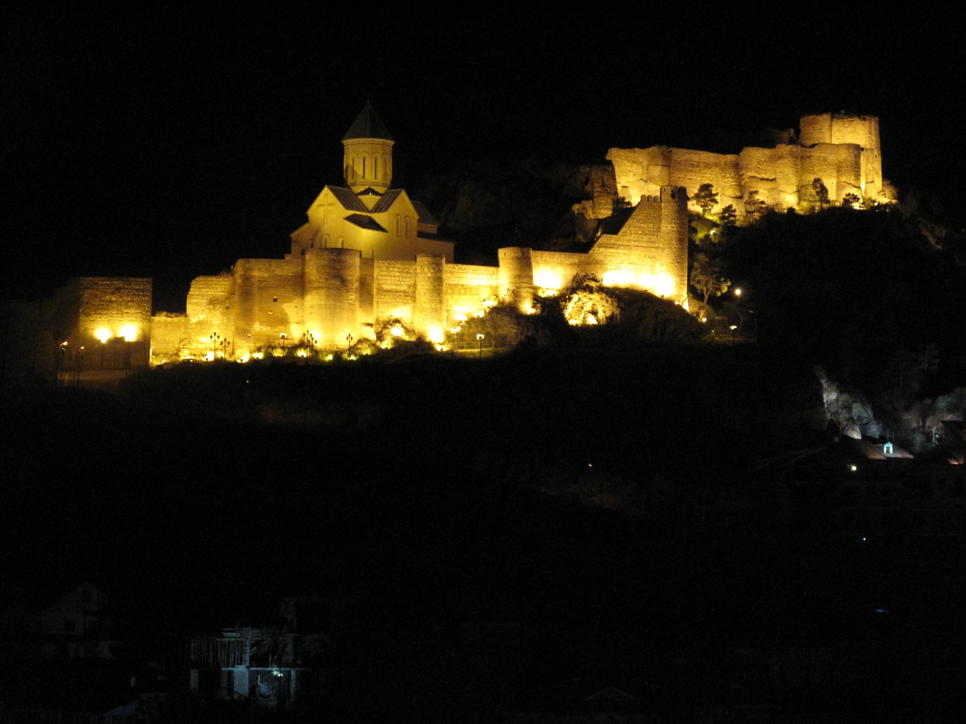
Thank you!

Slide 16
Georgi Chaltikyan, MD, PhD
Associate Professor of Surgery
Armenian Association of Telemedicine (AATM) www.armtelemed.org
Phone: +374 95 911 110 e-mail: gchaltikyan@armtelemed.org
Disclosure: Dr. Chaltikyan is Medical Consultant to LimbachLab–Armenia
LIVER INTERNATIONAL SYMPOSIUM • October 12-13, 2012 • Tbilisi, Georgia

