Slide 1
Hepatitis E: E is for Elusive
Robert G Gish MD
Professor Consultant Stanford University
TransCaucasus Liver Symposium
September 2014
Tbilisi Georgia

Slide 2
Disclosures
None

Slide 3
Thank you to: for your slide and publication support
Ken Sherman
Heiner Wedemeyer/Michal Manns
Carrie Frenette
Rollie Dickson
Harvey Alter
Saleem Kalilli
Ray Kim

Slide 4
Lecture
Cases
Clinical Presentation
Genotypes
Human and animal hosts
Testing and epidemiology
Treatment

Slide 5
Hepatitis E Case 1
80 yo male presents with jaundice
6 weeks prior started allopurinol 300 mgs per day
3 week prior fatigue, nausea, abd discomfort , dark urine. Allopurinol DC
No history of liver disease, ETOH viral risk factors.
PMH
CAD Chronic renal dysfunction
DM type 2 Hypercholesterolemia
HTN Hypothyroidism
GERD Gout
Medications (all for several years)
Colchicine Promethazine Simvastatin L-thyroxine Metformin
Davern Gastroenterology 2011;141:1665-1672
Notes:
denied fever,
chills, rash or itching

Slide 6
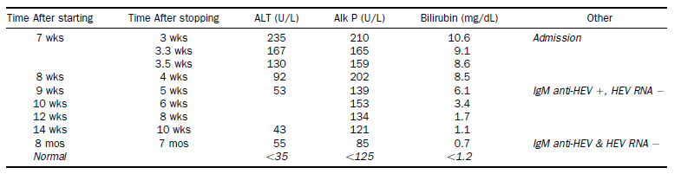
Hepatitis Case 1
Admit: Jaundiced, no fever, rash, stigmata CLD
HAV, HBV, HCV serologies (-), SmAb 1:320,
ANA (-) . US, CT abd no path findings
Dx Highly likely DILI from allopurinol.
Discharge
Davern Gastroenterology 2011;141:1665-1672
Notes:
Serum obtained 5 weeks after presentation was positive for IgG and IgM anti-HEV but without HEV RNA
The presentation and clinical course were typical of drug-induced liver disease, but allopurinol
typically causes immunoallergic hepatitis within 1 to 4 weeks of starting therapy with prominence of fever, rash and eosinophilia initially. Nevertheless, the patient stopped allopurinol soon after beginning to feel unwell and presented for evaluation well into recovery by which times these early manifestations may have resolved. Serological testing was compatible with recent acute HEV infection, but the clinical features and serum enzymes were atypical of acute viral hepatitis.
Initially, the case was judged as “highly likely” due to allopurinol-induced acute liver injury. Upon
re-review with knowledge of the HEV serology, the case was judged to be probably allopurinol hepatotoxicity, but possibly acute hepatitis E.

Slide 7
Hepatitis E Case 1
Serologic testing After Discharge
Diagnosis HEV
FU 6 months later no sxs liver disease
HEV Anti IgM(+)/IgG(+) RNA (-)
HEV anti IgG(+) IgM(-)/RNA (-)V
Davern Gastroenterology 2011;141:1665-1672
Notes:
Serum obtained 5 weeks after presentation was positive for IgG and IgM anti-HEV but without HEV RNA
The presentation and clinical course were typical of drug-induced liver disease, but allopurinol
typically causes immunoallergic hepatitis within 1 to 4 weeks of starting therapy with prominence of fever, rash and eosinophilia initially. Nevertheless, the patient stopped allopurinol soon after beginning to feel unwell and presented for evaluation well into recovery by which times these early manifestations may have resolved. Serological testing was compatible with recent acute HEV infection, but the clinical features and serum enzymes were atypical of acute viral hepatitis.
Initially, the case was judged as “highly likely” due to allopurinol-induced acute liver injury. Upon
re-review with knowledge of the HEV serology, the case was judged to be probably allopurinol hepatotoxicity, but possibly acute hepatitis E.

Slide 8
Hepatitis Case 2
50 y male with well compensated ESLD due to HCV/ETOH
Presents with jaundice, new onset ascites requiring hospitalization
No recent travel
Labs
Baseline Peak
ALT(iu/l) 112 2328
Bili(mg/dl) 2.5 35
INR 1.1 2.0
Laboratory testing on admit
HEV IgM(+), IgG (-), RNA (+) Genotype 3
Hospitalized 14 days with recovery
De Silva Digestive and Liver Disease 2012;44:930-934
Notes:
denied fever,
chills, rash or itching

Slide 9
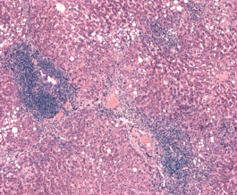
Hepatitis Case 3
44 yo female, Living donor Renal Transplant 9-2003
2004 ALT 76, AST 36 2006 4x ULN persisted
HAV, HIV HBV, CMV, EBV, Autoimmune testing (-)
Bx :lymphocytic portal Infiltrate with piecemeal necrosis, stage 2 fibrosis
4-2009 HEV anti-IgG (+) RNA (+)
Lowering immunosuppression
ALT/AST WNL
RNA (-)
Fibroscan 1 yr later F0-F1
Halleux Trans Infectious Disease 2012;14:99-102

Slide 10
Hepatitis E Clinical
Incubation time 2-8 weeks
Peak viremia is during incubation period and early phase of subclinical or symptomatic disease
Initial symptoms of usually nonspecific
include flu-like symptoms, malaise myalgia, arthralgia, weakness, and vomiting.
May have jaundice, itching, uncolored stools, and darkened urine
May be misdiagnosed as DILI
3% in US , 12% in UK
Asymptomatic infections 2-4 x greater than symptomatic infections
Features different in autochthonous* (gen 3,4) and Genotypes 1 and 2
Hoofnagle NEJM 2012, Davern Gastro 2011
*au·toch·tho·nous ôˈtäkTHənəs/ adjective
1.(of an inhabitant of a place) indigenous rather than descended from migrants or colonists.

Slide 11
Occurrence of HEV Infection
Source: Human or zoonotic
Factors: Contaminated water or under-cooked pork or game meat
Route of transmission: Fecal-oral
Liver- main target organ
Mechanism of delivery and basis of tropism remains unclear
Extra-hepatic tropism unlikely, but not excluded

Slide 12
HEV versus HAV
Clinically indistinguishable
Virological characteristics:
HAV much more stable in the environment
>x100 higher fecal titer
 | HAV | HEV
Incubation | ~ 30 days | ~ 40 days
Dose-dependent severity | No | Yes
Mortality in general | 0.1-2% | 1-4%
Mortality in pregnancy | No difference | Up to 20%
Bimodal disease | Common | Rare
Chronicity | No | No/yes Transplant patients
In developed region | Epidemic, endemic | Ab+, but rare disease
In developing region | Ab+, but rare disease | Epidemic, endemic
Age | Older children, young adults
Emerson. NEJM 2004;351:23, Percell. J Hep 2008;48:494

Slide 13
Comparison of NHANES III and IV 1988-94 (N= 18,695) 2009-2010 (N= 7885)

Slide 14
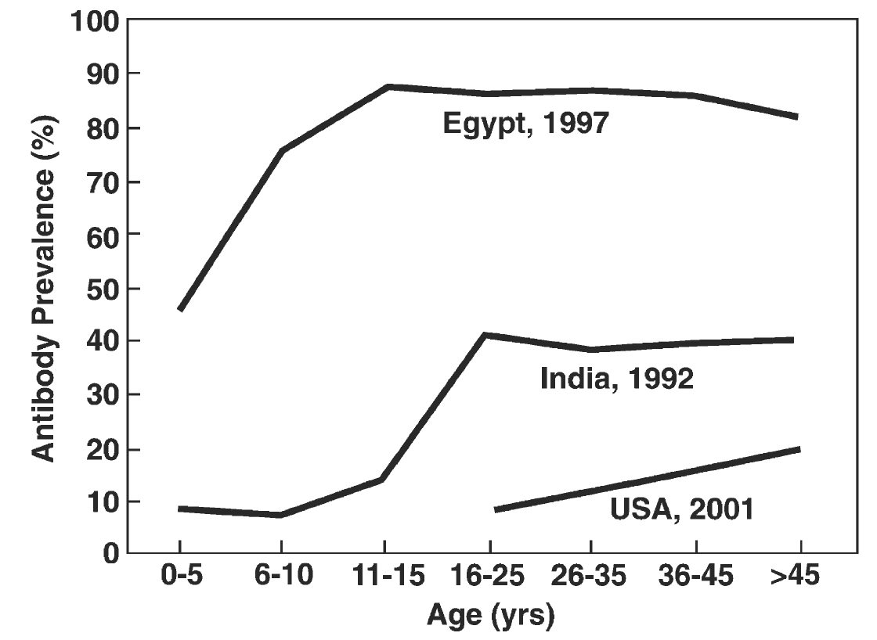
HEV Prevalence: 3 countries
Percell. J Hep 2008;48:494

Slide 15
CDC Lab Based Surveillance for HEV Infection in the US 2005-2012
154 Clinical Non-A,B,C Hepatitis Cases Referred to CDC
26 (17%) HEV infected
11 traveled to endemic area
15 non-travelers “autochthonus”
Mean Age | 32 | 61
Icteric | 92% | 47%
Organ Transplant | 0 | 47%
Gt3 | 0/4 | 8/8
Fulm. Hep Failure | 0 | 3

Slide 16
HEV SEROPREVALENCE in patients with Chronic Liver Disease
Odds Ratio
Atiq et. al. EMERGING INFECT DIS 2009

Slide 17
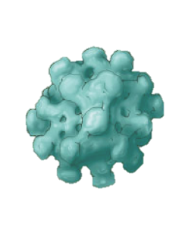
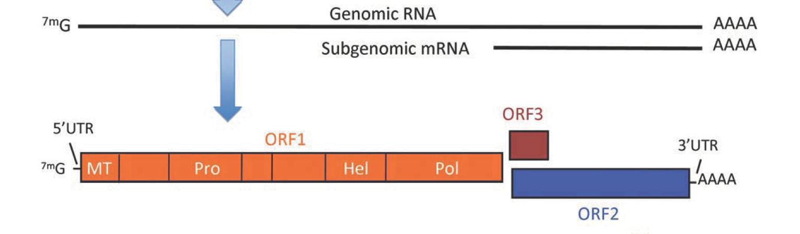
HEV
RNA virus (family Hepeviridae)
Polyprotein:
- Methyltransferase
- Protease
- Helicase
- Polymerase
Capsid
Regulatory
(viral egress?)
Aggarwal. Hepatology 2011;54:2218

Slide 18
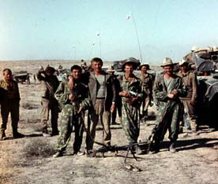
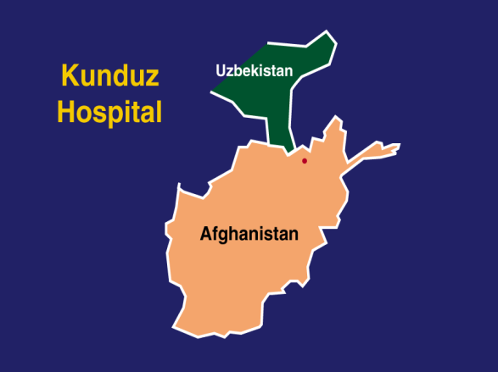
HEV: HISTORY
1978: Water-borne epidemic in Kashmir caused 20,000 icteric cases; 700 FH; 600 deaths; not HAV
1980: Epidemic hepatitis among Russian soldiers in Afghanistan; not HAV related
1983: Russian/Armenian volunteer swallows fecal extract from 9 acute cases in the Afghan epidemic and recovers 27-30nm VLP from his acute phase stool (Balayan)
CDC recovers identical VLP from macaques inoculated with acute phase stool; serial passage
1990: Bile from cyno macaques used in differential hybridization to clone HEV (Reyes, G:Gene Labs)

Slide 19
Dedicated to Dr Michael Balayan, who at much risk to his life undertook a self-inoculation experiment to prove the infectious and transmissible nature of the enteric non-A, non-B hepatitis agent (Balayan MS, et al. Intervirology; 20:23-31, 1983)
Notes:
Therefore, this lecture is Dedicated to Dr Michael Balayan, who at much risk to his life undertook a self-inoculation experiment to prove the infectious and transmissible nature of the enteric non-A, non-B hepatitis agent . This landmark experiment was published by Dr Balayan MS, et al. in the Intervirology; 20:23-31, 1983.

Slide 20
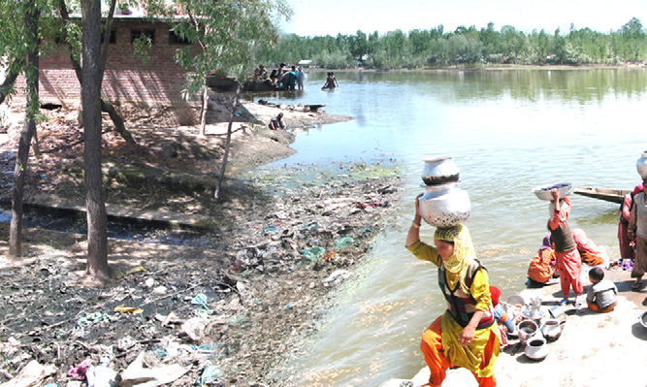
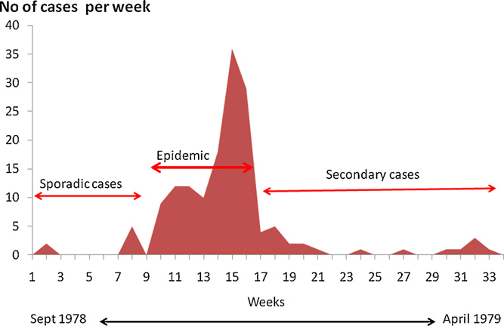
… end of 1970s - 1980s
Kashmir Valley, India
Nov 1978-April 1979
275 clinical cases, 11-40 years old in villages with common water source, among 16,620 inhabitants
Rate of fulminant hepatitis was 4.4%
Khuroo MS. Am J Med 1980; 68
Former soviet republics of Central Asia- Turkmenistan, Kyrgyzstan, Uzbekistan, 1980 and 1986
Ketiladze / Favorov / Shahgildyan
Smaller outbreaks: India (1982), Nepal (1984), Algeria (1985), Mexico (1986)
Notes:
Between November 1978 and April 1979, Khuroo MS. (Am J Med 1980; 68) investigated an outbreak of 275 clinical cases, 11-40 years old, among 16,620 inhabitants of villages in Kashmir Valley of India, with common water source. Rate of fulminant hepatitis was 4.4%.
In 1980 - 1986, in the former soviet republics of Central Asia- Turkmenistan, Kyrgyzstan, Uzbekistan, another series of outbreaks occurred (Ketiladze / Favorov / Shahgildyan). One quarter of pregnant woman infected during the outbreak died; among the rest of the cases – lethality did not exceed 3%.
Smaller outbreaks were registered in India (1982), Nepal (1984), Algeria (1985), Mexico (1986)

Slide 21
Hepatitis E Virus (HEV)- Breakthrough of 1990s
1990: Reyes isolated a nucleic acid clone representing part of hepatitis E viral genome from bile of an experimentally-infected animal.
1991-1992: Tam and Huang sequenced entire HEV genome showing heterogeneity of Asian and Mexican isolates- genotypes 1 and 2, respectively.
1992: Dawson developed first anti-HEV EIA showing that IgM is a short-lived marker of recent infection
1992-2000: Improvement of serologic assays and development of molecular tests
Notes:
JPERZ@CDC.GOV
21
1990: Reyes isolated a nucleic acid clone representing part of hepatitis E viral genome from bile of an experimentally-infected animal.
1991-1992: Tam and Huang sequenced entire HEV genome showing heterogeneity of Asian and Mexican isolates- genotypes 1 and 2, respectively.
1992: Dawson developed first anti-HEV EIA showing that IgM is a short-lived marker of recent infection
1992-2000: Improvement of serologic assays and development of molecular tests
STOP HERE.
Hepatitis E is caused by a spherical, non-enveloped virus, approximately 32-34 nm in diameter. Hepatitis E virus contains a single-stranded RNA molecule and it is classified in Genus Hepevirus. Four genotypes of hepatitis E are known.
The main mode of hepatitis E virus (HEV) transmission is person-to-person through the fecal-oral route. Since hepatitis E is a waterborne disease, consumption of contaminated water or uncooked food are major risk factors for transmission of HEV. Perinatal transmission from infected women is common. Occasionally transfusion and organ transplantation-associated cases of hepatitis E are been reported.
HEV can spread zoonotically since animals, such as non-human primates, pigs, deer susceptible to infection with the virus.
A few words about Clinical features of hepatitis E…
Incubation period is 2–9 weeks (mean 6 weeks).
Hepatitis E clinical attack rates are highest in young adults 15–49 years of age. Generally, hepatitis E is a self-limited disease. However, in pregnant women hepatitis E is associated with fulminant hepatitis and 10-25% fatality rate.
Signs and symptoms of disease during primary infection include jaundice, fever, loss of appetite, abdominal pain, and lethargy.
Hepatitis E was considered a self-limiting disease. Last year however there were reports of hepatitis E lasting for more than 6 month among recipients following organ transplantation, thus suggesting that hepatitis E may take even a course to chronicity.
Pregnant women (particularly those infected during the second or third trimester) may progress to liver failure, and their infants are at risk of spontaneous abortion and premature delivery.
People with pre-existing chronic liver disease may undergo further hepatic decompensation during HEV infection.

Slide 22
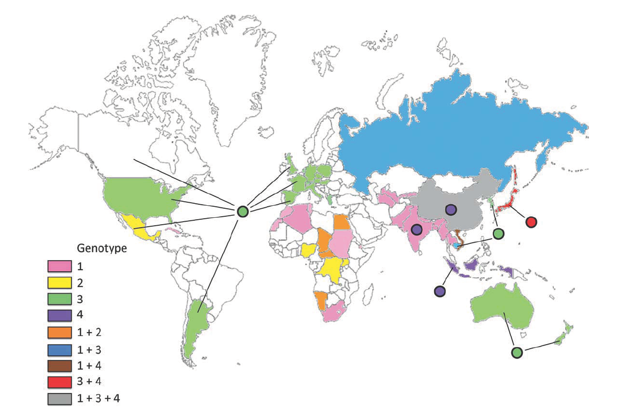
HEV Genotypes
5 genotypes: 1/2 (human), 3/4 (human, swine) and 5 (avian)
Aggarwal. Hepatology 2011;54:2218

Slide 23
HEV: Clinical Differences Genotypes
Characteristics | Genotypes 1 and 2 | Genotypes 3 and 4
Occurrence in U.S. | Travel-related, imported | Autochthonous
Rate of icteric illness | High | Low
Infection |  | Infection in majority of young healthy patients is asymptomatic
Disease
Age distribution | Rates highest adolescents and young adults | Rates highest among older adults (ave 60 yrs), co morbidities
Sex distribution | Similar rates men/women | Higher rates men >3:1
Mortality | High among pregnant women(10-25%) 3rd trimester | High older adults Chronic liver dz up to 70%
Extra hepatic features | Few | Neurologic complications, glomerulonephritis
Chronic infection | None | Immunosuppressed (common)
Hoofnagle NEJM 2012;367:1237-44; Kamar Lancet 2012;379:2477-2488
Notes:
Recently, neurological complications were described in
seven (6%) of 126 patients with acute and chronic HEV3
infection.121 These complications included infl ammatory
polyradiculopathy, Guillain-Barre syndrome, bilateralbrachial neuritis, encephalitis, and ataxia and proximal
myopathy. HEV RNA was detected in the CSF of all four
patients with chronic HEV infection. Neurological
symptoms completely resolved or signifi cantly improved
in patients who achieved viral clearance.121 Clonal HEV
sequences in the serum and CSF in one patient showed
quasispecies com partmentalisation, suggesting that
neurological symptoms could be linked to the emergence
of neurotropic variants.12
of HEV-related membranoproliferative
glomerulonephritis and membranous glomerulonephritis
have been reported in France in patients with chronic
HEV3 infection,85 and in India in patients with acute
HEV1 infection.125 Acute pancreatitis126 and severe
thrombocytopenia127 have also been reported during acute
HEV infection.

Slide 24
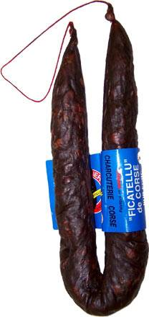
How Might Non-Swine Handlers be Exposed to Contaminated Pork? [Caution: “This slide is not for the queasy” Dr Harvey Alter]
Gastro Elitism Movement: wild boar pappardelli, pigs feet Milanese
Figatelli (raw pork sausage) : favorite in Southern France
Liver slime from pig poop is pooled and used to irrigate soil and plants
(don’t forget to eat your veggies)
Dunkin Donuts sells pork donuts in China
Scrapple made from pig heads and liver
11% of raw pig liver in US markets tested HEV RNA+
USDA recommendations:
cook pork meat to 145F; organ meats to 160F

Slide 25
ASIAN SEAFOOD RAISED ON PIG FECES APPROVED FOR US CONSUMERS
(Bloomberg News)
Vietnam: “Nguyen Van Hoang packs shrimp headed for US in dirty plastic tubs. He covers them with ice made from tap water that the Health Ministry says should be boiled before drinking because of the risk of contamination.” Pig farms abundant and water run-off possible.
Vietnam ships 100 million pounds of shrimp per year to the U.S.; 8% of the shrimp Americans eat
“At a tilapia farm in China’s Guangdong provence, Chen feeds the fish partly with feces from hundreds of pigs and geese”….about 27% of seafood Americans eat comes from China; FDA inspects only 2.7% of imported food.

Slide 26
HEV Acute on Chronic Decompensation A problem in India?: ?not clearly document in other regions
% HEV IgM
Kumar et al., IND J GASTRO, 2004

Slide 27
Hepatitis E as a Cause of Acute Liver Failure*
The US ALF Study Group has enrolled >1800 adults since 1998
Final analysis was conducted on 699
3/699 (0.4%) tested igM anti-HEV +
2 had high titer of IgG anti-HEV
No HEV RNA detected
Conclusion: Acute HEV infection is rare cause of ALF in the United States
*Data from NIH HEV Scientific Workshop, Bethesda, 26 March 2012

Slide 28
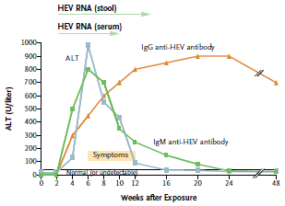
Course of Acute HEV Infection
Early as 3 days up to 16 weeks
1 week to 5 weeks
Initial ALT rise IgM and HEV RNA present
Titers of anti-HEV IgG can be detected early in infection and persist
Hoofnagle NEJM 2012;367:1237-44 Khudyakov Virus Research 2011;161:84-92 Zang Rev Med Virol 2012;22:339-349
Notes:
HEV RNA detectable in stool and serum during the incubation
period, with the subsequent appearance of the IgM and IgG anti-HEV antibodies.
The level of IgM antibody peaks early and becomes undetectable
during recovery, whereas the level of the IgG antibody continues to increase and persists in the long term. Clinical symptoms (fatigue, nausea,
and jaundice) begin shortly after elevations in serum alanine aminotransferase
(ALT) levels. HEV RNA disappears from serum with recovery, whereas
detectable virus usually persists longer in stool
HEV RNA detected in stool and serum in incubation period prior to rise in ALT/AST or clinical symptoms (fatigue, nausea, jaundice)
RNA in serum is lost with recovery, in stool may persist longer
IgM and IgG usuall preceed ALT rise and onset of symptoms.
IgM is detected for 3-12 months
IgG is detected for life
Hoofnagle

Slide 29
Wedemeyer Gastro 2012

Slide 30
CLINICAL OUTCOMES
 | ACUTE DISEASE | CHRONIC DISEASE | MORTALITY
Immunocompetent | YES | NO | LOW
Pregnancy | YES | NO | VARIABLE
Chronic Liver Disease | YES | NO | HIGH
Immunosuppressed -HIV -Post-Transplant -Cancer Chemotx | YES | YES | VARIABLE

Slide 31
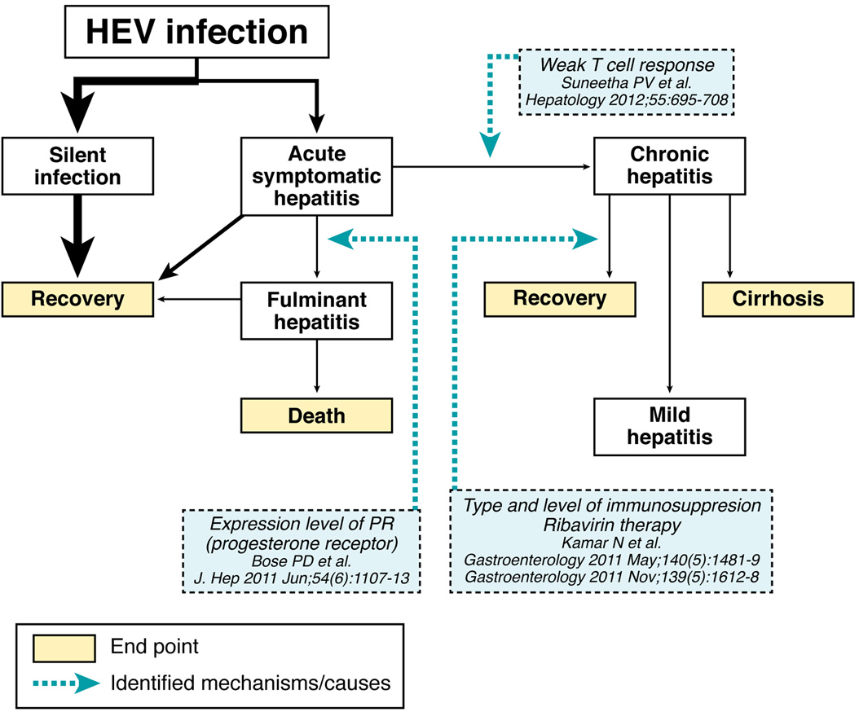
HEV Gen 3 Immunosuppressed
Adapted Wedemeyer Gastro 2012;142:1388-1397

Slide 32
HEV Problems with serologic assays
Sensitivity/Specificity complicated by lack of understanding of underlying HEV prevalence
Detection of anti-HEV among “negative” controls (Goldsmith et al., 1992)
High HEV seroprevalence in nonendemic countries (Thomas et al., 1997)
Different prevalence rates using different assays
Khudyakov Virus Research 2011;161:84-92

Slide 33
Conclusion Anti-HEV Ab Testing in Immunocompetent Patients
Acute HEV can be accurately diagnosed using Anti-HEV IgM Ab testing
The assay used should incorporate the Recombinant protein pE2 encoded by protruding region of ORF-2
Testing for anti-HEV IgG is not helpful for active infection given >/=15% adults in West countries (+)
Exposure to HEV can be documented with Anti HEV IgG testing with use of an appropriate assay pE2 assay

Slide 34
HEV in Pregnant Women
More frequently affected
2nd and 3rd trimester
20-50% of HEV infected pregnant women develop fulminant hepatitis
Mortality rate 20% in India and Pakistan
Mortality rates 15-25% if infected in 3rd trimester
Increased frequency of spontaneous abortion, stillbirth, and neonatal deaths
Aggarwal R. J Gastro and Hepato 2000
Khuroo, J Viral Hep 2003

Slide 35
Diagnosis Acute HEV Infection in Immunocompetent Pts
HEV anti-IgM: best test for acute HEV .
HEV RNA detected for Ave 2wks serum, 4 wks stool
Serum RNA (+) during incubation and early illness but may be (-) by time of jaundice or clinical sxs
(-) 34-50% tested at or near onset of illness(IgM+)
Dx by serum RNA may be of limited value
HEV anti-IgG suggests exposure to HEV infection
May be present in acute or chronic
Hoofnagle NEJM 2012;367:1237-44 Khudyakov Virus Research 2011;161:84-92 Zang Rev Med Virol 2012;22:339-349
Notes:
HEV RNA detectable in stool and serum during the incubation
period, with the subsequent appearance of the IgM and IgG anti-HEV antibodies.
The level of IgM antibody peaks early and becomes undetectable
during recovery, whereas the level of the IgG antibody continues to increase and persists in the long term. Clinical symptoms (fatigue, nausea,
and jaundice) begin shortly after elevations in serum alanine aminotransferase
(ALT) levels. HEV RNA disappears from serum with recovery, whereas
detectable virus usually persists longer in stool
HEV RNA detected in stool and serum in incubation period prior to rise in ALT/AST or clinical symptoms (fatigue, nausea, jaundice)
RNA in serum is lost with recovery, in stool may persist longer
IgM and IgG usuall preceed ALT rise and onset of symptoms.
IgM is detected for 3-12 months
IgG is detected for life
Hoofnagle

Slide 36
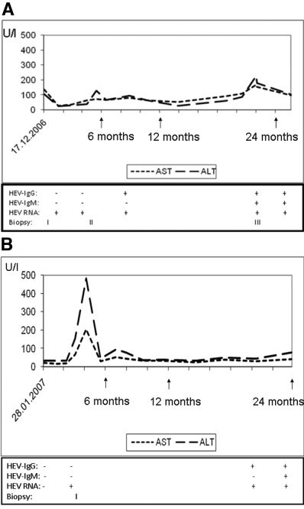
CHRONIC HEV INFECTION in Transplant Recipients
Pischke et. al. LIVER TRANSPLANTATION 2010

Slide 37
RISK AND FACTORS HEV Chronicity in Transplant
Total with Acute HEV Post Transplant- 85
17 Centers in Europe
31% Liver Transplants
Chronicity Rate- 69.5%
Factors in Multivariate Analysis
Tacro > CyA
Low Platelet Count at Time of Diagnosis of HEV
Kamar et al., GASTROENTEROLOGY 2011

Slide 38
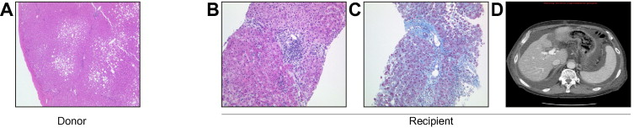
RAPID DISEASE PROGRESSION AFTER OTLTx
1 Year Post-OTLTx
Attributed to Acute Rejection
150 Days Post-Tx
Schlosser et al., J HEPATOL 2012

Slide 39
CHRONIC HEPATITIS IN PATIENTS INFECTED WITH HEV AFTER SOLID ORGAN TRANSPLANTS
Multicenter review of 85 HEV-infected recipients in 17 Centers
56/85 (66%)
Chronic HEV
18 (32%)
Cleared after
dose reduction
18 (32%)
Untreated
20 (36%)
Treated
2
Died
Cirrh.
14
SVR
6
Viremic
13
Viremic
Kamar, N: Gastro 2011;140:1481
CIRRHOSIS: 8/56(14%)

Slide 40
Natural History of Hepatitis E in OTR*
Acute hepatitis characterized by modest ALT elevation- median ~150 U/L (0.5-26 ULN)
Spontaneous clearance occurs in ~40% cases
More frequently among those infected later after the transplantation
Viral clearance not always associated with development of anti-HEV IgG
Reactivation in persons previously exposed (IgG anti-HEV) does not occur- no need for special monitoring
For those with chronic HEV infection cirrhosis can occur within 2-3 years in some cases
*Data from NIH HEV Scientific Workshop, Bethesda, 26 March 2012

Slide 41
HEV IN NIH HIV SOT COHORT
166 pre-transplant subjects
113 awaiting liver transplant Including 10 dual organ candidates
53 awaiting kidney transplant
Adaltis and Wantai EIA
ORF1-2 PCR Amplification
No positives at baseline
Stool not available
%
Sherman et al, J VIRAL HEP (in press)

Slide 42
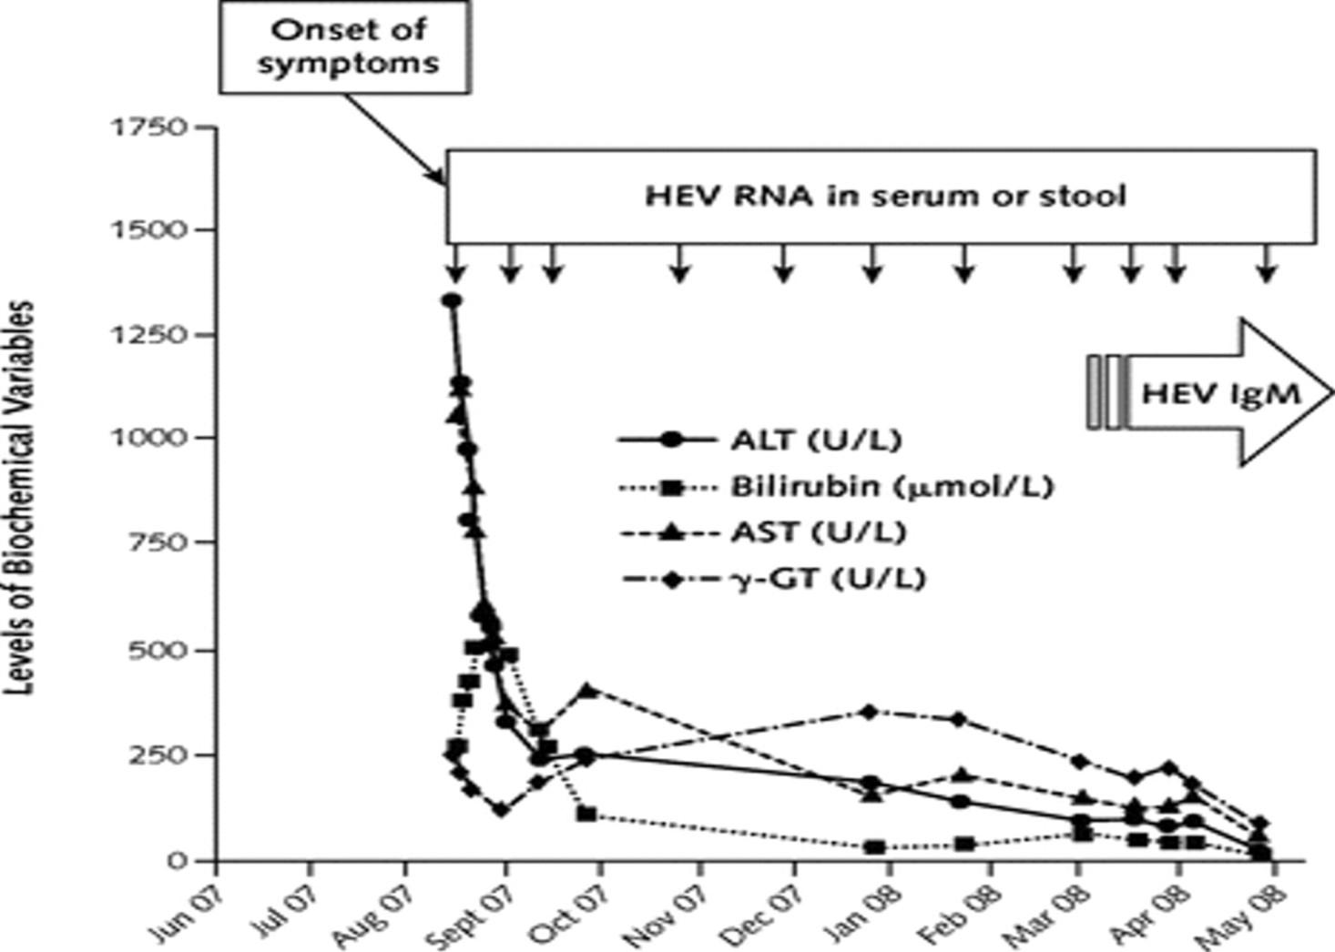
Chronic Hepatitis After Hepatitis E Virus Infection in a Patient With Non-Hodgkin Lymphoma Taking Rituximab
Ann Intern Med. 2009;150(6):430-431.

Slide 43
HEV FOLLOWING LIVER TRANSPLANTATION IN CHILDREN
267 Liver Transplanted Children
22 With Chronic Graft Hepatitis
1 HEV Viremia
Anti-HEV IgG
Negative- MP
Positive- Wantai
Ribavirin
Cure
Junge et al, PED TRANSPLANT, 2013

Slide 45
TREATMENT OF CHRONIC HEV
Pegylated Interferon
Ribavirin
Withdrawal of Immunosuppression
18/56 Cleared HEV with reduced immunosuppression (Kamar et al, GASTRO, 2011)

Slide 48
Hepatitis E Vaccines*
In animal studies, several truncated recombinant HEV capsid protein have been found to induce specific a antibodies, and to protect against liver injury following subsequent challenge with homologous and heterologous strains of the virus.
An HEV DNA vaccine has also been shown to induce serum anti-HEV antibodies in cynomolgus macaques, and protect against a heterologous challenge.
*Aggarval R., JGH 2011; 26; Suppl. 1

Slide 49
Blood Transmitted HEV in Endemic Area (Khuroo M. J GastroHep 2004;19:778)
Retrospective Study
Prospective Study
145 Multiply-Tx
250 Non-Tx
25 Tx
25 Non-Tx
13 (9%) IgM+
HEV RNA+
P<.001
2 (0.8%)
IgM +
HEV RNA+
3/22 (13.6%)
Suscept.HEV Infected
0/25
Suscept.
HEV
Infected
OR= 12
Retro: Tx <3 Mos. Pre-test
Traced to 4 donors
HEV RNA+; IgM+
13/30 (43%) HEV RNA+
P<.001
1/50 (2%) HEV RNA+
OR=37

Slide 50
Hepatitis E: chronic
Almost always in immunocompromised
Organ transplant recipients, chemotherapy, stem cell transplant and HIV5
Associated with eating game, mussels, pork products and liver.
HEV inactivated with heating above 70 centigrade
HEV RNA moderate-to-high levels in serum and stool persisting for years
May have progressive liver disease with fibrosis or cirrhosis
Hoofnagle NEJM 2012;367:1237-44 Kamar Am J transplant 2012;2281-2287
Notes:
Infections in liver transplant via organs or blood transfusions at this time felt to be very low, screening not recommended.
Reactivation of HEV IgG (+) after Tx not reported

Slide 51
HEV Ephemeral?

