Slide 1
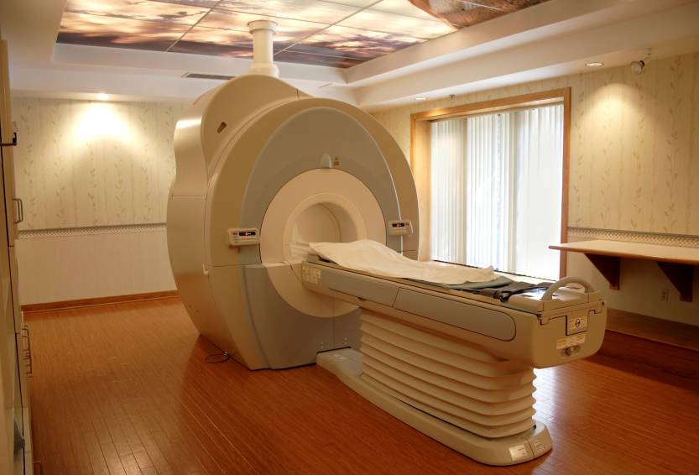
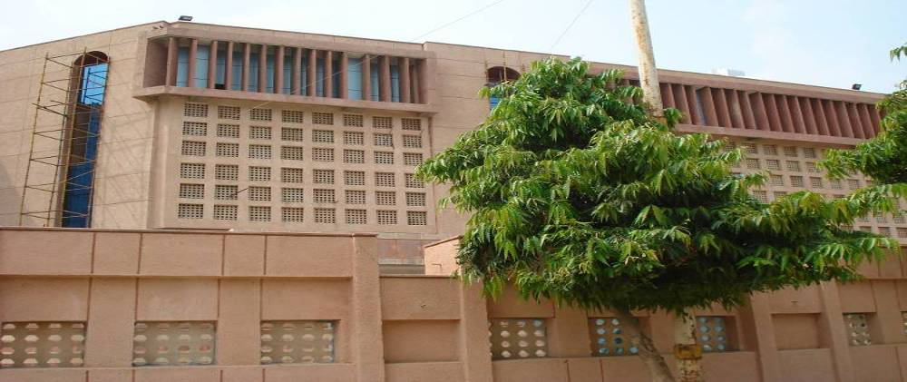


1st Transcaucasian Conference , Georgia 9.14
Institute of Liver & Biliary Sciences
Acute on Chronic Liver Failure: 2014
Dedicated to Excellence in Patient Care,
Teaching & Research in Liver & Biliary Diseases
A Deemed University
Dr. S K Sarin
shivsarin@gmail.com
Vasant Kunj, New Delhi, India
www.ilbs.in

Slide 2

Disclosure
I have no conflict of Interest or disclosures to make
Notes:
The authors do not have any conflict of Interest or disclosures

Slide 3
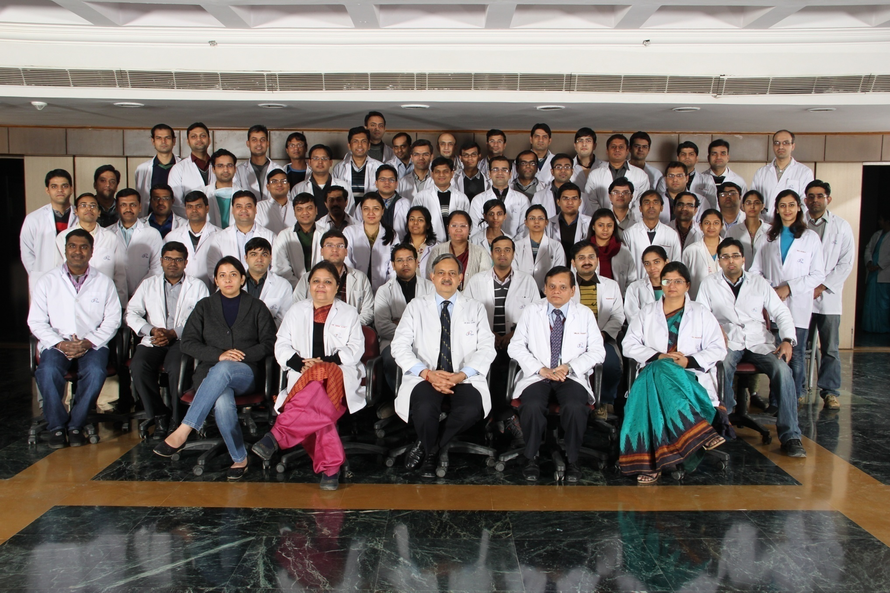

ILBS Residents

Slide 4
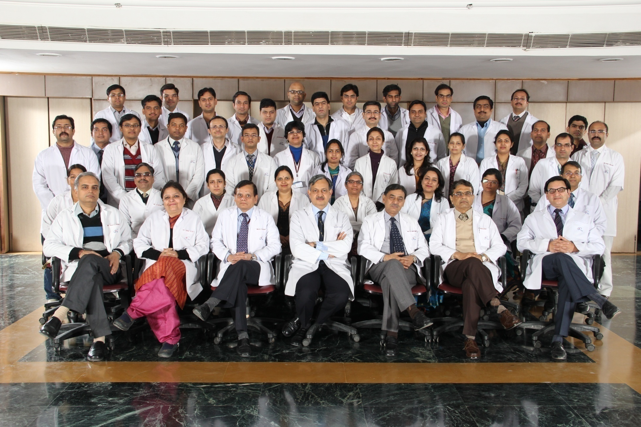
ILBS : Faculty

Slide 5
Institute of Liver & Biliary Sciences
APASL – ACLF
Consensus 2014
APASL- ACLF RESEARCH CONSORTIUM (AARC)

Slide 6
Talking points
ALF vs. ACLF : Definition, Etiology 2014
Etiology, Natural History – 50-60% mortality
Diagnosis
Treatment
Specific : HBV - Tenofovir, Alcohol - Steroid
Complications
HE, Cerebral Edema
AKI, Infection/Sepsis
Role of GCSF
Liver Dialysis
Liver Regeneration
Liver Transplant
www.aclf.in

Slide 7

Liver Failure : Time Line !!
ACUTE LIVER FAILURE: Jaundice + HE
Chronic Liver Failure
French, Chinese
UK/ IASL
US
AASLD
ACUTE LIVER FAILURE
ACUTE LIVER FAILURE
Japanese
No
pre-existing
Liver Disease
8 Wk
26 Weeks
1 Wk 4 Wk
Hyper Acute Sub acute
acute
www.aclf.in

Slide 8
Liver Failure :Time Line !!
ACUTE LIVER FAILURE: Jaundice + HE
Chronic Liver Failure
French, Chinese
UK/ IASL
US
AASLD
ACUTE LIVER FAILURE
ACUTE LIVER FAILURE
Japanese
No
pre-existing
Liver Disease
8 Wk
26 Weeks
1 Wk 4 Wk
Hyper Acute Sub acute
acute
ACUTE ON CHRONIC
Jaundice + Coag+ Ascites
UK
APASL
US
Spontaneously
Decompensated
CLD
CH/
CLD
4 Wk 6Wk 8Wk 12 Wk
2 wk 4 Wk 8Wk 12 Wk

Slide 9
Clinical Case
38 Yr., M
Pulmonary Koch’s,
On anti tubercular treatment
Clinical presentation
On examination
Jaundice+ , Liver span 12 cm, Spleen not palpable
Ascites+

Slide 10
Case 1: On Anti-Tubercular Therapy
Parameters | Day 25
Platelet (thousand/cumm) | 1,56000
Bilirubin (mg%) | 22.5
ALT(U/L) | 212
Creatinine (mg%) | 0.8
Grade of Vx | 0
TJ Liver Biopsy
Serology
www.aclf.in

Slide 11
Case 1: On ATT
Parameters | Day 25
Platelet (thousand/cumm) | 1,56000
Bilirubin (mg%) | 22.5
ALT(U/L) | 212
Creatinine (mg%) | 0.8
Grade of Vx | 0
TJ Liver Biopsy
Serology | HBsAg+, Anti HBe+ IgM HBc –
www.aclf.in

Slide 12
Case 1: On ATT
Parameters | Day 25
Platelet (thousand/cumm) | 1,56000
Bilirubin (mg%) | 22.5
TLC | 9.4
ALT(U/L) | 212
Creatinine (mg%) | 0.8
Grade of Vx | 0
TJ Liver Biopsy
Serology US | HBsAg+, Anti HBe+ IgM HBc – Liver coarse, PV 15.5, Ascites
www.aclf.in

Slide 13
Case 1: On ATT
Parameters | Day 25 | Day 32
Platelet (thousand/cumm) | 1,56000 | 1,43000
Bilirubin (mg%) | 22.5 | 47.0
TLC | 9,400 | 24,000
ALT(U/L) | 212 | 186
Creatinine (mg%) | 0.8 | 1.2
Grade of Vx | 0
TJ Liver Biopsy |  | HAI – 5, F 3
Serology US HVPG | HBsAg+, Anti HBe+ IgM HBc – Liver coarse, PV 15.5, Ascites | 16 mm Hg
www.aclf.in

Slide 14
Case 1: On ATT
Parameters | Day 25 | Day 32 | Day 49
Platelet (thousand/cumm) | 1,56000 | 1,43000 | 98,000
Bilirubin (mg%) | 22.5 | 47.0 | 49.8
TLC | 9,400 | 24,000 | 12.300
ALT(U/L) | 212 | 186 | 88
Creatinine (mg%) | 0.8 | 1.2 | 2.2
Grade of Vx | 0
TJ Liver Biopsy |  | HAI – 5, F 3
Serology US HVPG | HBsAg+, Anti HBe+ IgM HBc – Liver coarse, PV 15.5, Ascites | 16 mm Hg | HE+, HRS
www.aclf.in

Slide 15
Case 1: On ATT
Parameters | Day 25 | Day 32 | Day 49
Platelet (thousand/cumm) | 1,56000 | 1,43000 | 98,000
Bilirubin (mg%) | 22.5 | 47.0 | 49.8
TLC | 9,400 | 24,000 | 12.300
ALT(U/L) | 212 | 186 | 88
Creatinine (mg%) | 0.8 | 1.2 | 2.2
Grade of Vx | 0
TJ Liver Biopsy |  | HAI – 5, F 3
Serology US HVPG | HBsAg+, Anti HBe+ IgM HBc – Liver coarse, PV 15.5, Ascites | 16 mm Hg | HE+, HRS
Patient died of ACLF day 51 with Type 1 HRS, HE and SBP
Should we have diagnosed at Day 25 or 32 !!

Slide 16
Case - 2
36 Yrs, obese, diabetic
No significant past illness
Ascites
Jaundice
Prodrome
0
5
10
15
20
On examination
Jaundice+ , Pedal edema
Ascites+
Liver span 14 cm
Spleen not palpable

Slide 17
Case -2
Parameters | Day 20 | Day 27 | Day 32
Bilirubin (mg%) | 24.2
Albumin (gm%) | 3.1
ALT(U/L) | 682
Creatinine (mg%) | 0.8
Varices | 0
TLC | 11.300
Serology US

Slide 18
Case -2
Parameters | Day 20 | Day 27 | Day 32
Bilirubin (mg%) | 24.2
Albumin (gm%) | 3.1
ALT(U/L) | 682
Creatinine (mg%) | 0.8
Varices | 0
TLC | 11,300
Serology US | IgM HEV+, Liver coarse echo, PV 14.5 mm, ascites +

Slide 19
Case -2
Parameters | Day 20 | Day 27 | Day 32
Bilirubin (mg%) | 24.2 | 36.7
Albumin (gm%) | 3.1 | 2.9
ALT(U/L) | 682 | 324
Creatinine (mg%) | 0.8 | 1.9
Varices | 0
TLC | 11,300 | 26,500
Serology US HVPG | IgM HEV+, Liver coarse, PV 14.5 mm, ascites

Slide 20
Case -2
Parameters | Day 20 | Day 27 | Day 32
Bilirubin (mg%) | 24.2 | 36.7
Albumin (gm%) | 3.1 | 2.9
ALT(U/L) | 682 | 324
Creatinine (mg%) | 0.8 | 1.9
TLC | 11,300 | 26,500
TJ Liver Biopsy |  | HAI – 7, F 3
Serology US HVPG | IgM HEV+, Liver coarse, PV 14.5 mm, ascites | 18 mm Hg

Slide 21
Case -2 AVH-E on NASH
Parameters | Day 20 | Day 27 | Day 32
Bilirubin (mg%) | 24.2 | 36.7 | 38.8
Albumin (gm%) | 3.1 | 2.9 | 3.2
ALT(U/L) | 682 | 324 | 250
Creatinine (mg%) | 0.8 | 1.9 | 3.2
TLC | 11,300 | 26,500 | 19,400
TJ Liver Biopsy |  | HAI – 7, F 3
Serology US HVPG | IgM HEV+, Liver coarse, PV 14.5 mm, ascites | 18 mm Hg
Patient died on day 32 with, Type 1 HRS and Hepatic Encephalopathy

Slide 22

Liver Failure Scenarios
Previously Undiagnosed ....... Previously Diagnosed CLD
Normal liver
Fatty liver
Chronic hepatitis
Compensated cirrhosis
Decompensated cirrhosis
Acute insult
Acute insult
Acute insult
Acute insult
Acute insult
Acute-on-chronic liver failure - HT
?
First decompensation of compensated cirrhosis - NHT
Acute liver failure
Further worsening of decompensated cirrhosis
www.aclf.in

Slide 23
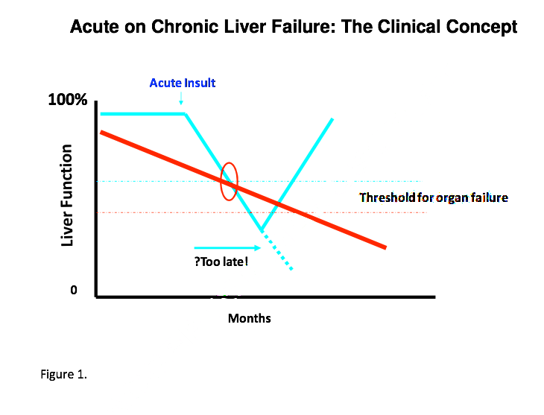
EXTENT OF INJURY AND LIVER RESERVE : ALF vs. ACLF
Threshold for LF & Transplant: ALF
Threshold for MOF
Golden window
www.aclf.in

Slide 24
EXTENT OF INJURY AND LIVER RESERVE : ALF vs. ACLF
Threshold for LF & Tx: ACLF
Threshold for LF & Transplant: ALF
Threshold for MOF
Golden window
Need to asses histoptahological Injury !!

Slide 25
ACLF
Patients Present as ALF but have underlying CLD
Assess reversibility terminology
Need to define acute insult
Need to define the liver failure
Need to define underlying chronic liver disease
Sarin et al Hepatol Intern 2009

Slide 26
Basic concept “ Presentation as ALF in a patient with CLD”
2008
Data Base 20 countries – 200 patients
www.aclf.in

Slide 27
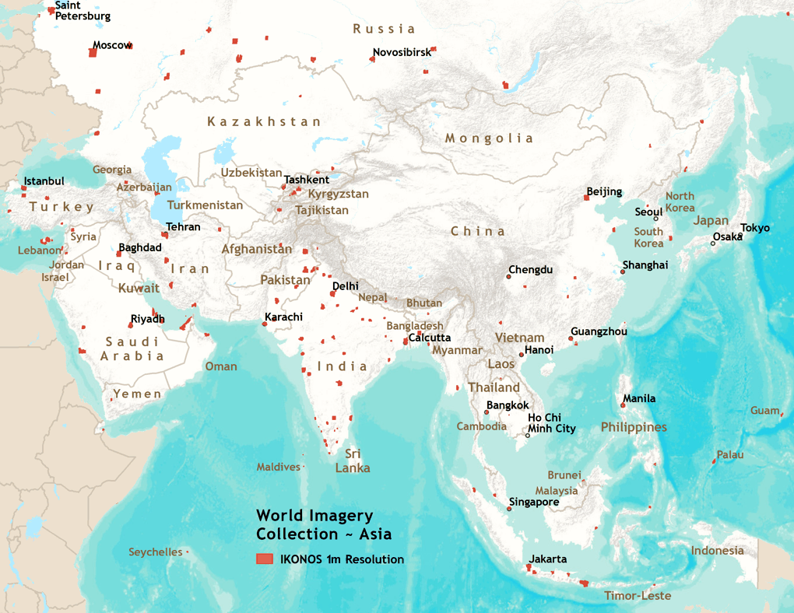
ACLF 2012-13
Armenia: 27
Turkey: 15
Japan: 2
Pakistan: 81
China: 108
South Korea: 68
India: 1120
Bangladesh: 127
Egypt: 25
Hong Kong: 12
Thailand: 52
SriLanka: 16
Malaysia: 75
AARC DATA
Singapore: 16
Indonesia: 4
www.aclf.in

Slide 28
Definition of ACLF - APASL Sarin SK Hep Int 2009 Proposed 2014
Acute hepatic insult manifesting as jaundice (>5mg/dl) and coagulopathy (INR>1.5),
complicated within 4 weeks by ascites and/or encephalopathy
in a patient with previously diagnosed or undiagnosed chronic liver disease.
www.aclf.in

Slide 29
ACLF West : CLIF Definitions
A condition occurring within 4 wk of jaundice and/or an inciting event in patients with CLD with or without cirrhosis which results in hepatic decompensation associated with failure of two or more extrahepatic organs, and results in increased mortality (?) within 3 mo
In previously decompensated, compensated or early decompensated cirrhosis.
Related to SIRS due to bacterial infection, alcoholic injury or other as-yet unidentified mechanisms
Gastroenterology 2013

Slide 30
Definitions : Merits
Summary 1
EASL- AASLD:
Severity of liver dysfunction assessed by extra hepatic organ failure
Prognostic grading
CLIF- SOFA score
APASL:
Clinical easy, definition
Defines acute & chronic insults
Based on and defines liver failure
SEPSIS MUST
NO SEPSIS

Slide 31
Etiology: Acute Insult
Infectious etiology
HBV reactivation
Non- infectious etiology
Alcohol
Unknown
Hepatotoxic drugs, herbs
Flare of AIH, Wilson
HEV, HAV, HCV
Others
www.aclf.in

Slide 32
Etiology: Chronic Insult
Alcohol
Not included
Steatosis
HBV
Cholestatic liver disease
MLD
HCV
NASH, NAFLD
www.aclf.in

Slide 33
How do we diagnose ACLF !
Labs
Biopsy
Endoscopy
HVPG
Other tests
www.aclf.in

Slide 34
Liver biopsy in ACLF
www.aclf.in

Slide 35

Histological predictors of in-hospital mortality-
Ductular Bilirubinostasis
Mallory Hyaline bodies
Presence of bilirubinostasis more commonly associated with risk of subsequent infection in ACLF
Acute-on-chronic liver failure: an early biopsy is essential?
(Jalan R & Mookerjee RP; Gut Nov 2010 Vol 59 No 11)
www.aclf.in

Slide 36
Features indicating Acute insult
www.aclf.in

Slide 37
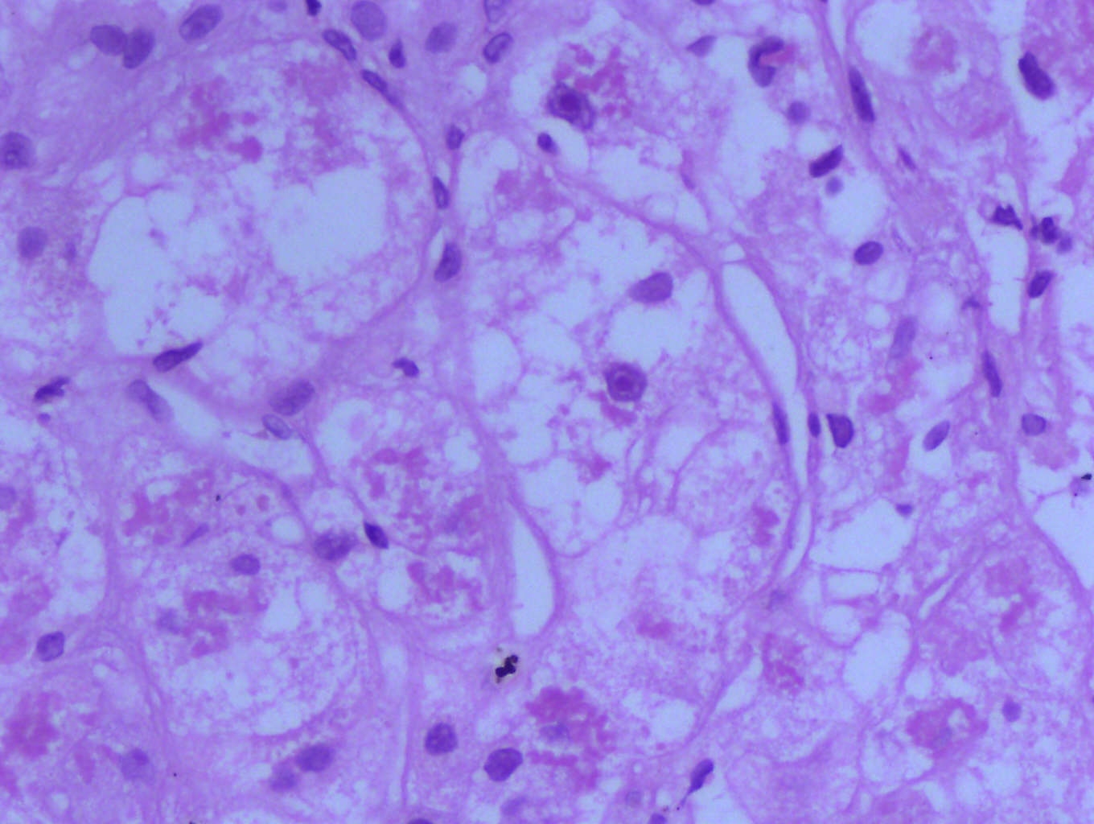
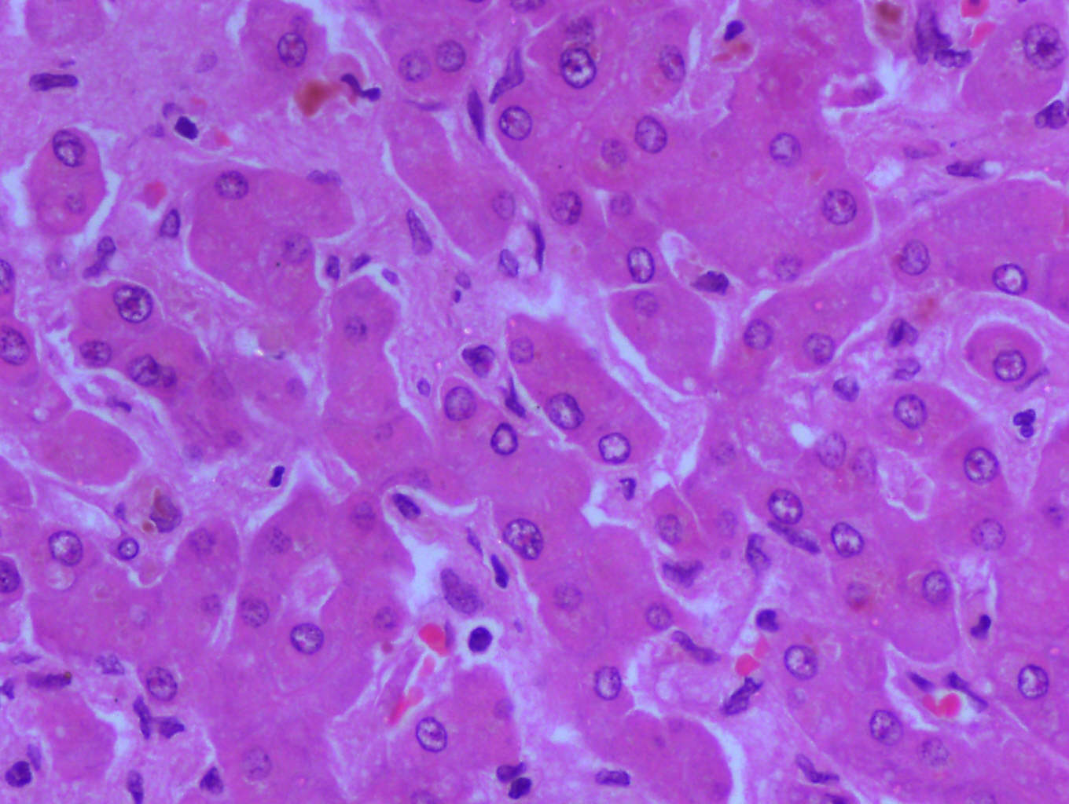
Ballooning degeneration
Eosinophilic degeneration
www.aclf.in

Slide 38
Features indicating Chronic Liver disease
www.aclf.in

Slide 39
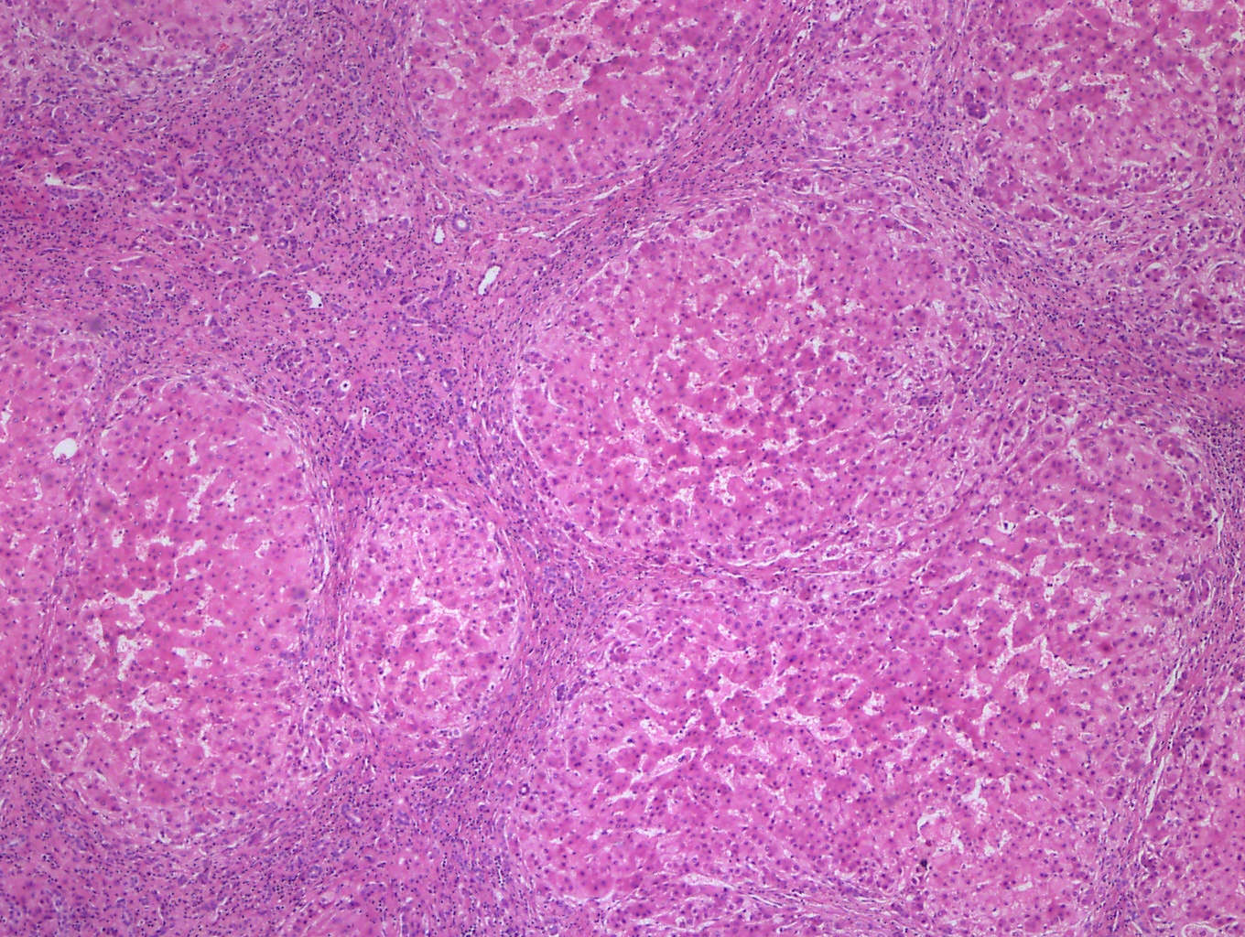
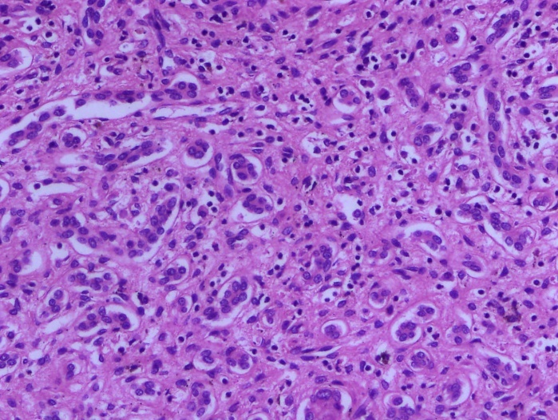
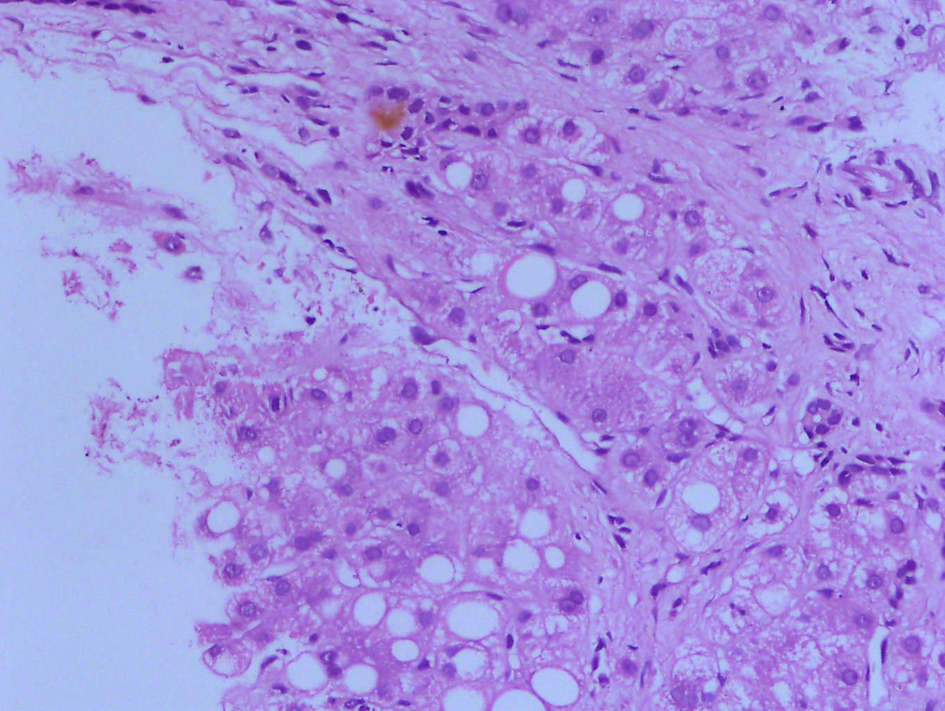
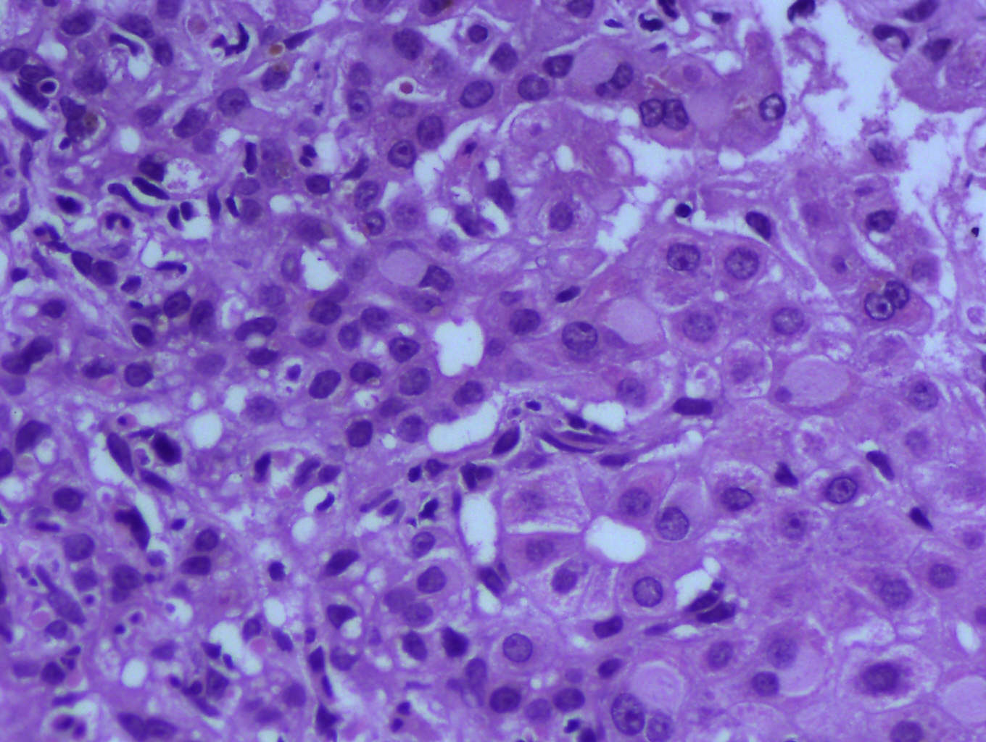
www.aclf.in

Slide 40
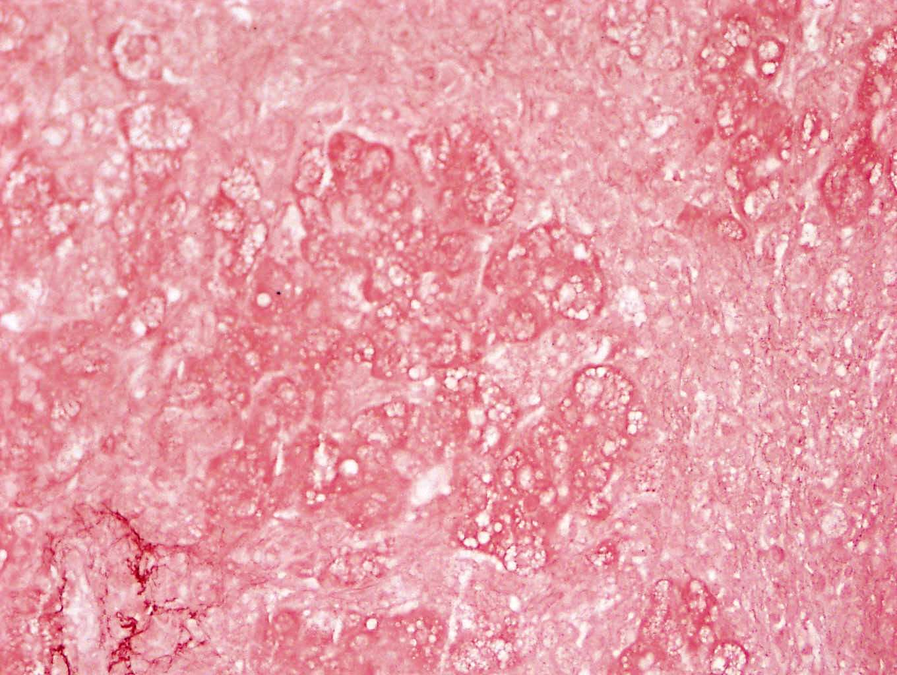
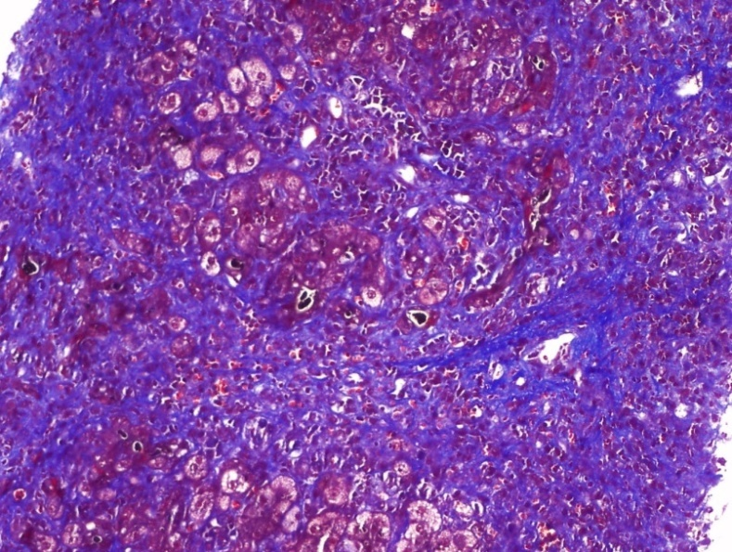
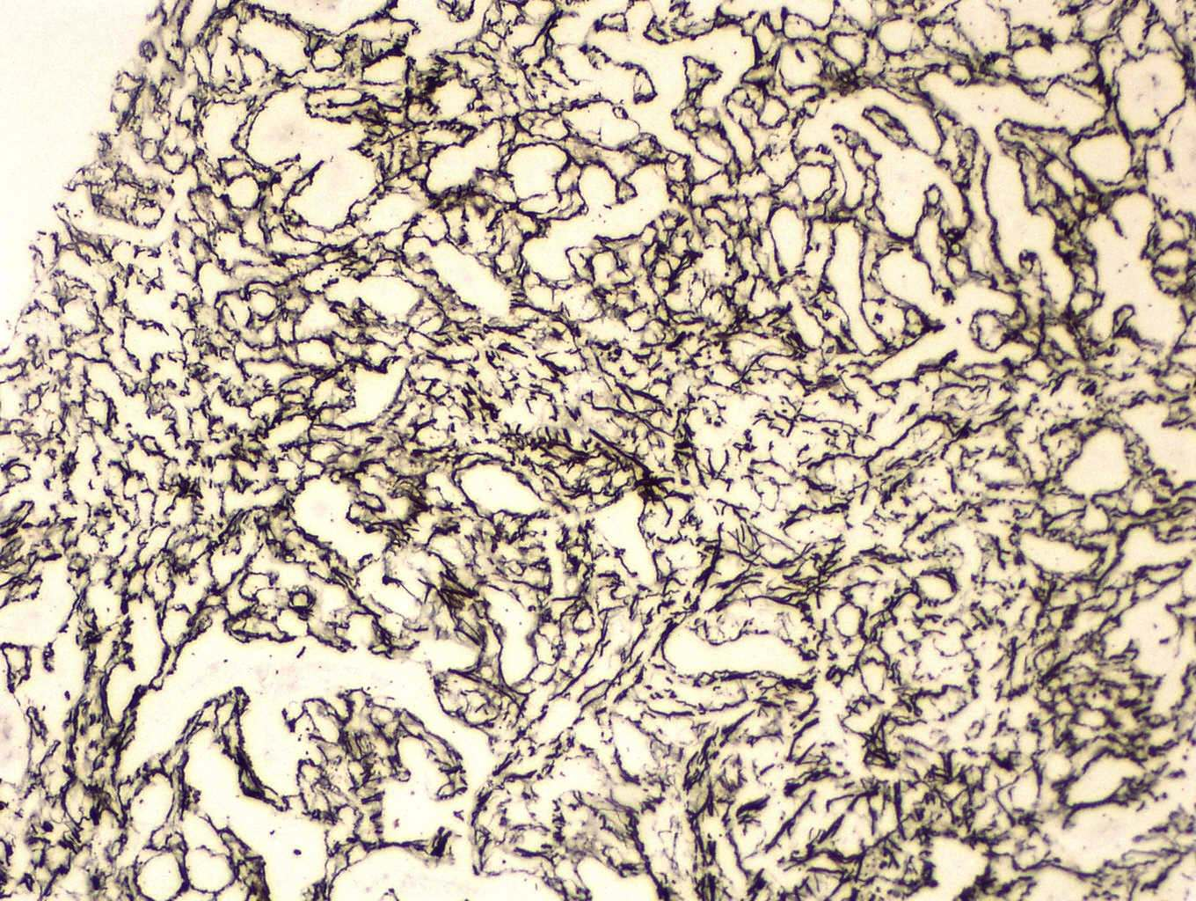
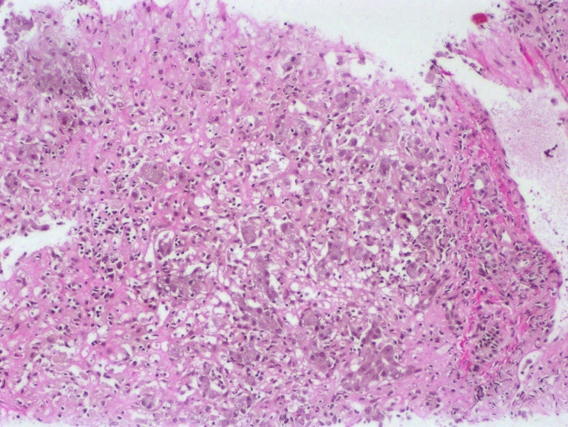
Performing special histochemical stains- Important
Orcein
Masson Trichrome
Reticulin
Van Gieson
www.aclf.in

Slide 41
Talking points
ALF vs. ACLF : Definition, Etiology
Etiology, Natural History – 50-60% mortality
Diagnosis
Treatment
Specific : HBV - Tenofovir, Alcohol - Steroid
Complications
HE, Cerebral Edema
AKI, Infection/Sepsis
Role of GCSF
Liver Dialysis
Liver Regeneration
Liver Transplant

Slide 42
Treatment for ACLF
Liver transplant
Suppress Virus
Tenofovir¹
Definitive therapy
1. Garg V et al., Hepatology 2011;53:774–80.

Slide 43
Results: Survival after 12 wks
Tenofovir improves survival in ACLF due
to HBV Reactivation
Dx: HBV DNA > 2x10(4)
Tenofovir Improves Survival
10/27 (37%) patient
Tenofovir: 8/14 (58%)
Placebo : 2/13 (17%)
p = 0.02
>2 log reduction in 2 weeks , 89% survival,
<2 weeks – 0 survival
Garg V et al., Hepatology 2011;53:774–80.

Slide 44
Treatment Approaches for ACLF
Liver transplant
Suppress Virus
Tenofovir¹
Definitive therapy
1. Ameliorate Liver Injury
2. Prevent Sepsis,
3. Augment Liver regeneration
G-CSF 300 mcg/d²
1. Garg V et al., Hepatology 2011;53:774–80. 2. Garg V et al., Gastroenterology 2012;142:505–512.

Slide 45
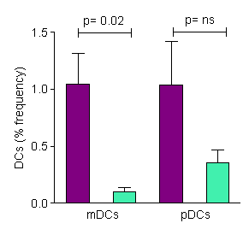
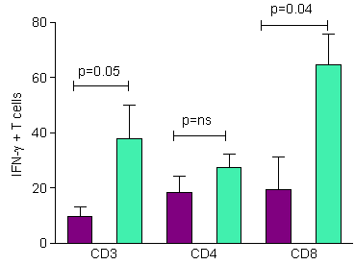


ACLF: survivors vs. non-survivors
Lower frequencies of
DCs in non-survivors
Increased IFN-γ levels in
the liver of non-survivors
Survivor
Non Survivor
Khanam et al Liv Int 2014
Notes:
We also investigated the percentage of dendritic cells and IFN- gamma level in in survivors and compared with the non survivors. Myeloid Dendritic cells were significantly high in survivor group than non survivors. Increase in pDCs was also observed in survivors, indicating potential role of dendritic cells in ACLF. IFN- gamma level was significantly high in non survivors than survivor confirming its role in hepatocellular injury.

Slide 46
Amelioration of Liver Injury by GCSF by recruiting DCs and decreasing IFNr secretion

Slide 47

In ACLF Impaired T cell, DC, neutrophil, monocyte, response

Slide 48
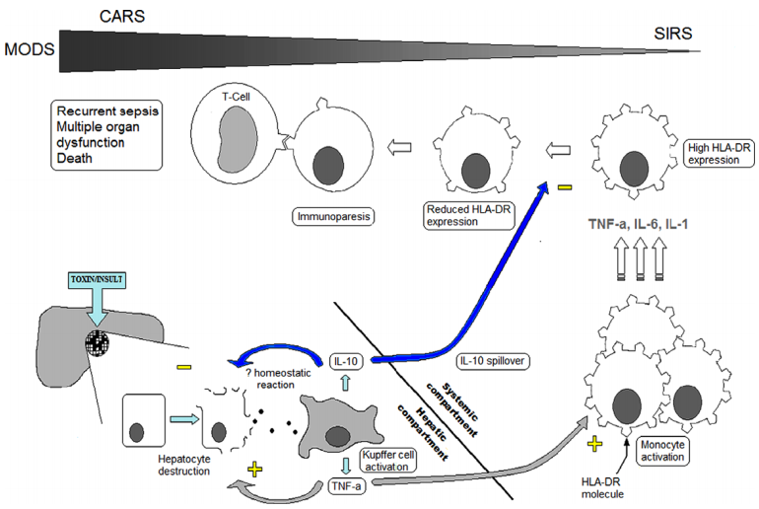
ACLF: Liver Failure leads to Sepsis !
www.aclf.in

Slide 49

Infections in ACLF
Dr. Hasmik Ghazinian
Prompt identification of infections in cirrhosis & institution of appropriate antibiotics is helpful in preventing progression to sepsis, organ failure & mortality. No data, but same analogy could be applied to ACLF (3a, C)
It is difficult to differentiate SIRS from early sepsis (1b, A)
Non-hepatic infections are common in ACLF (1a, A)
www.aclf.in

Slide 50
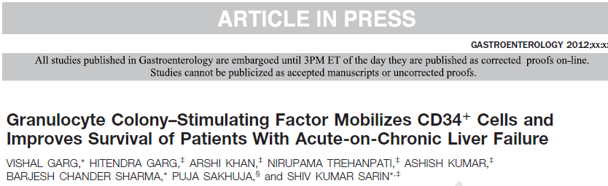
Prevention of Sepsis
Garg V et al., Gastroenterology 2012;142:505–512.

Slide 51
Post GCSF Development of HRS, HE, sepsis improved
P=0.009
P=0.02
P=0.03
3: SBP
4: Chest infection
Garg V et al., Gastroenterology 2012;142:505–512.

Slide 52
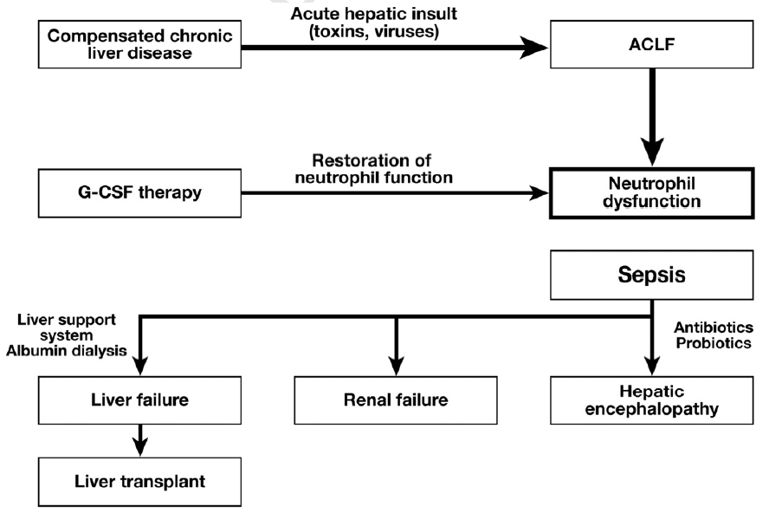
Mechanism of GCSF Therapy in ACLF
Improved DC Function
Garg et al Gastroenterology 2012

Slide 53
Organ Dysfunction in ACLF
Kidney and Brain
SIRS, high bilirubin and HE have increased risk of
development and progression of AKI. (3b, C)
Vasoconstrictor are less effective in ACLF who have
volume non-responsive AKI or HRS (3b, B)
HE is seen in 40-50% of the ACLF patients (2b, C)
Lactulose, rifaximin, NH3 lowering strategies (1a, B)
www.aclf.in

Slide 54
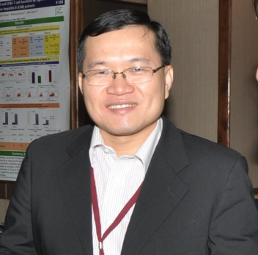
Organ Dysfunction in ACLF
Dr. Guan Huei Lee
Hepatic Encephalopathy
HE is present in about 40-50% of the ACLF patients (2b, C)
Grade III-IV HE is associated with increased mortality (2b, B)
MRI/CT brain may help in ACLF with Gr. III-IV HE when intracerebral hemorrhage or other brain pathology is suspected
(3b, C)
Lactulose, rifaximin, NH3 lowering strategies remain the main therapy for HE (1a, B); more evidence is needed in ACLF
www.aclf.in

Slide 55
Treatment options for ACLF
Liver support dialysis
Liver transplant
Suppress Virus
Tenofovir¹
Definitive therapy
Bridge
Ameliorate Liver Injury and prevent Sepsis, Augment Liver regeneration
G-CSF 300 mcg/d²
1. Garg V et al., Hepatology 2011;53:774–80. 2. Garg V et al., Gastroenterology 2012;142:505–512.

Slide 56
Alternatives to liver transplant in ACLF

Slide 57
Liver dialysis in ACLF

Slide 58
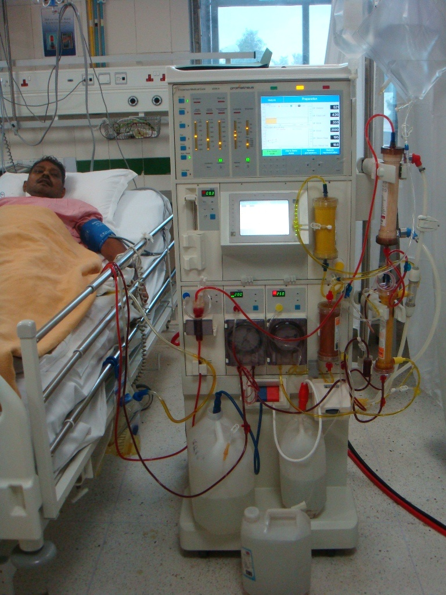
Liver Dialysis Treatment
at ILBS (PROMETHUS)

Slide 59
Liver dialysis (n=52) : MELD Score
MELD median (range)
Pre-dialysis | Post-dialysis (n=19)
35( 12-57) | 29 ( 13-47)

Slide 60
ACLF : Liver Transplant Approach
ACLF
MELD>30
ACLF
MELD<30
MELD SCORE <30
LIVER DIALYSIS
LIVER TRANSPLANT
Concept slide based on Ling et al 2012

Slide 61
Alternatives to liver transplant in ACLF Liver Regeneration

Slide 62
Liver Regeneration by GCSF
Garg V et al., Gastroenterology 2012;142:505–512.

Slide 63
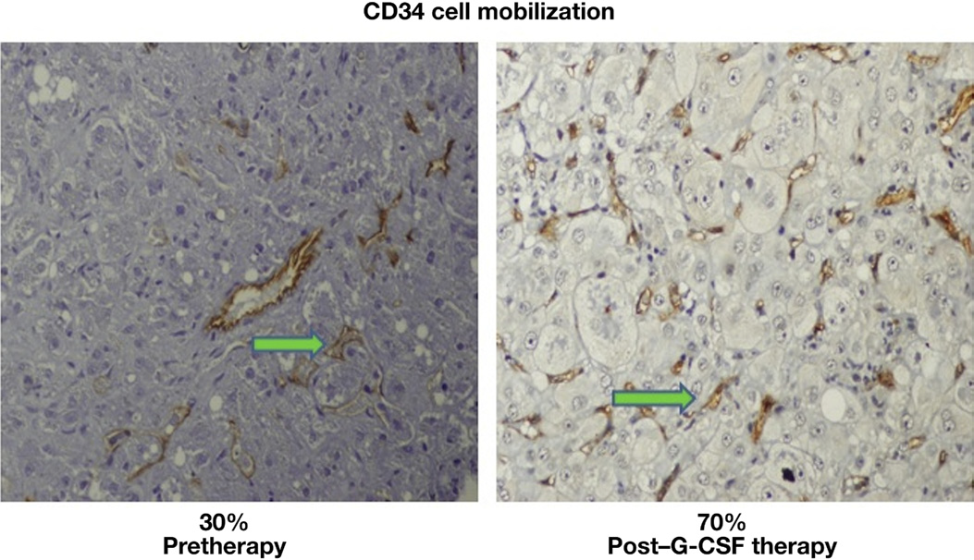
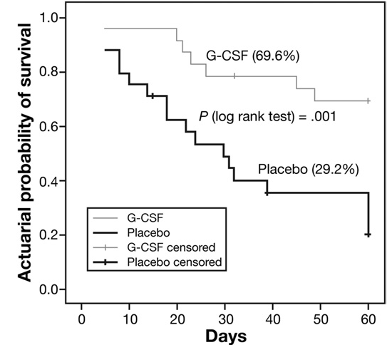
G-CSF mobilizes CD34 cells and improves survival of patients with ACLF
Untreated ACLF, 70% die in 2 mo
300 mcg/d sc, 12 doses of GCSF
Garg et al . Gastroenterology 2012

Slide 64
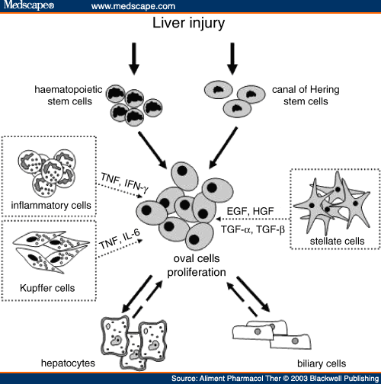
In vivo liver regeneration & immune restoration: Role of G-CSF
G-CSF
Macrophages/ Monocytes
Garg et al . Gastroenterology 2012
Notes:
Acute hepatic insult leads to mobilization of HSC and proliferation of canal of hering stem cells. This leads to oval cell proliferation and ultimately to hepatic regeneration. G-CSF therapy induces proliferation of HSC, or may directly stimulate hepatic regeneration thru activation of hepatic stellate cells

Slide 65
G-CSF + Erythropoeitin

Slide 66
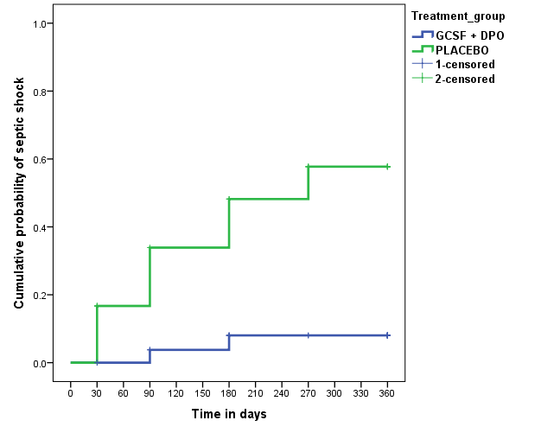

Probability of sepsis in Decompensated cirrhosis
Chandan et al (under review)

Slide 67
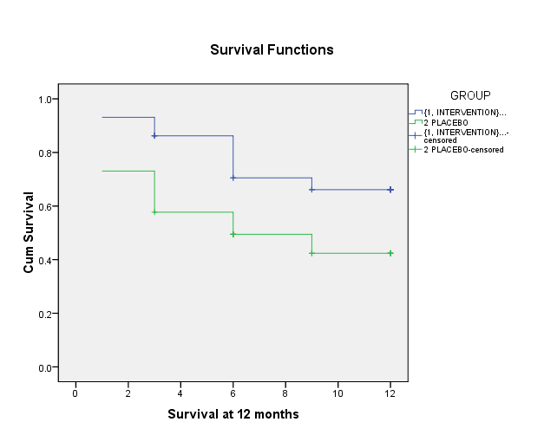
Transplant free survival
P=0.04
68.9%
46.2%
Kumar C et al unpublished data

Slide 68
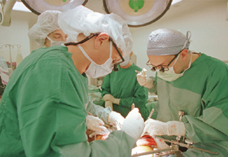
Liver transplantation: The final savior
www.aclf.in

Slide 69
Transplant Data from HongKong
Fan ST et al., Hepatol Int 2009
 | FHF (n=37) | Acute exacerbation of HBV (n=50) | Cirrhosis with AD (n=99) | Cirrhosis (n=301)
Early complication | 70% | 62% | 70% | 52.5%
Post-op hemodialysis | 5.4% | 10% | 11.1% | 0%
ICU days > (median) | 6 | 6 | 5 | 4
Hospital mortality | 2.7% | 4% | 5.1% | 7%
One-year overall survival | 97% | 96% | 95% | 90%
Five-year overall survival | 92% | 93% | 90.5% | 79.3%

Slide 70
ILBS Liver Transplant Program
Total | 156
DDLT | 6
LDLT | 150
ACLF | 13 (10 survived)
Most economical : 11.5 Lacs,
>90% success

Slide 71
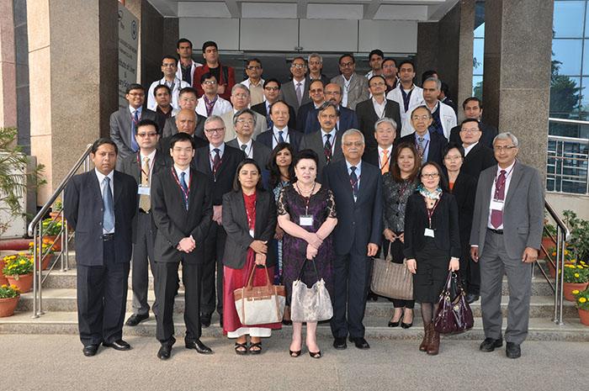
www.aclf.in
February 22-23 , 2014

Slide 72
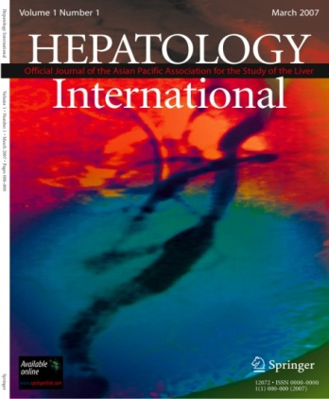
Institute of Liver & Biliary Sciences
Summary:
ACLF: 2014 Perspectives
www.ilbs.in
ALF – Coagulopathy + Jaundice + HE, 4 wk
ACLF – Coag + Jn. + ascites/HE 4 wk, 55% 4 wk mort.
Acute : Alcohol, HBV reactivation, HEV, ATT, drugs
Chronic : Alcohol, HBV, Cryptogenic, HCV
TJLB – diagnosis, prognosis
Treatment : Tenofovir, NAC, Rx of AKI, HE
Prevent sepsis - GCSF – recruits DC, neutrophil, monocyte function, ↓rIFN, prevents liver injury, sepsis, CD34+ enhances regeneration
Liver dialysis – a bridge, reduces MELD
Transplant – best <30 MELD, 90% 5 yr survival
ACLF Consensus 2014
shivsarin@gmail.com

