Slide 1



Management of HCV in Children
Manal Hamdy El-Sayed
Professor of Pediatrics
Ain Shams University
Egyptian National Committee for
Control of Viral Hepatitis
Liver Symposium, Georgia, October 12th-13th 2012

Slide 2

Key Points
Epidemiology
Hepatitis C in high risk children
Natural History
Treatment

Slide 3
Why HCV in Children?
Infection is mostly asymptomatic
Children do not undergo biochemical testing or donate blood
Many children with HCV have normal ALT values
Risk factors are not known or sought by care-providers
Extrahepatic manifestations are rare
Pediatricians do not consider HCV infection

Slide 4
Egyptian Children at Risk for HCV Infection
Recurrent blood or blood product transfusion or multiple invasive procedures
Adolescents with high risk behavior (illicit drug use)
Children born to HCV-infected mothers
Children with an infected house-hold member in Egypt

Slide 5
i
Standards of Care in Egypt
(Hepatitis C Prevention)
National screening of blood for HCV started 1993 (ELISA)
Only 15% of blood is screened by NAT
Pregnant women are not routinely screened for anti-HCV
Weak infection control programs (MOH-ICP started in 2003) or harm reduction interventions for IDU
No national registry (MOH epidemiological surveillance unit since 1999)
Antiviral treatment not supported by the Government (except for adults since 2007)

Slide 6

HCV National Survey: DHS 2008
Prevalence of HCV in Egypt 2008
Percentage of HCV-infected individuals between 15-59 years
Anti-HCV prevalence:
-15 years 3.8%
-19 years 4.9%
www.measuredhs.com/pubs/pdf/FR220/FR220.pdf

Slide 7
Geographic Distribution of HCV in Egypt
Mediterranean Sea
†
Lower Egypt
11.5%
Cairo
6.2%
N
Upper Egypt
10.2%
Red Sea
EGYPT

Slide 8
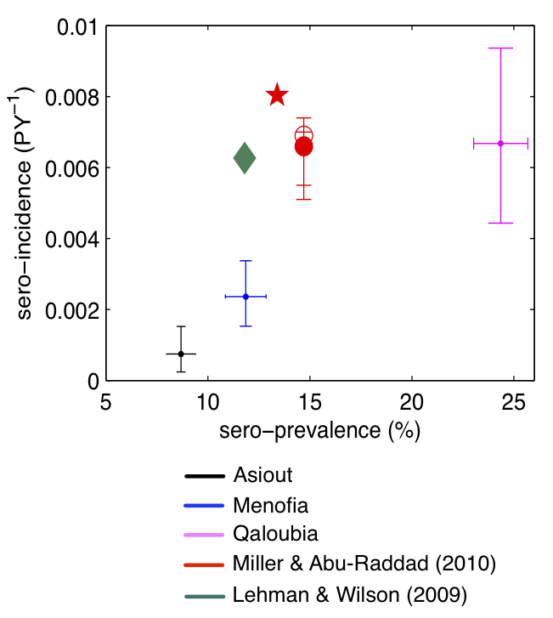
High HCV incidence
Estimated at 2‰ / year at national level,
Corresponding to
165 000 new infections per year.
Berban et AL, J Viral Hepatitis, 2012

Slide 9
HCV Prevalence Studies in Children
A prospective study in 3 Egyptian villages examined incidence of community-acquired infection in children
2852 uninfected infants were prospectively followed from birth for up to 5.5 years
The incidence rate at all ages was 2.7/1000 person-years (PY).
It was 3.8/1000 PY during infancy and 2.0/1000 PY for the 1-5-years age group
Saleh et al, Trans R Soc Trop Med Hyg. 2010

Slide 10
HCV Prevalence Studies in Children
A prospective cohort study determined perinatal HCV in 1,863 mother-infant pairs in rural Egyptian villages.
This study found 15.7% and 10.9% of pregnant women were anti-HCV and HCV-RNA +ve, respectively.
Among 329 infants born of these mothers, 33 (10.0%) WERE +ve for both anti-HCV and HCV-RNA 2 months following birth-29 (12.5%) having HCV-RNA positive mothers and 4 (with transient infections) having mothers with only anti-HCV.
Shebl et al, J Med Virol, 2009

Slide 11
HCV Prevalence Studies in Children
1042 children 1-9 years were screened for anti-HCV . Children with elevated ALT and/or detectable antiHCV were tested for HCV RNA and compared with two negative controls.
Asymptomatic HCV infection was detectable in 2.02% Egyptian children El-Raziky et al, WJG 2007
692 children with type 1 DM and 1042 non-diabetic children were screened for anti-HCV
Anti-HCV prevalence in diabetic children below 9 years of age was comparable to that of non diabetic children (2.5% vs. 1.4%; p=0.25). El-Karaksy et al, Curr Diabetes Rev. 2010

Slide 12
Perinatal and Intrafamilial Transmission
A cohort study in Egypt following infants born to HCV-RNA+ mothers for 4 yrs revealed <1% transmission vertically and another 1% during the 2 yrs following delivery (Stoszek, 2002)
HCV intrafamilial clustering was reported more from sibling-sibling (31%) and to a lesser extent from mother-child (23%), Father-child (12%) or husband-wife (6%) (Plancoulaine et al, 2008)

Slide 13
Clinical Features of
HCV Infection in Children
Acute infection is rarely symptomatic
Chronic infection is rarely symptomatic
- Chronic fatigue may be difficult to assess
- Extrahepatic manifestations are much less
common than in adults

Slide 14
Fibrosis in Chronic HCV Acquired in Infancy – “…a matter of time?”
Biopsies from 112 pediatric patients with chronic HCV
Results: Sex, genotype and route of infection did not correlate with stage of fibrosis
Age of patients at time of biopsy (p < 0.002) and duration of infection (p < 0.0005) correlated with stage of fibrosis
Guido et al. Amer J Gastroenterol 2003;98:660-3

Slide 15
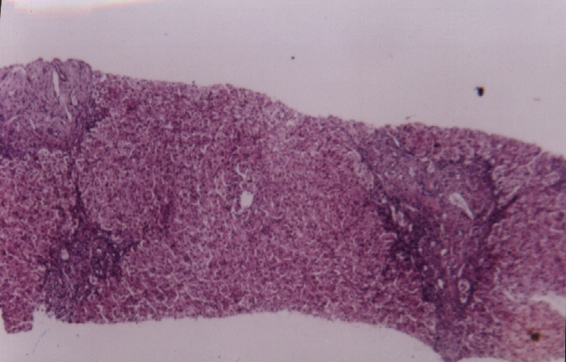
Natural History of HCV Infection in Children-
Critical Issues
Reactivation
Distension of portal tracts with lymphocytic infiltrate. Foci of
piece meal necrosis. Fibrous tissue expansion of portal tracts.
Grade 10/18, Stage 3/6
A 10 yr old with relapsing ALL and HCV-related reactivation

Slide 16
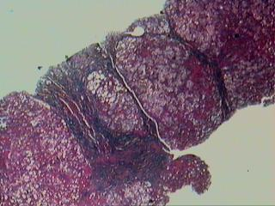
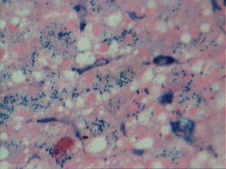
Natural History of HCV Infection in Children-Critical Issues
Iron
HCV-infected female (16 years old)
cured of Wilm’s Tumor 9 years before
Ishak score: Modified HAI: 9/18.
Fibrosis score: 5/6.
METAVIR score: A3F3.

Slide 17
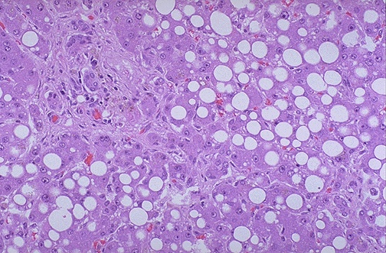
Natural History of HCV Infection in Children-Critical Issues
Steatosis
Female 16yrs old, diabetic for 11yrs, HBA1C 8.8%, HCV +ve

Slide 18
PEDS-C Baseline Histology
Liver biopsies in 121 children before treatment revealed moderate or severe inflammation in 41%.
5 had bridging fibrosis and 2 (1.7%) had cirrhosis.
Inflammation correlated with fibrosis and ALT, but not age, BMI or genotype
Steatosis correlated with ALT and BMI.
Overweight children had more fibrosis.
Goodman Z et al. Hepatology 2008;47:836-43

Slide 19
Natural History of HCV Infection in Children-Summary
May be different in children infected by transfusion vs those infected perinatally
May be different according to underlying disease for which transfusion was indicated
Benign in the first 20-25 yrs in most instances: a few have aggressive disease
Not known in the third decade and beyond

Slide 20
HCV in Childhood
“Goals of Therapy”
Sustained normalisation of ALT
Sustained virologic response
Improvement in hepatic histology
Decrease risk of cirrhosis
Decrease risk of HCC

Slide 21
Rationale to Treat HCV
during Childhood
Higher SVR rate in older studies using conventional IFN
Cost advantage using weight-based and BSA-based dosing
Relative absence of co-morbid factors
Benefits of eradicating HCV before risky behaviors associated with transmission
Better tolerance of medications (?)
Excellent compliance with treatment

Slide 22
Chronic HCV in Children
Treatment
IFN-alfa2b and ribavirin combination was the only approved therapy (since 2003)
Peginterferon-alfa2b with ribavirin was FDA approved for children beginning at age 3 years in the U.S. December 2008
Peginterferon-alfa2a with ribavirin was
FDA approved for children beginning at age 5 years August 2011

Slide 23
Peginterferon and ribavirin
Open-labeled, uncontrolled pilot study*, 61 children and adolescents
  peginterferon alfa-2b at 1.5 g/kg weekly, plus
  oral ribavirin (15 mg/kg × day) for 24 or 48 weeks.
Sustained viral response in
  22 (47.8%) of 46 patients with genotype 1
  13 (100%) of 13 with genotype 2 or 3
  1 of 2 with genotype 4
*Wirth S, et al. Hepatology 2005;41(5):1013

Slide 24
Schering-Plough Pediatric Trial
107 Treatment Naïve Children
3 to 17 years of age
PEG α_{2b} 1.5 mcg/kg/week
Ribavirin 15 mg/kg/day
GT 1, 4
GT 3, HVL*
GT 2
GT 3, LVL
48 weeks
24 weeks
*HVL: >600,000 IU/ml

Slide 25
Schering-Plough Pediatric Trial
GT 1, 4
GT 3 HVL
GT 2
GT 3 LVL
55% SVR
96% SVR

Slide 26
FDA approved dose recommendations
In the pediatric population, the recommended dose of PEGINTRON is 60 mcg/m2/week subcutaneously in combination with 15 mg/kg/day of REBETOL orally in two divided doses.
The treatment duration for patients with HCV genotype 1 is 48 weeks and for patients with HCV genotype 2 or 3 it is 24 weeks.

Slide 27
FDA approved recommendations
Patients receiving PEGINTRON combination therapy (excluding those with HCV genotype 2 or 3) should be discontinued from therapy at week 12 if their HCV RNA dropped less than 2 log10 compared to pretreatment or at 24 weeks if they have detectable HCV RNA at treatment week 24.

Slide 28

C- Free Child
Funded through the Egyptian Liver Care
Society and Sawiris Foundation under the
supervision of the NCCVH
Six treatment centers: (Cairo Liver Institute
(TMRI), Ain Shams University, Cairo University,
Mansoura University, Menoufia Liver Institute
and Assiut University)
322 children were recruited in a 3 months period
and the first injection was given June 12th 2010

Slide 29
Inclusion Criteria
Age 3-18 years
Hb > 10 gm/dL
Neutrophil count > 1500/mm³
Platelets > 75000/mm³
Random blood glucose WNL
ALT above ULN on 2 occasions at least 2 months apart
Albumin > 3.5 gm/L
PT < 3 sec above ULN
Creatinine WNL
TSH WNL
ANA < 1/40
HBsAg negative
HCV-Ab positive
HCV-RNA positive
Liver biopsy showing HAI > 3/18 and/or > F 1 (Ishak score)
Signed informed consent

Slide 30
Exclusion Criteria
BMI > 95th percentile (Egyptian Growth Curves)
Uncontrolled diabetes (HbA1C > 6.5)
Multitransfused (s ferritin > 500)
Major CNS trauma or seizures requiring medications
Decompensated heart disease
Evidence of retinopathy
Psychiatric disorders
Autoimmune disease (ANA)
Steroids or immunosuppressive therapy
Substance abuse (alcohol, IV drugs, ….)
Hypersensitivity to interferon or ribavirin
Interferon therapy within 1 year
Any cause of liver disease other than HCV
Co-infection with HBV
Alpha one antitrypsin deficiency
Wilson's disease
Decompensated liver disease
Autoimmune hepatitis
Hemosiderosis by liver biopsy
Others

Slide 31
Adverse Events
0- Asked but negative response
1- Mild (does not interfere with daily activity)
2- Moderate (interferes with daily activity)
3- Severe
4- Life-threatening

Slide 32
Center | W 0 No | W 12 Total Responders No (%) |  | W 24 Total Responders No (%) |  | W 48 Total Responders No (%)
NHTMRI (A1) | 48 | 47 | 33(68.8) | 33 | 28(58.3) | 28 | 26(54.2)
NHTMRI (A2) | 71 | 70 | 48(67.6) | 47 | 35(49.3) | 35 | 34(47.8)
AbuReish (B) | 40 | 40 | 23(57.5) | 23 | 22(55) | 22 | 21(52.5)
Ain Shams (C) | 48 | 48 | 30(62.5) | 29 | 26(54.2) | 25 | 24(50)
Mansoura (D) | 49 | 49 | 32(65.3) | 32 | 27(55.1) | 27 | 24(49)
Menoufia (E) | 48 | 47 | 37(77.1) | 37 | 33(68.8) | 30 | 30(62.5)
Assiut (F) | 18 | 17 | 12(66.7) | 12 | 9(50) | 9 | 8(44.4)
Total | 322 | 318 | 215(66.8) | 213 | 180(55.9) | 176 | 167(51.8)

Slide 33
Suggested Management of HCV in Children
Child > 3 years
with positive anti-HCV
HCV
infection
confirmed?
PCR negative
PCR positive
Repeat in
6-12 months
General measures
PCR negative
Treatment
Indicated?
STOP

Slide 34
Interferon
contraindications?
No
Yes
Consider liver bx
STOP
Fibrosis
Stage 0
Fibrosis
> Stage 0
Consider deferring treatment
Consider treatment
Treat obesity/insulin
resistance first
Examine school and other
Activities
Assure patient compliance
Provide appropriate support
Peginterferon + ribavirin

Slide 35
Chronic Hepatitis C in Children:
Therapeutic Challenges
Timing of therapy
  Mild disease
  Very good compliance
  Very good tolerance of therapy
Management of non-responders
  Access to new therapies
Treatment of adolescents with active substance abuse
Treatment of children with iron overload

Slide 36
Management of Chronic Viral Hepatitis: General Measures
Avoid Transmission to Others
  Avoid sharing of razors, toothbrushes, nail clippers
  Blood precautions
  Sexual precautions for HBV
Delay Progression of Liver Disease
  Hepatitis A and (Hepatitis B) immunizations
Do not exclude children from work, school, play, child-care or other settings based on HCV infection status
Tell the school nurse???

Slide 37
What is needed?
National awareness and screening program
National registry
Vaccination against HAV and HBV
Special programs for adolescent IVDUs and orphans
Strict infection control procedures in hematology/oncology settings
Legislative procedures

Slide 38
Important issues that need to be addressed
Managing blood draws and home injections
Child stigma
Strict infection control procedures in the
hematology setting
Family screening
Government support for HCV treatment in children

Slide 39
Summary
CHC in children shares some features as with adults
Risk factors, natural history, treatment goals may be different
Children with CHC may have advanced liver disease and significant fibrosis
Children will benefit from therapy with peg-interferon and ribavirin
The challenges are to identify those children and select the best regimen

Slide 40
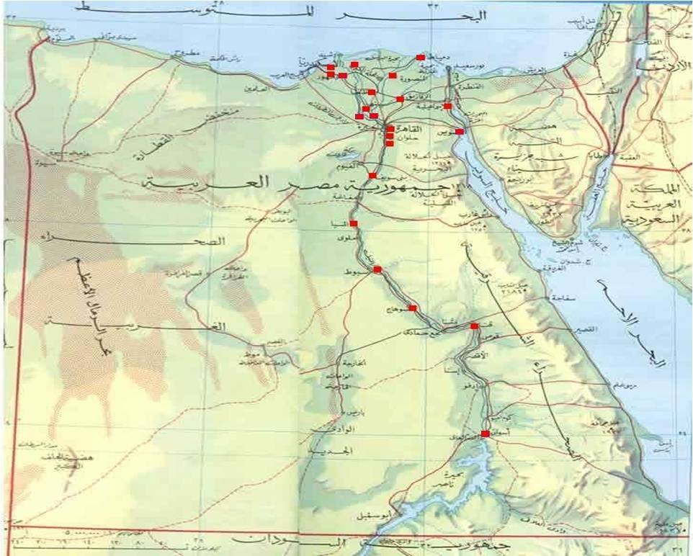
HCV treatment centers

Slide 41

THANK YOU
Egyptian Folk Dancer

