Slide 1
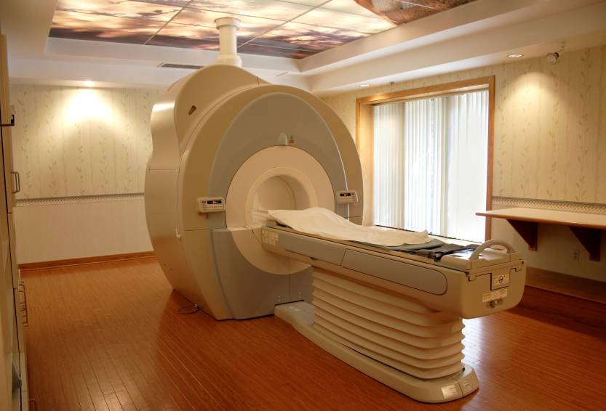
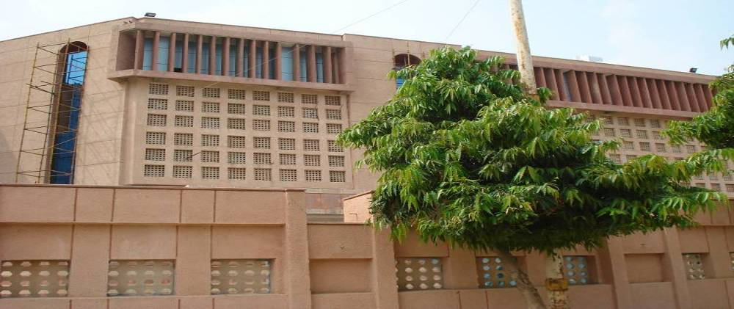

Georgia 9.14
Institute of Liver & Biliary Sciences
Acute Variceal Bleed: New Management Paradigms
A Deemed to be University
Dr S K Sarin
shivsarin@gmail.com
Future of Hepatology
New Delhi, India
www.ilbs.in

Slide 2
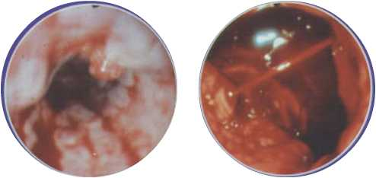

43 y old man with hemetemesis

Slide 3
Endoscopy : Spurt, Nipple sign, Collapsed varices

Slide 4
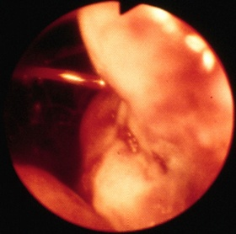
GOV1 Bleed

Slide 5
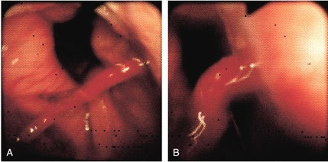
Varix in Hiatus hernia

Slide 6
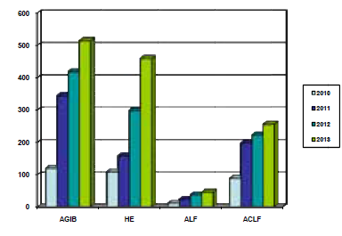
Acute Variceal Bleed (AVB)
ILBS Data

Slide 7

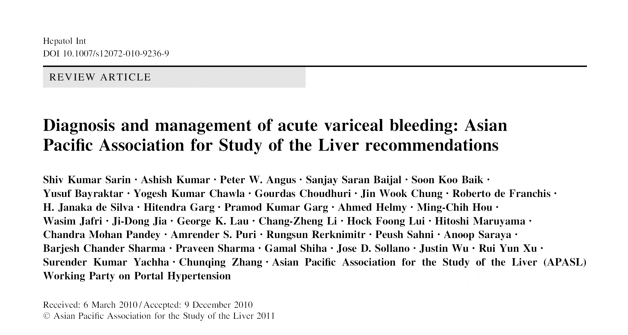

Slide 8
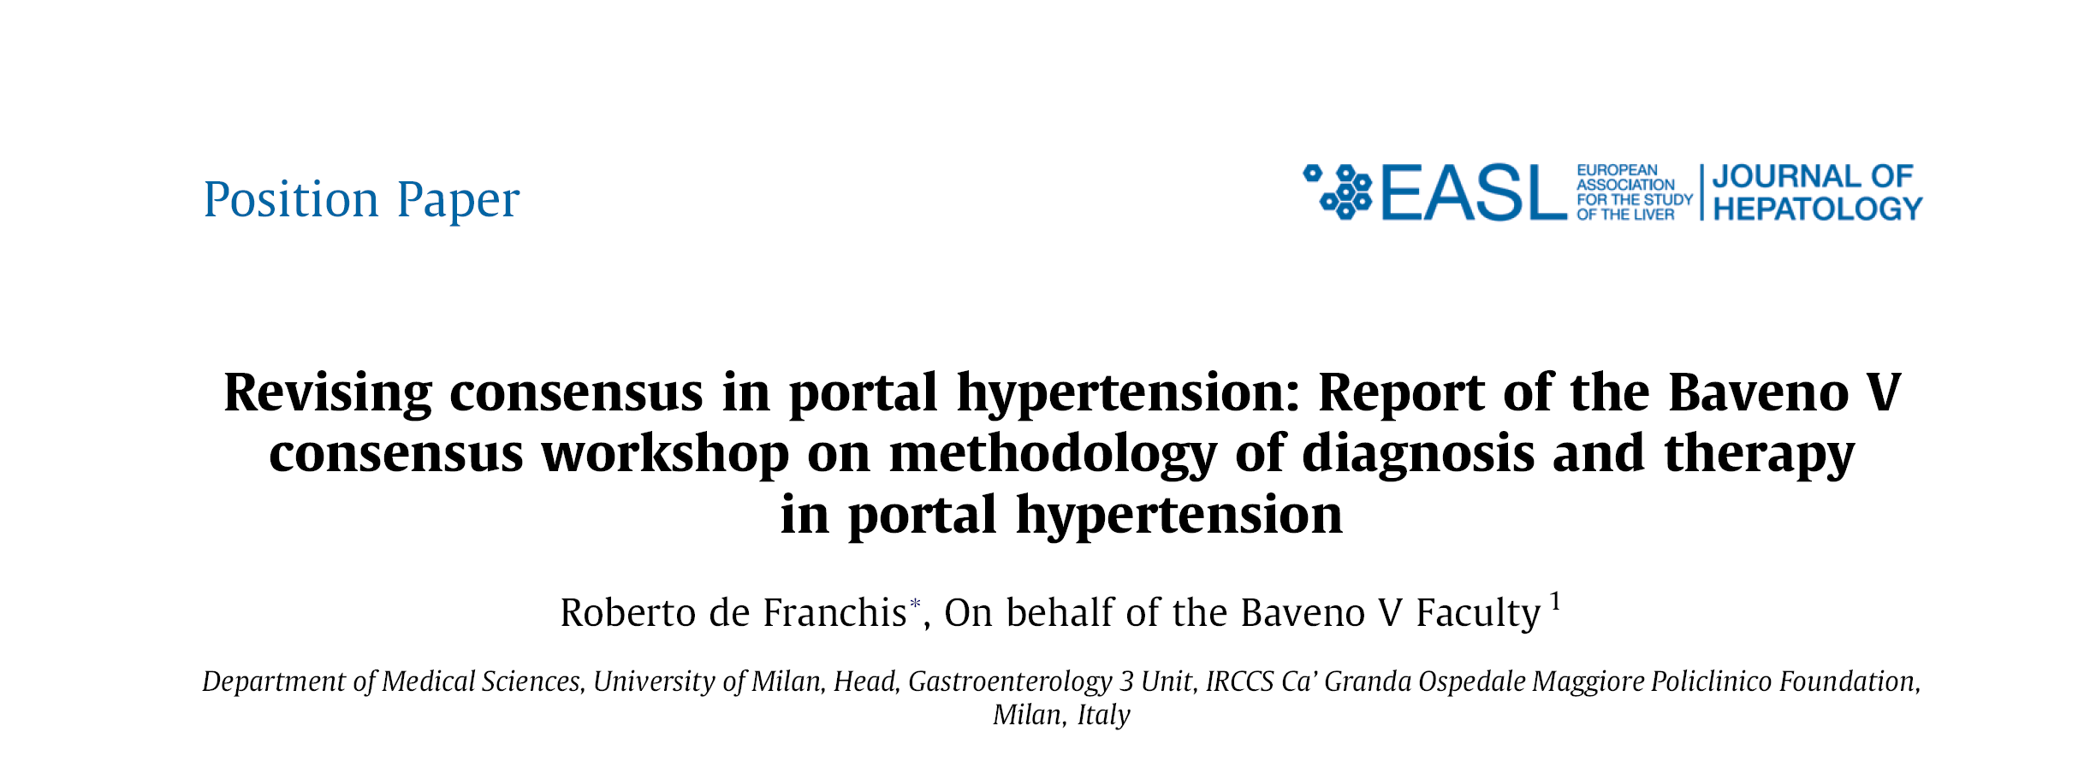
Baveno V (J Hepatol 2010)

Slide 9
Topics
Definitions
Diagnosis, Evaluation, Severity Assessment
Initial Management & Monitoring
Role of Endoscopy
Rescue Therapies
TIPS
Danis Ella Stent
Gastric Variceal Bleeding

Slide 10
Acute Variceal Bleeding (AVB)
Definition:
In a known or suspected case of PHT presence of:
Hematemesis within last 24 h of presentation, and / or
Ongoing melena, with last melanic stool within last 24 hr.

Slide 11
The time frame for the AVB episode is 48 h
State | Time frame from t₀ | Sub-types | Time frame from t₀
Acute Variceal Bleeding | 48 h | Active (Based on endoscopy) | 48 h
 |  | Inactive (Based on endoscopy) | 48 h
Rebleeding | After 48 h | Very early rebleed | 48 h to 120 hr
 |  | Early rebleed | 6 d to 42 d
 |  | Late rebleed | After 42 d

Slide 12
Control of AVB
Cessation of bleeding with hemodynamic stability for 24 hr after therapy.
In patients with active bleeding at endoscopy, cessation of bleeding should be confirmed at the end of the procedure

Slide 13
Failure to control of AVB
Any of the following events, whichever occurs first, within 48 hr from t0 combination therapy is instituted:
Fresh hematemesis after 2 hr of drugs + EVL
>2 g drop in Hb (6% drop in Hct) if no transfusion is administered
Increase in heart rate and decrease of systolic BP with adequate infusion
Death
(Note: The first three criteria would require modification of therapy)

Slide 14
Resuscitation Fluid volume replacement
Colloids, Crystalloids avoided particularly saline, give glucose
Volume to maintain:
BP of 90-100 mm Hg
HR <100
CVP 1-5 mm Hg
Diuresis of 40 mL/h

Slide 15
Blood volume restitution
Blood, to maintain:
Hb 7-8 g/dL
HCt 21-24%
PRBC

Slide 16
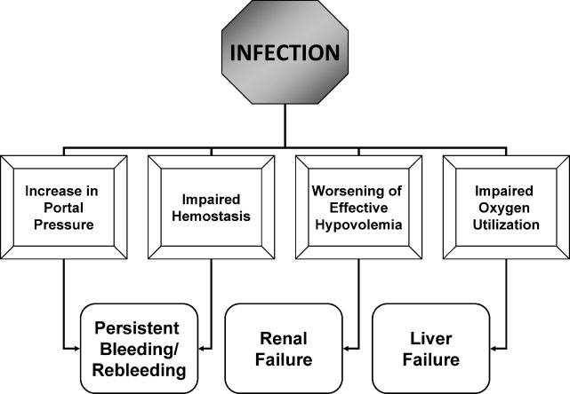
Infections in AVB can perpetuate bleeding
Semin Respir Crit Care Med 2012;33:46–54.

Slide 17
Antibiotics in AVB
IV ceftriaxone (2-4 g/day)
- decreases bacterial infections
- increases survival

Slide 18
Management of coagulopathy and thrombocytopenia
No benefit of recombinant activated factor VII (rFVIIa) in cirrhotic patients with AVB

Slide 19
Topics
Definitions
Diagnosis, Evaluation, Severity Assessment
Initial Management & Monitoring
Role of Endoscopy
Rescue Therapies
TIPS
Danis Ella Stent
Gastric Variceal Bleeding

Slide 20

Asian Pacific Association for Study of Liver, Hepat Int 2011
Acute Variceal Bleed: Management 2014
Cirrhosis with acute bleeding
“Door to Needle” Time <30 min
- Terlipressin/ Somatostatin equally good
- PPI, Antibiotic
“Door to Scope” Time
<6 hr
Elective
Treatment
EVL + Drug 2 d*
Persistent Bleeding OR
Early Rebleeding
Consider a second endoscopic Rx
Rescue Therapy
(TIPS/ PTVE / Ella Danis stent, Surgery, BRTO)
Failure or Rebleeding

Slide 21
Topics
Definitions
Diagnosis, Evaluation, Severity Assessment
Initial Management & Monitoring
Role of Endoscopy
Rescue Therapies
TIPS
Danis Ella Stent
Gastric Variceal Bleeding

Slide 22
Failure of Therapy
Uncontrolled Bleed – 6 hr
Blood > 4 units
Hemodynamic Instability
Change / Augment Therapy

Slide 23
Outcome of AVB
Success in Control of AVB - 70-80%
Failure of Combo – 20% !
HVPG, CTP, PVT
Post-EVL Ulcers
Options :
TIPS
PTVE
SEMS

Slide 24
Prognostic Indicators for “5-day Failure” to control bleeding, Early Rebleeding or Death
Variable
Hazard
Ratio
HVPG ≥20mmHg
11.4
Bacterial infection
4.6-9.7
Active bleeding at endoscopy
2.1-3.7
Portal vein thrombosis
3.1
Child-Pugh Class
2.7
Moitinhi ,GE 99, Bernard GE, 95, D’Amico Hepatology 2003, Avgerinos et al, Hepatology, June 2004

Slide 25
Combination of Somatostatin plus EVL is Similar to EVL alone in Control of Acute Variceal Bleeding: A Double Blind RCT
Only Study
Vibhu V Mittal, Sanjeev Jha, Nitin Gupta, Ram C Soni , Vishal Garg , Ashish Kumar, Barjesh C Sharma, S K Sarin

Slide 26
AVB : Trial Profile
Non-cirrhotic portal hypertension (n=22)
Age <12 or >75 years (n=6)
HE grade 3 or 4 (n=13)
Renal failure (n=8)
Bleeding from additional source (n=5);
Already on vasoactive drugs (n=9); Already received EVL or EST (n=7); H/O surgery for PHT or TIPS (n=1); CAD (n=2);
HCC (n=4);
HVPG not possible within 24 hrs (n=17)
Refusing to participate (n=3)
PHT with acute bleed n=158
Exclusion
N- 97
Cirrhotics with Acute variceal bleed
Randomization
N=61
EVL + Somatostatin
N = 31
EVL + Placebo
N = 30

Slide 27
Primary End Points
% of patients
No difference
Matters
 | EVL + Somatostatin (n-31) | EVL + placebo (n-30) | p value
Rebleed, n(%) | 10(32) | 8(27) | 0.632
Death , n(%) | 3(10) | 3(10) | 0.966

Slide 28
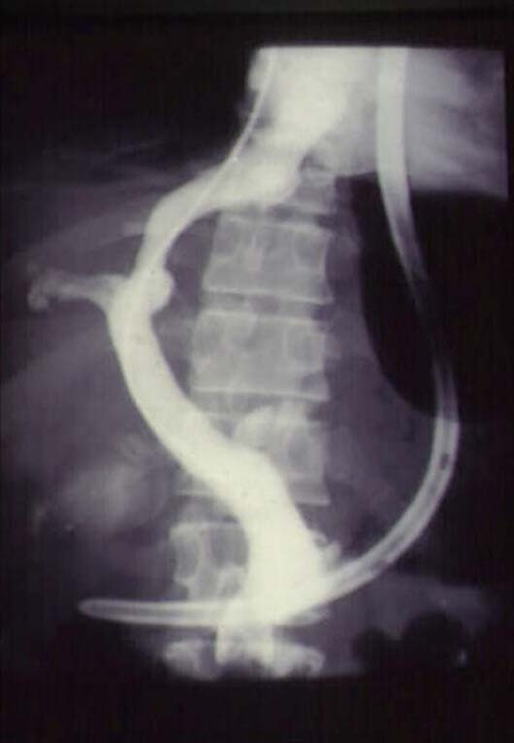
TIPS as Rescue in AVB

Slide 29
Early TIPS Improves Survival Garcia Pagan et al. June 2010, NEJM
Early TIPS Drugs + EBL
(n=32) (n=31)
Rebleeding 1 14 (P=0.001)
No bleed 97% 50% (P<0.001)
Survival 86% 61% (P<0.001)

Slide 30
TIPS In Acute Refractory
Variceal Bleeding
ILBS Experience

Slide 31
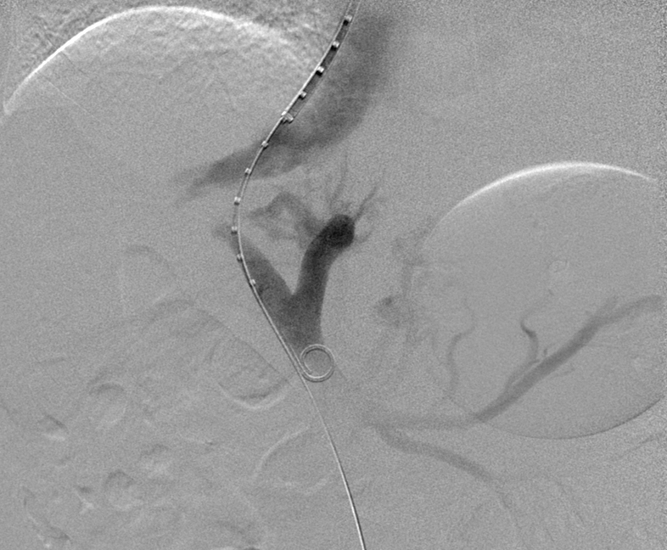
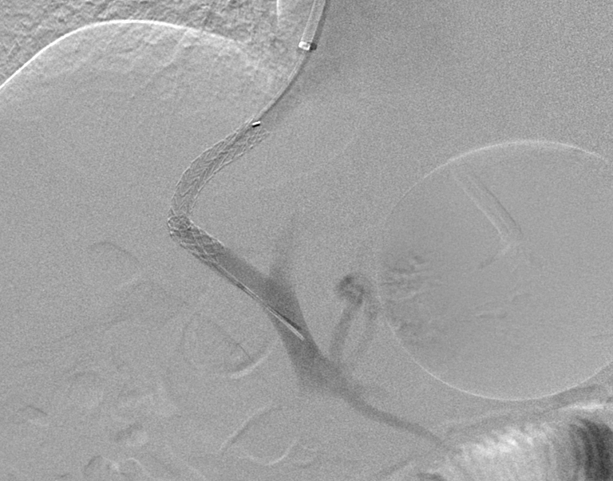
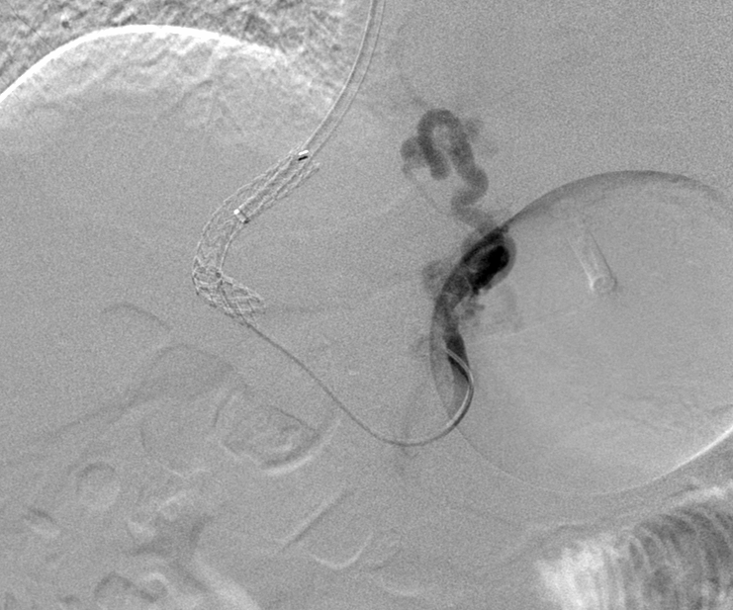
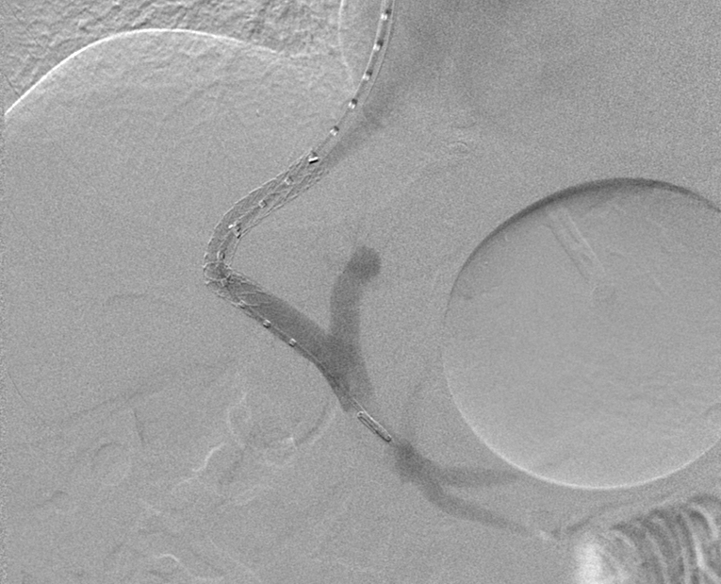

Slide 32
Emergency TIPS: ILBS (2010-12)
Number of Patients (n) | 34
Age (in years) Mean Range | 47 27-69
Sex (M/F) | 31/3
Etiology of Liver disease Alcoholic Hepatitis-B Hepatitis-C Non-Alcoholic Steatohepatitis Alcohol + HBV/HCV Cryptogenic Autoimmune | 23 1 1 2 3 3 1

Slide 33
Emergency TIPS: ILBS (2010-12)
Child-Pugh Score (n=34) Mean Range | 11 6-15
Child-Pugh Class ; % A B C | 3 (1) 32 (11) 65 (22)
MELD; % (n=34) 0-18 19-25 >25 | 29 (10) 26 (9) 44 (15)

Slide 34
Vasopressor Support

Slide 35
Results of TIPS creation
Technical Success % | 100 (34/34)
Hemodynamic Success % | 97 (33/34)
Porto-systemic Gradient (n=34) (mmHg) Before TIPS After TIPS Reduction | 23 (9-47) 7 (1-13) 12 (2-35)
Glue Embolisation | 1/34
Recurrent Bleeding | 9% (3/34) Post EVL Ulcer (1), Coagulopathy (2)

Slide 36
Survival According to MELD Status

Slide 37
Management of Post EVL Ulcer Bleed (2011- ‘5.12)
386 under went EVL
(Sec Prophylaxis)
Post EVL ulcer Bleed N= 25 (6%)
(Median duration = 10 (2-30) days
Endotherapy
(N=16)
Endotherapy + TIPS
(N=9)
Rebleed/ Failure to control bleed: n=8/16 (50%)
Death: n= 10/16 (62%)
Rebleed/ Failure to control bleed:
n= 1/9 (11%)
Death: n= 2/9 (22%)
P value: 0.08 and 0.09

Slide 38
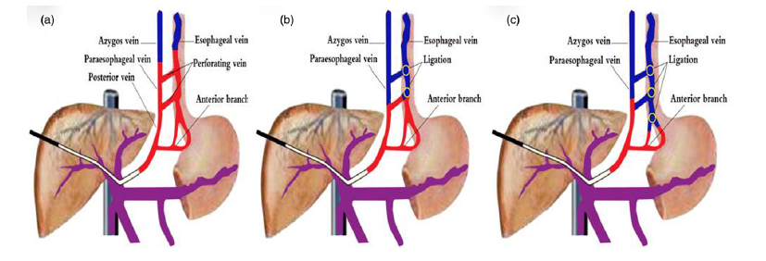
Journal of Digestive Diseases 2013; 14; 388–395
PTVE
Notes:
The three percutaneous transhepatic variceal embolization obliteration types and the adjunctive endoscopic variceal ligation (EVL) showing (a) complete obliteration, where the lower endoscopic varices (EV) and feeding veins are completely obliterated with no need of EVL; (b) partial obliteration, where the lower EV are not obliterated and adjunctive EVL is performed; and (c) trunk obliteration, where the lower EV and cardiac varices are not obliterated and EVL is added.

Slide 39
Acute Variceal Bleed
Drugs
Endotherpay
TIPS
Ella Danis Stent – Post EVL ulcer bleed

Slide 40
Causes of Early rebleed
Factors associated with failure to control acute hemorrhage
Spurting varices
High Child-Pugh score
High hepatic venous pressure gradient
Infection
Portal vein thrombosis
Factors associated with early rebleeding
Severe initial bleeding
Overly aggressive volume resuscitation
Infection
High hepatic venous pressure gradient
Complications of endoscopic therapy Renal failure
Factors associated with late rebleeding
High Child-Pugh score
Large variceal size
Continued alcohol use
Hepatocellular carcinoma
Med Clin N Am 2008
Notes:
This table shows the causes of continued bleeding or recurrent bleeding, and EVL ulcer usually cause early rebleeding however some times it also caused failure to control bleeding

Slide 41
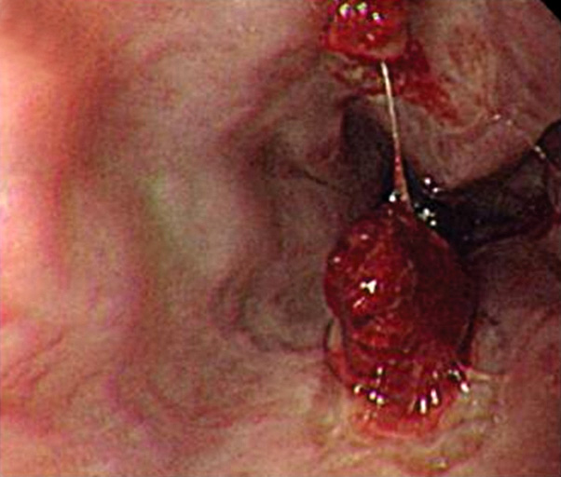
Management of Post-EVL Ulcer bleed
Notes:
Gud morning everyone. In the next 15-20 min I will be discussing how to manage the Post EVL ulcer bleed. EVL ulcer well known, serious but poorly described entity, It leads to early rebleed and some time failure to control bleed. Undoubtaly many of us have burned our hands while managing EVL ulcer related bleed

Slide 42
Management of Post-EVL Ulcer bleed
Notes:
Gud morning everyone. In the next 15-20 min I will be discussing how to manage the Post EVL ulcer bleed. EVL ulcer well known, serious but poorly described entity, It leads to early rebleed and some time failure to control bleed. Undoubtaly many of us have burned our hands while managing EVL ulcer related bleed

Slide 43
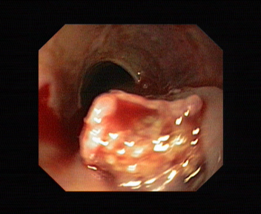
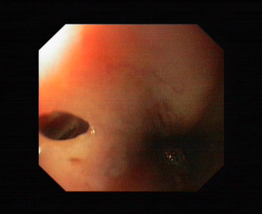
Post Glue Sinus formation
Pre Glue endoscopy
Post Glue after 7 days
Notes:
This is same sinus formation, seen in ILBS after 4-5 days of Glue injection. Patients died after few hrs.

Slide 44
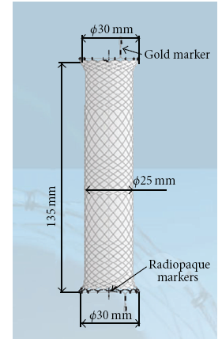
SX-Ella Danis stent
Notes:
This is fully deployed stent which is 135 mm long and 25 mm wide including radiopaque markers as well as the gold markers for stent removal

Slide 45
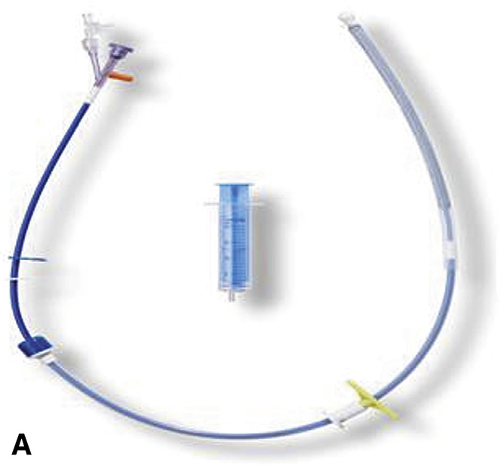
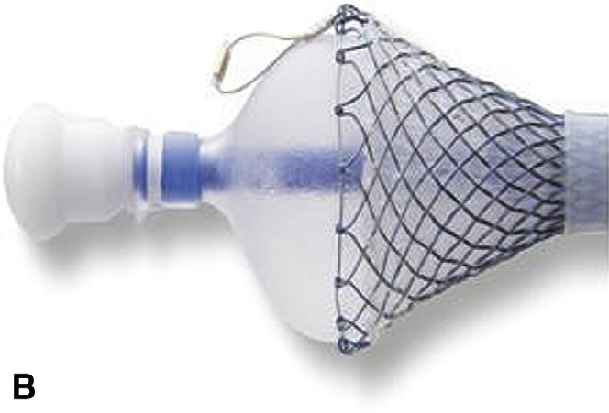
SX-Ella Danis stent
Insertion device that has a 26F diameter and is 60 cm long
Balloon at the distal end of the insertion device (shown partially inflated) allows anchoring of the distal end of the stent at the cardia during deployment
Notes:
SEMS is a new method for the control of variceal hemorrhage. It control the bleeding by temponade of varices in the lower esophagus. The SX-Ella Danis stent (Ella-CS, Hradec Kralove, Czech Republic) is a removable, covered, self-expanding metal stent (SEMS) that can be deployed in the lower esophagus over an endoscopically placed guidewire. It is supplied preloaded in an insertion device that has a 26F diameter and is 60 cm long.
without radiological screening. The stent controls bleeding by tamponade of varices in the lower esophagus and may have several advantages over current salvage methods of hemostasis. First, the stent can be inserted and deployed without radiological or even endoscopic assistance,
making the device an attractive option when emergency endoscopy or a physician experienced in BT is unavailable. Second, after deployment of the stent, the oral route for fluids and nutrition is maintained and, in contrast to BT, there is no requirement for airway protection by endotracheal intubation.

Slide 46
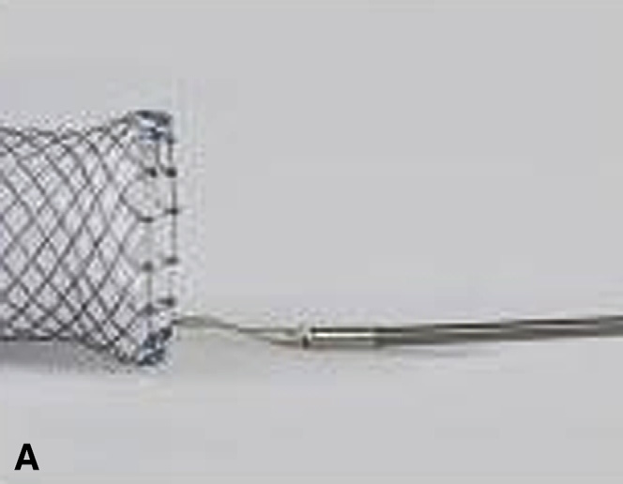
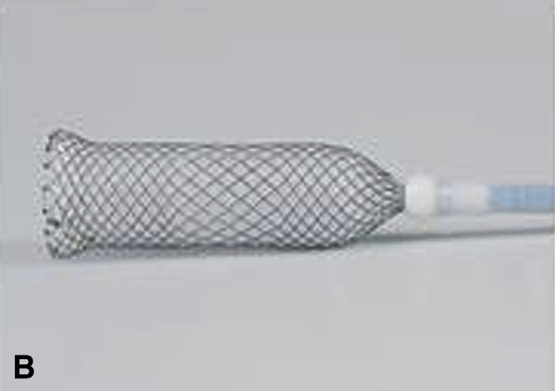
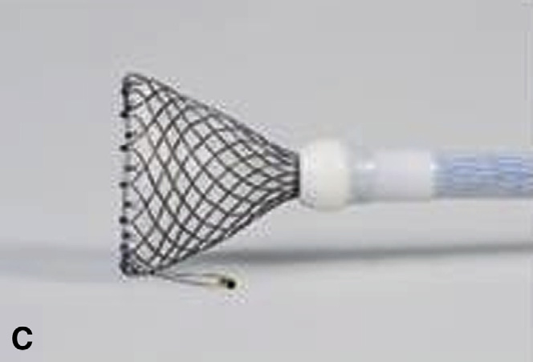
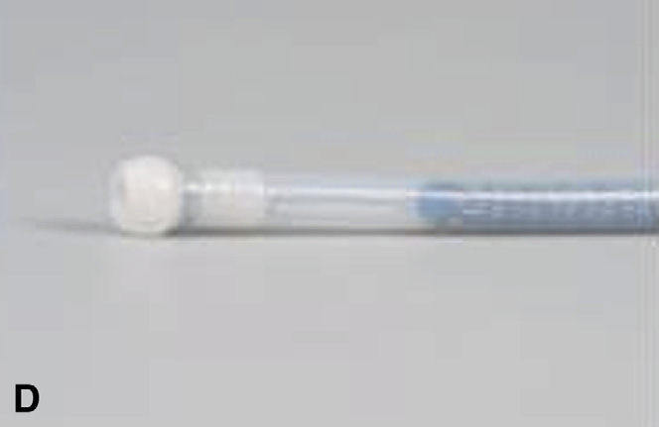
SX-Ella Danis stent (Method of stent removal)
Notes:
This is the diagramatic represenrtation of method of stent removal. And the stent is remove using the PEX-Ella extractor (Ella-CS) by using the following technique. At upper endoscopy, the retrieval loop at the top of the stent was snared with the hook of the PEX-Ella device and locked in position (Fig. 2A). The endoscope was then removed, leaving the wire in situ attached to the proximal retrieval loop, and the extraction device, which consists of a blunt-endodplastic sheath, is advanced over the wire. Gentle traction on the wire while advancing the removal sheath gradually constrains the stent within the removal device until all the stent is constrained in the stent extractor (Fig. 2B). Once the stent had been fully constrained, the PEX-Ella device is removed from the esophagus, and the esophagus is inspected endoscopically

Slide 47
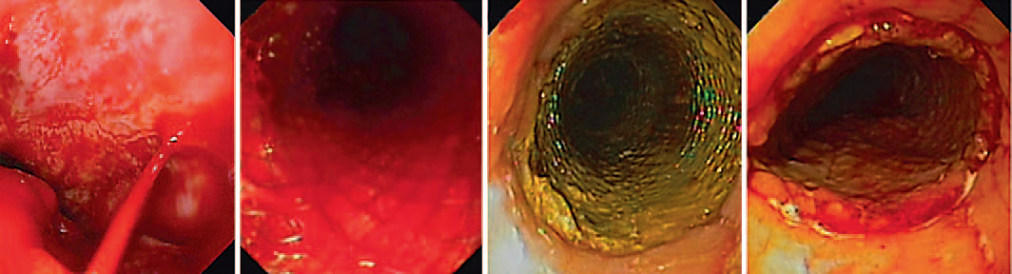
Digestion 2012;85:185–191
Representative endoscopic images of SEMS insertion and removal
a
b
c
d
a Bleeding from esophageal varix without hemostasis after band ligation. b Esophagus directly after SEMS implant. c Esophagus 7 days after stent
implant, prior to removal. d Esophagus directly after stent removal.

Slide 48
Rescue Therapy in AVB: SX-Ella Danis stent
Journal & Year | No. of Patients | Indication | % of patients , control bleeding (immediate) | % Patients Survival
Endoscopy 2006 | 20 | Refractory variceal bleed | 100% | 100% 2 wks survival
Surgical Endoscopy 2008 | 34 | Refractory variceal bleed | 100% | 30% 2 months mortality
Disease Esophagus 2010 | 1 | EVL induced Ulcer | 100% | Alive 2 wks
G I Endoscopy 2010 | 9 | Refractory variceal bleeding | 90% | 60% 6 wks survival
Notes:
This table shows the studied which used denis ella stent in patients of refractory bleed and EVL induce ulcer, However no studied was controlled. But all studies showed the benefit IN TERMS OF REDUCING BLEED AND SURVIVAL..

Slide 49
ILBS experience on SX-Ella Danis stent
Total patients | 8
Bleeding controlled | 7 (88%)
Patient survived | 45(62%%)

Slide 50
K.R. 43 yr., Alcoholic, Child’s C Cirrhotic, Obliterated Esophageal varices
Presented with acute variceal bleed
I V Terlipressin
3 units of blood
4 hr later:
NGT aspirate fresh blood
Emergency endoscopy

Slide 51
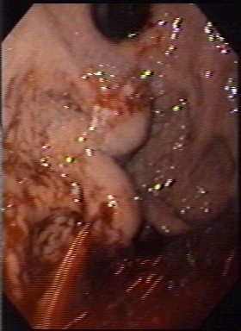

Slide 52
Gastro- esophageal Varix (GOV) Type 2

Slide 53
Gastric Varices (GV) : Prevalence
Overall 20-29%
Bleeders > Nonbleeders 27% vs. 4%
Non-cirrhotics > Cirrhotics 32% vs. 21%
BJ Surg 1988, BMJ 1988, BJ Surg 1989, Hepatology 1992, G I Endoscopy 1997

Slide 54
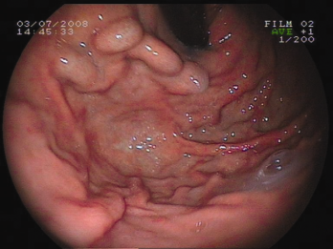
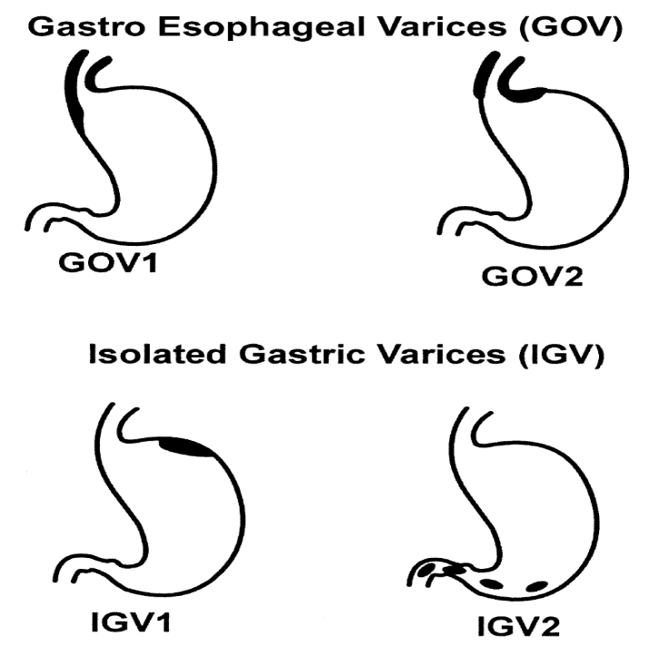
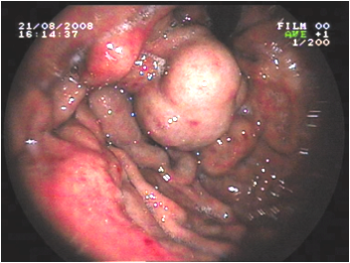
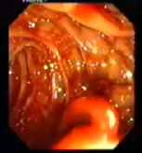
GV: Classification, based on location
and their prevalence
70%
21%
7%
2%
Sarin et al, Am J Gastroenterol, 1989,
Hepatology 1992

Slide 55
GV : Natural History
Bleed
Frequency
Severity
Predictors
Hemodynamics
Growth
Bailliere’s Clin Gastroenterol 1992

Slide 56
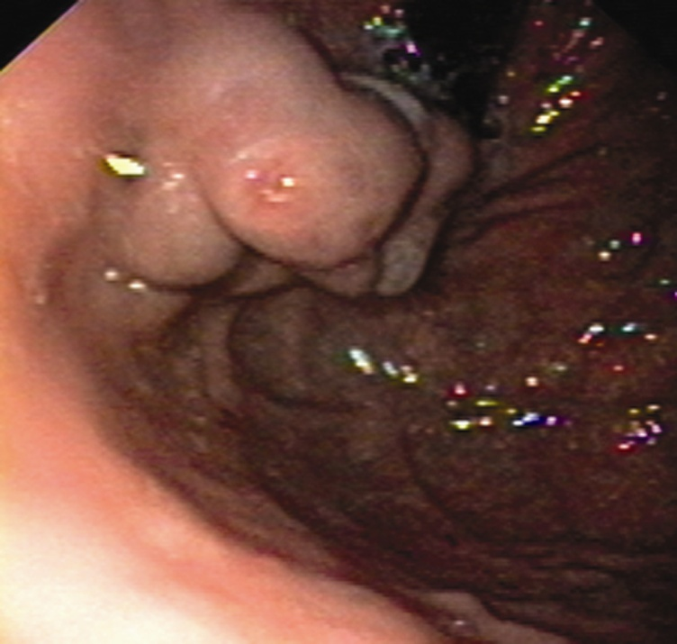
GOV2: Predictor of Rebleed Signs of recent hemorrhage

Slide 57
Management of Gastric Varices
Acute Gastric Variceal Bleed
Secondary Prophylaxis
Primary Prophylaxis

Slide 58
GV : Management of Acute Bleed
Drugs
No data
Balloon tamponade
Linton > SBT
Endoscopic therapies
Interventional radiology
TIPS
BRTO
PTVE
Splenic artery embolization
Surgery

Slide 59
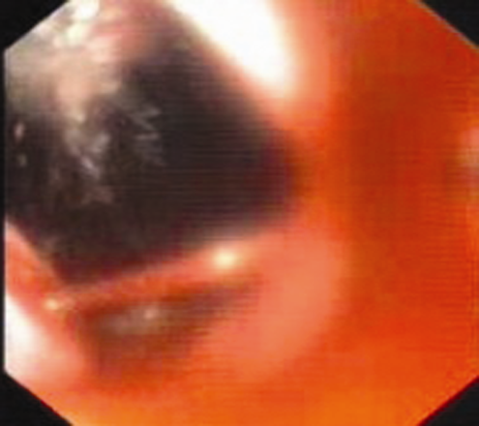
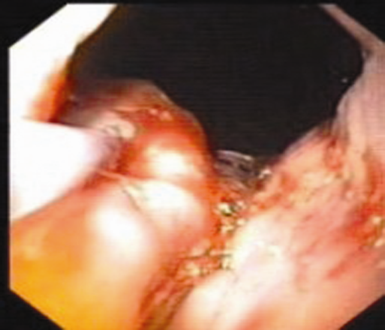
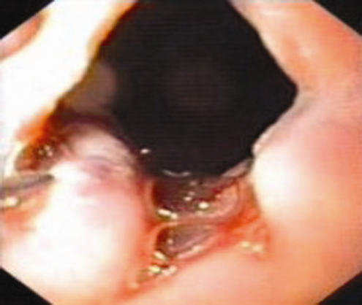
GV : Cyanoacrylate Injection in Acute GOV1 Bleed

Slide 60
Glue for Acute GV Bleed
Studies 20, n = 931
Retrospective 11
Prospective 6
RCT 3
Mean Follow up (mo) 23 (6-60)
Hemostasis rate 93%* (71-100)
Rebleeding rate 26% (7-58)
Mortality rate 31% (4-83)
Kind et al 2000, *Belletrutti et al. Cand J Gastro 2008

Slide 61
TIPS in GV Bleed
Studies | 8
RCT | None
Sample size > 30 | 4
Patients | 269
Rescue TIPS for GV Bleed | 80%
Hemostasis | >90%
Rebleed | 16-41%
Mortality (1 year)* | 21-60%
Follow-up | 11 (7-37)
Policy : All acute GV bleed, Gluefailure go to TIPS
*Survival benefit with TIPS only if HVPG > 12 mm Hg
Baranage Hepatology 1999, Sanyal 2003, Tripathi et al. Gut 2002

Slide 62
Glue vs. TIPS for Gastric Variceal Bleeding Procaccini et al ,G I Endosc 2009
Retrospective study : n=105
Rebleeding same at 72 h, 3 mo, 1 yr
Survival same at 1 yr
Morbidity, rehospitalization : 41% vs. 1.6% , P <.001

Slide 63
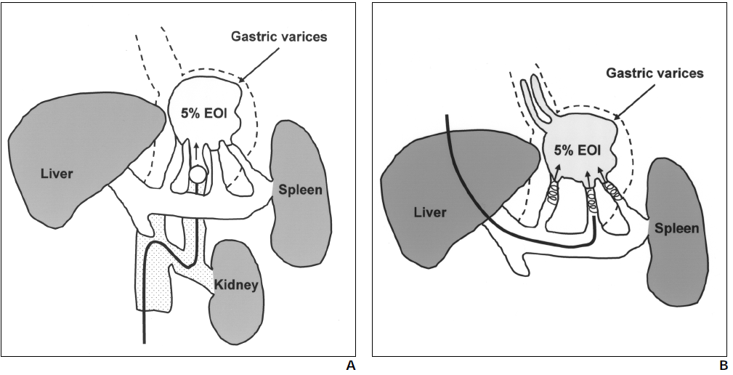
GV : Interventional Radiology
Transcatheter Sclerotherapy / Percutaneous Transvenous Variceal Embolization (PTVE)
Balloon Retrograde Transvenous Obliteration (BRTO)
EOI – Ethonalamine Oleate with Iopamidol
Hirota 1999
Ninoi et al AJR 2004
Zhang et al.J Clin Gastroenterol. 2009

Slide 64
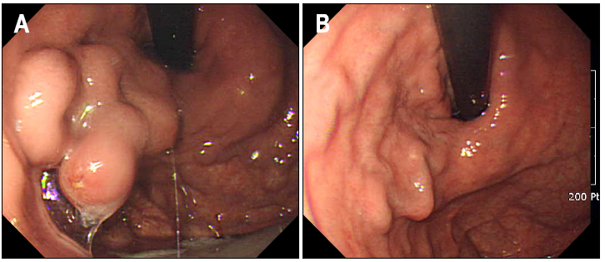
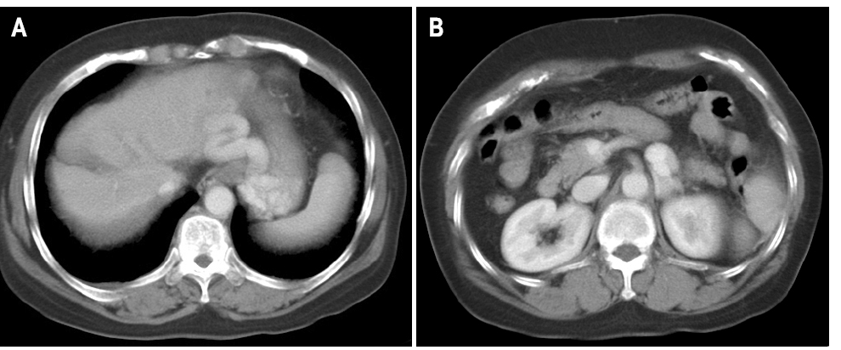
Large GOV1
2 months
G R Shunt
Lee and Kim 2009

Slide 65
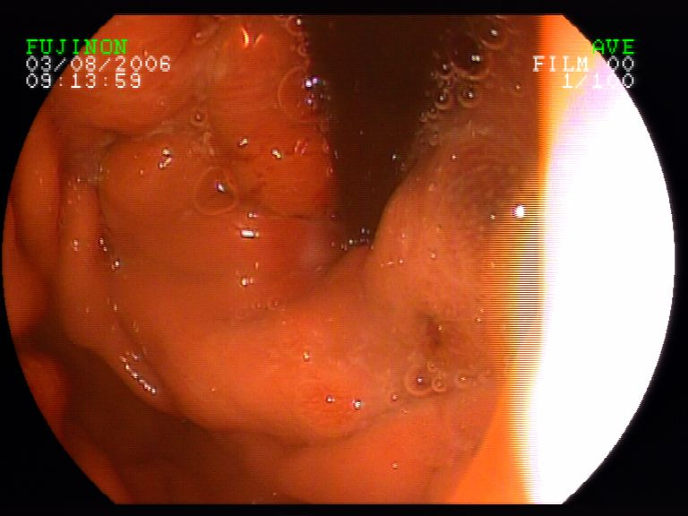
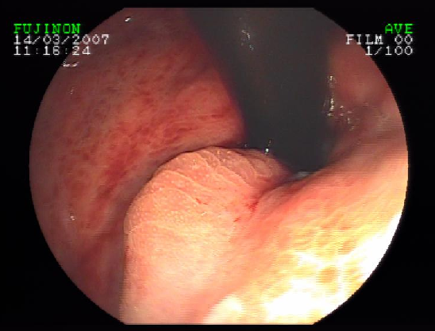
IGV1 : 6 months After PTVE

Slide 66
APASL Consensus 2011
Gastric Varix
Acute Bleed
Resuscitation + Vasoactive drugs
GOV2, IGV1
GOV1
Tissue Adhesives
(2nd Line: Band Ligation, Thrombin, GVS)
Treat esophageal varix,
Glue – if bleed continues
Bleed Control
Yes
No
Second Glue !! Balloon
Secondary Prophylaxis
Glue, TIPS, BRTO,
Generalized
Segmental PHT
Spleno-portal axis patent
Splenectomy, Splenic artery embolization
Yes
No
Salvage TIPS or BRTO
2nd line : Shunt, devascularization in decompensated cirrhosis
BRTO
Devascularization
Sarin 2009

Slide 67
Summary : Acute Variceal Bleed
Georgia 2014
Definitions, Liver Pressure – Pivotal, Easy.
ICU Care – Prevent hepatic ischemia
Hb 7-8, Antibiotics,
OV: Drugs (door to needle <30 min)
+ EVL (door to scope <6 hrs)
Rescue : TIPS, PTVE, Ella Danis Stent
Surgery :
Gastric Varices –
Glue, TIPS

