Slide 1
HBV coinfections HDV HCV HIV
Geoff Dusheiko
Kings College Hospital London

Slide 2
Liver disease in HIV
HCV or HBV
Immune Restoration Disease
Direct Cytotoxicity
Chronic Hepatitis
Alcohol
Drugs
Medications
Drug-related Hepatotoxicity
NASH
HIV
HAART

Slide 3
Hepatitis B and HIV coinfection
~ 8% of HIV-infected persons coinfected with chronic hepatitis B.
High prevalence regions: for example sub Saharan Africa
HBV generally acquired in childhood
HIV infection is acquired later in life sexual transmission
HIV coinfection may exacerbate liver disease
Morbidity of HBV HIV coinfection
May be the result of increased replication
HBV reactivation
Likelihood of chronicity of HBV
Accelerated progression to fibrosis cirrhosis
Risk of HCC at a younger age
Inoue T, Microb Cell 3:420-437. Thornton AC, Aids 31:2525-2532. Singh KP Aids 31:2035-2052. Hawkins C, J Acquir Immune Defic Syndr 76:298-302. Kilonzo SB,. J Trop Med 2017:5629130. Vinikoor MJ Clin Infect Dis 64:1343-1349. Boyd A Am J Trop Med Hyg 97:1936-1942. 187. Kouame GM Clin Infect Dis doi:10.1093/cid/cix747. Chambal LM PLoS One 12:e0181836. Easterbrook PJ, Curr Opin HIV AIDS 12:302-314. Lange B BMC Infect Dis 17:693. Deressa T, PLoS One 12:e0190149. Chan LCurr Opin Nephrol Hypertens doi:10.1097/mnh.0000000000000392. De Clercq E. Biochem Pharmacol doi:10.1016/j.bcp.2017.11.023. Boyd A, J Int AIDS Soc 20:21426. Grant J, Trop Med Int Health 22:744-754. 196. Haban H, Benchekroun S, Sadeq M, Benjouad A, Amzazi S, Oumzil H, Elharti E. 2017. Assessment of the HBV vaccine response in a group of HIV-infected children in Morocco. BMC Public Health 17:752. Manyahi J, BMC Pregnancy Childbirth 17:109. Forbi JC, J Gen Virol doi:10.1099/jgv.0.000776. Hutin Y, JMIR Public Health Surveill 3:e91. Ndow G, PLoS One 12:e0179025. 201. Omatola CA, Onoja BA, Thomas T. 2017. High Rate of Hepatitis B Virus Surface Antigenemia Among People Living with HIV/AIDS in Kakuri, Kaduna State, North West Nigeria. Viral Immunol 30:516-5

Slide 4
Co-infection: HIV and hepatitis B
Impact of HIV on HBV natural history
Higher progression to chronic infection
Higher HBeAg positivity
Higher HBV DNA levels
Higher rate of eAg reactivation
Lower ALT levels and hepatic inflammation
More rapid liver disease progression
Notes:
This international study was designed to address the question of whether HIV management with ART could be done differently to allow sparing use of ART minimising cost and toxicity.
Clinical endpoint study which will allow us to say whether these strategies improve quality of life minimising toxicity but maintains HIV control and does not lead to an increase in clinical events

Slide 5
Diagnosis HIV and HBV coinfection
Assessment of risk factors and repeated testing.
A diagnosis of HIV requires a full assessment and staging of liver disease.
Non-invasive scores including FIB-4 and transient elastography are useful in this group.
It is recommended that all persons with HIV or HBV infection be tested for coinfections
Inoue T, Microb Cell 3:420-437. Thornton AC, Aids 31:2525-2532. Singh KP Aids 31:2035-2052. Hawkins C, J Acquir Immune Defic Syndr 76:298-302. Kilonzo SB,. J Trop Med 2017:5629130. Vinikoor MJ Clin Infect Dis 64:1343-1349. Boyd A Am J Trop Med Hyg 97:1936-1942. 187. Kouame GM Clin Infect Dis doi:10.1093/cid/cix747. Chambal LM PLoS One 12:e0181836. Easterbrook PJ, Curr Opin HIV AIDS 12:302-314. Lange B BMC Infect Dis 17:693. Deressa T, PLoS One 12:e0190149. Chan LCurr Opin Nephrol Hypertens doi:10.1097/mnh.0000000000000392. De Clercq E. Biochem Pharmacol doi:10.1016/j.bcp.2017.11.023. Boyd A, J Int AIDS Soc 20:21426. Grant J, Trop Med Int Health 22:744-754. 196. Haban H, Benchekroun S, Sadeq M, Benjouad A, Amzazi S, Oumzil H, Elharti E. 2017. Assessment of the HBV vaccine response in a group of HIV-infected children in Morocco. BMC Public Health 17:752. Manyahi J, BMC Pregnancy Childbirth 17:109. Forbi JC, J Gen Virol doi:10.1099/jgv.0.000776. Hutin Y, JMIR Public Health Surveill 3:e91. Ndow G, PLoS One 12:e0179025. 201. Omatola CA, Onoja BA, Thomas T. 2017. High Rate of Hepatitis B Virus Surface Antigenemia Among People Living with HIV/AIDS in Kakuri, Kaduna State, North West Nigeria. Viral Immunol 30:516-5

Slide 6
Treatment of HIV and HBV coinfection
Tenofovir and emtricitabine have activity against both HIV and HBV and are ﬁrst-line
Together with appropriate ART are usually recommended for HIV HBV coinfection.
Renal insufficiency may require a modification of treatment with tenofovir.
Entecavir can be added to an appropriately potent suppressive ART regimen.
Tenofovir alefenamide offers effective ART activity with less renal or bone toxicity
Effective suppression of both viruses can limit progression of hepatic fibrosis
Liver transplantation affords the opportunity of efficacious salvage treatment for those with end stage liver disease due to HIV and HBV coinfection.
Vaccination is the most effective tool to prevent HBV infection; vaccine responsiveness is lower in HIV infected children

Slide 7
Management of HIV co-infected patients
Recommendations:
All HIV-positive patients with HBV co-infection should start antiretroviral therapy (ART) irrespective of CD4 cell count. (Evidence level II-2, grade of recommendation 1)
HIV-HBV co-infected patients should be treated with a TDF- or TAF-based ART regimen. (Evidence level I for TDF, II-1 for TAF, grade of recommendation 1)
EASL 2017 CPG HBV, J Hepatol 2017

Slide 8
HIV and HBV elimination
Challenges to elimination of HBV HIV coinfection remain
Particularly regarding diagnosis access to treatment of HBV where HIV treatment is selectively supported.
In many regions, pregnant women routinely screened for HIV but not HBV
Systematic surveillance required in endemic regions
Low cost generic medications have been crucial in expanding treatment programs for HIV,
but their use requires extension to treatment of HBV infection.
Inoue T, Microb Cell 3:420-437. Thornton AC, Aids 31:2525-2532. Singh KP Aids 31:2035-2052. Hawkins C, J Acquir Immune Defic Syndr 76:298-302. Kilonzo SB,. J Trop Med 2017:5629130. Vinikoor MJ Clin Infect Dis 64:1343-1349. Boyd A Am J Trop Med Hyg 97:1936-1942. 187. Kouame GM Clin Infect Dis doi:10.1093/cid/cix747. Chambal LM PLoS One 12:e0181836. Easterbrook PJ, Curr Opin HIV AIDS 12:302-314. Lange B BMC Infect Dis 17:693. Deressa T, PLoS One 12:e0190149. Chan LCurr Opin Nephrol Hypertens doi:10.1097/mnh.0000000000000392. De Clercq E. Biochem Pharmacol doi:10.1016/j.bcp.2017.11.023. Boyd A, J Int AIDS Soc 20:21426. Grant J, Trop Med Int Health 22:744-754. 196. Haban H, Benchekroun S, Sadeq M, Benjouad A, Amzazi S, Oumzil H, Elharti E. 2017. Assessment of the HBV vaccine response in a group of HIV-infected children in Morocco. BMC Public Health 17:752. Manyahi J, BMC Pregnancy Childbirth 17:109. Forbi JC, J Gen Virol doi:10.1099/jgv.0.000776. Hutin Y, JMIR Public Health Surveill 3:e91. Ndow G, PLoS One 12:e0179025. 201. Omatola CA, Onoja BA, Thomas T. 2017. High Rate of Hepatitis B Virus Surface Antigenemia Among People Living with HIV/AIDS in Kakuri, Kaduna State, North West Nigeria. Viral Immunol 30:516-5

Slide 9
Hepatitis B and D coinfection
HDV: small defective RNA virus
Propagates only in individuals with coexistent HBV infection
Following either simultaneous transmission or after superinfection
HDV virions attach to cellular heparin sulfate proteoglycans
Subsequent entry into hepatocytes mediated by irreversible binding of the large HBsAg to the N terminal pre-S1 region the hepatocyte- specific human (NTCP) receptor
Lempp FA, J Hepatol 59:949-956. Hughes SA, Lancet 378:73-85. Wranke A, Hepatology 65:414-425. Soriano V, Aids 28:2389-2394. Wedemeyer H, N Engl J Med 364:322-331. Heidrich B, Hepatology 60:87-97. Wedemeyer H, J Hepatol 60:S2-S3. Rizzetto M. 2017. Expert Opin Investig Drugs 26:999-1005. Koh C, Lancet Infect Dis 15:1167-1174.Rizzetto M, Lancet Infect Dis15:1119-1120. Wedemeyer H, Antiviral Res doi:10.1016/j.antiviral.2016.07.004. Beilstein F, J Virol doi:10.1128/JVI.01416-17. Bazinet M, Lancet Gastroenterol Hepatol 2:877-889.

Slide 10
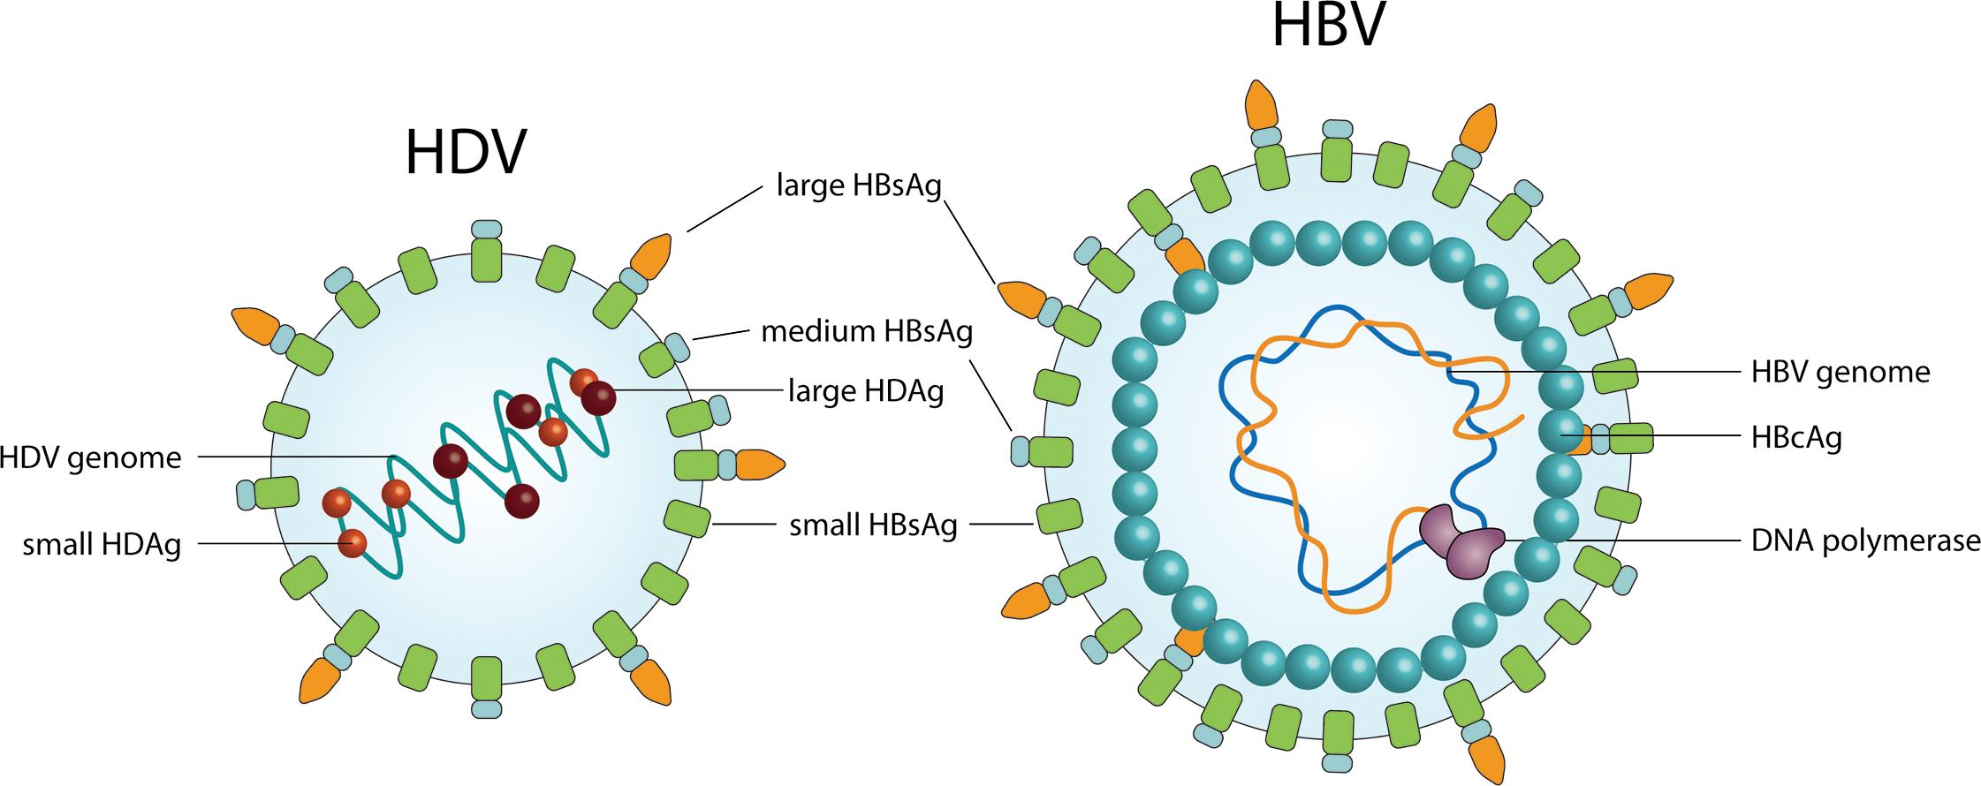
Hepatitis B and D coinfection
Requires HBsAg from HBV for Viral Assembly / Packaging
HBV
HDV
ss circular RNA
HDV small / large antigen
HBV surface antigen
ds DNA
HBV core antigen
HBV surface antigen
Giersch K and Dandri M, J Clin Transl Hepatol 2015
Notes:
SD asks GD explain the virology of hepatitis D virus
Discovered 1970’; Mario Rizetto
Hepatitis delta virus is a small, defective RNA virus that can propagate only in individuals who have coexistent hepatitis B virus after simoultaneous transmission of the two viruses or via superinfection of an established HBV carrier.
Circular genome 1700 nucleotides smallest virus human virology
Transcribed by host RNA polymerases
The HDV virion contains HDV RNA and hepatitis delta antigen (HDAg). HDV rNA is a single stranded highly base-paired, circular, and so far the smallest genome of any animal virus. HDAg is the only protein that is known to be encoded by the HDV genome. It consists of two isoforms : the large HDAg and the small HDAg. To establish infection, HDV requires the HBsAg provided by the HBV to assemble the hybrid virion, which is composed of the viral RNA genome and antigen (HDAg) enveloped by HBsAg.
Source of HBsAg may be transcription from cccDNA as well as HBsAg transcribed from integrated viral genomes
Genomic
antigenomic strand single ORF hepatitis delta antigen two isoforms large and small
35-40 nm particle
Sole enzyme: ribozyme

Slide 11
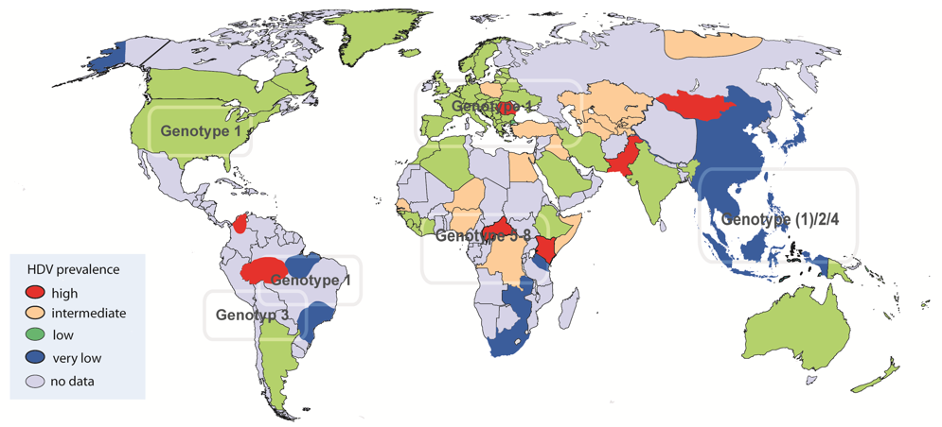
Prevalence of hepatitis delta
Of 270 million chronic carriers of HBV, 15 million with serological evidence of exposure to HDV¹
Outbreaks still occur and population migration from endemic countries is increasing – the threat of HDV infection remains
There are regional differences in the epidemiology of HDV.
Several genotypes have been described: Genotype 1 is prevalent worldwide; genotype 2 is found in Japan and Taiwan; genotype 3 in the Amazon Basin; genotype 4 in Taiwan and Japan and genotype 5 to 8 in individuals of African origin
¹Pan American Health Organization 2012. Available from: http://www.paho.org/hq/. [Accessed: May 2018]; Figure: www.hepatitis-delta.org
Notes:
From the 90s in the industrial world HBV vaccination, public health measures against HIV and improved sociohygenic conditions have led to the efficient control of HBV infection and to a conseguent decline of hepatitis D incidence rates. However HDV infection rates have not declined further in the past 10 years. Current residual reservoir of HDV in Europe consists of two pools : local ageing patients with advanced liver disease and young immigrants with active chronic hepatitis D from areas in which HDV infection remains endemic.

Slide 12
Natural history: what is the difference between coinfection and superinfection?
Co-infection
Super-infection
HDV
HBV
HDV
Healthy individuals
HBV carrier
3–4%
Fulminant hepatitis
Rare
Chronic HBV/HDV
hepatitis
7–10%
Fulminant hepatitis
80%
Chronic HBV/HDV
hepatitis
90%
Recovery
with immunity
10–15%
Acute severe disease
Death
Cirrhosis
Death
Cirrhosis
Recovery
Notes:
In HBV/HDV coinfection the fate of HDV is determined by the host response to HBV, which in more than 90% of adults results in viral clearance. Acute coinfection can be more severe than HBV monoinfection and can result in acute liver failure. HDV superinfection of an individual with chronic HBV results in chronic hepatitis delta infection in most of the people. Superinfection can present as acute hepatitis in a previously undiagnosed HBsAg carrier. Patients with hDV suuperinfection are often show to have severe hepatitis and undergo more rapid progression to cirrhosis.

Slide 13
HBV and HDV coinfection: Diagnosis
Diagnosis of HDV infection requires testing of HBsAg positive individuals for anti-HDV antibodies
If positive, a test for HDV RNA in serum to confirm HDV viraemia is mandatory.
Testing for HDV antigen
in serum
Reserved for liver tissue staining.
All HBsAg positive individual should be tested.
Testing rates remain low in many countries, including in immigrants and intravenous drug users.
Tests for HDV antigen and RNA require standardization.

Slide 14
Management of HDV co-infected patients
Treatment remains difficult
However, loss of HDV RNA during follow-up is more frequent in IFN treated patients
and is associated with less liver-related complications and clinical disease progression.
Recommendations:
PegIFNa for at least 48 weeks is the current treatment of choice in HDV-HBV co-infected patients with compensated liver disease. (Evidence level I, grade of recommendation 1)
In HDV-HBV co-infected patients with ongoing HBV DNA replication, NA therapy should be considered. (Evidence level II-2, grade of recommendation 1)
PegIFNa treatment can be continued until week 48 irrespective of on-treatment response pattern if well tolerated. (Evidence level II-2, grade of recommendation 2)
EASL 2017 CPG HBV, J Hepatol 2017

Slide 15
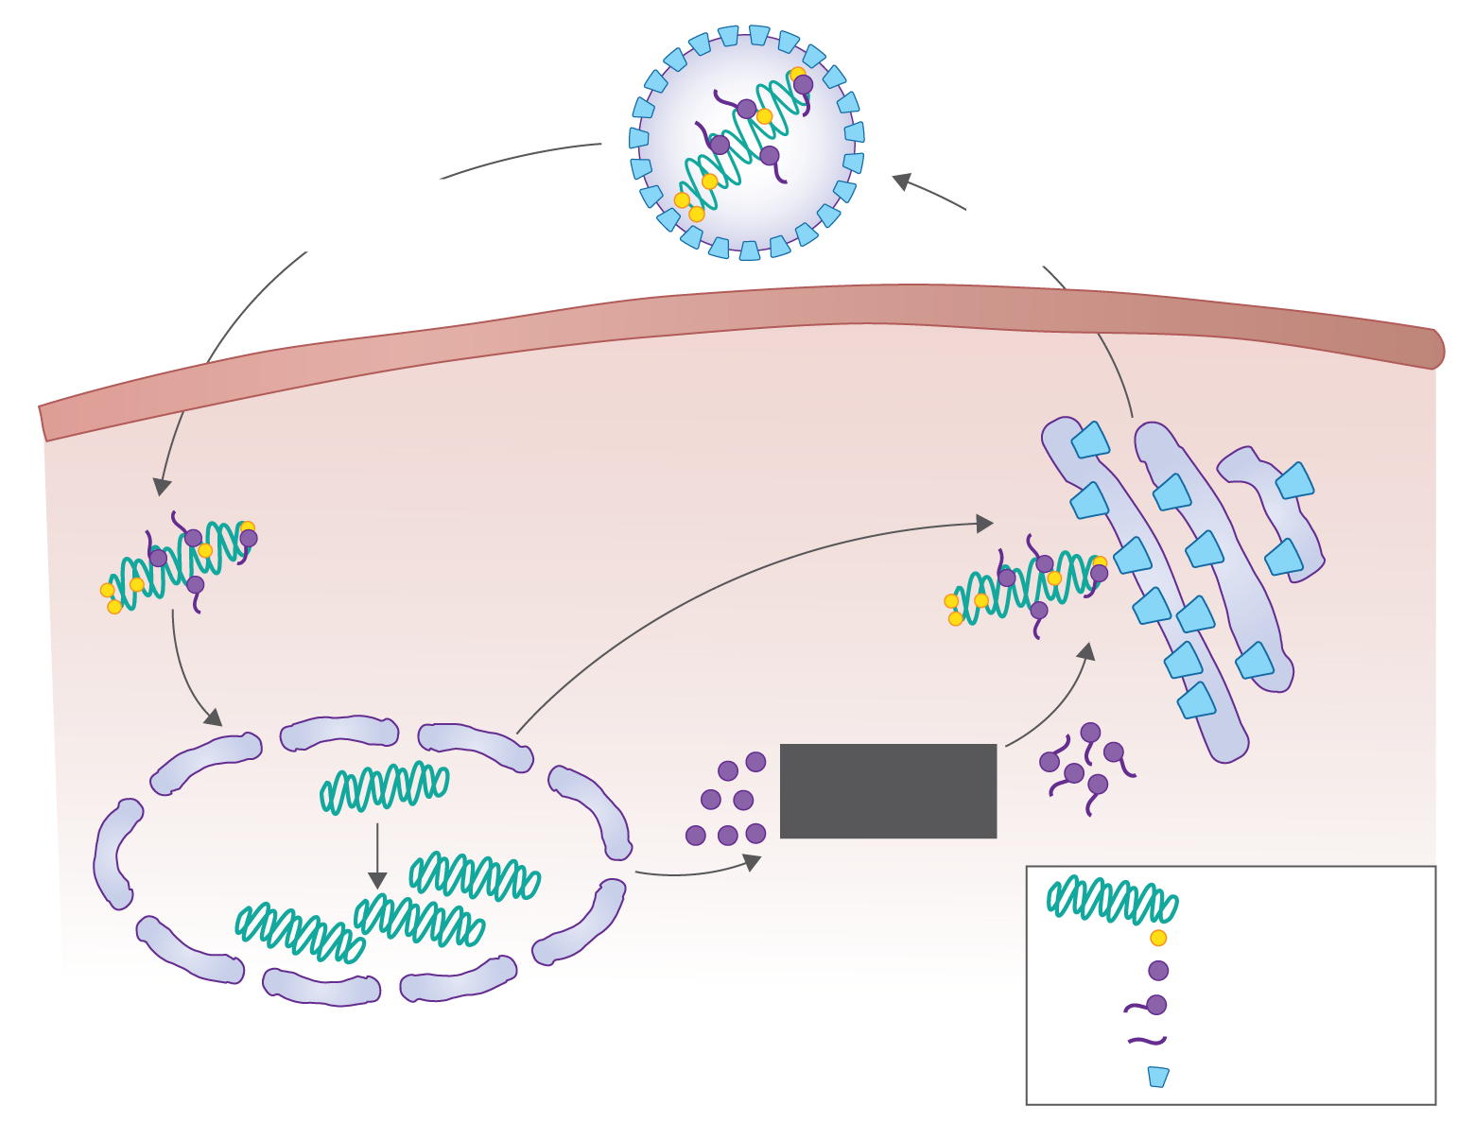
The HDV lifecycle and potential new treatment targets
HDV genome
large delta antigen
Entry Inhibitors
(i.e. Myrcludex-b)
Attachment and entry
small
delta
antigen
Release of Progeny
X
Cytoplasm
Transport to Nucleus
Lambda IFN
HDV genome
Assembly
HBV surface antigen
large
HDAg
Prenylation
prenylated
LHDAg
Replication
HDV genome
small HDAg
large HDAg
prenylated LHDAg
prenyl moiety
HBsAg
Courtesy J Glenn AASLD EASL consensus 2016
Notes:
Assembly prenyl lipid modification = prenylation of its nucleocapsid like protein
Lipid envelope embed with HBsAg protein
Large delta antigen
Prenylation inhibition
HBsAg provides means of exit and entry into cells
19 aa of large delta antigen last 4 aa CXXX box modification
Substrate prenyltransferase catalyse 15-20 carbon prenyl lipid
Disrupt this

Slide 16
Hepatitis B and C coinfection
Potentially shared modes of transmission
HBV and HCV coinfection not uncommon in highly endemic areas
Among individuals with a high risk of parenteral infections.
Worldwide prevalence of HBV HCV coinfection is not carefully documented
Could be underestimated if occult HBV infection is included
High prevalence of HCV coinfection h reported in anti-HBc positive individuals
Sseveral high risk groups: prisoners, intravenous drug users, and in endemic region
The relative role of the infecting viruses in determining final clinical picture not defined.
Coinfection is encountered among people living with AIDS
HBV and HCV are prevalent in HIV positive cohorts in South India (0.02% to 3.2%)
Prevalence of HBV and HCV coinfection 10% was found in the TREAT Asia HIV Observational Database (TAHOD
Chu CJ, J Gastroenterol Hepatol 23:512-520. Perumalswami PV, Minerva Gastroenterol Dietol 52:145-155. Yachimski P, Curr Infect Dis Rep 7:299-308. Zhang C, AIDS Care 29:974-977. Yang R, J Viral Hepat 24:1192-1193. Saravanan S, World J Gastroenterol 13:5015-5020. Desikan P, Indian J Med Microbiol 35:332-339. Mohammadi M, Virol J 6:202. Devi Kh S, 107:144, 146-147. Umutesi J, BMC Infect Dis 17:315. Silva CMD, PLoS One 13:e0203272. Sato S, J Hepatol 21:159-166. Bellecave Hepatology 50:46-55. Pontisso P, Antivir Ther 3:137-142. Coppola N, Antivir Ther 13:307-318. Cheruvu S, Clin Liver Dis 11:917-943, ix-x. Yan BM, Can J Gastroenterol 19:729-730. Chen SW, Lee TS, Hu CC, Chang LC, Chien RN. Scand J Infect Dis 39:351-354. Crockett SD, Ann Clin Microbiol Antimicrob 4:13. Sagnelli E, Infection 32:144-148. Weltman MD, J Viral Hepat 2:39-45. Wang H, J Viral Hepat 25:930-938. Kruse Hepatology 60:1871-1878. Morsica G, Infection 37:445-449.

Slide 17
Viral interference HBV HCV
Clinical observations
interference between the two viruses frequently characterized by an inhibition of HBV replication and HCV dominance
In patients with HCV-HBV co-infection, HBV DNA level is often low or undetectable
May fluctuate widely
HCV usually the main driver of chronic inflammatory activity.
Not invariable
Chu CJ, J Gastroenterol Hepatol 23:512-520. Perumalswami PV, Minerva Gastroenterol Dietol 52:145-155. Yachimski P, Curr Infect Dis Rep 7:299-308. Zhang C, AIDS Care 29:974-977. Yang R, J Viral Hepat 24:1192-1193. Saravanan S, World J Gastroenterol 13:5015-5020. Desikan P, Indian J Med Microbiol 35:332-339. Mohammadi M, Virol J 6:202. Devi Kh S, 107:144, 146-147. Umutesi J, BMC Infect Dis 17:315. Silva CMD, PLoS One 13:e0203272. Sato S, J Hepatol 21:159-166. Bellecave Hepatology 50:46-55. Pontisso P, Antivir Ther 3:137-142. Coppola N, Antivir Ther 13:307-318. Cheruvu S, Clin Liver Dis 11:917-943, ix-x. Yan BM, Can J Gastroenterol 19:729-730. Chen SW, Lee TS, Hu CC, Chang LC, Chien RN. Scand J Infect Dis 39:351-354. Crockett SD, Ann Clin Microbiol Antimicrob 4:13. Sagnelli E, Infection 32:144-148. Weltman MD, J Viral Hepat 2:39-45. Wang H, J Viral Hepat 25:930-938. Kruse Hepatology 60:1871-1878. Morsica G, Infection 37:445-449.

Slide 18
Natural History HBV HCV coinfection
Suggested that disease progression enhanced in coinfected patients.
Compared with mono-infected patients, HBV HCV coinfected patients have more severe liver injury, greater likelihood of cirrhosis and decompensated cirrhosis and a higher incidence of HCC
Higher total Scheuer score, histological portal and lobular inflammation and fibrosis
Incidence of cirrhosis, HCC, and death significantly higher in patients with HBV coinfection and detectable HBV DNA compared to HCV mono-infection
Cumulative probability of development of HCC higher for HBV DNA-positive patients than for HBV DNA-negative patients (226).
Chu CJ, J Gastroenterol Hepatol 23:512-520. Perumalswami PV, Minerva Gastroenterol Dietol 52:145-155. Yachimski P, Curr Infect Dis Rep 7:299-308. Zhang C, AIDS Care 29:974-977. Yang R, J Viral Hepat 24:1192-1193. Saravanan S, World J Gastroenterol 13:5015-5020. Desikan P, Indian J Med Microbiol 35:332-339. Mohammadi M, Virol J 6:202. Devi Kh S, 107:144, 146-147. Umutesi J, BMC Infect Dis 17:315. Silva CMD, PLoS One 13:e0203272. Sato S, J Hepatol 21:159-166. Bellecave Hepatology 50:46-55. Pontisso P, Antivir Ther 3:137-142. Coppola N, Antivir Ther 13:307-318. Cheruvu S, Clin Liver Dis 11:917-943, ix-x. Yan BM, Can J Gastroenterol 19:729-730. Chen SW, Lee TS, Hu CC, Chang LC, Chien RN. Scand J Infect Dis 39:351-354. Crockett SD, Ann Clin Microbiol Antimicrob 4:13. Sagnelli E, Infection 32:144-148. Weltman MD, J Viral Hepat 2:39-45. Wang H, J Viral Hepat 25:930-938. Kruse Hepatology 60:1871-1878. Morsica G, Infection 37:445-449.

Slide 19
Management of HBV HCV coinfected patients
Fortunately coinfection is readily treatable
Recommendations:
Treatment of HCV with direct-acting antivirals (DAAs) may cause reactivation of HBV. Patients fulfilling the standard criteria for HBV treatment should receive NA treatment. (Evidence level II, grade of recommendation 1)
HBsAg-positive patients undergoing DAA therapy should be considered for concomitant NA prophylaxis until week 12 post DAA, and monitored closely. (Evidence level II-2, grade of recommendation 2)
HBsAg-negative, anti-HBc positive patients undergoing DAA should be monitored and tested for HBV reactivation in case of ALT elevation. (Evidence level II, grade of recommendation 1)
EASL 2017 CPG HBV, J Hepatol 2017

Slide 20
Antiviral treatment HBV HCV
Reports of HBV reactivation in HCV and HBV-coinfected patients during both interferon based and interferon-free DAAs HCV therapies
Pointing to necessity to closely monitor HBV coinfection, including chronic, occult, or resolved infection
The presence of coinfection with HBV does not however appear to impact SVR rates with DAA therapy, but may play a role in reactivation
There appears to be a very slight risk of reactivation in anti-HBc seropositive patients.
Chu CJ, J Gastroenterol Hepatol 23:512-520. Perumalswami PV, Minerva Gastroenterol Dietol 52:145-155. Yachimski P, Curr Infect Dis Rep 7:299-308. Zhang C, AIDS Care 29:974-977. Yang R, J Viral Hepat 24:1192-1193. Saravanan S, World J Gastroenterol 13:5015-5020. Desikan P, Indian J Med Microbiol 35:332-339. Mohammadi M, Virol J 6:202. Devi Kh S, 107:144, 146-147. Umutesi J, BMC Infect Dis 17:315. Silva CMD, PLoS One 13:e0203272. Sato S, J Hepatol 21:159-166. Bellecave Hepatology 50:46-55. Pontisso P, Antivir Ther 3:137-142. Coppola N, Antivir Ther 13:307-318. Cheruvu S, Clin Liver Dis 11:917-943, ix-x. Yan BM, Can J Gastroenterol 19:729-730. Chen SW, Lee TS, Hu CC, Chang LC, Chien RN. Scand J Infect Dis 39:351-354. Crockett SD, Ann Clin Microbiol Antimicrob 4:13. Sagnelli E, Infection 32:144-148. Weltman MD, J Viral Hepat 2:39-45. Wang H, J Viral Hepat 25:930-938. Kruse Hepatology 60:1871-1878. Morsica G, Infection 37:445-449.

Slide 21
Summary: Serological evaluation of coinfection
Detailed serological evaluations required for before initiation of antiviral therapy for hepatitis B or C.
Patients should be carefully characterized for the replicative status of HIV, HBV and HCV,
Presence of hepatitis D virus infection should be ascertained.
If HBsAg is present, HBV nucleoside analogue prophylaxis is indicated.
In anti-HBc -positive patients, serum ALT levels should be monitored, and HBsAg and HBV DNA should be tested if the ALT levels do not normalize or rise during anti-HCV therapy.
Monitoring of serum ALT levels is indicated in anti-HBs and anti-HBc antibody-positive patients.

