Slide 1
Can Georgia’s Experience in HCV Elimination Translate into HBV Elimination? The 2nd Transcaucasus Symposium on HBV Infection 27-28 September
Francisco Averhoff, MD, MPH
Division of Viral Hepatitis (DVH)
Centers for Disease Control and Prevention (CDC)

Slide 2
HCV Elimination: Why Georgia?
Small country: < 4 million population
Large HCV burden & complex epidemiology (transmission and genotypes)
Estimated > 6% HCV, civil war in the 1990s, large PWID population, GT1,2,3 prevalent
High demand for action from the public
Many families affected
Active community advocacy (PWID)
Cost a major barrier
Treatment capacity exists (ID Physicians)
Motivated government and civil society

Slide 3
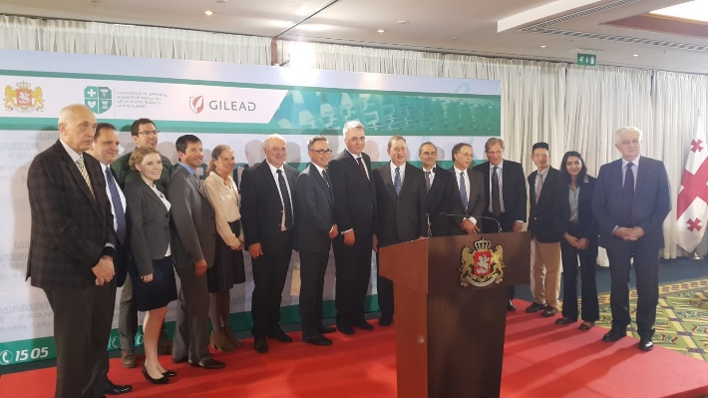
Georgia HCV Elimination Program
HCV Elimination Program launched on April, 2015
Gilead Sciences donated the DAAs
Goal: 90% reduction in HCV prevalence by 2020
5% chronic HCV prevalence (≈150,000) to be reduced to 0.5%

Slide 4
Georgia’s Road to HCV Elimination
Priority Activities 2015
Ensure screening, treatment and laboratory capacity and quality
National seroprevalence survey
Develop 5 year Elimination Plan
Establishment of Monitoring and Evaluation
Establish external Technical Advisory Group (TAG)
Develop treatment database, information systems
Establish partnerships

Slide 5
Partnerships
Georgia Ministry of Health
Georgia Clinical and AIDS Providers:
IDAIDS, NEOLAB, Mrchevelli, HEPA
Centers for Disease Control and Prevention (CDC)
Gilead Sciences Inc.
Abbott Diagnostics
University of Bristol, UK
Georgia Harm Reduction Network
World Health Organization (WHO); European Office & HQ
Global Fund for AIDS, TB & Malaria
Foundation for New Innovative Diagnostics (FIND)
Blood Systems Research Inst.
CDC Foundation
Training Programs in Epidemiology and Public Health Interventions Network (TEPHINET)
Johns Hopkins University
EASL-International Liver Foundation
Extension for Community Healthcare Outcomes (ECHO)
Liver Institute & Foundation for Education and Research (LIFER)

Slide 6
National Seroprevalence Survey—Disease Burden
Conducted 2015
Stratified, multi-stage cluster design
Total number of interviews – 6330 (90% response rate)
Total number of blood samples – 6010 (86% response rate)
Characteristics | % | Estimated # nationwide ≥18 years
Anti-HCV+ | 7.7% | 215,000
HCV RNA+ | 5.4% | 150,000
HBsAg+ | 2.9% | 81,000
Genotype Distribution
GT1= 40%
GT2= 35%
GT3= 35%
Sex, Age and Geography
Males aged 30-49 years
Regions (% positive): Imereti
Cities (% positive): Tbilisi

Slide 7
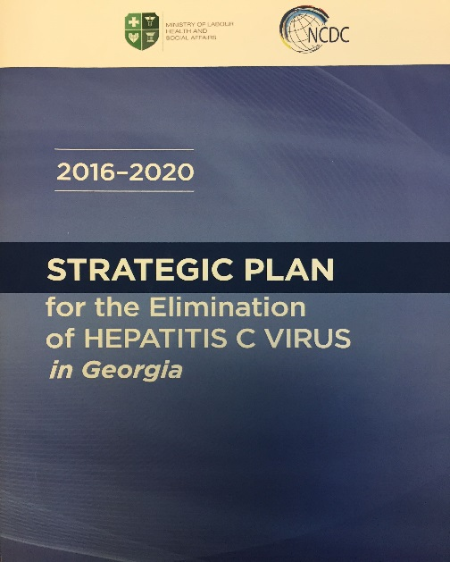
Strategic Plan for HCV Elimination in Georgia
Published March, 2017
Strategic Plan for HCV Elimination
Awareness/Advocacy
Prevent HCV transmission
Harm Reduction
Blood Safety
Infection Prevention & Control
Screening and linkage to care
Laboratory diagnostics
Care and treatment
Surveillance

Slide 8
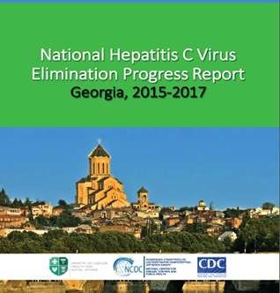
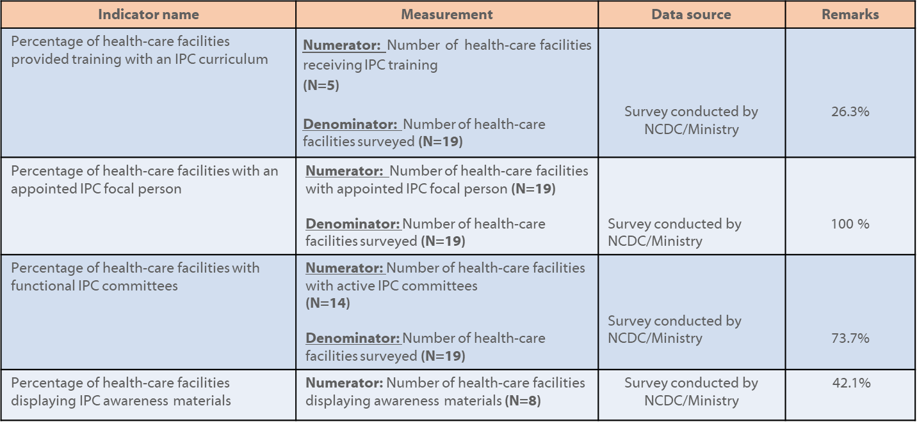
Monitoring and Evaluation (M&E)
Progress on 6 strategies
Monitoring and Evaluation indicators

Slide 9
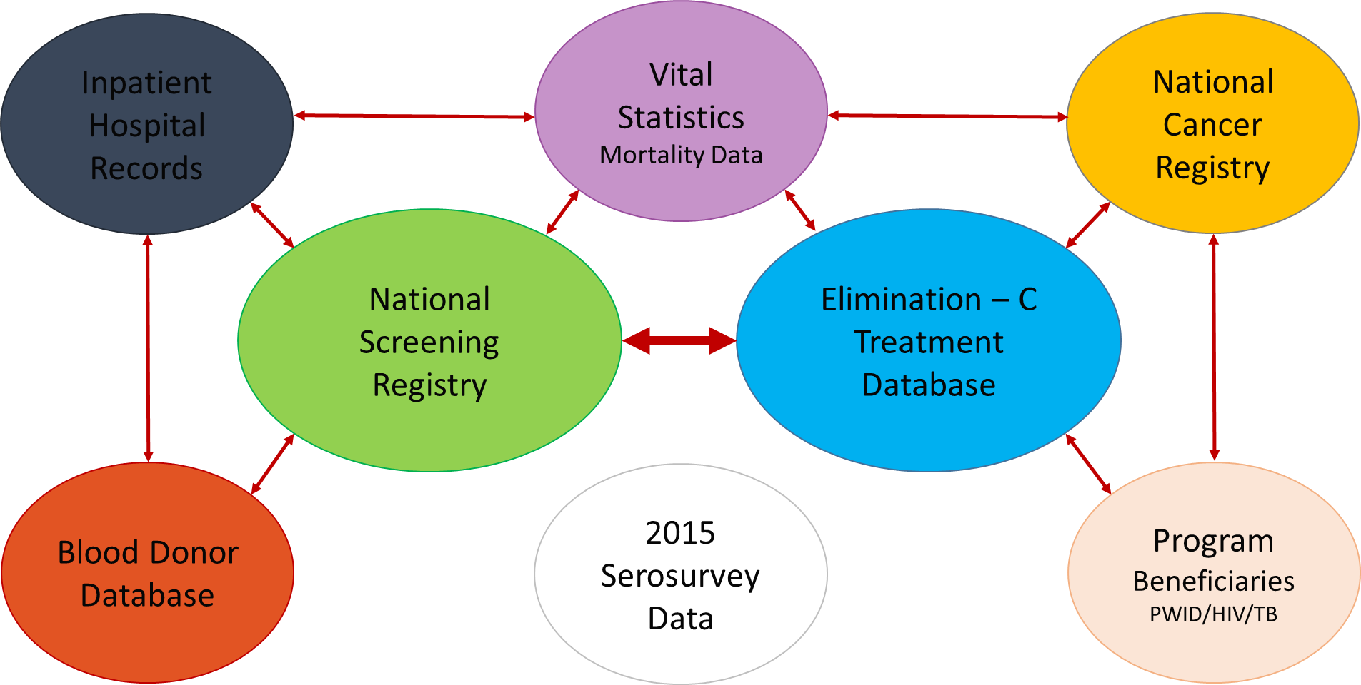
Georgia’s National Health Information Systems

Slide 10
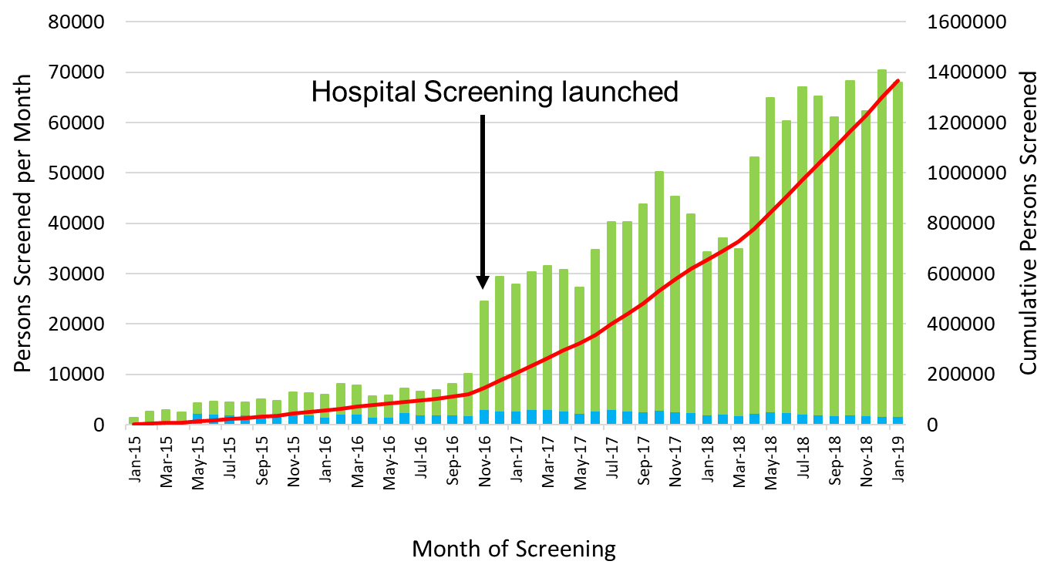
Persons Screened by Month, Georgia, Jan 2015-Jan 2019

Slide 11
HCV Treatment Sites, Georgia, 2019

Slide 12
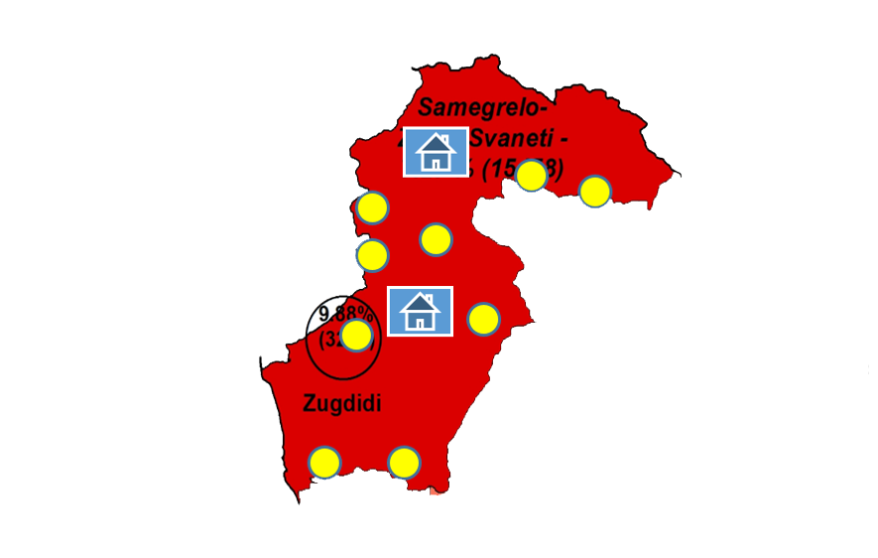
Integrated screening & referral, HIV/HCV/TB, primary health care, Samegrelo-Zemo Svanati, Georgia, 2017- 2018
“Umbrella Project”
SZS high prevalence TB, HIV, HCV region
Borders Abkhazia (West)
454 doctors & nurses trained
Screening for HCV, HIV, TB
Results
89,602 screened
Anti-HCV+: 2305
Anti-HIV+: 37
TB (presumptive)+: 177

Slide 13
Number of PWIDs & sex partners tested for HCV
26,025
25,328
15,662
Negative
Positive
% of AB Positive
Period: 2018 As of October 1st
Number of RDTs
Source: GHRN Data

Slide 14
Cost** of Diagnostics, Georgia, 2015-2018
**Cost in GEL
1 US$ = 2.8 GEL
Notes:
-Workup diagnostics cost: over 50% reduction from 2015 to 2018
-During treatment diagnostics cost: over 80% reduction from 2015 to 2018

Slide 15
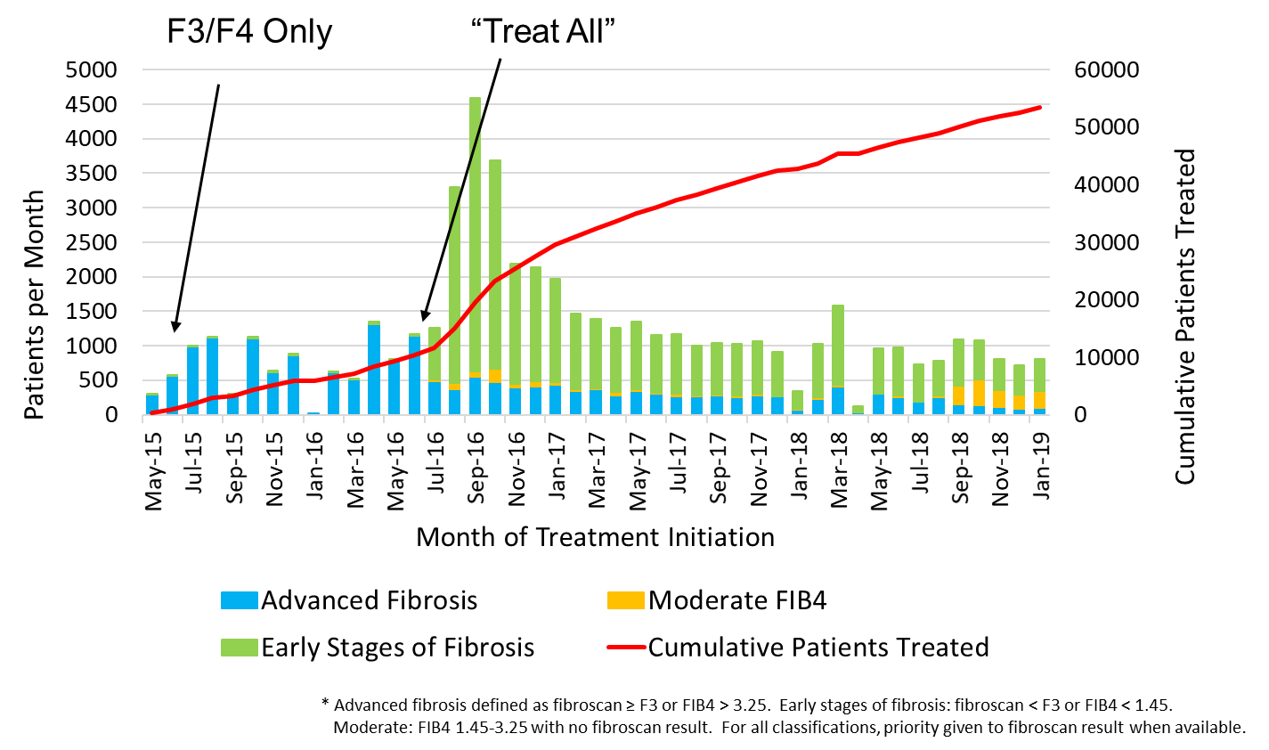
Fibrosis Stage* of Patients Initiating Treatment, Georgia, May 2015-January 2019

Slide 16
HCV Care Cascade, Georgia HCV Elimination Program, May 2015 – January 2019

Slide 17
Notes:
No significant overall trend by Year of Report ( during these years. Although the cases were nominally ordered by year of report, they have ultimately been grouped by year of diagnosis, and delayed reports were attributed to year of diagnosis (e.g., in late 2017, 291 cases were reported for 2015 and 2016, but had increased to 304 cases (an increase 0f 7%) by early 2019. Further adjustments might be expected.)

Slide 18
Primary liver cancer cases screened for HCV (n=210) and percent (%) positive, by age group, Georgia, 2015-17
Notes:
The 210 persons screened, persons 40-49 years at diagnosis were most likely to be positive

Slide 19
Continuous Learning, Feedback, & Exchange
Annual National HCV Elimination Workshop (Spring)
2014: HCV Elimination conceived
2015: Preparation for launch
2016: Monitoring & Evaluation Plan
2017: Improving access/screening of high risk populations
2018 & 2019: Decentralization of services
Technical Advisory Group (TAG) 2015 – 2018 (Fall)
International experts: at least one from each strategic focus
Meets annually in the Fall: 4th TAG meeting 28-30 November 2018
Recommendations
EASL (+/- AASLD, other) annual meetings since 2014

Slide 20
National Scientific Committee
Established in August 2016
Research agenda development supporting program
Review, approve, and support study proposals
Coordination (MoH, NCDC, International Organizations)
Members (permanent)
NCDC, MOH, 4 Tbilisi clinics, CDC
Data analysis support
Examples
Barriers to treatment (PWID, General population)
Pilot programs
Treatment outcomes

Slide 21
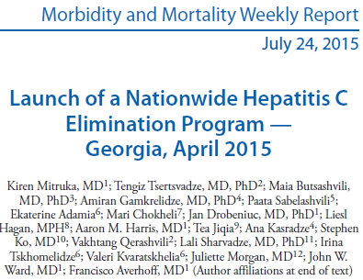
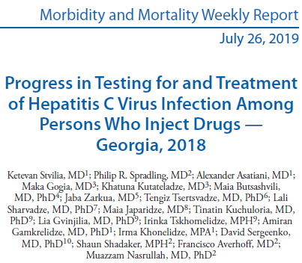

Slide 22
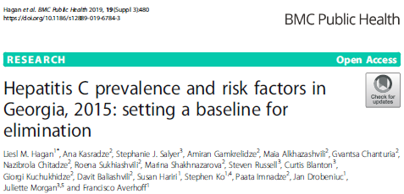
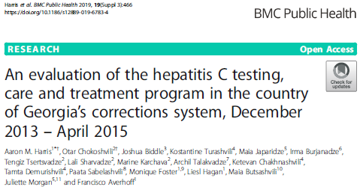

Slide 23
HCV Elimination Benefits the Health care System beyond HCV
Serosurvey:
Recognition of unsafe blood supply
HBV burden identified
Non-communicable disease burden in the population
Laboratory diagnositics
External Quality Assurance (EQA) principles can improve quality of testing broadly
Access for PWID and key populations
Increased access and investment for harm reduction and substance abuse prevention and treatment

Slide 24
HCV Elimination Benefits the Health care System beyond HCV (cont.)
Blood Safety
Improved donor pool (voluntary)
Improved quality of testing/EQA
Addressing gaps in HIV and syphilis testing
Capacity building
Improved information systems can be used for improving healthcare
Critical use of data and indicators principles to address HCV can be replicated for other public health priorities
HCWs with epidemiologic tools to address public health issues of importance

Slide 25
Georgia: First EASL International Liver Foundation (EILF) Center of Excellence in Viral Hepatitis Elimination, 2019
Criteria
A valid estimate of national/state viral hepatitis burden
A funded comprehensive strategic plan for the national/state elimination of viral hepatitis as a public health threat
A valid, time-bound, measurable targets for the national/state elimination of viral hepatitis as a public health threat
Demonstrable progress towards national/state elimination of viral hepatitis through valid indicators
High quality research outputs in relation to national/state elimination of viral hepatitis
Demonstrable state of the art viral hepatitis training and educational programming
Demonstrable partnership between state and non-state actors (academia, private providers, civil society groups, key affected groups and patients advocates) in hepatitis C elimination program planning and implementation
Clear ability, capacity and readiness to contribute to the achievement of viral hepatitis elimination in other countries/states through technical assistance

Slide 26
HBV Elimination in Georgia?

Slide 27
Comparison of HBV and HCV (key characterstics)
Characteristic | HBV | HCV
Transmission/ Infectious | Perinatal +/+++ Horizontal ++ Healthcare ++ Sexual + IDU ++ | Perinatal + Horizontal +/- Healthcare + Sexual +/- IDU ++
Chronic Infection | Varies by age: 5-90% | 70-80%
Vaccine Preventable | Yes | No
Therapy | Viral suppression/all-oral (lifelong?) | Curative/All-oral
Treatment Complexity (diagnostics, staging, management) | +++ (can be simplified?) | +

Slide 28
Disease Control Definitions
Control: reduce disease incidence, prevalence, morbidity, and mortality to acceptable local levels; requires continued intervention
Elimination of disease: incidence of disease caused by infection reduced to zero within a defined geographical area; requires continued intervention
Elimination of infections: incidence of infections reduced to zero within a defined geographical area; requires continued intervention
Eradication: worldwide incidence of infection permanently reduced to zero; continued intervention no longer needed
Extinction: infectious agent no longer exists in nature or in the laboratory
Dowdle W, MMWR, 1999

Slide 29
WHO Hepatitis Elimination Goal by 2030
Elimination of hepatitis as a public health issue of concern -remove sustained transmission, remove hepatitis as a leading cause of mortality:

Slide 30
Eliminating hepatitis (HBV & HCV) by 2030: A package of interventions with high impact
 |  | 2030 targets
Elimination is defined by impact indicators | Incidence | -90%
 | B. Mortality | -65%
Modelling suggests that taking 5 core interventions to sufficient coverage will achieve impact | 1. Three dose hepatitis B vaccine | 90%
 | 2. HBV PMTCT | 90%
 | 3. Blood and injection safety | 100 % screened donations
 |  | 100% safe injections
 | 4. Harm reduction | 300 injection sets/PWID/year
 | 5. Testing and treatment | 90% diagnosed
 |  | 80% eligible treated
PMTCT: Prevention of mother to child transmission
PWID: Person who injects drugs
Notes:
So what do we mean when we say we want to eliminate hepatitis by 2030 and how do we plan to do it? Our strategy defines elimination as a public health threat on the basis of a reduction of incidence of 90% and a reduction of mortality of 65% (From the 2015 baseline). To reach elimination, we modelled that we needed to reach sufficient coverage for five core interventions. Four are about prevention: hepatitis B vaccine, prevention of mother to child transmission of HBV, blood and injections safety, and harm reduction. The fifth is about testing and treatment with a target to diagnose 90% of persons living with hepatitis and another to place 80% of eligible patients on treatment. Let’s see what these targets look like graphically.

Slide 31
Eliminating HBV in Georgia by 2030: A package of interventions with high impact
 |  | 2030 targets
Elimination is defined by impact indicators | Incidence | -90%
 | B. Mortality | -65%
Modelling suggests that taking 5 core interventions to sufficient coverage will achieve impact | 1. Three dose hepatitis B vaccine | 90%
 | 2. HBV PMTCT | 90%
 | 3. Blood and injection safety | 100 % screened donations
 |  | 100% safe injections
 | 4. Harm reduction | 300 injection sets/PWID/year
 | 5. Testing and treatment | 90% diagnosed
 |  | 80% eligible treated
PMTCT: Prevention of mother to child transmission
PWID: Person who injects drugs
Notes:
So what do we mean when we say we want to eliminate hepatitis by 2030 and how do we plan to do it? Our strategy defines elimination as a public health threat on the basis of a reduction of incidence of 90% and a reduction of mortality of 65% (From the 2015 baseline). To reach elimination, we modelled that we needed to reach sufficient coverage for five core interventions. Four are about prevention: hepatitis B vaccine, prevention of mother to child transmission of HBV, blood and injections safety, and harm reduction. The fifth is about testing and treatment with a target to diagnose 90% of persons living with hepatitis and another to place 80% of eligible patients on treatment. Let’s see what these targets look like graphically.

Slide 32
Hepatitis B markers by Age, Georgia, 2015 (n≈ 81,000 HBsAg+)
Perinatal and routine HB vaccination introduced in 2002 (i.e. < 13 years of age in 2015)

Slide 33
Conclusions
Government Leadership and Ownership Key (significant investments) for HCV elimination
Ambitious Goals (90% reduction prevalence by 2020)
Civil Society & Clinicians actively engaged
Jump in!
Treatment program preceded comprehensive elimination program, secured funding, etc.
Be willing to learn as you go
Comprehensive Strategic Plan guides
Partnerships key to success : MOH, Clinicians, Civil Society, CDC, Gilead, & others

Slide 34
HBV Elimination: Why Georgia?
Small country: < 4 million population
Moderate HBV burden: 2.9% prevalence (81,000 adults in 2015)
Established vaccination program among infants and children in 2002
Risk of chronic infection among persons born after 2002 (<18 years in 2019) is likely very low
Therefore, target for screening (treatment) is 18 and older in 2020
Screening infrastructure exists: screening ongoing in blood banks and ANC (HBV), other sites (HCV only)
Treatment capacity exists (ID Physicians and hepatologists)
Diagnostic capacity exists (including molecular, elastography, etc.)
Robust health information systems: can be modified to accommodate hepatitis elimination

Slide 35
HBV Elimination: Why Georgia? (continued)
Technical Advisory Group (TAG) meets annually/advises for HCV- add HBV
Annual National Spring Workshop for planning activities
Monitoring and Evaluation (M&E) Program in place
Spillover benefits for other programs can benefit/leveraged for HBV elimination
Investments in strategic information, lab quality, advocacy & civil engagement, prevention (PWID-HR, Blood Safety, IPC), capacity building through CDC & other partner technical assistance
Commitment to science and research with dissemination (Scientific Committee)
EILF Center of Excellence for Viral Hepatitis Elimination: lessons from HCV elimination
HBV treatment and diagnostics access a barrier
Motivated government, civil society, partnerships?
Achievable by 2030!

Slide 36
Acknowledgements
Georgia Ministry and NCDC
Georgia Clinicians and NGOs
International NGOs
Industry Partners
WHO
CDC

Slide 37
Thank you!

