Slide 1

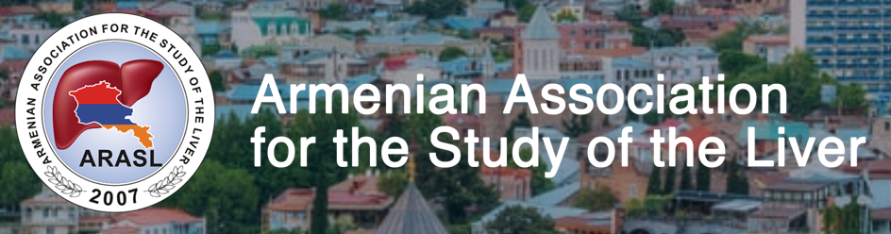



HBV and chronic kidney disease
George Lau
MBBS (HK), MRCP(UK), FHKCP, FHKAM (GI), MD(HK), FRCP (Edin, Lond), FAASLD (US)
Chair Professor & Co-Director
Liver Disease & Transplant Centre, The Fifth Medical Centre of Chinese PLA General Hospital – Humanity & Health Medical Group, Beijing, China
Chairman
Humanity and Health Medical Group, Hong Kong, HKSAR, China
Consultant in Gastroenterology & Hepatology
Humanity and Health Clinical Trial Centre, Hong Kong, HKSAR, China

Slide 2
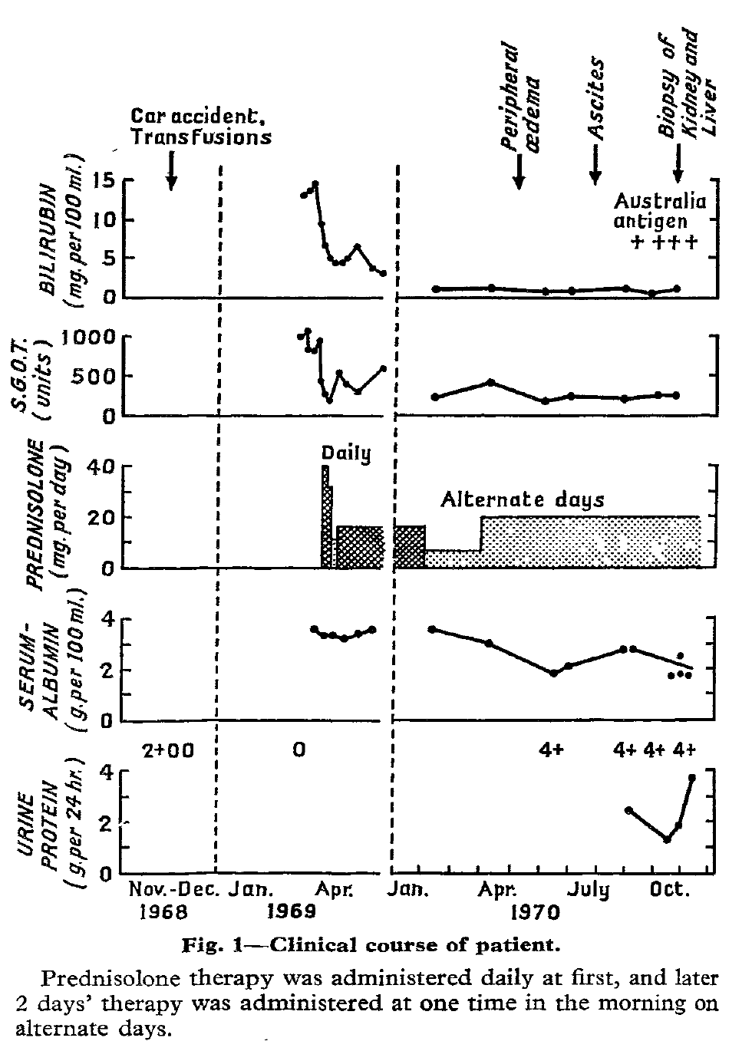
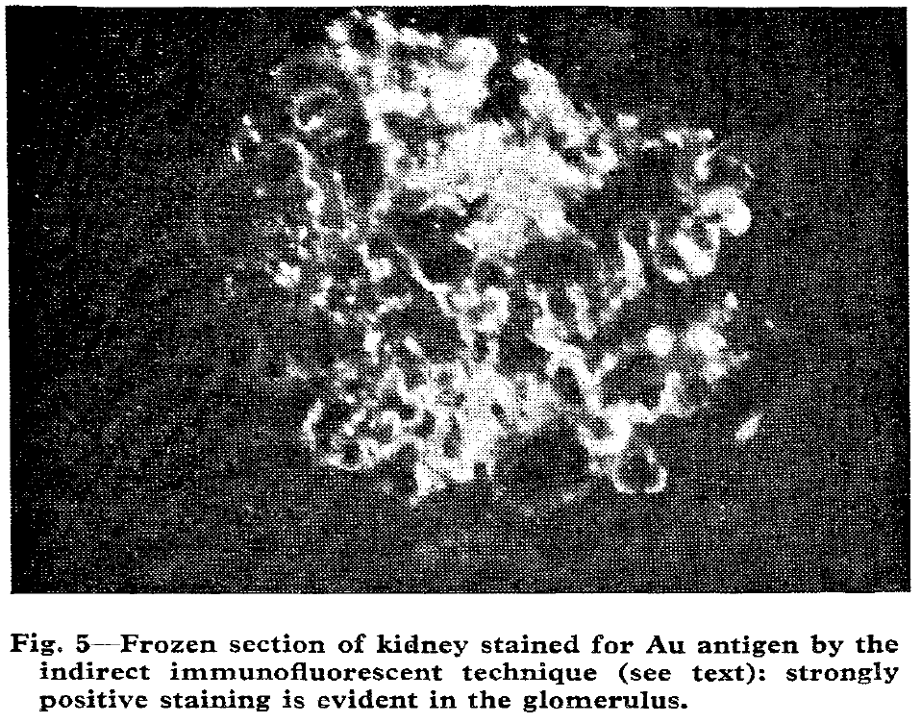

Glomerulonephritis with deposition of Australia antigen-antibody complexes in glomerular basement membrane
Post-transfusion
Au antigen was involved in the formation of immune complexes whose glomerular deposition initiated the pathologic process leading to the development of diffuse membranous glomerulonephritis
Combes B, et al. Lancet 1971; 2:234-7

Slide 3
Clinical and histological features of
HBV-induced kidney disease
Renal disease | Deposition | HBV antigen | Renal clinical manifestation
Membranous nephropathy (MN) | Subepithelial space | HBeAg | Nephrotic syndrome
Membranoproliferative glomerulonephritis (MPGN) | Mesangium Subendothelial space | HBsAg/ HBeAg | Nephrotic syndrome/nephritic syndrome
Mesangial proliferative glomerulonephritis (MsGN) | Mesangium Subendothelial space | HBeAg | Isolated microscopic haematuria or non-nephrotic proteinuria
Polyarteritis nodosa (PAN) | Medium-size arteries | HBeAg | Hypertension, microscopic haematuria, proteinuria, progressive renal insufficiency
Fabrizi F, et al. Expert Rev Clin Pharmacol. 2019;12(9):867-874.

Slide 4
Membranous nephropathy is the most common form of HBV related nephropathy.
HBV-related membranous nephropathy in adults has a slowly but relentlessly progressive clinical course in approximately one third of patients.
Lai KN, et al. NEJM 1991;324(21):1457-63.

Slide 5
Association between HBV and chronic kidney disease?
Chronic kidney disease defined by a reduction in glomerular filtration rate and/or increased urinary albumin excretion
Fabrizi F, Donato F, Messa P. Ann Hepatol. 2017;16(1):21–47.

Slide 6
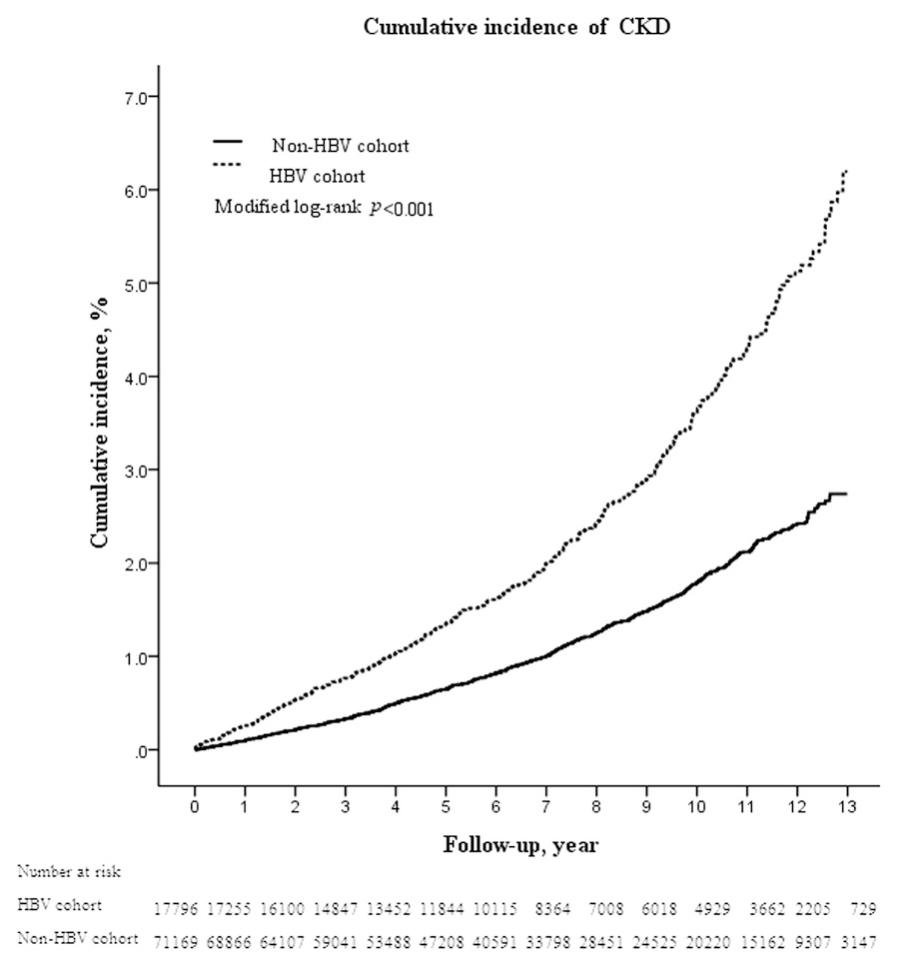
13-year cohort study: chronic kidney disease risk among treatment-naive CHB
Untreated chronic HBV infection is associated with increased risk of CKD, especially males and younger age
Chen YC, et al. BMC Nephrol. 2015;16:110.

Slide 7
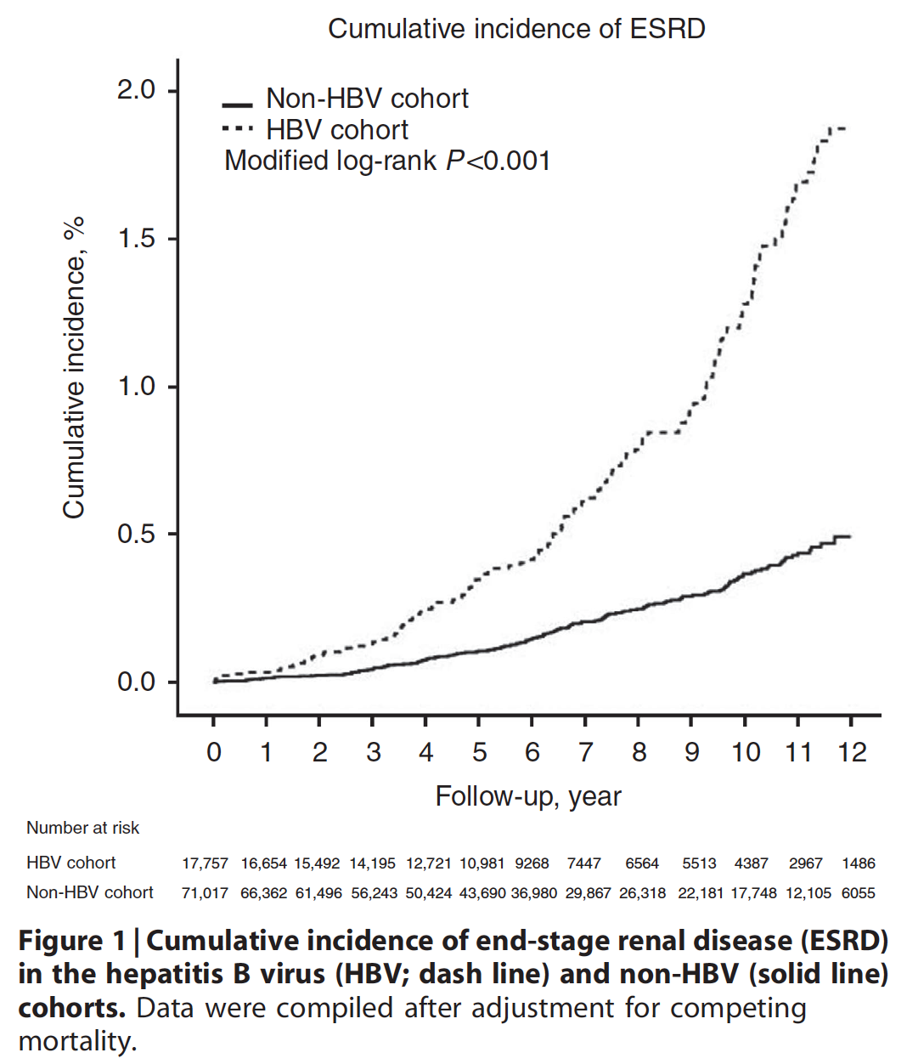
HBV infection increases the risk of end-stage renal disease
17,758 CHB patients vs. 71032 match control without HBV
Untreated chronic HBV infection is associated with increased risk of ESRD
High-risk HBV-infected patients should have targeted monitoring for the development of ESRD
Chen YC, et al. Kidney Int. 2015; 87(5):1030-8.

Slide 8
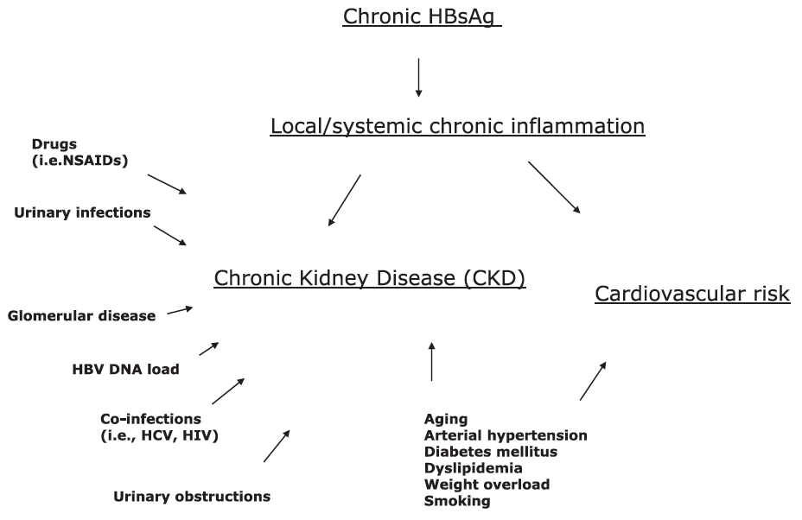
Hepatitis B virus infection and chronic kidney disease
Fabrizi F, et al. Expert Rev Clin Pharmacol. 2019 12(9):867-874.

Slide 9
Association between hepatitis B virus and chronic kidney disease: a systematic review and meta-analysis
16 studies (n = 394,664 patients)
No relationship occurred between HBV positive status and chronic kidney disease (n = 7, n = 109,889)
HBV infection is possibly associated with a risk of developing reduced glomerular filtration rate in the general population
No link between HBV seropositive status and frequency of chronic kidney disease or proteinuria was noted in cross-sectional surveys
Fabrizi F, Donato F, Messa P. Ann Hepatol. 2017;16(1):21–47.

Slide 10
Anti-HBV for patients with kidney disease
 | Initial treatment (NUC) | Regimen adjustment
AASLD 2018 ¹ | ETV or TDF | All NAs except TAF require dose adjustment in persons with creatinine clearance <50 mL/min.
EASL 2017² | Recommend TAF rather than TDF in selected patients : Age >60 yrs old, abnormal renal function, defined as eGFR <60 mL/min/1.73 m², albuminuria or low phosphate levels and patients on haemodialysis. | Patients on TDF at risk of development and/or with underlying renal or bone disease should be considered for a switch to ETV or TAF, depending on previous LAM exposure (Evidence level II-2/I, grade of recommendation 1).
APASL 2016³ | TDF or ETV | It is important of appropriate dose adjustment of NAs according to the calculated CrCl. Physicians should be aware of the necessary drug dose adjustments according to creatinine clearance as well as the potential nephrotoxicity and long-term drug efficacy.
Norah A. Terrault, et al. Hepatology. 2018 Apr;67(4):1560-1599.
2. European Association for the Study of the Liver. J Hepatol. 2017 Aug;67(2):370-398
3. Sarin SK, et al. Hepatol Int. 2016 Jan;10(1):1-98.

Slide 11
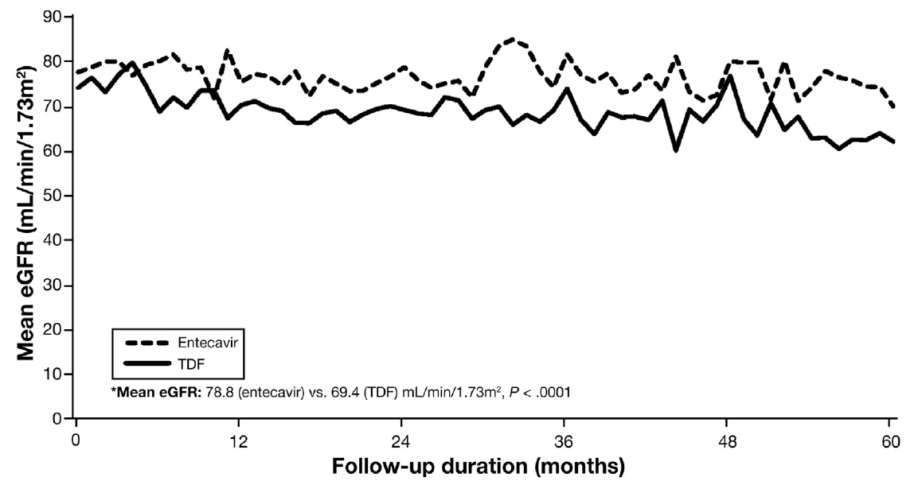
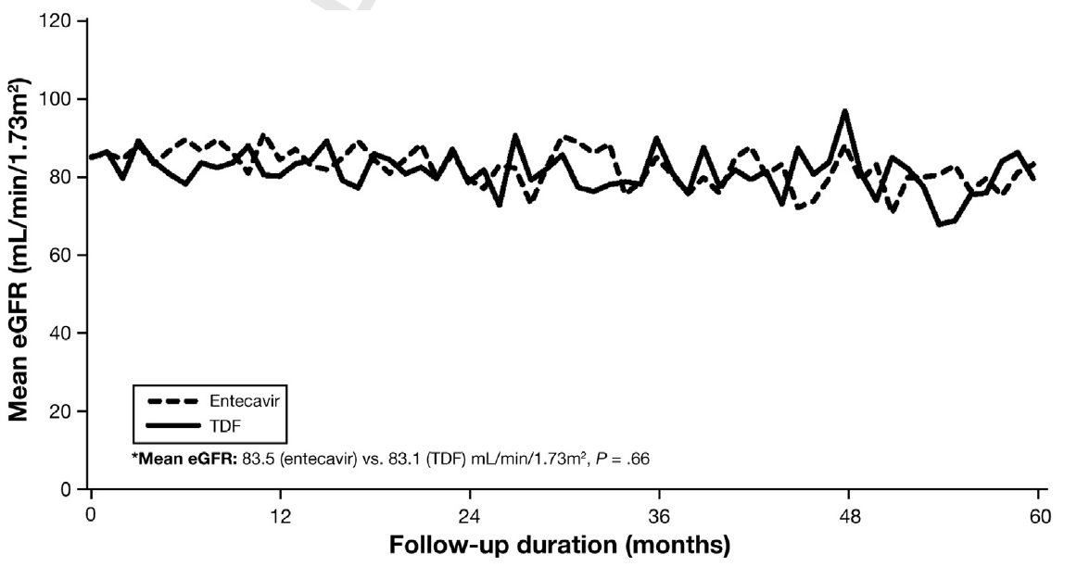
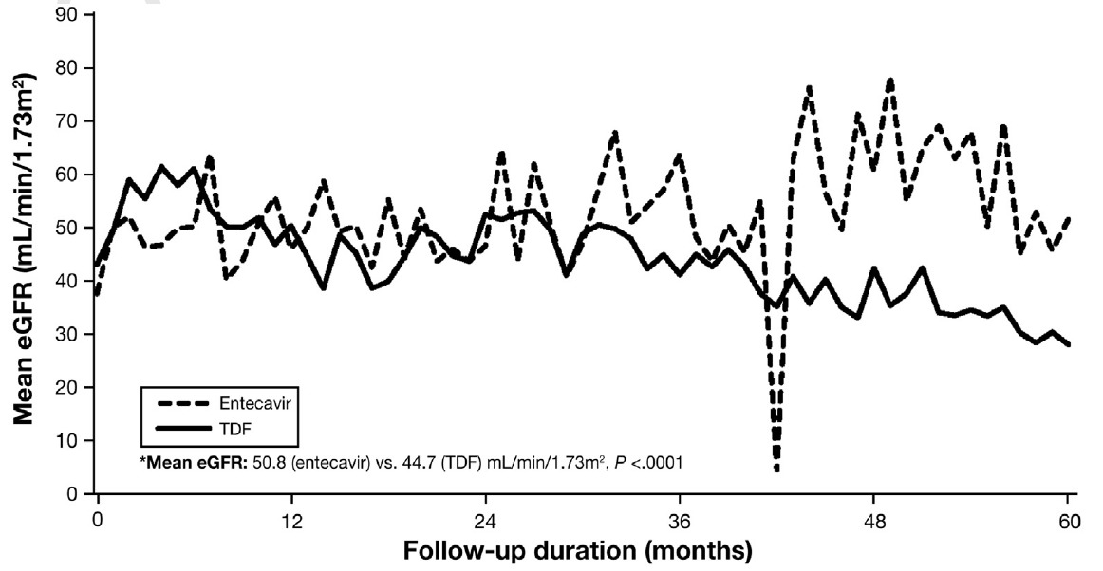
Renal function during follow-up: ETV vs TDF
Retrospective study, propensity score matching(PSM)
Baseline eGFRs predict short-or median term renal safety during NUC treatment
Overall, P < 0.0001
Baseline eGFRs ≤ 60mL/min/1.7 m²,
mean eGFR, P=0.66
Baseline eGFRsmL/min/1.73 m² ≥ 60,
mean eGFR, P < 0.0001
Trinh S, et al. Clin Gastroenterol Hepatol. 2019 Apr;17(5):948-956.e1

Slide 12
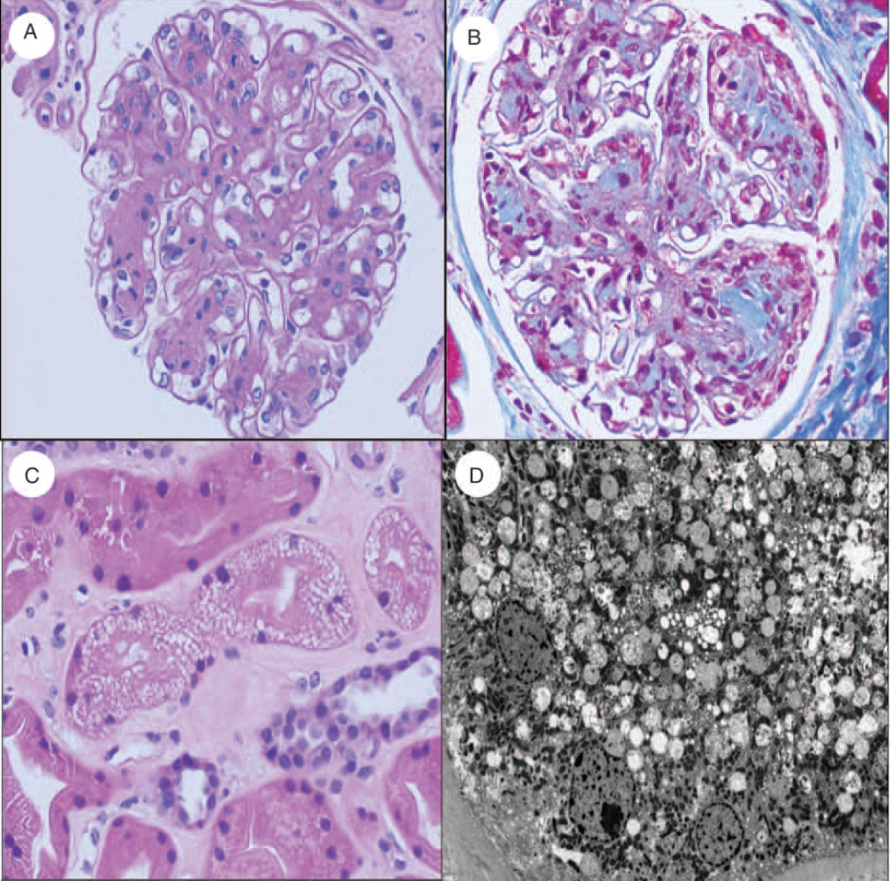
Is TAF really safe as expected? experience from HIV field
Tenofovir alafenamide nephrotoxicity in an HIV-positive patient: A case report.
This case suggests that at risk individuals may experience tubular mitochondrial injury from lower concentrations of tenofovir with TAF
Biopsy showed mesangial expansion with peripheralized thickened capillary loops consistent with diabetic nephropathy and segmental
endocapillary leukocytes (A, B). Tubular epithelial vacuolization is observed on (C) routine H&E stain(D)
Novick TK, et al. Medicine (Baltimore). 2017 Sep;96(36):e8046

Slide 13
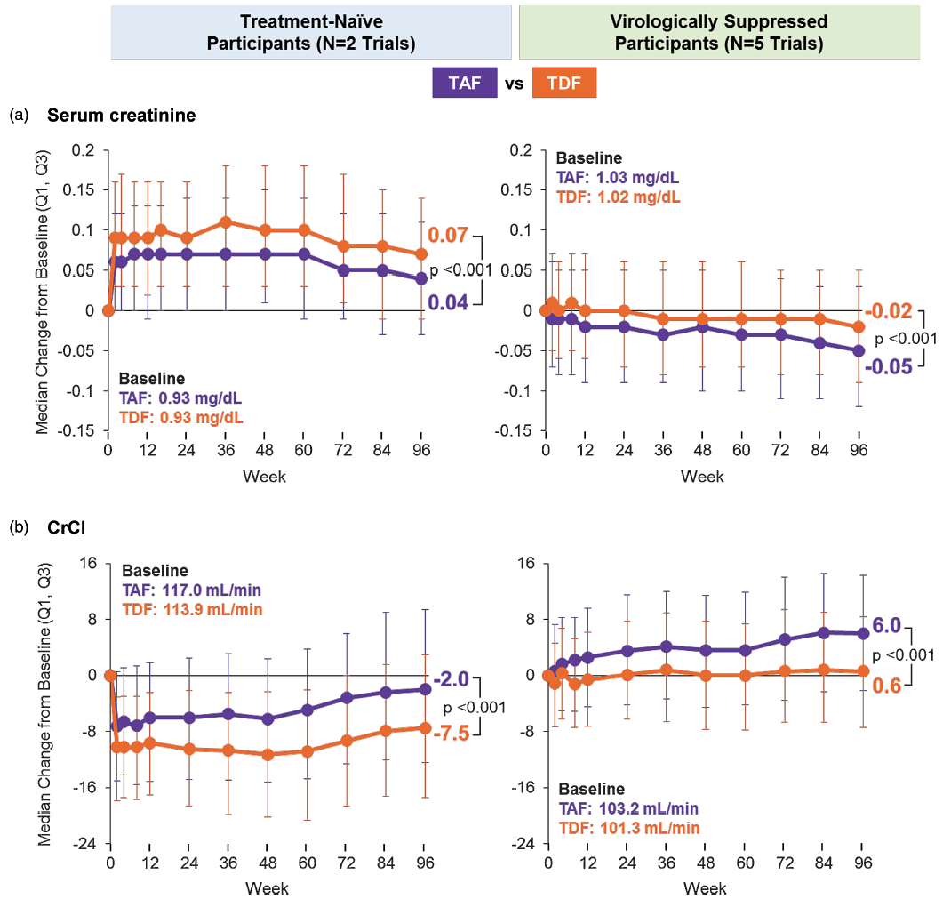
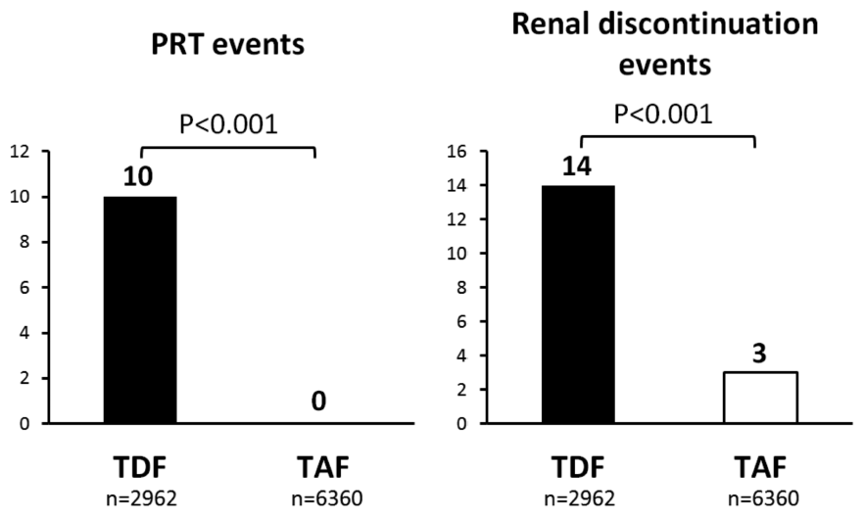
Renal safety: TAF vs. TDF, a pooled analysis of 26 clinical trials, experience from HIV field
These pooled data from 26 studies, with over 12 500 person-years of
follow-up in children and adults, support the comparative renal safety of TAF over TDF
Gupta S, et al. AIDS. 2019 Jul 15;33(9):1455-1465.

Slide 14
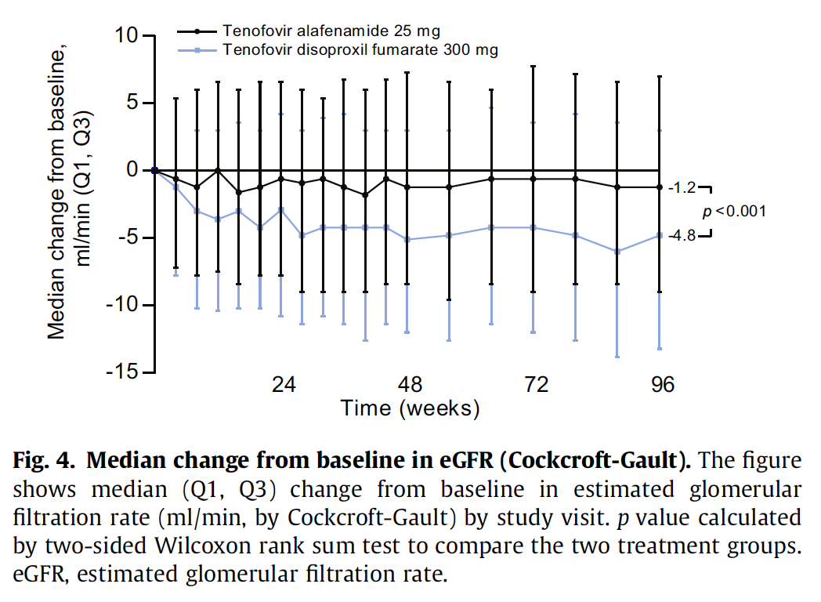
Renal safety: 96 weeks TAF Vs TDF
All patients enrolled had creatinine clearances ≥ 50 ml/min and most patients were ≤65 years old and without comorbidities
TAF had a significantly smaller median change in estimated glomerular filtration rate by Cockcroft-Gault method (1.2 vs. 4.8 mg/dl; p <0.001)
Agarwal K, et al. J Hepatol. 2018 Apr;68(4):672-681.

Slide 15


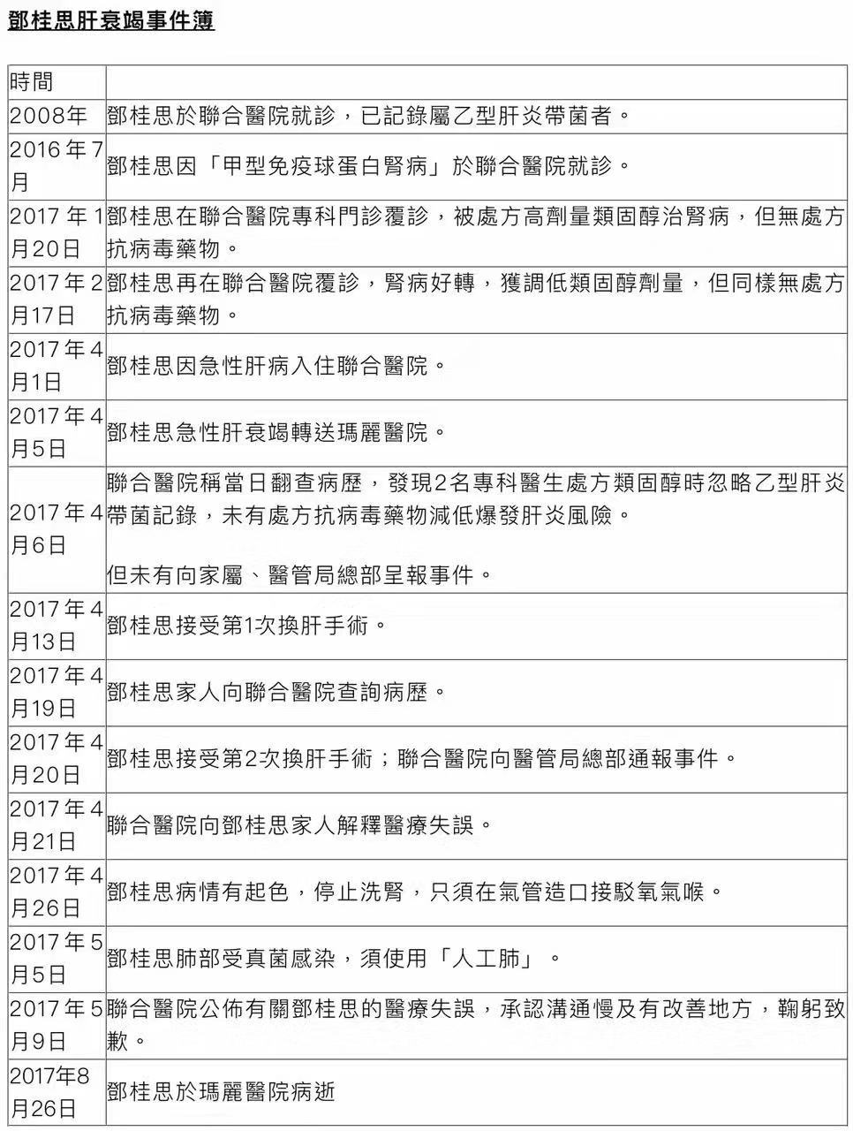


A recent tragic case in Hong Kong-HBV reactivation

Slide 16
Risk of HBV reactivation when using corticosteroids
High-dose corticosteroids carries a significant risk of HBV reactivation
Low-dose corticosteroid therapies such as prednisone 10 mg/day orally over 4 weeks may increasethe risk of reactivation up to 10% in HBsAg-positive individuals
Medium-dose corticosteroids such as prednisone 10–20 mg/day orally may increase the risk of reverse seroconversion in HBsAg-negative and anti-HBc–positive individuals
Rohit Loomba and T. Jake Liang. Gastroenterology 2017;152:1297–1309

Slide 17
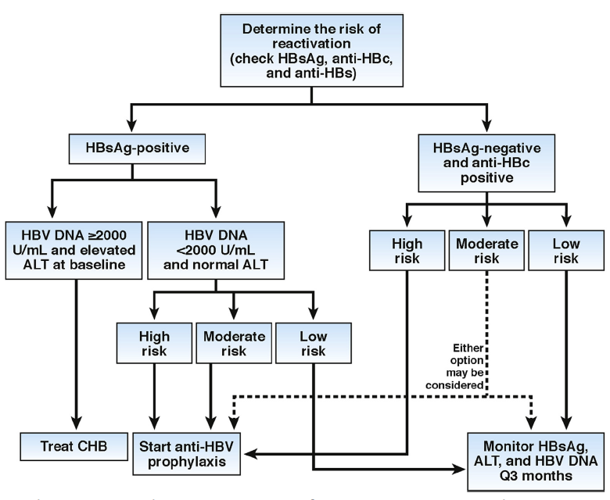
Prevention of HBV Reactivation Associated With Immune Suppressive therapy
Rohit Loomba and T. Jake Liang. Gastroenterology 2017;152:1297–1309

Slide 18
Conclusions
Chronic kidney diseases in CHB patients
Immune-mediated-rare
Increase in incidence?
TAF better then TDF
HBV reactivation
Preventable

Slide 19







OUR TEAMS
Liver Disease & Transplant Centre, The Fifth Medical Centre of Chinese PLA General Hospital – Humanity & Health Medical Group, Beijing, China
Humanity and Health Medical Group, Hong Kong, HKSAR, China
Institute of Translational Hepatology (Beijing)

