Slide 1
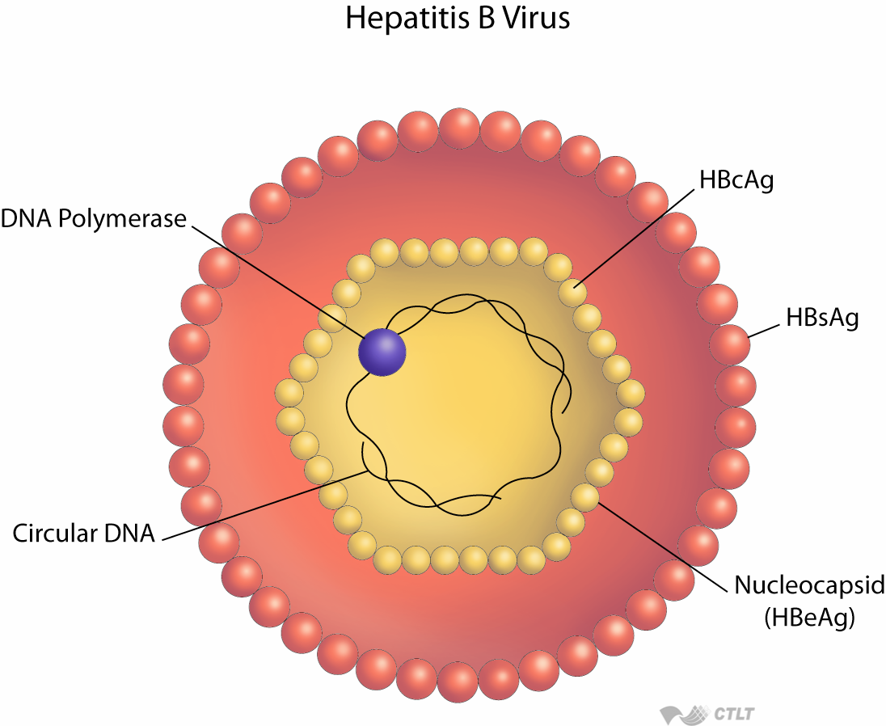
Are we ready to think about HBV elimination in Armenia?
The 2nd Transcaucasus Symposium on HBV Infection
Tbilisi - 2019
Lilit Avetisyan, MD, PhD
Deputy Director-General of NCDC, MoH, Armenia

Slide 2
Dynamics for morbidity of acute viral hepatitis B

Slide 3
Hepatitis B

Slide 4
Structure of Causes of Acute Viral Hepatitis B ,2018.

Slide 5
Cases of acute viral hepatitis B according to sex in 2018

Slide 6
Hepatitis B Preventive Vaccination Process:
Hepatitis B vaccination was introduced in 1999.
High rates of hepatitis B vaccination: 95% -98%
2016:Inclusion of hepatitis B vaccination among risk groups in the National Vaccination Schedule

Slide 7
VHB incidence and vaccination coverage
1990-2015 (6 months)
Introduction of VHB vaccination
90 cases
VHB Incidence
VHB Incidence / 0-14 children
VHB Coverage
Source: NSS, Immunization data, 1990-2015 (6 months)

Slide 8
Preventive measures for HB
Immunization
Surveillance
Epidemiological studies for each case
Early detection of hepatitis among risk groups
Medical staff training
Medical waste safe management
Periodic medical examination of medical staff
Implementation of disinfection and sterilization standard in medical centers and beauty salons
Public awareness

Slide 9
Tools for HBV elimination
Diagnosis
Prevention
HBV
Access to
Treatment
HBV Cure
Nagayam, Lancet Glob Health 2016

Slide 10
Program for Viral Hepatitis Prevention and Control for 2019-2023
Order N1387-L dated May 27, 2019 of the Minister of Health
Purpose: To reduce morbidity and mortality in chronic hepatitis B and C by 2030, as a target to eliminate a public health threat.
Challenges:
Collaboration with all stakeholders
Early detection
Effective treatment
Prevention at all levels
Public awareness on risks

Slide 11
Strategic directions
1
Development of Surveillance System - Liver cancer - Cirrhosis
2
Provision of hepatitis B elimination measures based on the principles of evidence-based medicine, primary prevention of hepatitis B among the population according to the National Immunization Program
Development of HBV Prevention and Patient Treatment Policies and State Support
4
Development of infection control process in MC, ensuring professional safety of healthcare worker and safety of injections
3

Slide 12
Strategic directions
1
Introduction and implementation of treatment approaches at all levels in line with international approaches in the fight against viral hepatitis
Formation and development of a system according to international methodology for drugs usage aimed at treatment of patients with viral hepatitis
3
Development of laboratory control system for diagnostics

Slide 13
Strategic directions
1
Development of cooperation with HIV/AIDS prevention programs
2
3
Public awareness on risks
Continuous education of medical staff

Slide 14
Program financing
State Budget
Targeted funding by international organizations:
Targeted Funding by NGOs
Other financial sources not prohibited by law.

Slide 15
Anticipated result
80% or more coverage of hepatitis B vaccinaton among risk groups, including health care workers
≥95 coverage vaccination rate among newborns up to 15 days of age
≥95% coverage hepatitis B vaccination rate among children under 1 year of age
For the prevention of infection’s vertical transmission from hepatitis B-infected mothers, 90% of pregnant women are involved in hepatitis B screening

Slide 16
Anticipated result 1.
Provision of hepatitis B elimination measures
10% decrease in mortality of extrahepatic hepatitis
50% of people living with and tested for viral hepatitis B are aware of their illness
75% coverage of those diagnosed with viral hepatitis B in the treatment process in accordance with accepted standard

Slide 17
Thank you!

