Slide 1
Georgian
Hepatology
Association
Armenian Association For the Study
of the Liver
The 2nd Transcaucasus Symposium on HBV Infection 2019
September 27-28.2019
Courtyarard Marriott, Tbilisi, Georgia
Register: https://ts-hbv.con/
Case Presentation
Violeta Sargsyan, MD, Phd
The head of Clinical services
Clinical center “Armenicum”, Yerevan, Armenia

Slide 2
Patient S.V.
Male
31 years old
Height – 185 sm
The weight – 118 kg

Slide 3
first detection of Hepattis B markers
For the first time, markers of viral hepatitis B were detected on 02/25/2016 by accident, during a planned medical examination
HBsAg+, anti-HCV (IFA)- , anti-HIV1/2 (IFA) –
Computer Tomography:
The liver has clear, locally bumpy contours, with transverse dimensions of 235x120 mm, the liver parenchyma is diffusely moderately heterogeneous, and the density is unevenly reduced to 45 units.
The spleen has smooth contours, measuring 125.5x150x72 mm
CT diagnosis : diffuse changes in the liver. Splenomegaly. Signs of portal hypertension

Slide 4
Patient history
From 06/14/2016 to 02/07/2016, the patient was examined and treated in Infectious Diseases Hospital N2, Sochi, Russian Federation
Anamnesis of the disease: No complaints, does not note deterioration in working capacity and well-being, leads an active lifestyle
Epidemiological anamnesis: Denies promiscuous sexual intercourse, drug use, surgery, blood transfusion. Dentist visit periodically

Slide 5
Blood tests
HBV-DNA+
HBVDNA quantitative 3,6x10^3 ME/ml
HBsAg+
Ab-HBsAg-
HBeAg-
Ab-HBeAg+
Ab-Hbcore-lg-M-
Ab-Hbcore-lg-total+
Ab-HDV- total -
AFP-3,7 Ед/л (N)

Slide 6
Blood tests
Data | HGB g/L | RBC ${10}^{12}$/l | WBC ${10}^{9}$/l | NEU ${10}^{9}$/l | LYM ${10}^{9}$/l | MON % | PLT ${10}^{9}$/l | HCT % | ESR Mm/h
14.06. 2016 | 177 | 5.9 | 6.5 | 3.5 | 2.1 | 8.1 | 114 | 50.5 | 2
Data | GLU Mmol/l | BILI Mkmol/l | ALT/ AST m/L | PT % | CREAT mkmol/l | TP/ ALB g/L | GGT U/L | ALK U/L | LDH U/L | UREA mmol/L
14.06. 2016 | 4.8 | 13.4/6.7 | 140/ 48 | 78 | 100.7 | 65.8/ 43.0 | 43 | 70 | 226.4 | 3.3
Ultrasound- hepatomegalia, steatohepatozes
Elastometria- F0 Metavir

Slide 7
Clinical Diagnosis
Chronic viral Hepatitis B, replicative phase, with moderate biochemical activity, F0 on the Metavir scale.

Slide 8
treatment
Entecavir (Baraclude) was recommended as starting antiviral therapy. Entecavir at a dosage of 0.5 mg / day.
At the time of discharge from the hospital (in 14 days 07/01/2016):
HBV-DNA was not detected, HBsAg +, ALT, AST, GGT, alkaline phosphatase, bilirubin were normal.

Slide 9
After 3 month of the treatment (3.10.2016)
HBV-DNA was not detected, HBsAg +, ALT, AST, GGT, alkaline phosphatase, bilirubin, CBC are normal.

Slide 10
virological breakthrough
17.01.2017 - HBV-DNA 1.2x〖𝟏𝟎〗^(𝟐 ) МЕ/мл
HBsAg +, ALT, AST, GGT, alkaline phosphatase, bilirubin were normal
Ab-HDV- total -
F0 Metavir score
Recommendation: To increase the dose of Entecavir up to 1mg/day.
Visit in a month

Slide 11
07.02.2017
10.04.2017
Тест | Результат
HBV quantitative | 20 IU/ml,1,30Log(68 cps/ml)
HBsAg-Mtr | 15570.54(lg-4,19) IU/mL
HBe | 0.481S/CO
ALT | 120
AST | 41
Результат | Норма
10 IU/ml,1.00 Log(34 cps/ml) | Abbott RealTime HBV Viral Load LOD 10 IU/mL
21080.32 (lg-4,32) IU/mL | <0.05 IU/mL
0.278 S/CO | <1.0 S/CO
Elastography: picture of a heterogeneous liver with alternating focal fibrosis, focal hepatosis. F2 on Metavir scale

Slide 12
Complete blood count ( Armenicum Clinical Center)
 | 2017-06-14 | Норма
WBC(g/l) | 5.71 | 4.6-10.2
RBC (x10¹²/l) | 5.78 | 4.2-6.0
HGB | 186 | 130 -172
HCT (%) | 0.502 | 0.377-0.537
PLT (x10⁹/l) | 385 | 148-341
MCV | 86.8 | 80-97
MCH | 32.1 | 27-31.2
MCHC | 370 | 318-354
RDW (%) | 10.6 | 11.6-14.8
LYM (%) | 1.64 | 0.6-3.4
ESR (mm/ч) | 26 | <20

Slide 13
Blood Tests ( Armenicum Clinical Center) 14.06.2017
N | Тест | Резултат | Норма
1 | ALB | 35 g/L | 35-50 g/L
2 | Urea N | 1.82 mmol/L | 0.79-3.87 mmol/L
3 | Urea Test | 3.9 mmol/L | >50y.:3.0-9.2 mmol/L
4 | CREA | 70.3 umol/L | 63.6-110.5umol/L
5 | Glucose | 5.61 mmol/L | >60 years: 4.44-6.38mmol/L(80-115 mg/dL)
6 | CrCl | 174 mL/min | >18y.:90-150mL/min
7 | PT-t | 12.9 second | 9.4-12.5 сек.
8 | INR | 1.14 | 0.8-1.2
9 | PT-Quick | 82 % | 70-120%

Slide 14
blood Tests ( Armenicum Clinical Center) 16.06.2017
Test | Result | Norma
HDV quantitative(AmpliSens) | 569 IU/mL, (2.76 Log ) | AmpliSens RealTime HDV Viral Load LoD 4 IU/mL
HBV quantitative | 31 IU/ml,1.49 log(1000 cps/mL) | Abbot Real Time HBV Viral Load LoD 10 IU/mL
HBsAg-Mntr | 16020.19 (lg-4,20) IU/mL | <0.05 IU/mL

Slide 15
Diagnosis 17.06.2017
Chronic viral hepatitis B + D
REPLICATED PHASE with moderate biochemical activity
Shear wave Elastografia F2 Metavir
Recommendation: Treatment Peg. Interferon $α$-$2^{a}$ 180 mkg/0.5 m/L x1 week s/c

Slide 16
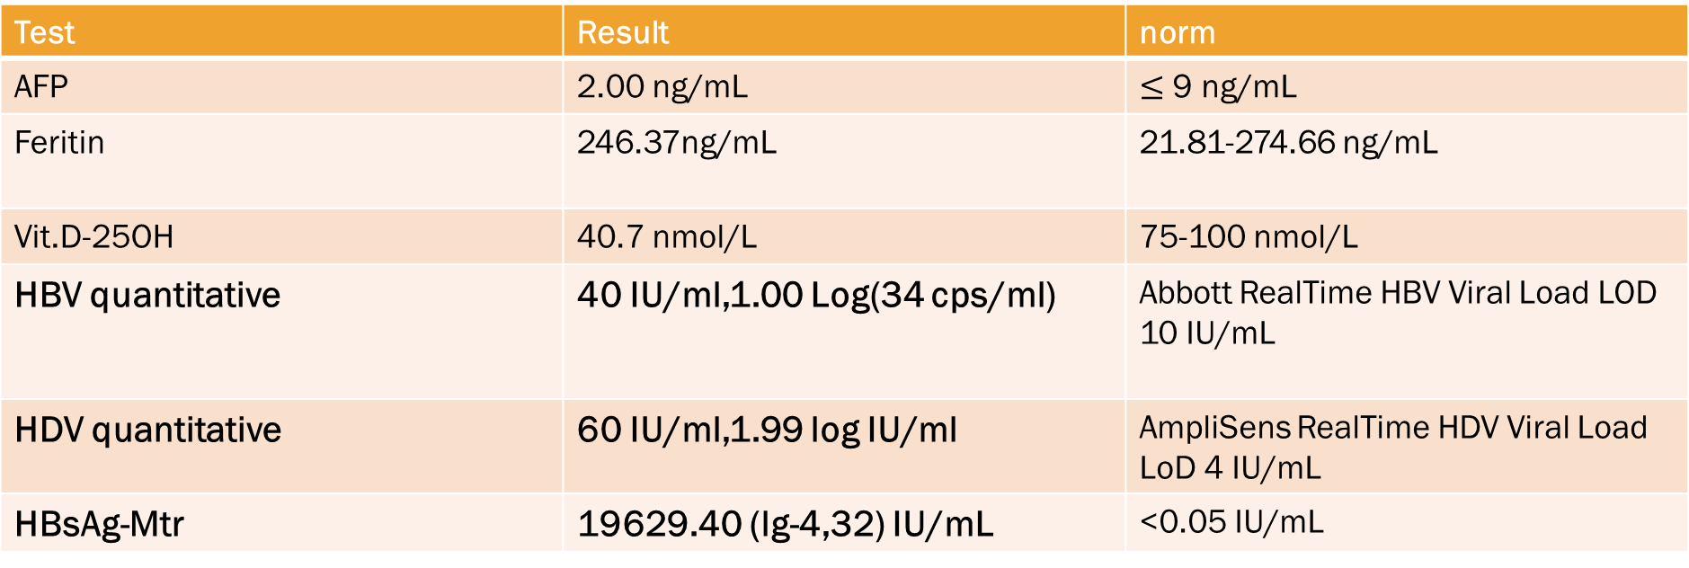
17.07.2017
Test | Result | norm
AFP | 2.00 ng/mL | $≤$ 9 ng/mL
Feritin | 246.37ng/mL | 21.81-274.66 ng/mL
Vit.D-25OH | 40.7 nmol/L | 75-100 nmol/L
HBV quantitative | 40 IU/ml,1.00 Log(34 cps/ml) | Abbott RealTime HBV Viral Load LOD 10 IU/mL
HDV quantitative | 60 IU/ml,1.99 log IU/ml | AmpliSens RealTime HDV Viral Load LoD 4 IU/mL
HBsAg-Mtr | 19629.40 (lg-4,32) IU/mL | <0.05 IU/mL
ALB | 37 g/L | 35-50 g/L
Urea Test | 4.3 mmol/L | >50y.:3.0-9.2 mmol/L
CrCl | 171 mL/min | >18y.:90-150mL/min
TT | 17.6 second | 10.3-16.6 second
ALT | 95 U/L | < 55 U/L
AST | 38U/L | 5-34 U/L

Slide 17
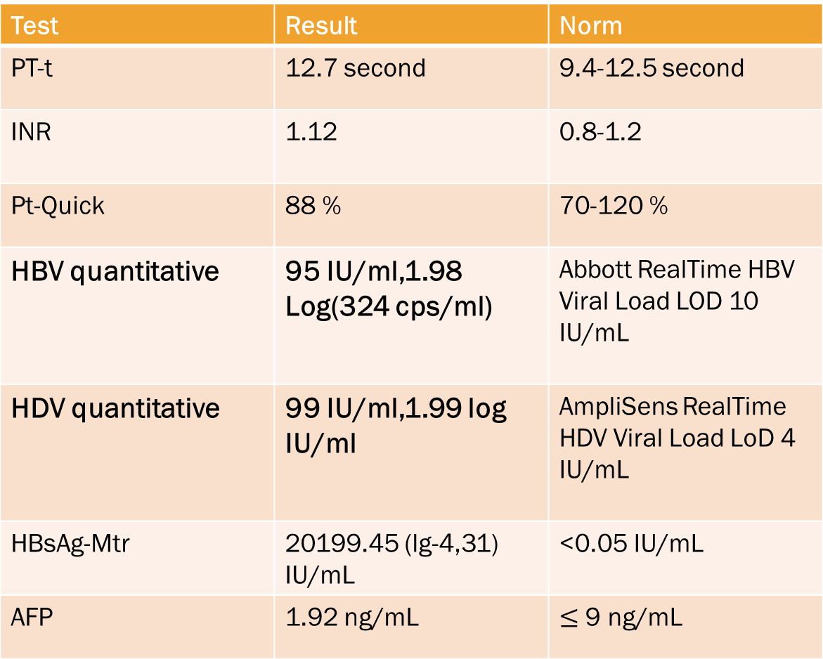
2017-09-22
Test | Result | Norm
PT-t | 12.7 second | 9.4-12.5 second
INR | 1.12 | 0.8-1.2
Pt-Quick | 88 % | 70-120 %
HBV quantitative | 95 IU/ml,1.98 Log(324 cps/ml) | Abbott RealTime HBV Viral Load LOD 10 IU/mL
HDV quantitative | 99 IU/ml,1.99 log IU/ml | AmpliSens RealTime HDV Viral Load LoD 4 IU/mL
HBsAg-Mtr | 20199.45 (lg-4,31) IU/mL | <0.05 IU/mL
AFP | 1.92 ng/mL | $≤$ 9 ng/mL

Slide 18
2018-08-27
Test | Result | Norm
PT-t | 12.2 second | 9.4-12.5 second
INR | 1.03 | 0.8-1.2
Pt-Quick | 94 % | 70-120 %
HBV quantitative | 12 IU/ml,1.08 Log (40cps/ml) | Abbott RealTime HBV Viral Load LOD 10 IU/mL
HBsAg-Mtr | 3606.86 (lg-3,56) IU/mL | <0.05 IU/mL
Ferritin | 321.22 ng/mL | 21.81- 274.66 ng/mL
ALB | 37 g/L | 35-50 g/L
CREA | 188.69 umol/L | 63.6-110.5umol/L
CrCl | 212 mL/min | >18y.:90-150mL/min
TT | 15.9 second | 10.3-16.6 second
ALT | 107 U/L | < 55 U/L
AST | 41 U/L | 5-34 U/L

Slide 19
2019 May
HBV q | 13 IU/mL. 1.11 Log (44 cop/ml) | Abbott RealTime HBV Viral Load LOD 10 IU/mL
HbsAg- Mtr | 736.41 (lg 2.87) IU/mL | <0.05 IU/mL
ALT | 54 U/L | < 55 U/L
AST | 24 U/L | 5-34 U/L

Slide 20
2019 septеmber
Test | Result | Norm
HBV quantitative | 11 IU/ml,1.04Log (36 cps/ml) | Abbott RealTime HBV Viral Load LOD 10 IU/mL
HBsAg-Mtr | 2801.22 (lg-3,45) IU/mL | <0.05 IU/mL
PIVKA | 25.21 mAU/ml | <50.9 mAU/ml
AFP | 1.53ng/ml | <8.78ng/ml
HDVquant | 226 IU/ml
PCA (антитела к париетальным клеткам) | 1:32 - positive | 1:10
ANA (Антинуклеарные антитела) | АНА титр 1:100, Тип свечения:плотное мелкогранулярное ядерное (AC- 2) | 1 :< 100

Slide 21
Questions???
Why didn’t we get a preferable result?
Could steatohepatosis influence the treatment?
Could a prescribed earlier Baraclude complicate the treatment?
How to continue the treatment?
Is it efficient (advisable) to include the patient in a clinical trial with Myrcludex?

